Slide 2
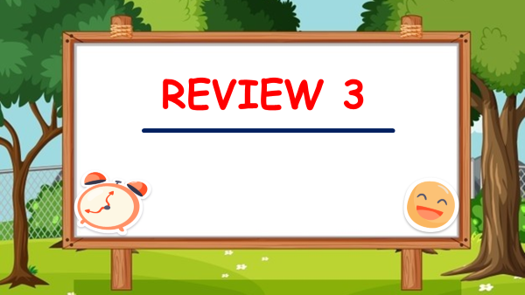

Slide 3
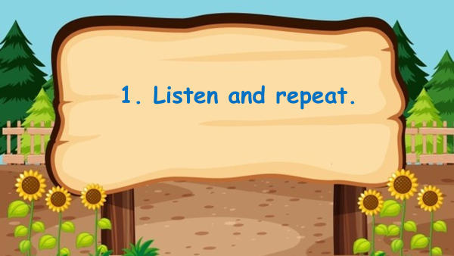

Slide 4
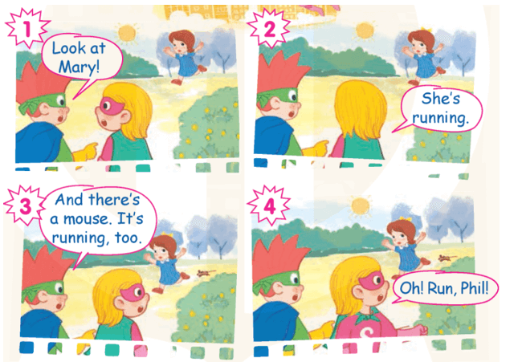


Slide 5


Slide 6
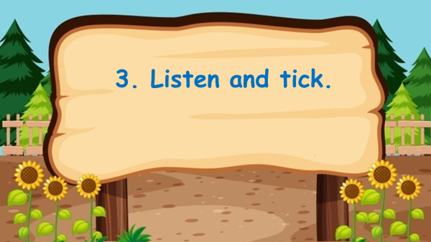

Self - check
✓
✓
✓

Slide 7



Slide 8
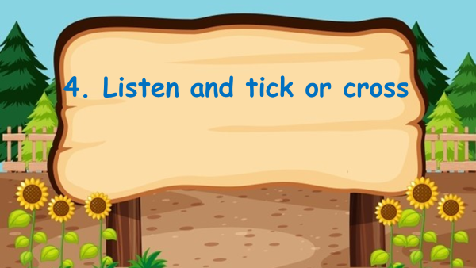

1. Look at the lake.
2. Look at the bus.
✓
✗
✓
✗
3. That's a mango.
4. How many mops? - Three.

Slide 9
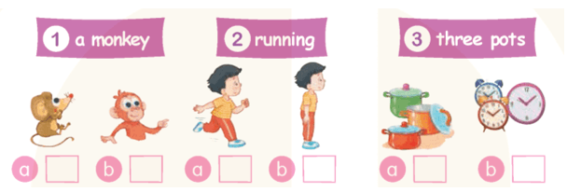
4-Read and tick.
✓
✓
✓

Slide 10
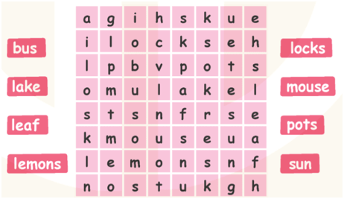
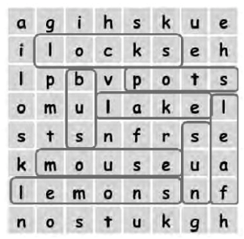
5-Find the words.

Slide 11
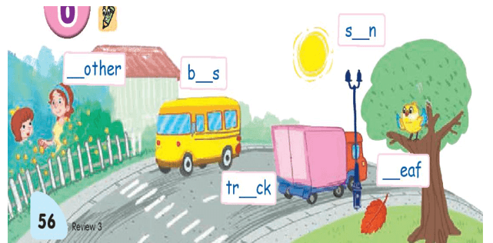
6-Write the letters.
U
M
U
L
U

