Slide 2

REVIEW 1

Slide 3


Warm-up and Review

Slide 4

I. OBJECTIVES.
By the end of the lesson, pupils will be able to:
- Repeat and understand a short story.
- Identify and say the words they have learnt.
1. Language.
- Sounds : /b/ (letter b), /k/ (letter c), /æ/ (letter a), and /d/ (letter d)
- Vocabulary: ball, bike, Bill, book cake, car, cat, cup apple, bag, can, hat desk, dog, door, duck
2. Structures. Hi, I’m _____. (greeting and introducing someone’s name) Bye, _____. (saying goodbye) I have a _____. (talking about possession) This is my _____. (introducing someone’s thing) This is a ______. (introducing something)

Slide 5

Look and choose.
a. cat
b. dog
c. duck

Slide 6

Look and choose.
a. desk
b. door
c. duck

Slide 7

Look and choose.
a. desk
b. bag
c. hat

Slide 8

Look and choose.
a. ball
b. door
c. dog

Slide 9

Look and choose.
a. cake
b. hat
c. bag

Slide 10

Look and choose.
a. red
b. pen
c. bag

Slide 11

Look and choose.
a. apple
b. cake
c. can

Slide 12

Look and choose.
a. cat
b. can
c. cup

Slide 13


Very Good!

Slide 14
1. Listen and repeat.

Slide 15


Listen and repeat.
Hi! I’m Phonic Phil!
And I’m Super Sue!

Slide 16

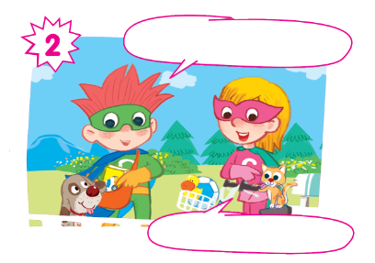
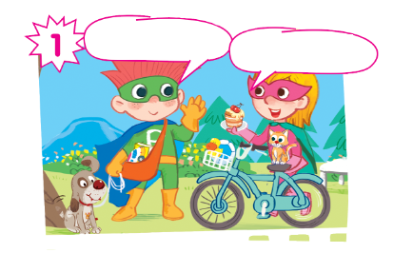
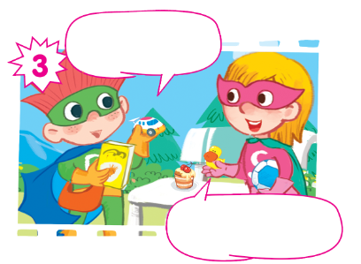
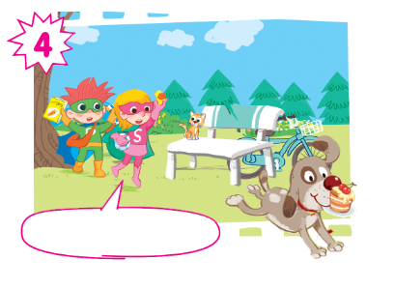
Oh, no! My cake!

Slide 17
Listen and repeat.
Hi! I’m Phil.
Hi! I’m Sue.

Slide 18
Listen and repeat.
Look! This is my dog.
And this is my cat.

Slide 19
Listen and repeat.
I have a car... and a book.
I have a ball... and a duck.

Slide 20
Listen and repeat.
Oh, no! My cake!

Slide 21
Listen and repeat.
Hi! I’m Phil.
Look! This is my dog.
Hi! I’m Sue.
And this is my cat.
I have a car... and a book.
I have a ball... and a duck.
Oh, no! My cake!
Oh, no! My cake!

Slide 22
Hi! I’m Phil.
Look! This is my dog.
Hi! I’m Sue.
And this is my cat.
I have a car... and a book.
I have a ball... and a duck.
Oh, no! My cake!
Oh, no! My cake!

Slide 23
2. Look and circle.

Slide 24
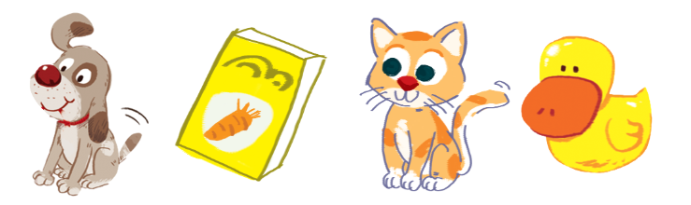
Look and circle.
dog cake cat duck book can car ball

Slide 25
Look and circle.
dog cake cat duck book can car ball

Slide 26
Look and circle.
cake cat duck book can car ball

Slide 27
Look and circle.
cake cat duck can car ball

Slide 28
Look and circle.
cake duck can car ball

Slide 29
Look and circle.
dog
book
cat
duck

Slide 30
3. Listen and tick.

Slide 31
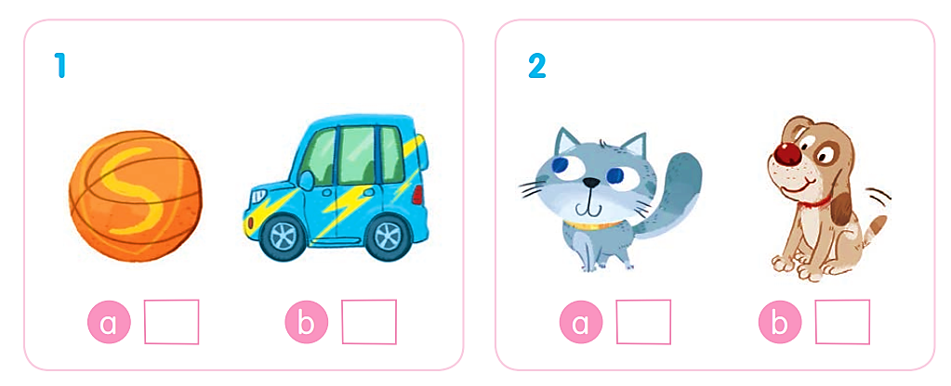
Listen and tick.

Slide 32
Listen and tick.
✓

Slide 33
Listen and tick.
✓

Slide 34
Listen and tick.
✓
✓

Slide 35
4. Listen and tick or cross

Slide 36
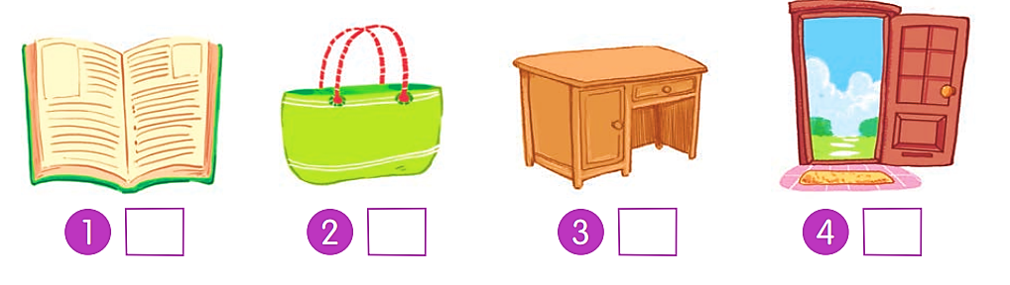
Listen and tick or cross.

Slide 37
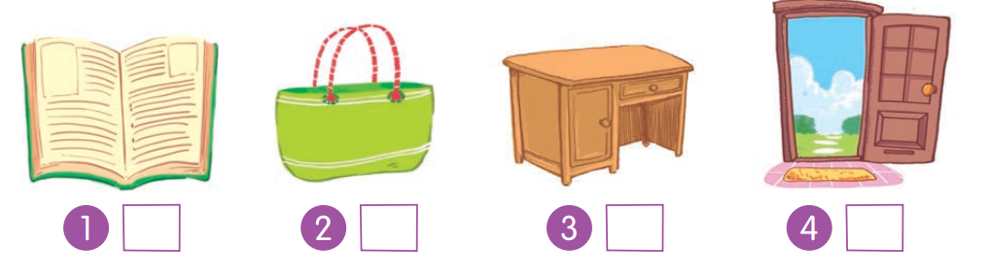
Listen and tick or cross.
✗

Slide 38
Listen and tick or cross.
✓

Slide 39
Listen and tick or cross.
✓

Slide 40
Listen and tick or cross.
✗

Slide 41
Listen and tick or cross.
✗
✓
✓
✗

