Slide 1


Slide 2

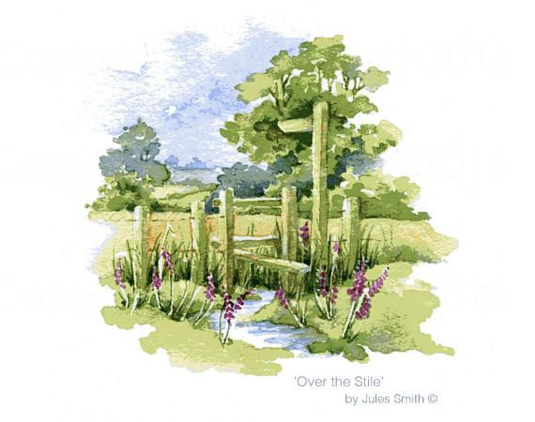
Unit
2
LIFE IN THE COUNTRYSIDE
LESSON 4: COMMUNICATION

Slide 3
LESSON 4: COMMUNICATION
WARM-UP
Jumbled conversation
Task 1: Listen and read the conversations. Pay attention to the highlighted sentences
Task 2: Work in pairs. Make similar conversations.
EVERYDAY ENGLISH
Task 3: Read the adverts for the two beautiful villages. Tick the boxes to show which village the statements describe. Sometimes both boxes need to be ticked.
Task 4: Work in groups. Take turns to talk about the similarities and differences between Duong Lam and Hollum.
Task 5: Work in pairs. Which village in 3 would you like to visit for a holiday? Explain your choice to your partner.
ADVERTS FOR BEAUTIFUL VILLAGES
Wrap-up
Homework
CONSOLIDATION

Slide 4
WARM-UP
1. Thank you. Yours’ re, too.
2. Happy birthday. Wow you’re wearing such a beautiful dress
3. Here is your present. I hope you like it.
JUMBLED
CONVERSATION
4. I’m glad you like it.
5. This is the best gift I have ever had. I love it.

Slide 5

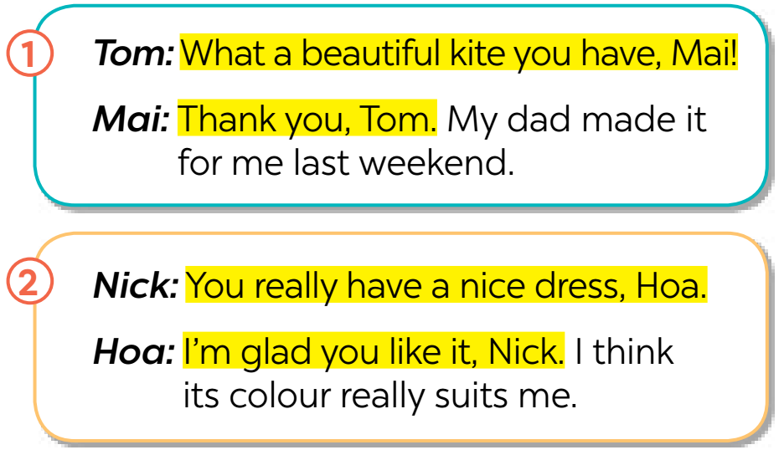


EVERYDAY ENGLISH
1
Listen and read the conversations. Pay attention to the highlighted sentences.
Giving compliments | Responding to compliments
- What a beautiful kite you have! - You really have a nice dress. | - Thank you. - I’m glad you like it.

Slide 6



EVERYDAY ENGLISH
2
Work in pairs. Make similar conversations to practise giving and responding to compliments, using the cues below.
– a shirt
– a bicycle
– a school bag

Slide 7
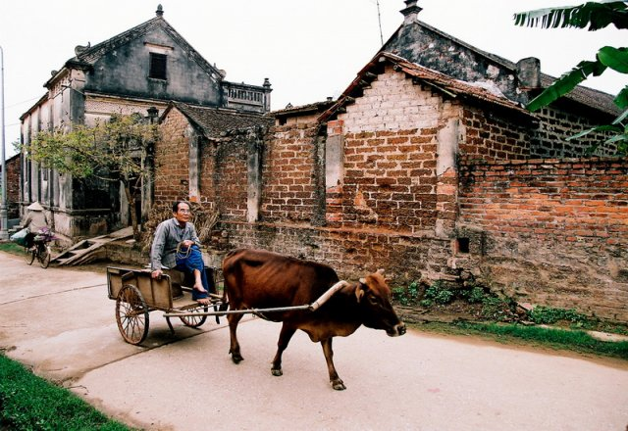


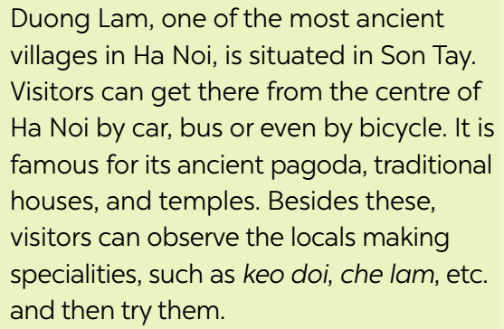
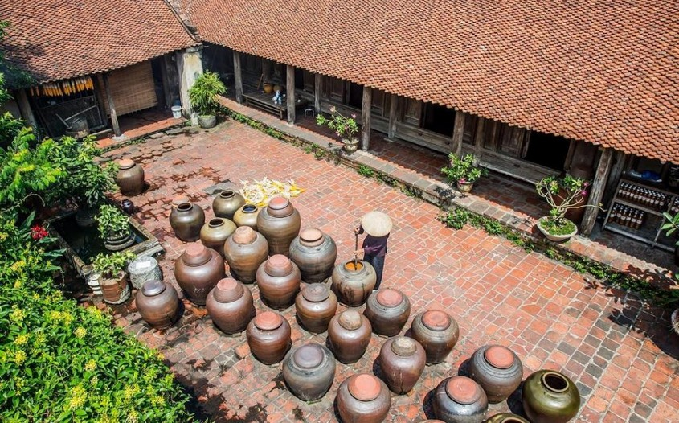
ADVERTS FOR BEAUTIFUL VILLAGES
4
Work in groups. take turns to talk about the similarities and differences between Duong Lam and Hollum
Duong Lam and Hollum are both ancient villages, …
https://www.youtube.com/watch?v=HgVzi6jIml8

Slide 8
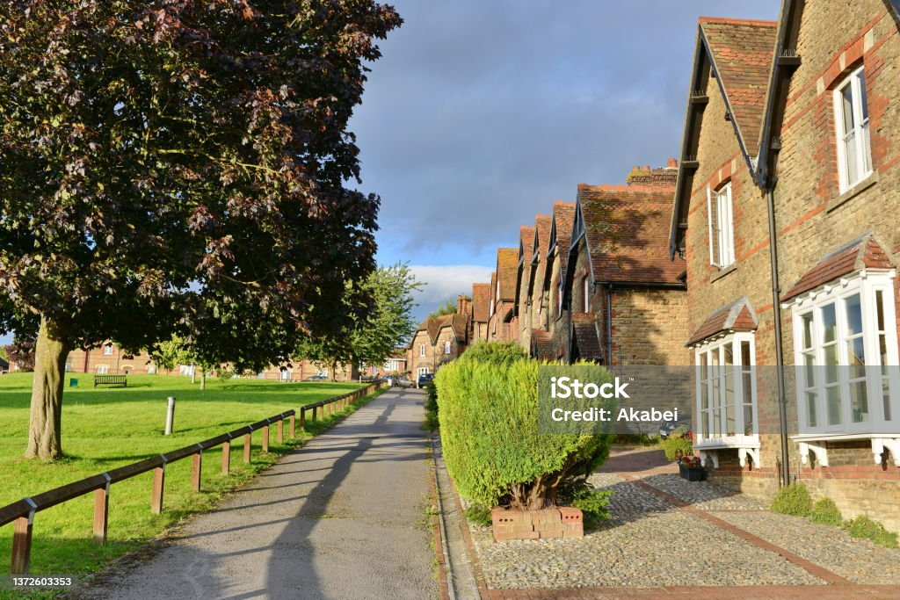
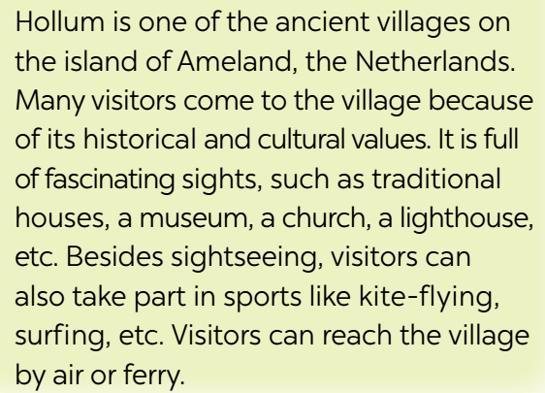
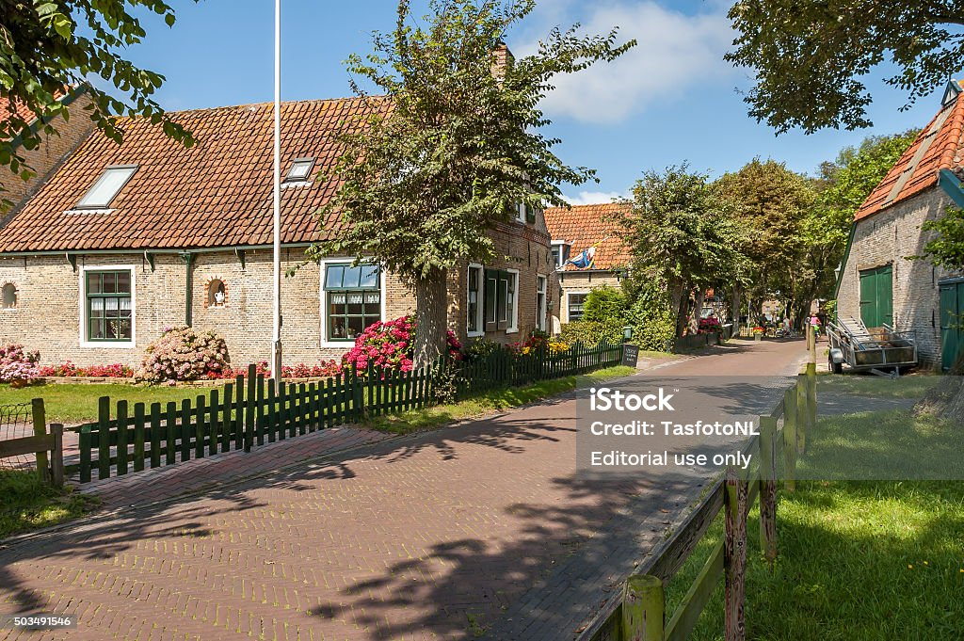
ADVERTS FOR BEAUTIFUL VILLAGES
4
Work in groups. take turns to talk about the similarities and differences between Duong Lam and Hollum
Duong Lam and Hollum are both ancient villages, …
https://www.youtube.com/watch?v=HgVzi6jIml8

Slide 9
ADVERTS FOR BEAUTIFUL VILLAGES
3
Read the adverts for the two beautiful villages. tick the boxes to show which village the statements describe. Sometimes both boxes need to be ticked.
Statements | Duong Lam | Hollum
1. It’s an ancient village.
2. We can visit an ancient pagoda, traditional houses, and temples in this village.
3. We can get there by plane or ferry.
4. We can go there by car, bus, or bike.
5. It has a lighthouse.

Slide 10
ADVERTS FOR BEAUTIFUL VILLAGES
4
Work in groups. take turns to talk about the similarities and differences between Duong Lam and Hollum
Duong Lam and Hollum are both ancient villages, …
https://www.youtube.com/watch?v=HgVzi6jIml8

Slide 11
ADVERTS FOR BEAUTIFUL VILLAGES
4
Work in groups. take turns to talk about the similarities and differences between Duong Lam and Hollum
Duong Lam and Hollum are both ancient villages, …
https://www.youtube.com/watch?v=HgVzi6jIml8

Slide 12
ADVERTS FOR BEAUTIFUL VILLAGES
4
Work in groups. take turns to talk about the similarities and differences between Duong Lam and Hollum
Duong Lam and Hollum are both ancient villages, …
https://www.youtube.com/watch?v=HgVzi6jIml8

Slide 13

ADVERTS FOR BEAUTIFUL VILLAGES
5
Work in pairs. Which village in 3 would you like to visit for a holiday? Explain your choice to your partner.
Example:
A: Which village would you like to visit for a holiday?
B: Duong Lam, of course!
A: Why?
B: Because I love watching the locals making specialities and …

Slide 14

CONSOLIDATION
1
Wrap-up
What have we learnt in this lesson?
How to give and respond to compliments

Slide 15

CONSOLIDATION
2
Homework
Do exercises in the workbook.

Slide 16

Website: hoclieu.vn
Fanpage: facebook.com/www.tienganhglobalsuccess.vn/

