Slide 1


Slide 2

LESSON 7: LOOKING BACK & PROJECT
WARM-UP
Revision
Task 1: Complete the sentences with appropriate leisure activities.
Task 2: Write complete sentences from the given cues.
VOCABULARY
Task 3: Fill in each blank with the correct form(s) of the verb in brackets.
Task 4: Complete the passage. use the correct form(s) of the verbs in brackets and the pictures. add more words if necessary.
GRAMMAR
Interview some students from your class or from other classes.
Report your group’s findings to your class based on the following guiding questions
PROJECT
CONSOLIDATION
Wrap-up
Homework

Slide 3

Unit
1
LEISURE TIME
LESSON 7: LOOKING BACK & PROJECT
1

Slide 4
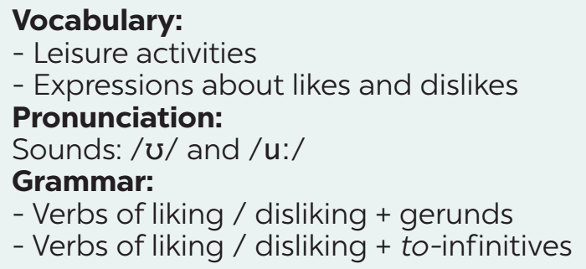

WARM-UP
What we have learnt in this unit:
REVISION

Slide 5
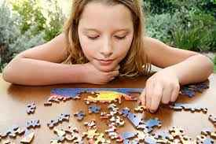
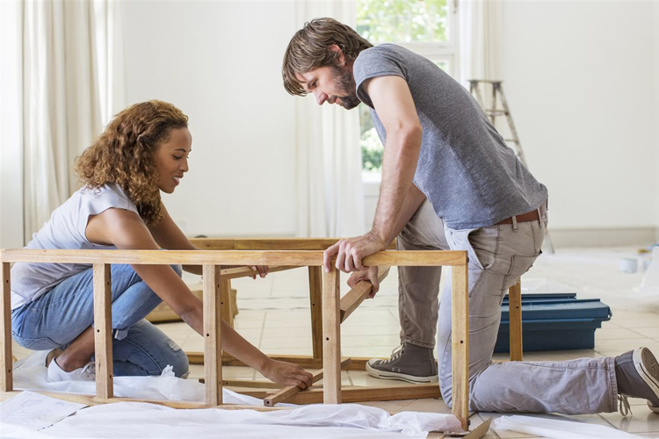




Slide 6
1
Complete the sentences with appropriate leisure activities.
1. Mai loves ___________ online for about 30 minutes a day. She thinks puzzles are good for the brain.
2. My favourite leisure activity is ________. I can make many things myself, such as paper flowers and bracelets.
doing puzzles
doing DIY
Messaging friends
3. _______________ is a popular way for teens to spend their free time. Many of them send messages to each other every day.
4. My brother is fond of ___________ with his friends. On Sundays, he usually plays football, goes swimming, or plays badminton with them.
5. Tom spends one hour on the Internet almost every day. He is keen on ____________.
playing sport
surfing the net

Slide 7
VOCABULARY
2
Write complete sentences from the given cues.
1. my cousin / crazy about / play / computer / games.
________________________________________________
2. they / interested / play / badminton / after school?
________________________________________________
3. I / not fond / make models / because / I / not patient.
________________________________________________
My cousin is crazy about playing computer games.
Are they interested in playing badminton after school?
I’m not fond of making models because I’m not patient.

Slide 8
VOCABULARY
2
Write complete sentences from the given cues.
4. - why / you / not into / cook?
_____________________________
- because / often / burn / myself.
_____________________________
5. my friends / keen / do judo / and / they / go / judo club /
every Sunday.
_________________________________________________________________
Why are you not into cooking?
Because I often burn myself.
My friends are keen on doing judo, so they go to the judo club every Sunday.

Slide 9
GRAMMAR
3
Fill in each blank with the correct form(s) of the verb in brackets.
1. Does Tom enjoy (cycle) _________ in the park with his friends?
2. Some teenagers don’t like (read) ______________ comic books.
3. Mai detests (play) _________ sport because it’s tiring.
4. Trang and Ann love (chat) ______________ with each other in their free time.
5. What do Nam and Mark prefer (do) ___________ at the weekend?
cycling
reading / to read
playing
chatting / to chat
doing / to do

Slide 10
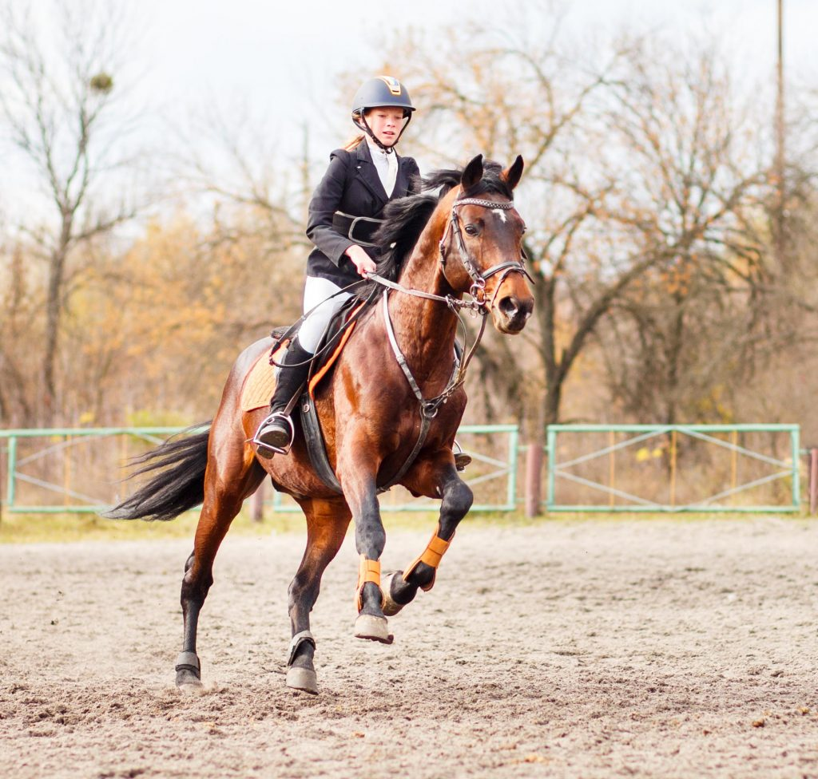
GRAMMAR
4
Complete the passage. Use the correct form(s) of the verbs in brackets and the pictures. Add more words if necessary.
Ann is my best friend. She usually has free time at the weekend. She adores
(1. ride) riding a horse at the riding club.

Slide 11


GRAMMAR
4
Complete the passage. Use the correct form(s) of the verbs in brackets and the pictures. add more words if necessary.
Sometimes, she likes (2. read) ___________________
or (3. message) _____________________________.
reading / to read books
messaging / to message her friends

Slide 12
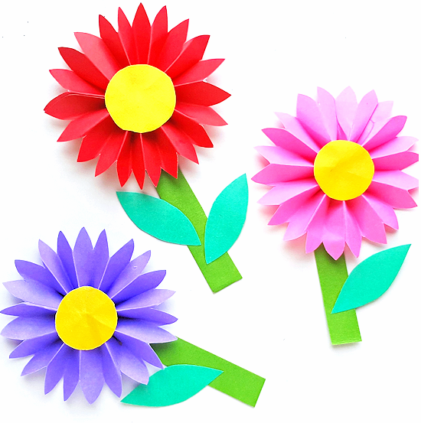
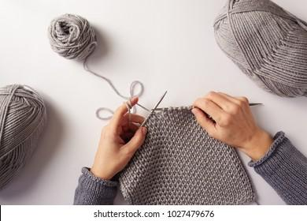
GRAMMAR
4
Complete the passage. Use the correct form(s) of the verbs in brackets and the pictures. add more words if necessary.
She also loves (4. make) __________________________ and (5. knit) ______________.
making / to make paper flowers
knitting / to knit

Slide 13
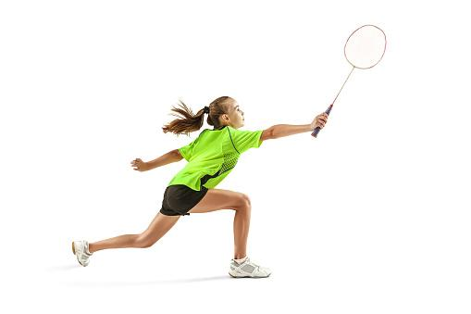
GRAMMAR
4
Complete the passage. Use the correct form(s) of the verbs in brackets and the pictures. add more words if necessary.
There is one thing she doesn’t like doing in her free time. She dislikes
(6. play) _______________.
playing badminton

Slide 14

PROJECT
LEISURE TIME SURVEY
Interview some students from your class or from other classes.
Collect the answers.
Report your group’s findings to your class based on the following guiding questions

Slide 15
CONSOLIDATION
1
Wrap-up
What have we learned in this lesson?
Review vocabulary related to leisure activities and expressions about likes and dislikes
Review verbs of liking / disliking followed by gerunds and / or to-infinitives to talk about likes and dislikes

Slide 16

CONSOLIDATION
2
Homework
Do exercises in the workbook.

Slide 17

Website: hoclieu.vn
Fanpage: facebook.com/www.tienganhglobalsuccess.vn/

