Slide 1


Slide 2

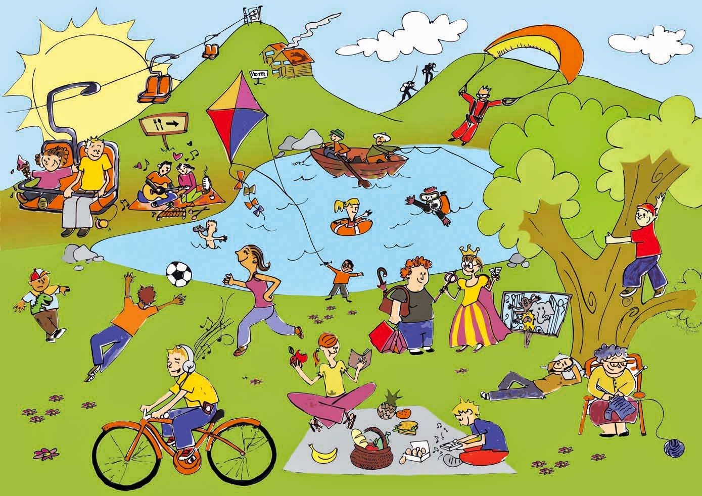
Unit
1
LEISURE TIME
LESSON 3: A CLOSER LOOK 2
1

Slide 3
LESSON 3: A CLOSER LOOK 2
WARM-UP
Warm up: Find someone who…
PRESENTATION
Verbs of liking / disliking + gerunds
Verbs of liking / disliking + to-infinitives
Task 1: Work in pairs. Put the verbs in the appropriate column.
Task 2: Choose the correct answer A, B, or C.
Task 3. Look at the pictures and complete the sentences, using the verbs in brackets in their suitable form.
Task 4: Complete the sentences about yourself.
PRACTICE
PRODUCTION
Task 5: Game: Likes and dislikes mimes
CONSOLIDATION
Wrap-up
Homework

Slide 4
WARM-UP
Go around the classroom and find:
Find someone who… | Name
likes playing computer games.
enjoys knitting.
detests cooking.
fancies going shopping.
loves doing puzzles.
hates hunting.
dislikes watching TV.
prefers going to the cinema.
Find someone who…

Slide 5

PRESENTATION
Verbs of liking
love
prefer
like
enjoy
fancy
Verbs of liking are used to express positive attitudes towards people or things.

Slide 6

PRESENTATION
Verbs of disliking
detest
hate
dislike
Verbs of disliking are used to express negative attitudes towards people or things.

Slide 7

PRESENTATION
Some verbs of liking and disliking can be followed by gerunds only.
Example: They dislike surfing the net.
Some are followed by both gerunds and
to-infinitives.
Example: I love going / to go to the cinema.

Slide 8

PRACTICE
1
Work in pairs. Put the verbs in the appropriate column.
love like detest fancy
dislike enjoy hate prefer
Verbs followed by gerunds only | Verbs followed by both gerunds and to-infinitives
detest
love
fancy
like
dislike
hate
enjoy
prefer

Slide 9
PRACTICE
2
Choose the correct answer A, B, or C.
1. I love ______, so in my leisure time, I go to some villages near Ha Noi to relax and enjoy the outdoors.
A. travelling B. travelled C. to travel
2. Tom enjoys ______ puzzles, especially Sudoku.
A. doing B. do C. to do

Slide 10
PRACTICE
2
Choose the correct answer(s).
3. When do you like ______ TV?
A. watched B. watch C. to watch
4. Do you fancy ______ to the cinema this weekend?
A. go B. going C. to go
5. I detest ______. I think it’s cruel to harm animals.
A. hunting B. to hunt C. hunt

Slide 11
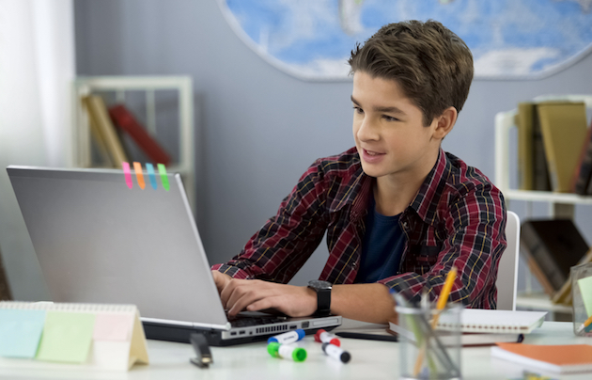
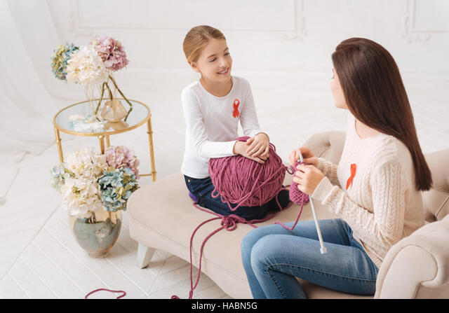
PRACTICE
3
Look at the pictures and complete the sentences, using the verbs in brackets in their suitable form.
likes surfing / to surf the Internet
1. Mark ___________________________. (like)
2. The girls ____________. (enjoy)
enjoy knitting

Slide 12
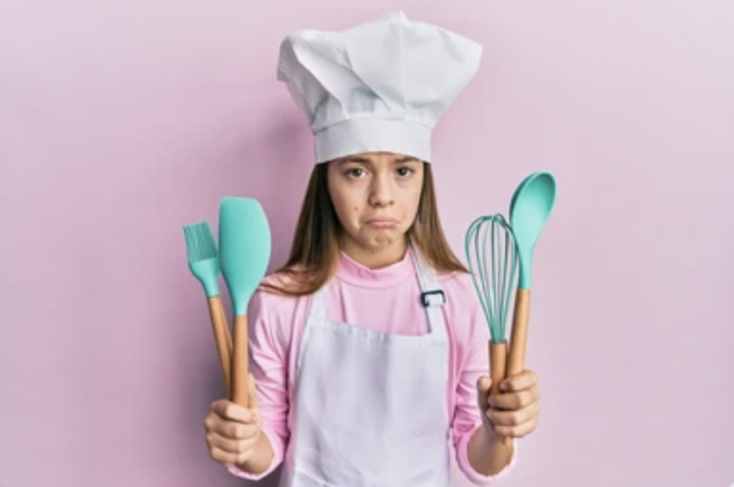
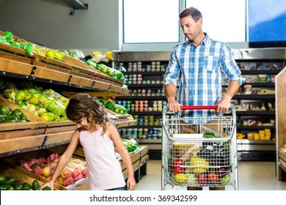
PRACTICE
3
Look at the pictures and complete the sentences, using the verbs in brackets in their suitable form.
3. My cousin ______________. (dislike)
dislikes cooking
hates going / to go shopping
4. My father________________________. (hate)

Slide 13
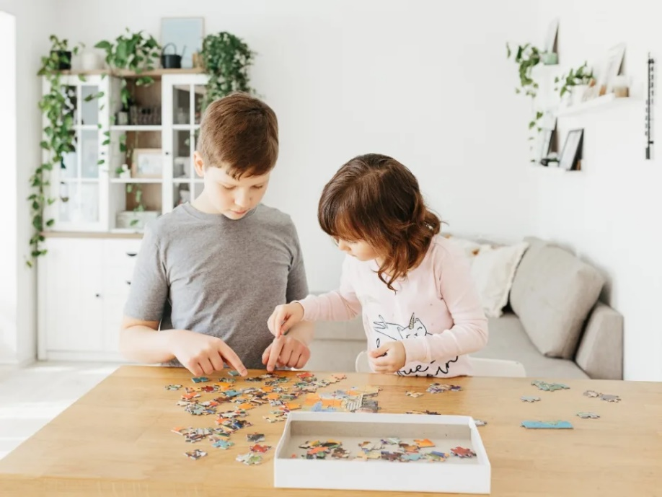
PRACTICE
3
Look at the pictures and complete the sentences, using the verbs in brackets in their suitable form.
5. Tom and his sister ______________________. (prefer)
prefer doing / to do puzzles

Slide 14


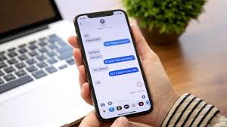
PRACTICE
4
Complete the sentences about yourself.
All about me
I like ______. I prefer ______. I love ______. | I dislike ______. I hate ______. I detest ______.

Slide 15

PRODUCTION
5
Likes and dislikes mimes
Work in groups. One mimes a leisure activity he / she likes or dislikes.
The others guess the activity by asking yes / no questions using the verbs they have learnt.
Example:
A: Do you like surfing the net?
B: No, I don’t.
C: Do you love messaging your friends?
B: Yes, I do.

Slide 16

CONSOLIDATION
1
Wrap-up
What have we learnt in this lesson?
How to use verbs of liking and disliking

Slide 17

CONSOLIDATION
2
Homework
Do exercises in the workbook.

Slide 18

Website: hoclieu.vn
Fanpage: facebook.com/www.tienganhglobalsuccess.vn/

