Slide 1



WELCOME TO OUR CLASS

Slide 2



Unit 5: Natural wonders of Viet Nam
LESSON 7
SKILL 2

Slide 3

* WARM –UP : Listen an EL song

Slide 4

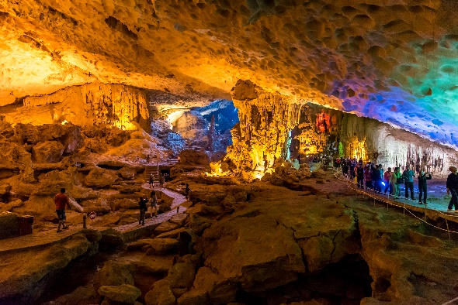
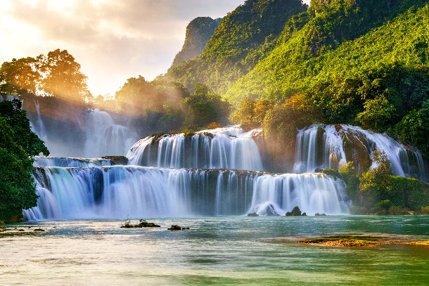
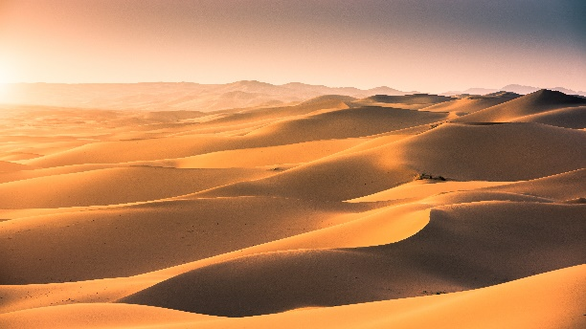
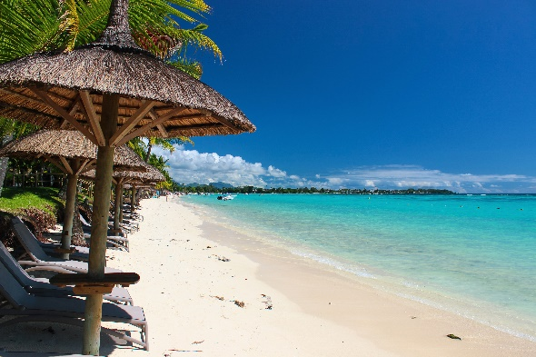
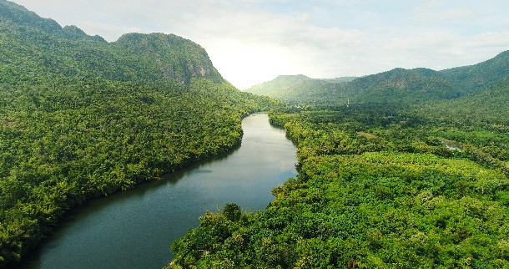
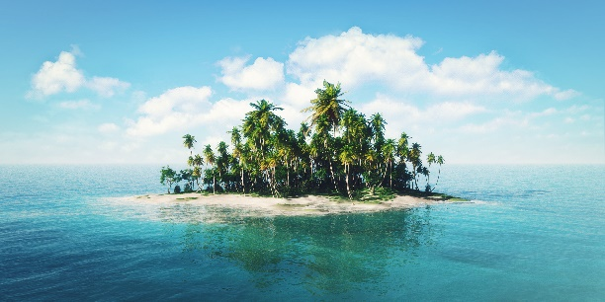
* Vocabulary
Write the name for each picture.
1.
waterfall
2.
cave
3.
desert
4.
river
5.
island
beach
6.

Slide 5

Match the name of a natural wonder in column A with a word indicating it in column B. 1 is an example.
A
B
1. Fansipan
a. Bay
d. mount
2. Ban Gioc
b. Island
c. waterfall
3. Ha Long
c. waterfall
a. Bay
4. Cuc Phuong
d. mount
e. forest
5. The Sahara
e. forest
f. desert
6. Con Dao
f. desert
b. Island

Slide 6


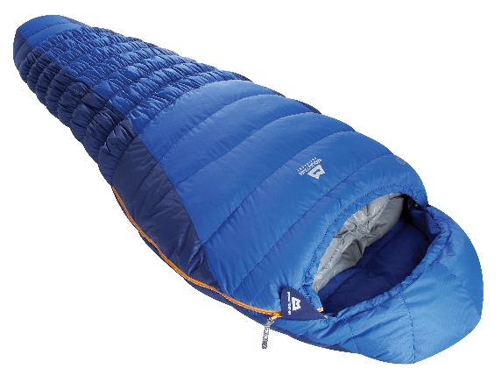
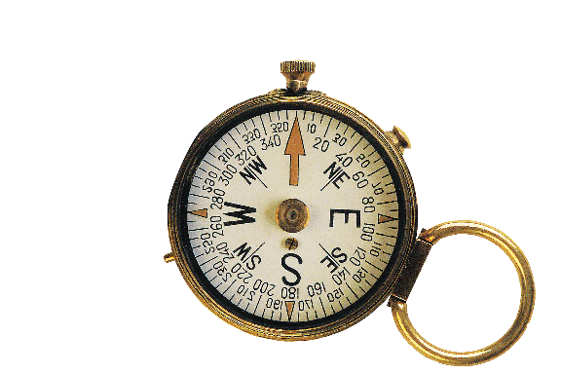
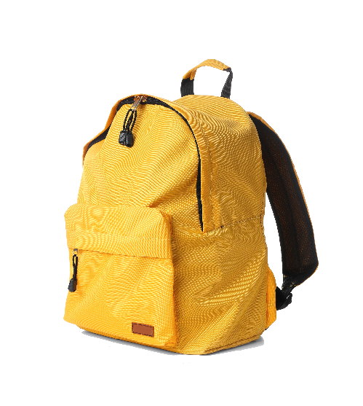
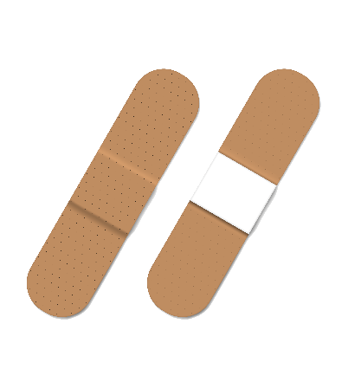
Write the words.
a. scissors
b. sleeping bag
c. compass
a.
b.
c.
d. backpack
e. plaster
d.
e.

Slide 7

* Grammar
Find the mistake in each sentence and correct it.
Example:
There is some wonderful camping sites in our area.
is are

Slide 8
1.
How many candles is on that birthday cake?
is are
2.
There are so much snow on the road.
are is
3.
Michael can play different musical instrument.
instrument instruments
4.
There are not much milk left in the fridge.
are is
5.
Don’t take too much luggages on your trip.
luggages luggage

Slide 9

Complete the dialogue, using must or mustn’t.
must
A:
It’s dangerous to go hiking there. You (1) tell someone where you are going.
Yes. And I (2) take a warm coat.
It’s very cold there.
B:
must
Right. But you (3) bring any heavy or unnecessary things with you.
A:
mustn’t
OK, and I (4) take a mobile phone. It’s very important.
B:
must
A:
mustn’t
And you (5) forget to bring a compass.

Slide 10
* EXERCISE: Rewrite the following sentences.
1. There are some chairs and a table in the kitchen.
→We have .
2. Not many people can understand his lecture.
→Only
3.It is wrong of us to throw rubbish.
→We mustn’t .
4.It is necessary for us to be present at the class discussion on Saturday.
→ We must .
5.The tour guide tells us not to throw rubbish.
→ The tour guide says that we .
some chairs and a table in the kitchen.
some / a few people can understand his lecture.
throw rubbish.
be present at the class discussion on Saturday
must not / mustn’t throw rubbish.

Slide 11
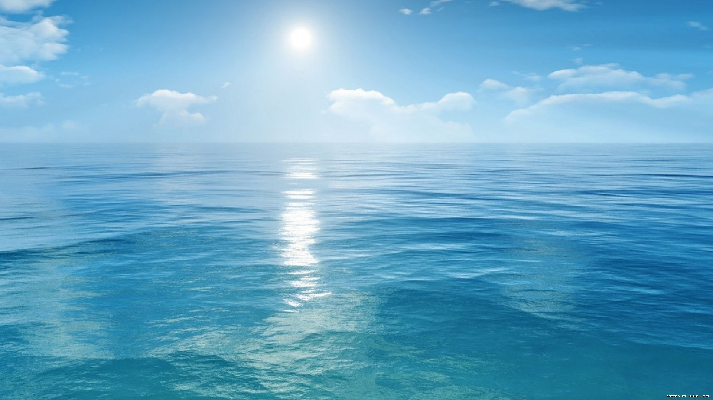

DREAM DESTINATION
In groups, make a poster about a natural wonder you would like to visit. In the poster, draw / print a picture of the place. Then give some information about the place:
what the natural wonder is
where it is
how you can go there
what it is special about
what you can do there
…

Slide 12
DREAM DESTINATION
Introduce the attraction to your class.

Slide 13

4. homework
Review Unit 5
Redo all the exercises.
Prepare UNIT 6.

Slide 14

Thank you very much.

