Slide 1

ENGLISH 6
Nguyen Thi Thu Ba
Nguyễn Thị Thu Ba

Slide 2
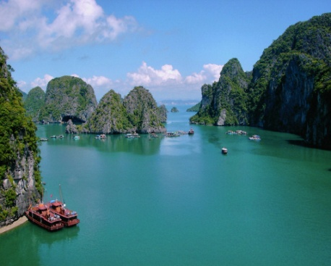
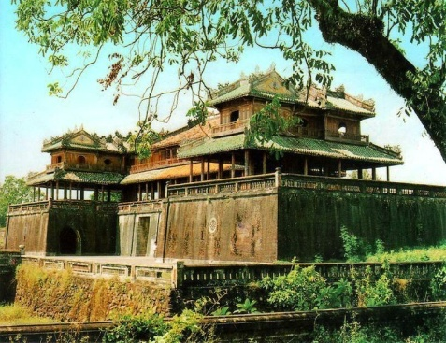
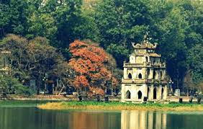
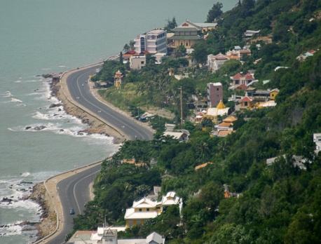
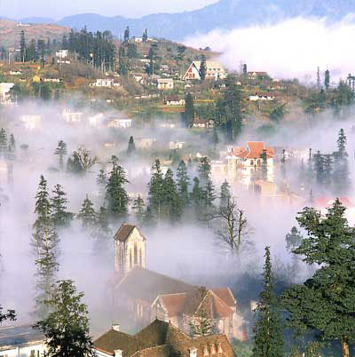
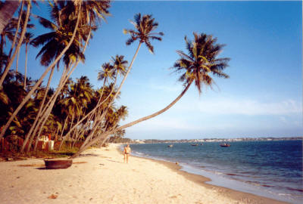
Look at the pictures and name the places in the pictures
2-
Hue
3-
Hoan kiem lake-
Ha Noi
1-
Ha Long Bay
4-
Mui Ne
5-
Vung Tau
6-
Sa Pa
What do you think about Ha Long Bay,………?

Slide 3


Unit 5: Natural wonders of Viet Nam
LESSON 6

Slide 4
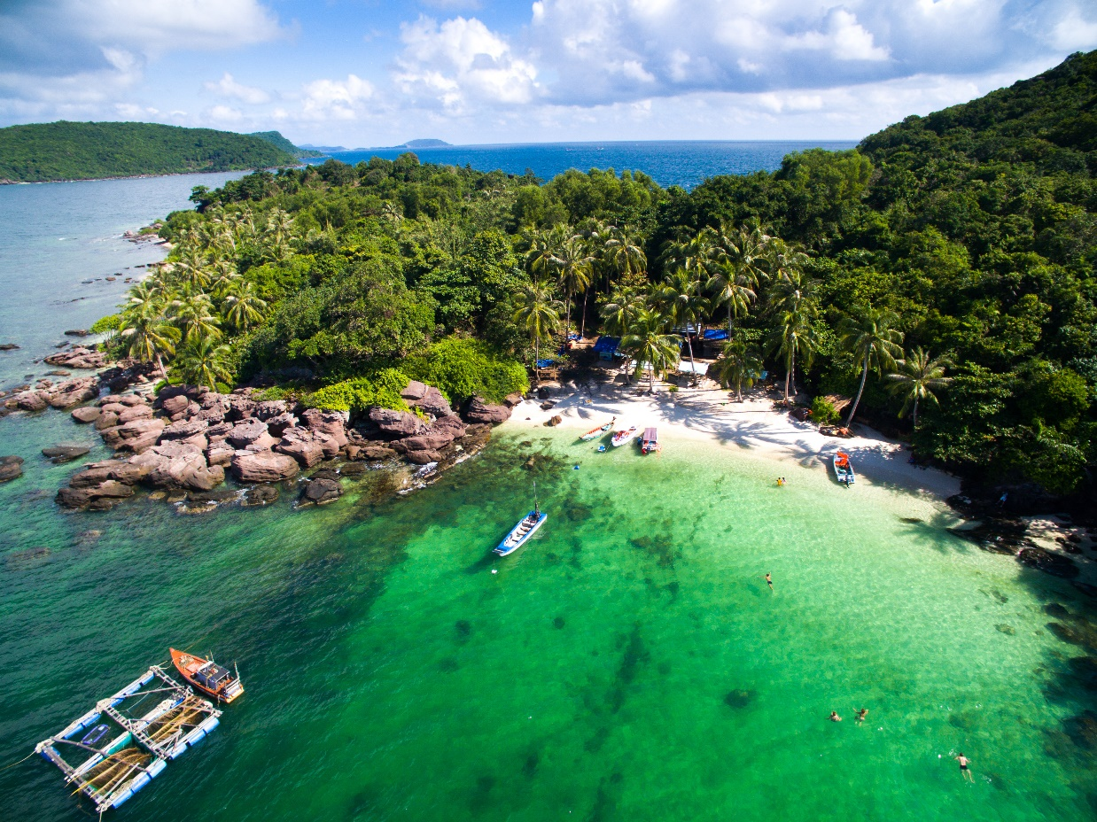
- Guess the name of the destination.
. Phu Quoc Island
Today we are going to listen to a talk about a famous natural wonder of Viet Nam. It’s Phu Quoc Island.

Slide 5



I/ Listening
Work in groups. Discuss the question.
What do you know about Phu Quoc Island?
a beautiful island
in Viet Nam
The food is delicous
In Kien Giang province.
visiting the night market,….
many entertaining activities
Listen to the talk and check your answers.

Slide 6

Listen again and tick () T (True) or F (False).
 |  | T | F
1. | Phu Quoc is a very beautiful island in Viet Nam.
2. | There are no green forests in Phu Quoc.
3. | Tourists can visit fishing villages and national parks there.
4. | You cannot play water sports in Phu Quoc.
5. | People sell interesting things at the markets.





2. F (It has beautiful beaches and green forest.)
T
4. F (Sailing and fishing are popular water sports.)

Slide 7
2.1 / Listen again and fill in the blanks
* Game: Lucky number
beaches
1. Phu Quoc has beautiful …………….. and green forests
resorts
2. It also has………………, hotels, and bars
airport
3. Phu Quoc has an international…………………………..
pagodas
4. Tourists can visit fishing villages, national parks, ……………and temples
popular
5. Sailing and fishing are ………………………..water sports.
1
2
3
4
5
6
7
LN 1 LN 4 3 2 5

Slide 8
AUDIO SCRIPT
Phu Quoc is a very beautiful island in Viet Nam. It is in Kien Giang. It has beautiful beaches and green forests. It also has resorts, hotels, and bars. The people here are friendly. Phu Quoc has an international airport, and travelling there is easy. Tourists can visit fishing villages, national parks, pagodas and temples. They also like to eat the seafood here. It is delicious. Sailing and fishing are popular water sports. You can buy interesting things at the markets on the island.

Slide 9

II/ Writing
Fill each blank in the network with the information about a travel attraction you know.
(3) How can you go there?
(2) Where is it?
(1) Name of the attraction
(5) What can you do there?
(4) What is special about it?

Slide 10
* Suggested answers:
(1) Name of the attraction
It’s Phu Quoc island
(2) Where is it?
It’s Phu Quoc island
(3) How can you go there?
You can fly to the island because it has an international airport
(4) What is special about it?
It’s one of the most famous natural wonders of Viet Nam and thousands of tourists visit it every year.
(5) What can you do there?
I can visit the fishing villages, the national parks, beautiful beaches, temples, pagodas, etc. I can enjoy some water sports like Sailing and fishing or buy interesting things at the night market.

Slide 11
=> Answer:
1. Ly Son island
2. Quang Ngai Province
3. By ship
4. It is a pristine island with exotic seafood
5. Go diving, swimming

Slide 12


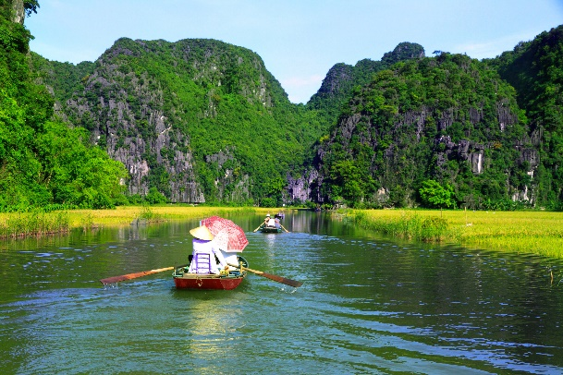
Use the notes in 3 to write a paragraph of about 50 words.
I am writing about
It is in
I am writing about Ly Son island. It is a beautiful island in Quang Ngai province. And it’s not far from here . You can go there by ship . It is a pristine island with exotic seafood. Ly Son island is famous for its friendliness, long beautiful beaches, and being “the kingdom of garlic.” There you can enjoy great Vietnamese seafood; Especially King crab. You can go diving and swimming. You can join exciting activities. I think, you should have a visit to Ly Son.

Slide 13
* Model writing:
I am writing about Ha Long Bay.
It is in Quang Ninh province. It’s very far from here
- about 500 kilomiters, so you can go there by bus or by train. Ha long Bay has many caves and islands. Tuan Chau is the biggest island in Ha Long Bay. You must take a boat ride around the islands. There you can enjoy great Vietnamese seafood. You can watch traditional dance. You can join exciting activities. Ha Long Bay is Vietnam’s most beautiful natural wonder.

Slide 14
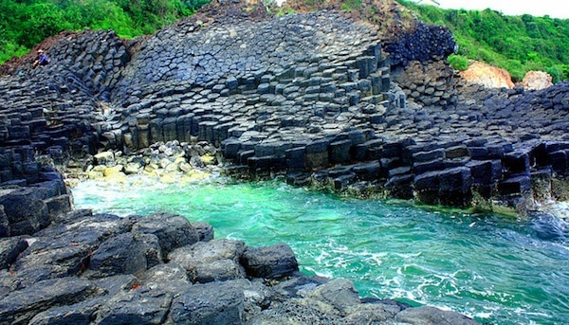
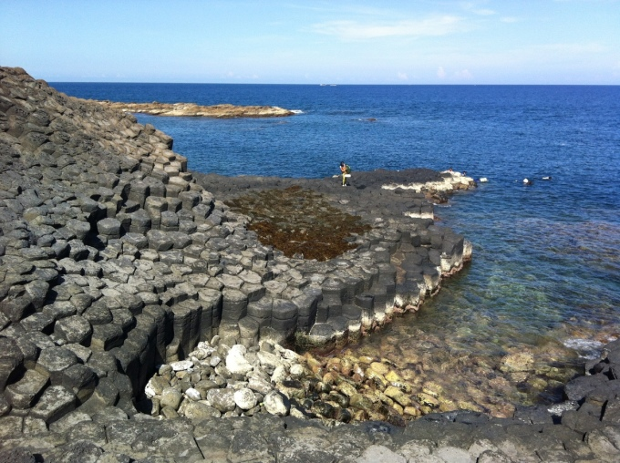
* Model writing:
I am writing about Ghenh Da Dia. It is in An Ninh Dong communine, Tuy A distrist, Phu Yen province. It’s about 35 kilomiters from Tuy Hoa City, Visitors can go there by car or by motorbike.
Ganh Da Dia is a wonderful natural landscape in Vietnam. The scenery here is very beautiful with many rock columns of different shapes and size. There you can take many beautiful photos. Then you can enjoy great Vietnamese seafood. You can join exciting activities.

Slide 15

4. homework
Rewrite the paraghraph in your notebook..
Do exercises in workbook.
Prepare looking back.

Slide 16

Thank you!
Have a nice day!

