Slide 1


Slide 2
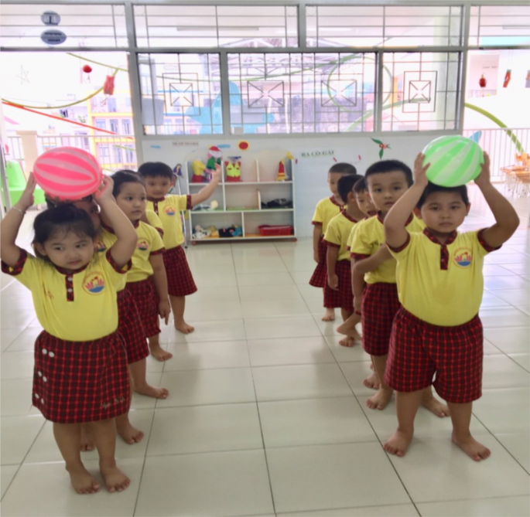

GAME: Pass the ball
Teacher plays the music. When music’s on, students pass the ball as fast as they can. When music’s off, the student taking the ball has to make a sentence with must/ mustn’t.

Slide 3
GAME: Pass the ball
Teacher plays the music. When music’s on, students pass the ball as fast as they can. When music’s off, the student taking the ball has to make a sentence with must/ mustn’t.

Slide 4


Unit 5: Natural wonders of Viet Nam
LESSON 4
Everyday English
* Making and accepting appointments

Slide 5

Listen and read the short conversation below, paying attention to the highlighted parts.
Steven: Duong, let’s go for a picnic this Sunday.
Duong: That’s fine. What time can we meet?
Steven: How about 9 o’clock?
Duong: Sure. I’ll meet you at that time.
They are Duong and Steven. Steven wants Duong to go picnic with him this Sunday.
What structures can he use?
If Duong agrees,
what does he say?
Notes:
Slide này không đúng.

Slide 6
How to make and accept appointments”.
* Making appointments:
- Let’s + V.
- How about …?
* Accepting appointments:
→ That’s fine.
→ Sure.

Slide 7


Work in pairs. Make a short conversation, following the example in 1.
Huy: Nam, let's go to the supermarket this Sunday morning.
Nam: That's great. What time can we meet?
Huy: How about 8 o'clock?
Nam: Sure, I'll meet you at that time

Slide 8

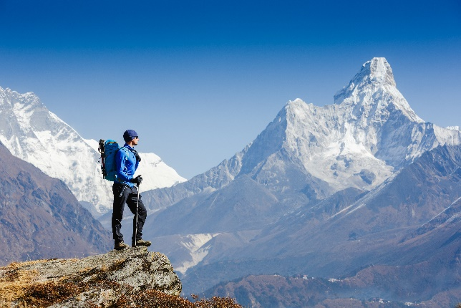

* A travel guide
Read the travel guide entry.
GLOBAL TRAVEL GUIDE
The Himalayas is a mountain range.
It’s very special. It has the world’s highest mountain – Mount Everest.
When visiting the Himalayas, remember to follow these rules.
You must ask before you visit the area.
You mustn’t travel alone. Always go in a group.
You mustn’t litter.
You must bring only the necessary things.
You must bring the right clothes too. Don’t bring shorts or T-shirts!
Notes:
City landmarks phải ở trên mục 3

Slide 9

Now make a list of the things you must bring to the Himalayas. Then add things you mustn’t bring.
MUST | MUSTN’T
- sleeping bag - plaster - packback - waterproof coat
compass
bicycle
shorts
- t-shirt
-

Slide 10

Role-play being a tour guide and a tourist. Tell your partner what to prepare for their trip to the Himalayas, and give reasons.
Example 1:
A: I’d like to go to the Himalayas next month.
B: OK. I think you must bring a waterproof coat. It’s cold and rainy there!
A: Yes. Anything else?
B: You must …, and you mustn’t …

Slide 11
Nga: Lan , let’s go somewhere this Saturday.
Lan : That’s fine. Where can we go?
Nga: How about the Ba To Park?
Lan Sure. I’ll meet you there at 9 o’clock.
Example 2:

Slide 12

* Homework
Learn new words
Do exercise in workbook
Prepare Skill 1

Slide 13


Thank you for your attention!

