Slide 1


Slide 2
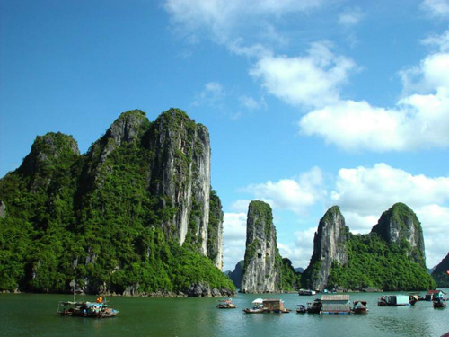
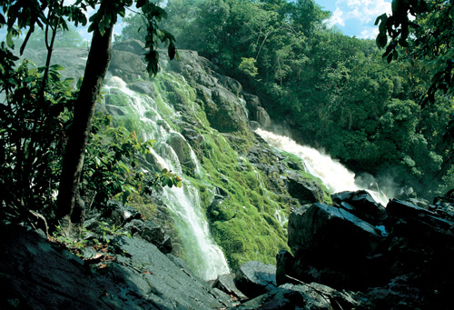
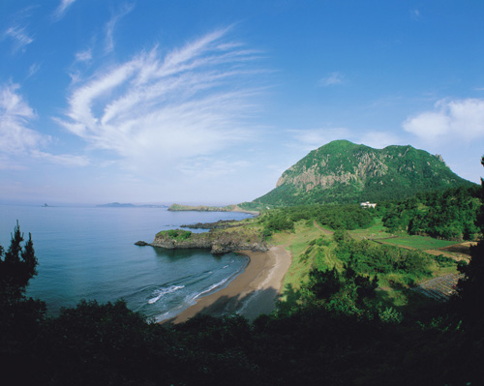
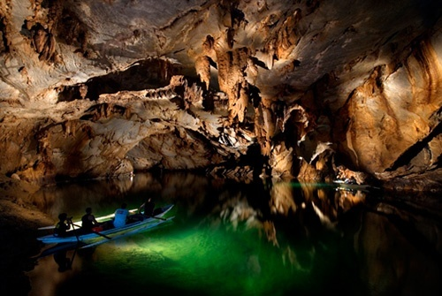
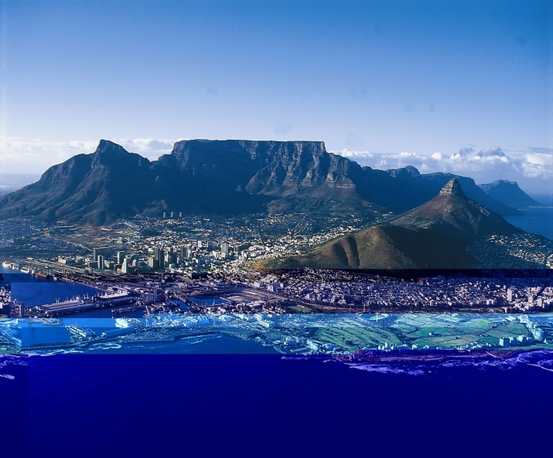
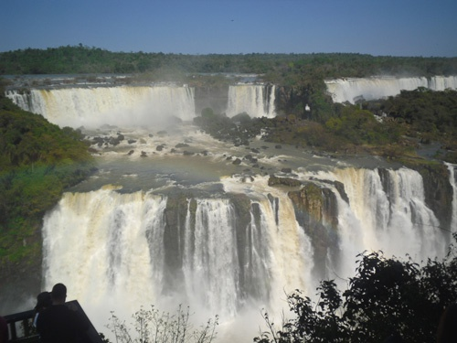
1. Ha Long Bay
2. Amazon rainforest
3. Jeju Island - Hàn Quốc
4. Underground river.
Princesa (Philippines)
5.Table Mountain –Châu phi
6. Waterfall - Brazil

Slide 3


Unit 5: Natural wonders of Viet Nam
LESSON 1

Slide 4
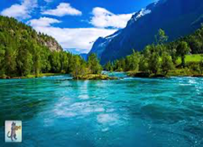
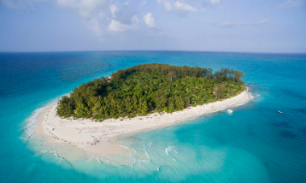
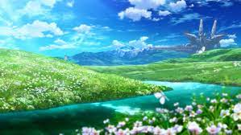
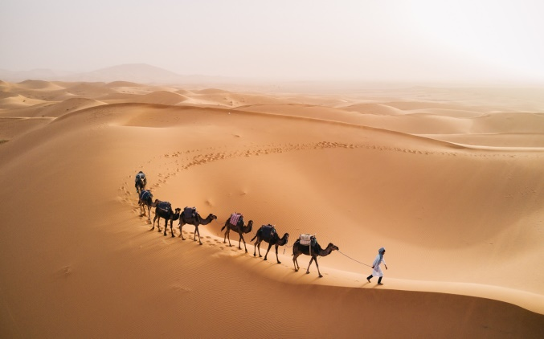
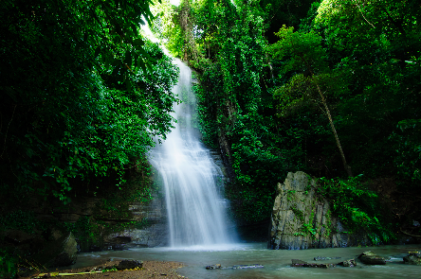
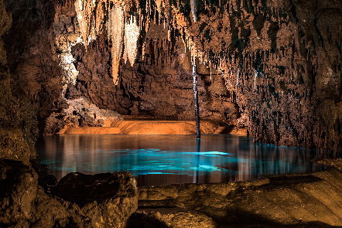
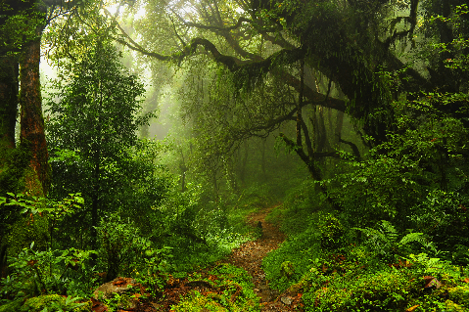
* Vocabulary:
- natural wonders (phr) :
kì quan thiên nhiên
- scenery (n):
phong cảnh
- islands :
hòn đảo
- desert :
sa mạc
- cave:
hang động
- waterfall:
thác nước
- forest:
khu rừng

Slide 5
* Checking vocab
What and Where
natural
wonders
forest
desert
scenery
islands
waterfall
cave

Slide 6



Listen and read.
Geopraphy Club
They are Alice, Elena and Nick.
1. Who are they?
2. What are they looking at?
3. What are they talking about?
They are looking at some photos/ pictures.
They are talking about attractive places in Viet Nam.
Notes:
Thiếu tên bài đọc.

Slide 7
Geopraphy Club
Alice: Hello, welcome to our Geography Club.
(Knock at door)
Alice: Come in, Elena. We’re just starting now.
But remember you must always be on time.
Elena: Sure. Sorry.
Alice: Today I’m going to talk about some natural wonders of Viet Nam.
Nick: Great! What’s that in the first picture?
Alice: It’s Ganh Da Dia in Phu Yen.
Elena: Wow. It looks amazing!
Nick: Is picture 2 Ha Long Bay?
Alice: Right. What do you know about it?
Nick: It has many islands.
Alice: Yeah! The scenery is wonderful. This picture shows Tuan Chau, a large island.
Tommy: How about picture 3?
…

Slide 8
* Questions.
1/ Who is the leader of Geography Club?
→ Alice
2/ What are they talking about?
→ They are talking about some natural wonders of Viet Nam
3/ What is Ganh Da Dia ? And where?
→ They are Rocks in Phu Yen
4/ Does Ha Long Bay have thousands of big and small
→ Yes, it does.

Slide 9

Complete the following sentences with the words from the box.
scenery
amazing
natural
islands
wonders
1.
People didn’t make Ganh Da Dia.
They are rocks.
natural
Ha Long Bay has thousands of big and small .
2.
islands
Ha Long Bay is charming and the is wonderful.
3.
scenery
4.
Ganh Da Dia has rock columns of different shapes and sizes.
amazing
5.
wonders
There are many natural and man-made in Viet Nam.

Slide 10

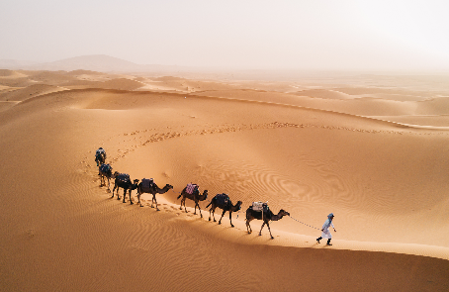
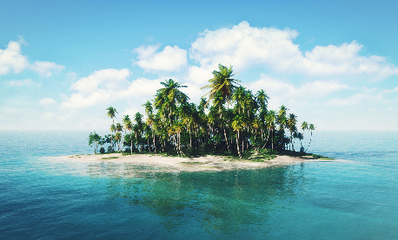
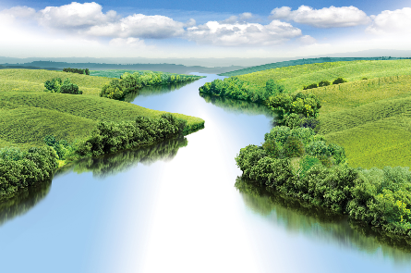
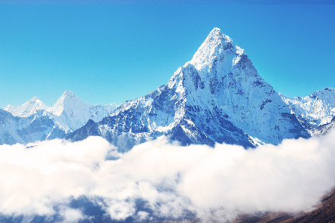
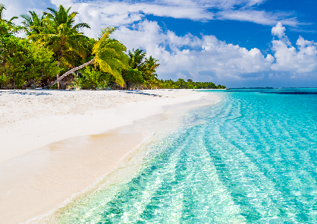
Listen and repeat the words, then label the pictures.
1. mountain
3. waterfall
5. cave
7. beach
2. river
4. forest
6. desert
8. island
a.
b.
c.
d.
e.
f.
g.
h.

Slide 11
Listen and repeat the words, then label the pictures.
1. mountain
3. waterfall
5. cave
7. beach
2. river
4. forest
6. desert
8. island
a.
b.
c.
d.
e.
f.
g.
h.

Slide 12


Work in groups. Choose the correct answer to each of the questions.
1.
Which is an island in Viet Nam?
A.
Con Dao
B.
Son Doong
2.
Where is Mount Fansipan?
A.
In Lao Cai
B.
In Quang Binh
3.
Which of the following is a national park?
A.
Thong Nhat Park
B.
Cat Tien Park
4.
Which of the following wonders is a cave?
A.
Cuc Phuong
B.
Phong Nha
5.
Which waterfall is in Cao Bang?
A.
Giang Dien Waterfall
B.
Ban Gioc Waterfall

Slide 13
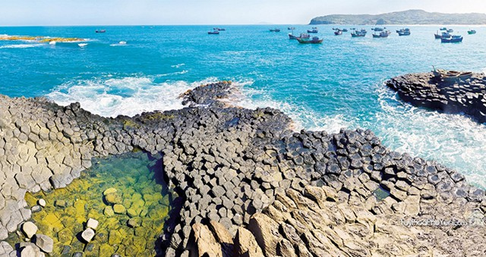
* Production
* List about a natural place of interest in your village / town / city, or a famous place you know about.
* Answer.
Ganh Da Dia.

Slide 14
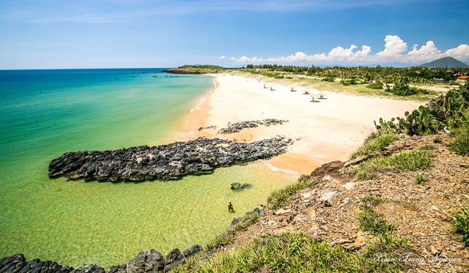
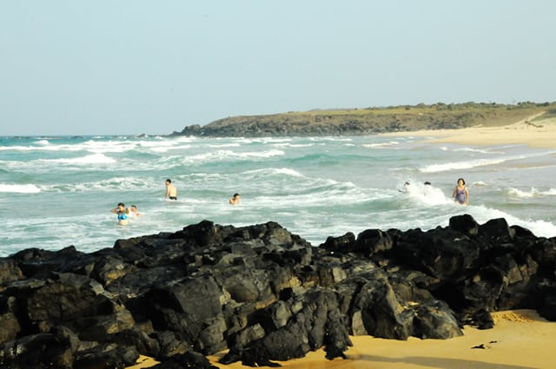
BAI XEP

Slide 15
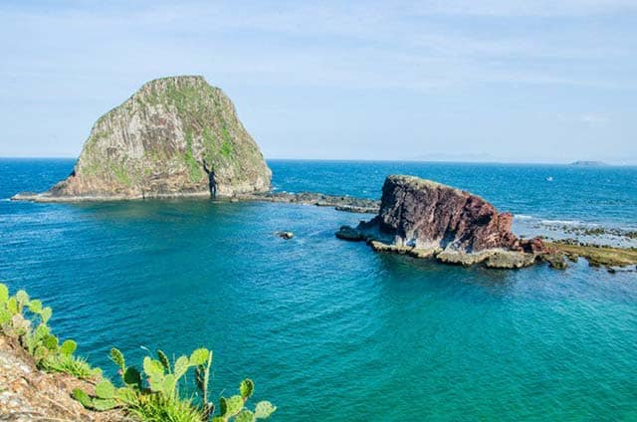
YEN ISLAND

Slide 16
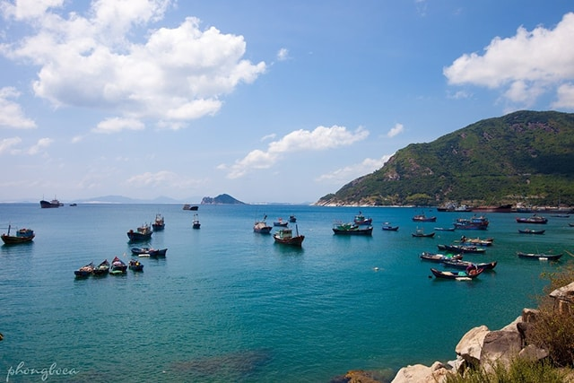
VUNG RO

Slide 17
* Homework
Learn new words
Read “Listen and read” again
Prepare A closer look 1

Slide 18


Thank you for your attention!

