Slide 1




Checking up the old knowledge.
Write 7
adjectives
you have
just learned
Make a sentence with a comparative adjective

Slide 2


Unit 4:
MY NEIGHBOURHOOD
LESSON 7

Slide 3

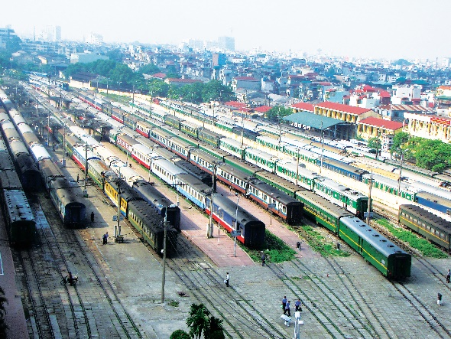
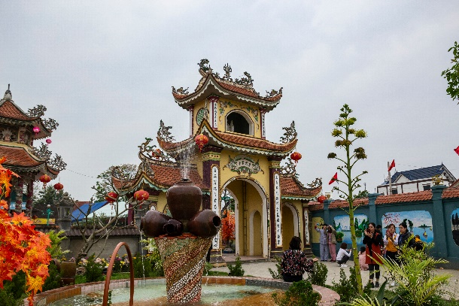
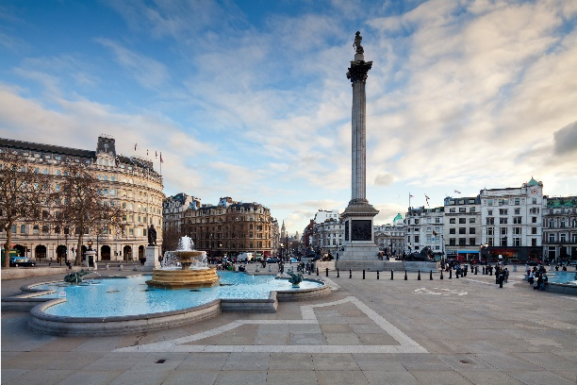
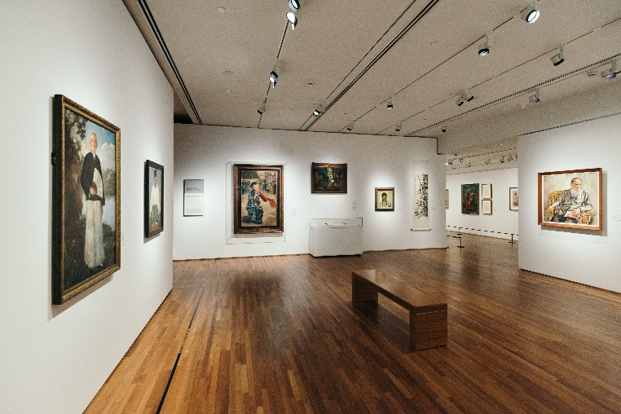
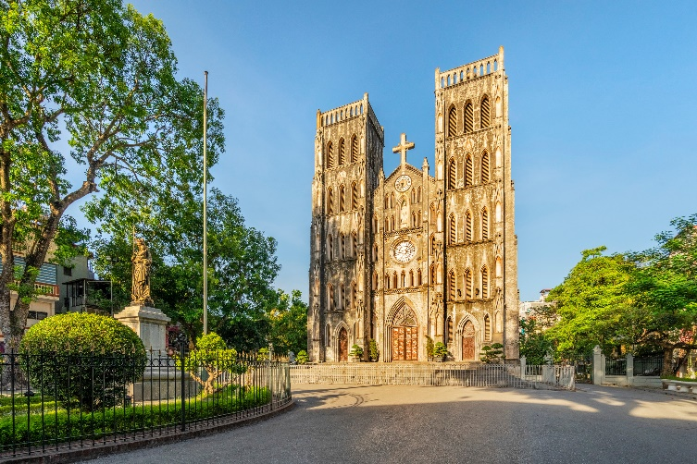
Write the name for each picture.

Slide 4
Write the name for each picture.
1. temple
2. railway station
3. square
4. art gallery
5. cathedral

Slide 5

* Grammar
Put the following adjectives in the correct column.
fast
hot
large
expensive
exciting
fast
hot
large
expensive
exciting
heavy
noisy
quiet
beautiful
heavy
noisy
quiet
beautiful
One syllable | Two syllables | Three or more syllables
fast
heavy
expensive
hot
noisy
exciting
large
quiet
beautiful

Slide 6

Now write their comparative forms in the table below.
Adjectives | Comparative form
fast | faster
beautiful
noisy
expensive
hot
exciting
quiet
heavy
large
more beautiful
noisier
more expensive
hotter
more exciting
quieter
heavier
larger

Slide 7

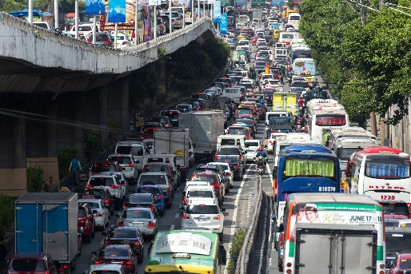
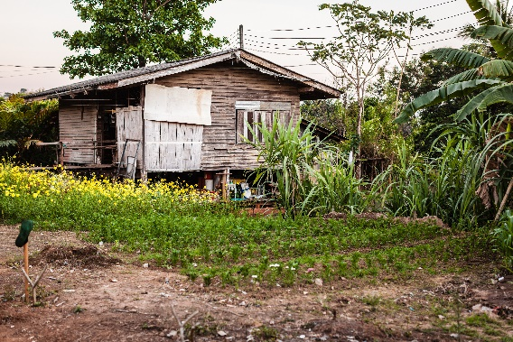
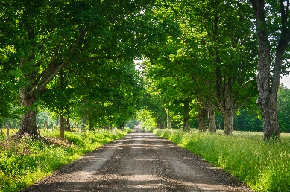
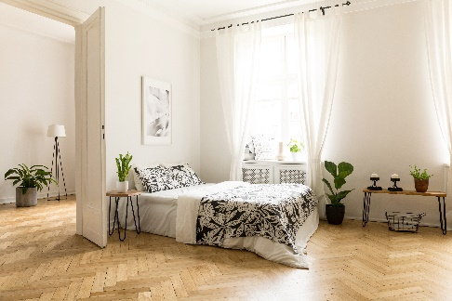
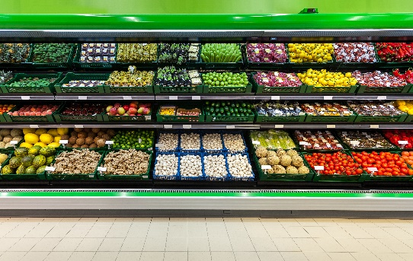
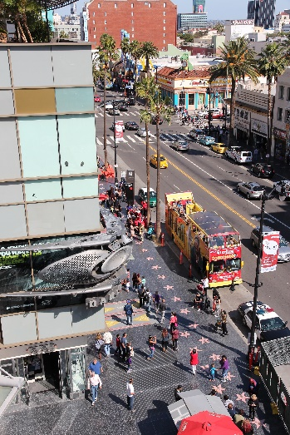
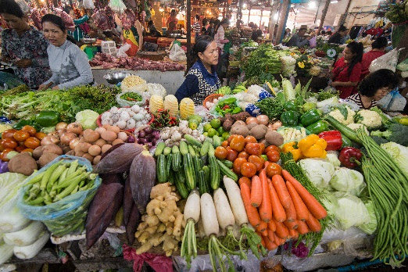
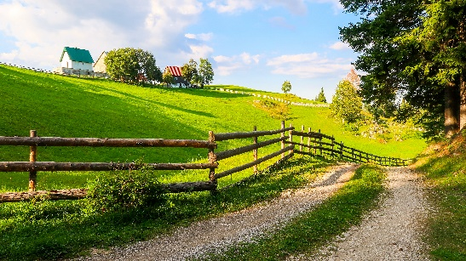
Complete the sentences comparing the pictures. Use the comparative forms of the adjectives below.
expensive
noisy
modern
peaceful

Slide 8



GAME:
LUCKY APPLE
5
3
3
6
1
4
2

Slide 9
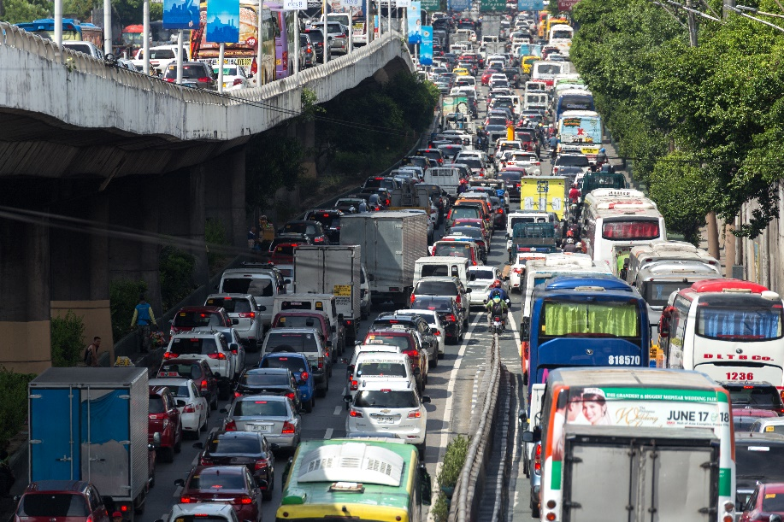

expensive
noisy
modern
peaceful
noisier
1. This street is ……………. than that one.

Slide 10


expensive
noisy
modern
peaceful
more modern
2. A city house is…. …………………..than a country house.

Slide 11
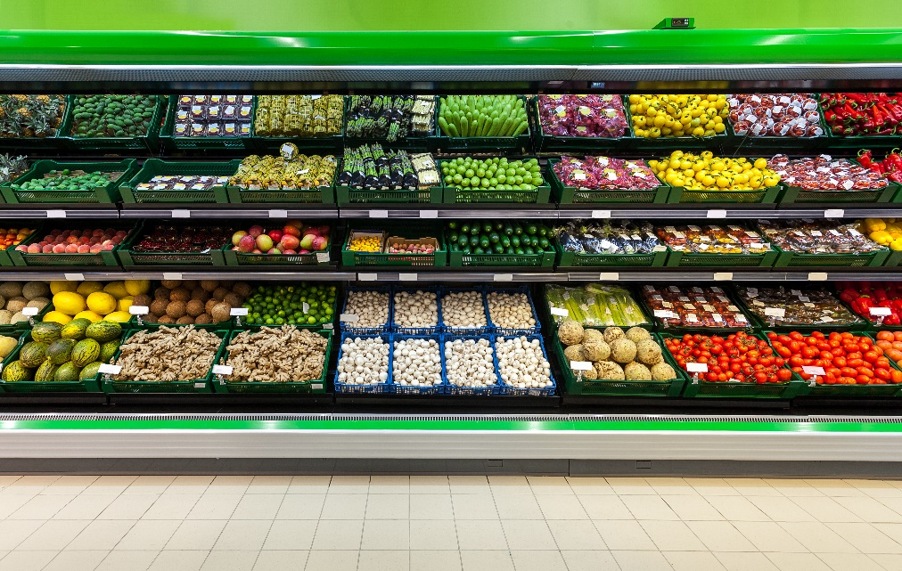

expensive
noisy
modern
peaceful
more expensive
3. Things at a corner shop are ……………………….than things
at a village market.

Slide 12


expensive
noisy
modern
peaceful
more peaceful
4. Life in the countryside is…. …………………than life
in the city.

Slide 13
LUCKY APPLE

Slide 14
LUCKY APPLE

Slide 15
PRODUCTION
* Rewrite the sentences using the words in brackets.
1. Quang is lazier than Ha. (HARD-WORKING)
2. A city is noisier than a village. (PEACEFUL)
3. There’s a post office on one side of my house and a café on the other. (BETWEEN)
4. Please tell me something about your neighbourhood. (CAN)
5. Oranges are cheaper than apples. (EXPENSIVE)

Slide 16



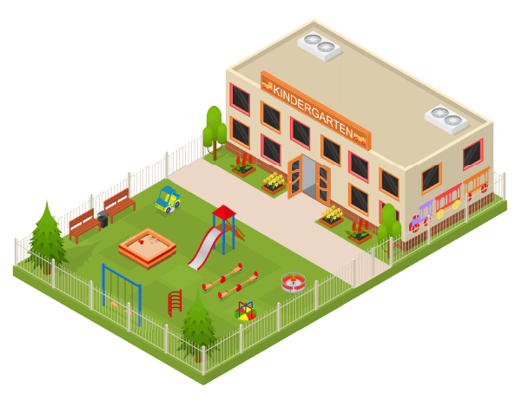
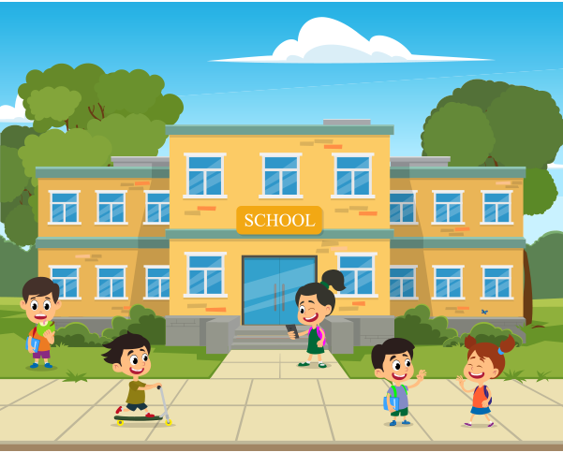
Draw a map of a neighbourhood. Write names of at least five places on your map.

Slide 17
Work in pairs. Take turns to ask for and give directions to the places on the map.

Slide 18

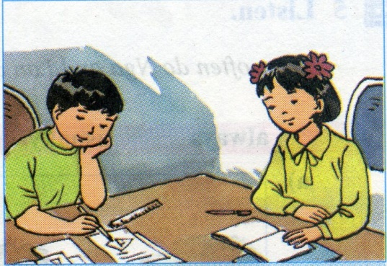

Homework:
Do the exercises in workbook.
Be ready for Unit 6

Slide 19

Thank you for your attention!

