Slide 1

Warmly welcome to our class
English 6 A1
Hoa Hoi Primary and Secondary School

Slide 2
*. Warm-up: Matching
B
A
1. Go straight on
2. Turn left at
the traffic lights.
3. Go past the bus stop.
4. Take the first turning
on the left.
5. Go to the end of
the road.
6. Go along the street
7. It’s on your right
Nó ở bên phải của bạn
c. Đi thẳng
d. Đi đến cuối con đường
e. Rẽ trái ở cột đèn giao thông
f. Rẽ trái ở chổ rẽ đầu tiên
g. Băng qua tram xe buýt
h. Đi dọc theo con đường
1.C 2.e. 3.g 4.f 5. d 6. a 7.b
Notes:
2

Slide 3

UNIT 4: MY NEIGHBOURHOOD
LESSON 5
READING AND SPEAKING

Slide 4
I/ READING
* Vocabulary
- suburb (n):
Khu ngoại ô
= the countryside
play football, go camping, go fishing…
where can do these activities?
- Outdoor activity (n):
hoạt động ngoài trời
- backyard (n):
sân sau
the yard behind the house)
- dislike (v)
# like
- incredibly (adv)
đáng kinh ngạc

Slide 5
* Checking words:
What and Where
suburb
dislike
incredibly
backyard
outdoor activity

Slide 6
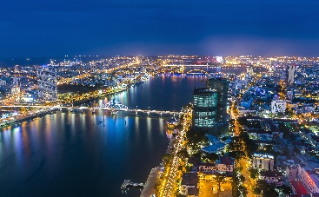
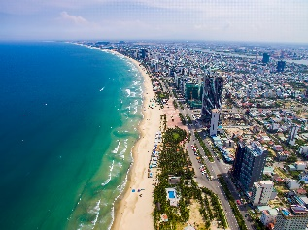
I/ READING:
*Read Khang’s blog.
MY NEIGHBOURHOOD
1.Where do you think Khang’s neighbourhood is?
2. What do you think about it?
3. What are there in the neighbourhood?
4. Do you like living there? Why?/ Why not?
In the countryside.
I think Khang’s neighbourhood is very nice and peaceful
There are a lot of trees, markets,...
Yes, I do. Because it is very peaceful.
→ You’re going to read Khang’s blog.

Slide 7


Read Khang’s blog. Look at the words in the box, then find them in the text and underline them. What do they mean?
http://www.myblog.com.vn/Khang
KHANG’S BLOG
Friday, December 23rd ...
MY NEIGHBOURHOOD
I live in the suburbs of Da Nang City. There are many things I like about my neighbourhood.
It’s great for outdoor activities because it has beautiful parks, sandy beaches and fine weather. There’s almost everything I need here: shops, restaurants, and markets. The people here are friendlier, and the food is better than in other places.
However, there are two things I dislike about it: there are many modern buildings and offices; and the streets are busy and crowded.
Posted by Khang at 4:55 PM

Slide 8

Read Khang’s blog again and fill the table with the information.
LIKES | DISLIKES
beautiful parks
modern buildings and offices
sandy beaches
busy and crowded streets
fine weather
shops, restaurant, markets
friendly people
good food

Slide 9

Read Khang’s blog again. Then answer the questions.
1.
Where is khang’s neighbourhood?
It is in the suburbs of Da Nang City.
2.
Why is his neighbourhood great for outdoor activities?
Because it has beautiful parks, sandy beaches and fine weather.
3.
What are the people in his neighbourhood like?
They are very friendly.
4.
How are the streets in his neighbourhood?
They are busy and crowed.

Slide 10
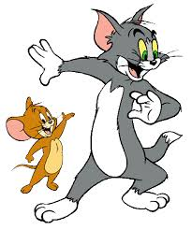

Read Khang’s blog again. Then answer the questions.
GAME : Lucky numbers
1
2
3
4
5
6

Slide 11
1.
Where is khang’s neighbourhood?
It is in the suburbs of Da Nang City.

Slide 12
2.
Why is his neighbourhood great for outdoor activities?
Because it has beautiful parks, sandy beaches and fine weather.

Slide 13
3.
What are the people in his neighbourhood like?
They are very friendly.

Slide 14
4.
How are the streets in his neighbourhood?
They are busy and crowed.

Slide 15

LUCKY NUMBER!

Slide 16
LUCKY NUMBER!

Slide 17
Read Khang’s blog again. Then answer the questions.
1.
Where is khang’s neighbourhood?
It is in the suburbs of Da Nang City.
2.
Why is his neighbourhood great for outdoor activities?
Because it has beautiful parks, sandy beaches and fine weather.
3.
What are the people in his neighbourhood like?
They are very friendly.
4.
How are the streets in his neighbourhood?
They are busy and crowed.

Slide 18

II. Speaking
Make notes about your neighbourhood.
Think about what you like / dislike about it.
LIKES | DISLIKES
- It’s great for outdoor activities
- The streets are busy and crowded during the day.
- There’s almost everything here:
- The people here are incredibly friendly
- The food’s very good.

Slide 19

Work in pairs. Ask and answer about what you like and dislike about your neighbourhood.
Example:
A: Where do you live?
B: I live in the suburbs of Da Nang City.
A: What do you like about it?
B: The weather is fine. The people are friendly
and the food is good.
A: What do you dislike about it?
B: The streets are busy and crowded.

Slide 20
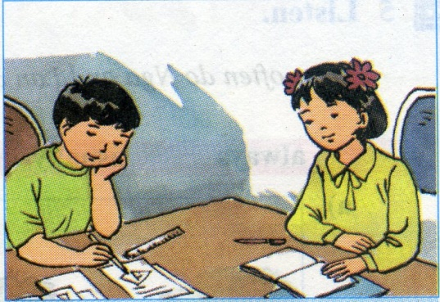
* HOMEWWORK:
- Do Ex inWB
Prepare: Skills 2 (Write a paraggraph about
your neighbourhood saying what you like or dislike)

Slide 21


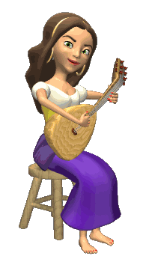


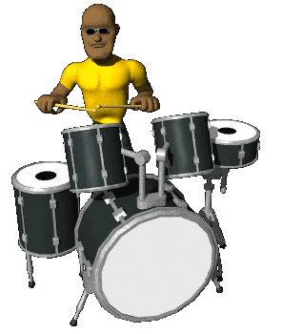





THANK YOU FOR ATTENTION!
GOOD BYE!
the end

