Slide 1

WELCOME  TO  OUR  CLASS
ENGLISH 6
Unit 3:
MY FRIENDS
TRA THI HONG LOAN

Slide 2

UNIT 3: MY FRIENDS

Slide 3
* Warm-up
* Brainstorming:
kind
slim
APPEARANCE
PERSONALITIES
Appearance: tall, short, beautiful, smart, …
Personalities: confident, careful, clever, funny, …

Slide 4


UNIT 3: MY FRIENDS
LESSON 7:

Slide 5

* Vocabulary
Choose the correct answer A, B, or C.
1.
Nick is very . He makes everyone laugh!
A.
confident
B.
funny
C.
active
2.
My sister always does her homework before class.
She’s very .
A.
hard-working
B.
creative
C.
careful
3.
Mi is . She helps me with my homework.
B.
C.
kind
A.
hard-working
friendly
4.
He is a person. He cares about everybody.
A.
B.
friendly
C.
clever
caring
5.
My best friend is very . She likes doing activities.
A.
B.
clever
C.
active
creative

Slide 6

GAME:
Lucky numbers
Answer questions about your classmates.
1.
Who has long hair in your class?
2.
Who has a small nose?
3.
Who has a round face?
4.
Does the classmate next to you have long hair?
5.
Does the classmate next to you have big eyes?

Slide 7
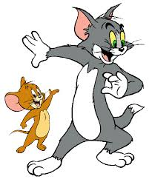
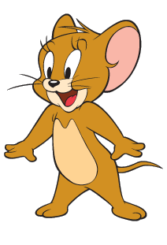
Questions: Lucky numbers
1
2
3
4
5
6

Slide 8
1. Who has long hair in your class?

Slide 9
2. Who has a small nose?

Slide 10
3. Who has a round face?

Slide 11

LUCKY NUMBER!

Slide 12
4. Does the classmate next to you have long hair?

Slide 13
5. Does the classmate next to you have big eyes?

Slide 14


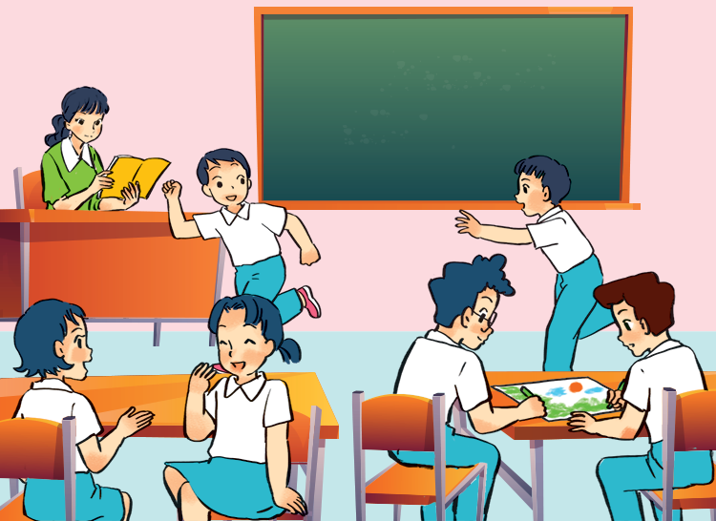
* Grammar
Put the verbs in brackets in the present continuous.
This is my class during break time. Some boys
(1. run) _______ around the class. Mi and Mai
(2. talk) _______. Nam and Phong (3. not talk) _______. They (4. draw) _______ something.
My teacher is in the classroom too. She (5. not teach) _______. She’s reading a book.

Slide 15

Put the verbs in brackets in the present continuous.
This is my class during break time. Some boys
(1. run) are running around the class. Mi and Mai
(2. talk) are talking. Nam and Phong (3. not talk) are not talking / aren’t talking . They (4. draw) are drawing something. My teacher is in the classroom too. She (5. not teach) is not
teaching / isn’t teaching. She’s
reading a book.

Slide 16

Put the verbs in brackets in the present simple or present continuous.
1.
are
doing
A: What
you (do) ?
B: I (write)
am writing / ‘m writing
an email to my friend.
2.
cycles
A: Mai usually (cycle) to school.
B: Really? I (not cycle)
I (walk) everyday.
don’t cycle.
.
walk
3.
A: Where is Phong?
he (do) his homework?
Is
doing
B: No, he (read)
is reading/ ‘s reading
a book in the living room.

Slide 17
* Consolidation
EX1. Fill each blank with a suitable word to complete the passage.
1. Mai has two (1)___________. Their names (2)___________ Binh and Nam. Binh likes English and he can (3)___________ it well. Nam doesn’t like English because it (4)___________difficult for him. He likes maths. Nam is a clever boy (5)___________class. He always gets good (6)___________in maths and physics. Binh and Nam like playing football and (7)___________ always play it after school. They (8)___________good friends.

Slide 18

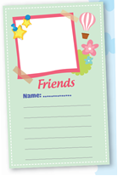
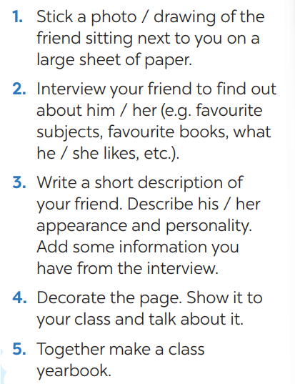
My class
yearbook
How to make
a class yearbook

Slide 19



Homework
Do exercise in workbook..
Prepare : Review 1.
Good bye !

Slide 20


Thank you for your attention!

