Slide 1


love

Slide 2
Warm up:
Game:Pelmanism
KIND
FRIENDLY
FUNNY
CLEVER
1
2
3
4
ACTIVE
6
7
CREATIVE
Vui vẻ
Năng động
5
8
9
10
11
12
Thân thiện
Sáng tạo
Tốt bụng
Thông minh

Slide 3


UNIT 3: MY FRIENDS
LESSON 4
Everyday English
Asking about appearance and personality

Slide 4


Listen and read the dialogue between Linda and Mi. Pay attention to the highlighted.
…
Linda: What does your best friend look like?
Mi: She’s short with long black hair.
She has bright brown eyes.
Linda: What’s she like?
Mi: She’s very kind and creative.
…
Notes:
Slide này không đúng.

Slide 5
* Note: Dùng động từ Be và Have dùng để miêu tả
1. Với động từ "tobe“ ( Dùng để miêu tả về tính cách)
S + be + adj
Ex: He is kind.
She is friendly
2. Với động từ Have (Dùng để miêu tả về ngoại hình)
S + have/has + (a/an) + adj + N
EX: My best friend has a round face.
He has big ears

Slide 6

Work with a classmate. Ask him / her about his / her best friend. Remember to use the two questions highlighted in 1.
Tuan: What does your best friend look like?
Hoa : She’s (He’s)………………………….
She(he) has bright brown eyes.
Tuan: What’s she like?
Hoa : She’s( He’s)………………………………

Slide 7
Date of birth and personality

Slide 8

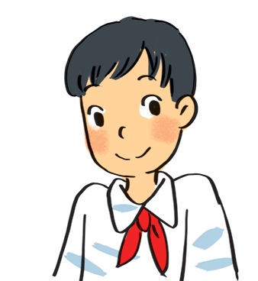
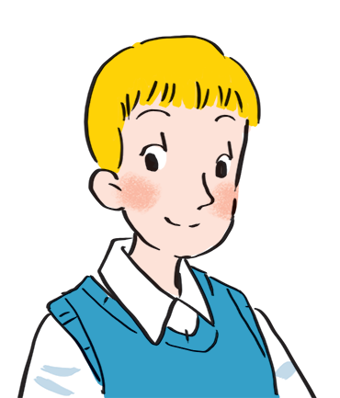
Read about these students in 4Teen magazine. Use one or two adjectives to describe them.
clever
I live in Da Nang. At home, I can do my homework without my parents’ help. At school, I like speaking English. I’m going to an English club now.
hard-working
I come from Cambridge. In my free time, I draw pictures and play the piano. I also help some old people near my house. I usually read to them at the weekend. Now I’m drawing in my garden.
creative
kind
Notes:
City landmarks phải ở trên mục 3

Slide 9

We may have different personalities because we have different birthdays.
Read the descriptions below. Do you think they match the friends in 3?
21/3 – 19/4 | confident, active
20/4 – 20/5 | loving, hard-working
21/5 – 21/6 | active, friendly
22/6 – 22/7 | caring, clever
23/7 – 22/8 | confident, creative
23/8 – 22/9 | careful, hard-working
23/9 – 23/10 | creative, friendly
24/10 – 21/11 | careful, funny
22/11 – 21/12 | clever, confident
22/12 – 19/1 | careful, hard-working
20/1 – 18/2 | friendly, clever
19/2 – 20/3 | kind, creative

Slide 10

Read the descriptions in 4.
Share your opinion with the class.
Example:
My birthday is …
It’s true that …
It isn’t true that …

Slide 11
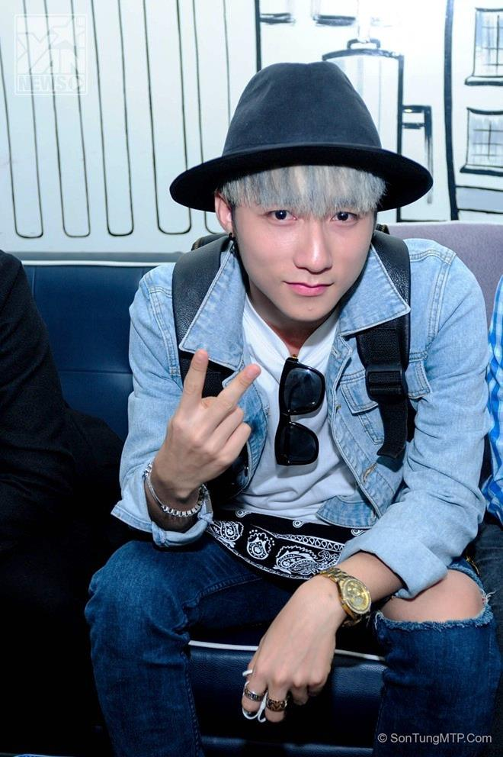
Can you describe him?
He has………….
He is

Slide 12
PRODUCTION
* Talk about your best friend
MODEL
  My best friend is Mai . We go to the same school, and we’ve been together for five years.
  Mai is very pretty. She has short black hair and big brown eyes. She is clever and hard-working, and she is also very funny. I like being with her. We often do our homework together, and she helps me a lot. I hope that in the future we’ll still be best friends.

Slide 13
homework
- Practice speaking about your best friend.
- prepare next lesson

Slide 14
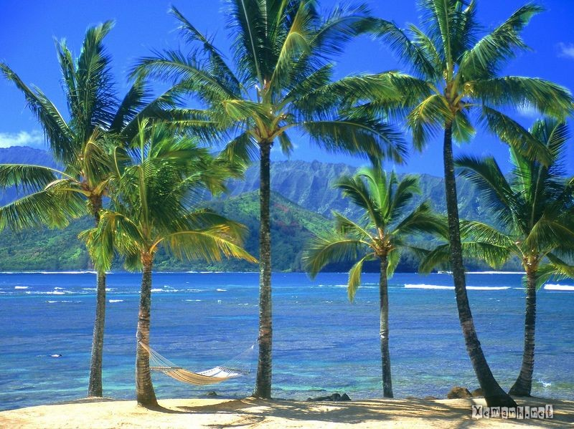
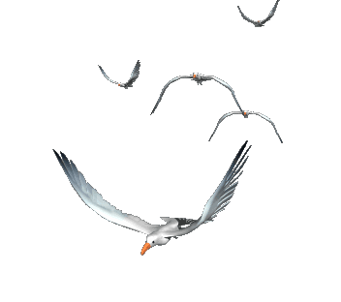




Goodbye!
See you again!

