Slide 1


Slide 2
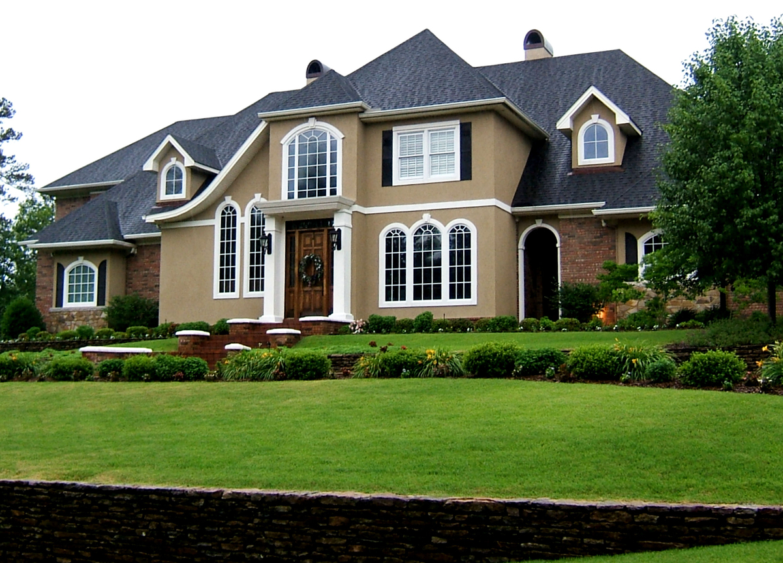
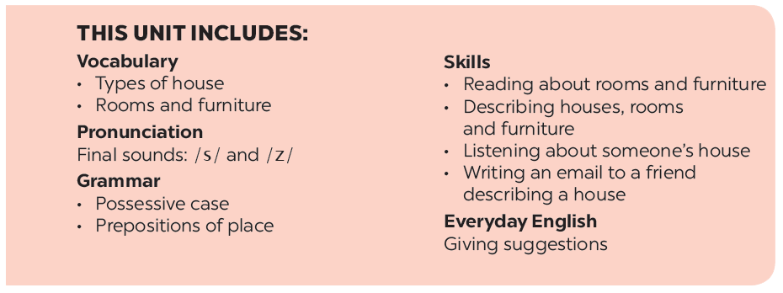
UNIT 2: MY HOUSE
LESSON 5

Slide 3
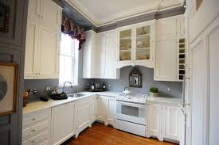
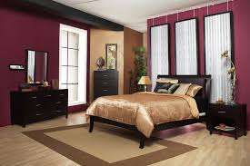
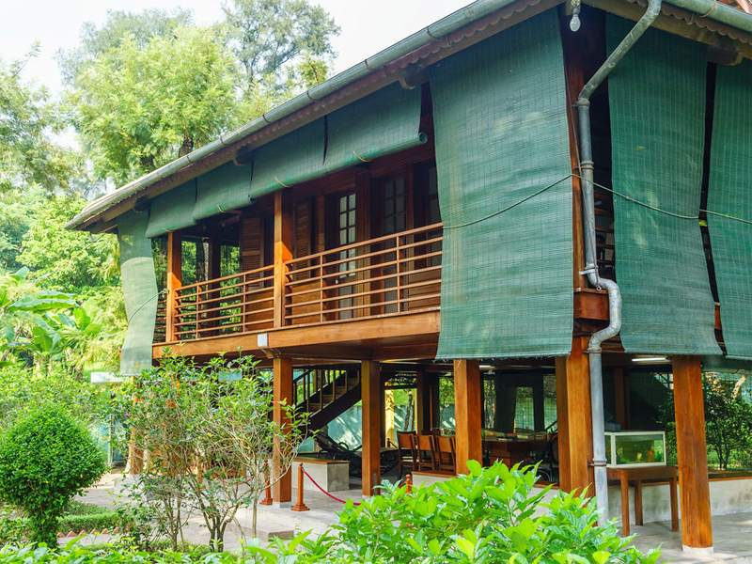
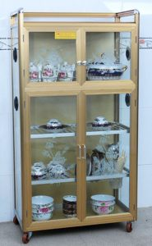
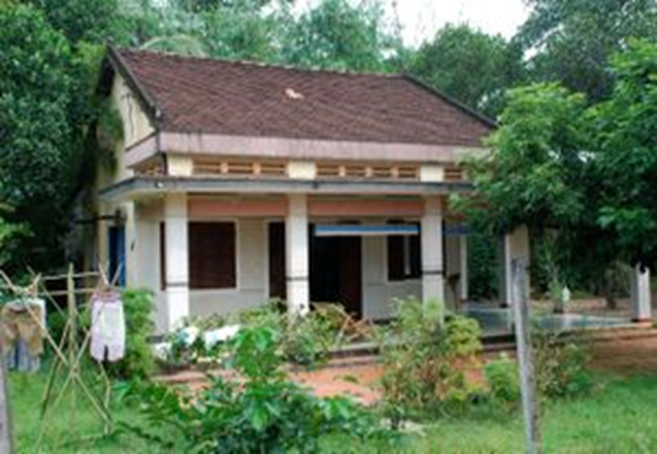
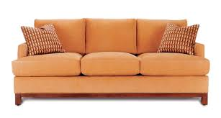
KIM’S GAME
kitchen
bedroom
stilt house
cupboard
country house
sofa

Slide 4
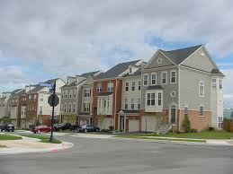
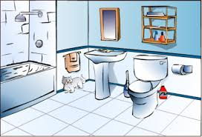
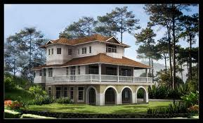
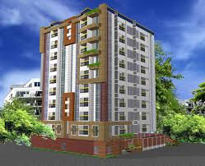
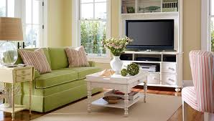
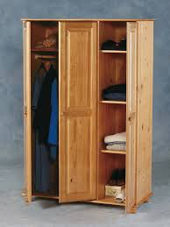
town house
bathroom
apartment
villa
livingroom
wardrobe

Slide 5
* Write the name of the pictures.
2 munites
Work in groups
KEYS

Slide 6


UNIT 1: MY HOUSE
LESSON 7:

Slide 7

* Vocabulary
Put the words into the correct group. Add a new word to each group.
dishwasher
dishwasher
country house
kitchen
bedroom
country house
kitchen
bedroom
town house
sink
fridge
town house
chest of drawers
sink
fridge
chest of drawers
living room
cupboard
living room
flat
bathroom
cupboard
flat
bathroom
Types of house | Rooms | Furniture
flat
bedroom
chest of drawers
town house
bathroom
sink
country house
kitchen
fridge
living room
dishwasher
cupboard

Slide 8

II. Grammar
Complete the second sentence with the correct possessive form.
1.
My teacher has a house next to our house.
teacher’s
house.
Our house is next to my
house.
2.
My brother has a TV.
This is my
TV.
TV.
brother’s
3.
Elena has a big bookshelf in her bedroom.
There’s a big bookshelf in
Elena’s
bedroom.
bedroom.
4.
My grandfather likes the kitchen the best.
The kitchen is my
grandfather’s
favourite room.
favourite room.
5.
My aunt has a daughter, Vy.
Vy’s
I’m cousin.

Slide 9

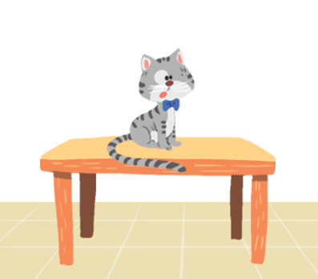
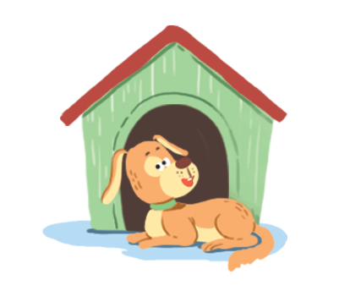

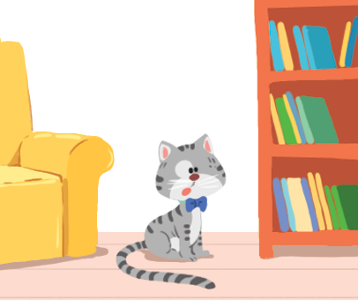


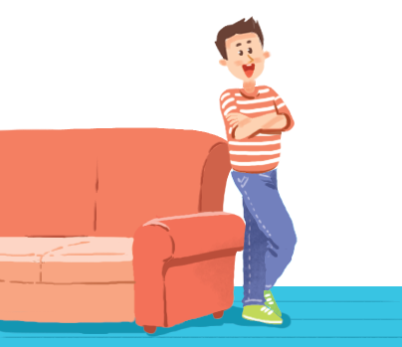
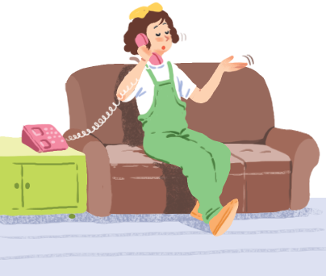
Make sentences. Use prepositions of place.
K
Game: Lucky number
1
2
3
4
5
6
7
8
1. The cat is on the table
4. The cat is behind the computer
2. The dog is in front of the doghouse
5. The girl is on the sofa
3. The cat is between the sofa and the bookshelf
6. The boy is next to the sofa

Slide 10

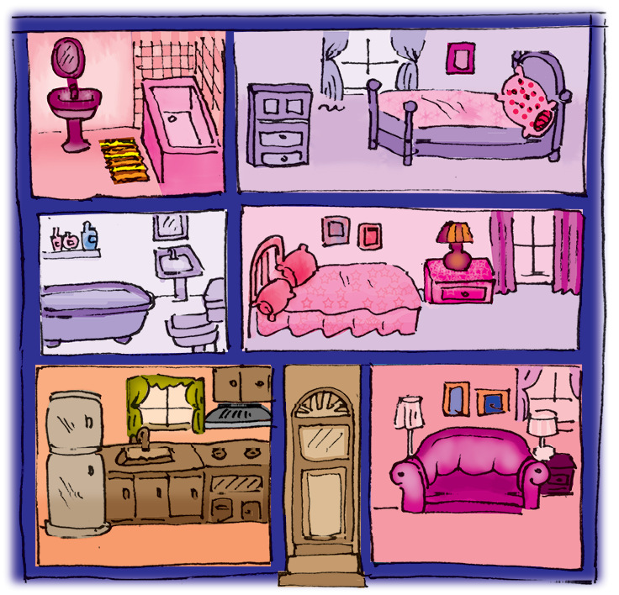
Write three sentences to describe your favourite room in your house. Write the sentences in your notebook.

Slide 11
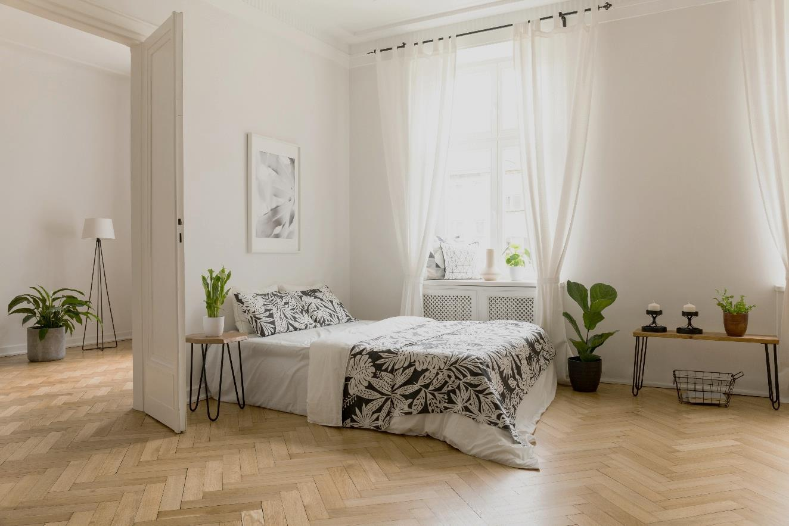
* Write three sentences to describe your favourite room in your house.
Example:
There’s a big bed next to the door.

Slide 12
1. There is a clock on the wall.
2. There are books on the bookshelf.
3. There is a desk next to the bookshelf.
4. There are two posters on the wall.
5. There is a laptop and a lamp on the desk.
6. There are three small plants in the corner.

Slide 13


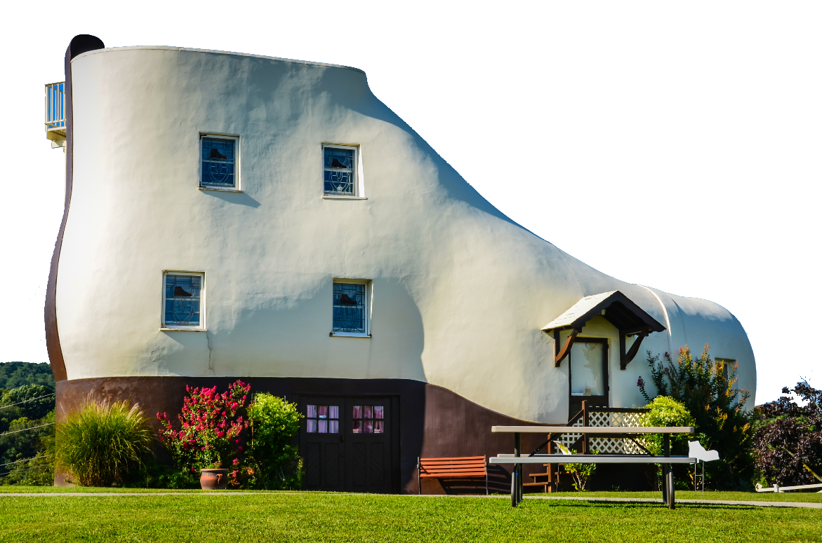
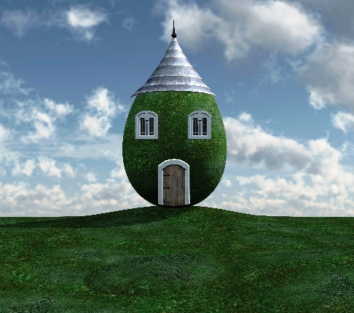
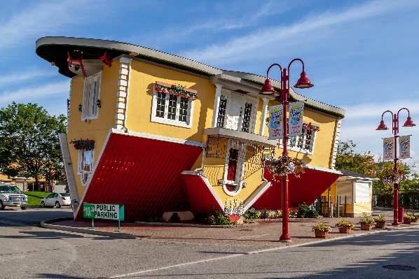
Which one would you like to live in? Why?
Now work in groups.
There are some strange houses
around the world.
Draw your own strange house.
Decorate it.
Tell the class about your house.
C
A
B

Slide 14

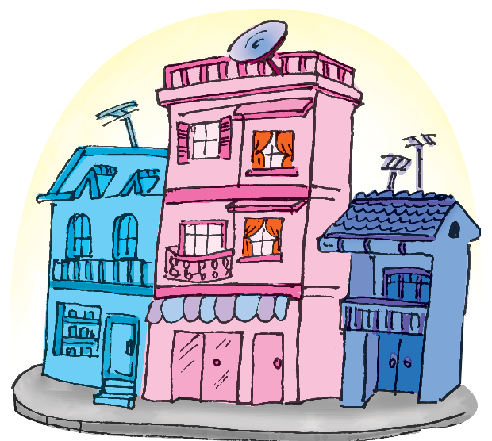
Communication, Activity 4, Page 21
Mi’s house

Slide 15
Homework
Learn by heart all the new words, grammar points
write a short passage about a dream house
( 80 words)
Do exercises in the work book
Prepare Unit 3: Getting started

Slide 16

Goodbye
See you again!!!

Slide 17
The cat is on the table
.
.
The cat
The dog
1.
is on the table.
2.
is in front of
2.The dog is in front of the doghouse
the doghouse.

Slide 18
3. The cat is behind the computer
3. The cat is between the sofa and the bookshelf
The cat
is between
The cat
3.
.
4.
is behind
.
the sofa and the bookself.
the computer.

Slide 19
is on the sofa.
The girl
The boy
5.
.
6.
is next to
.
the sofa.

