Slide 1


Slide 2
Unit 1: My new school.
Lesson 7
LOOKING BACK + PROJECT

Slide 3
* Game: Brainstorming
ruler
School things

Slide 4



UNIT 1: MY NEW SCHOOL
LESSON 2
Vocabulary
Grammar

Slide 5
* Vocabulary

Slide 6





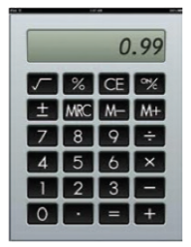

Look at the pictures. Write the correct words in the gaps.
1.
uniform
Our new is very nice.
2.
pencil sharpener
I have a red .
3.
notebook
This is my for writing English words.
4.
compass
We often use a in a
maths class.
5.
calculator
Can you lend me your for a minute?
6.
ruler
My new is short.

Slide 7
* Game: Brainstorming
Activities at school
study new lessons

Slide 8

Match the words in A with the words / phrases in B.
A
B
1.
study
a.
lunch
2.
do
b.
the piano
3.
play
c.
a uniform
4.
have
d.
exercise
5.
wear
e.
new words

Slide 9

* Grammar
Complete the sentences with the present simple.
1.
comes
He (come) from Da Nang.
2.
Do you learn Russian?
No, I (do not) .
don’t
3.
walks
She always (walk) to school with her friends.
4.
do
I often (do) my homework after school.
5.
teaches
Mr Nam (teach) history at my school.

Slide 10

Complete the text with the correct form of the verbs in brackets.
Hoang lives in a small house in the centre of his village. His house (1. be)…..near his new school. Every day, he (2. have) ….breakfast at 6 o’clock. Then he (3. walk)…… to school with his friends. Hoang and his friends (4. study) ………in grade 6 at An Son School. Hoang (5. like) ……… his new school.
Hoang lives in a small house in the centre of his village. His house is near his new school. Every day, he has breakfast at 6 o’clock. Then he walks to school with his friends. Hoang and his friends study in grade 6 at An Son School. Hoang likes his new school.

Slide 11

Put the adverb in brackets in the correct place in each sentence.
1.
I remember to do my homework. (always)
.
I always remember to do my homework.
2.
Nick gets good marks in exams. (usually)
Nick usually gets good marks in exams.
3.
We do not see a rabbit in town. (often)
We do not often see a rabbit in town.
4.
I read in bed at night. (rarely)
I rarely read in bed at night.
5.
Do you sing in the shower? (sometimes)
Do you sometimes sing in the shower?

Slide 12


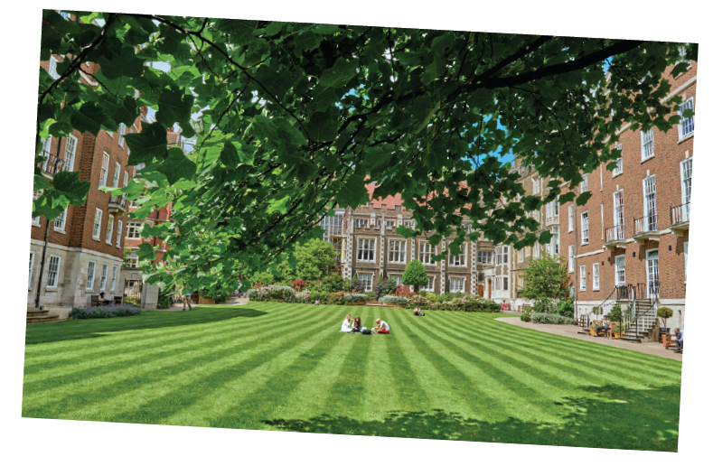
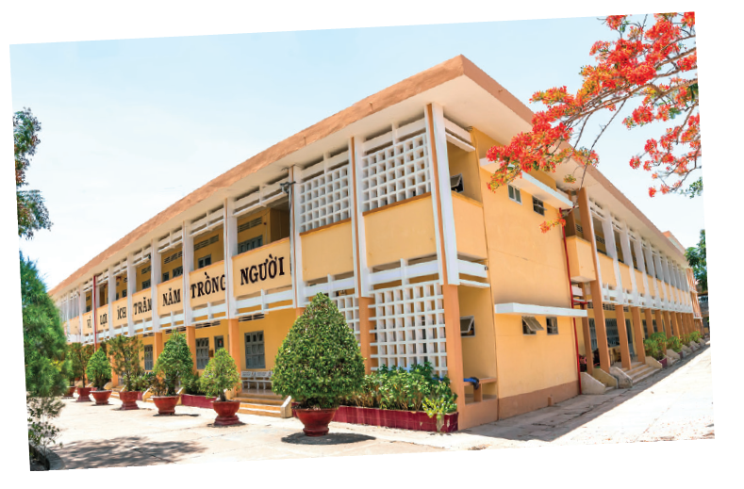
Work in groups.
Design your dream school. What does it look likes?
Is it:
in a town or in the country?
a boarding school?
an international school?
Does it have:
a swimming pool?
a video game room?
a greenhouse and a farm?

Slide 13
Work in groups.
Draw a picture of your dream school.
Present it to the class.

Slide 14
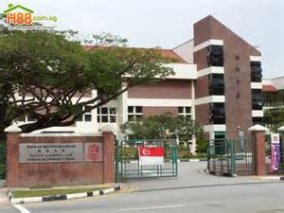
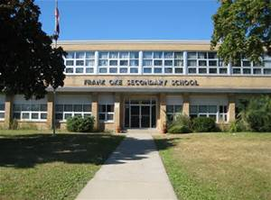
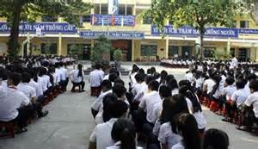
YOUR DREM SCHOOL.
Present it to the class.
* Model writing
Our dream school is located in Tuy Hoa city. It’s new and modern. The school has a big schoolyard with many tall trees. It has a computer room, music room, a library , a canteen and swimming pool… The classroom is very large with air conditional and fans. There is a big garden behind the school so that the students plant many kinds of trees, flowers, and vegetables there.

Slide 15
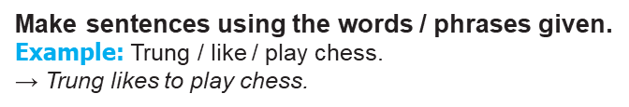
Practice
1. IT / Trong’s favourite subject. 2. . Mrs Hoa / our teacher / English. 3. There / six coloured pencils / my friend’s box. | 4. Where / Ms Lan / live? 5. Shall / introduce you / my best friend, An Son?

Slide 16
Homework
Revise unit 1 for a fifteen-minute test
Prepare Unit 2: Getting started

Slide 17

Goodbye!
See you again!

