Slide 2









WARM-UP and REVIEW
Guess the places

Slide 3
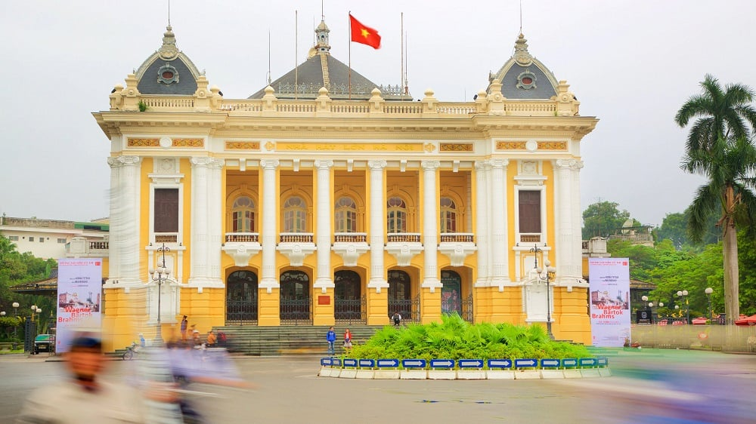
Ha Noi Opera House

Slide 4
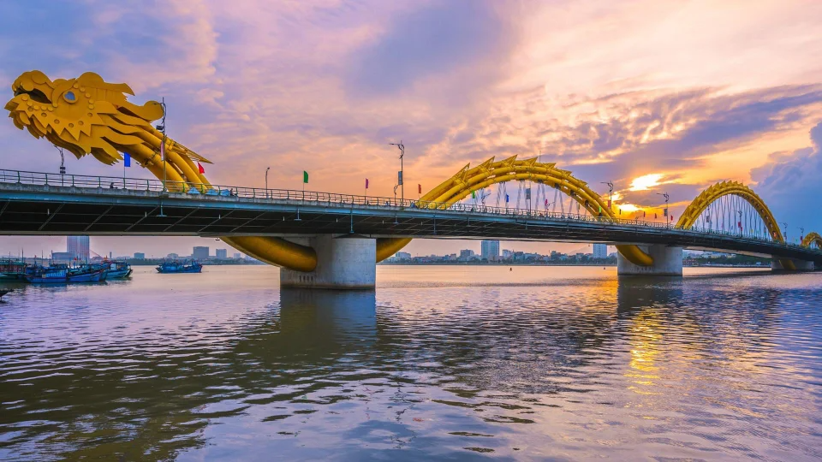
Dragon Bridge

Slide 5
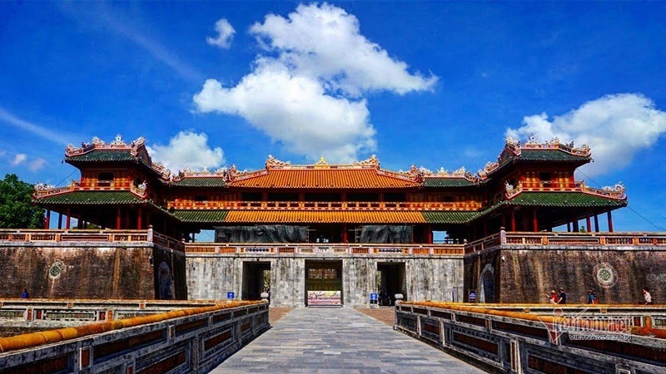
Ngo Mon Square

Slide 6
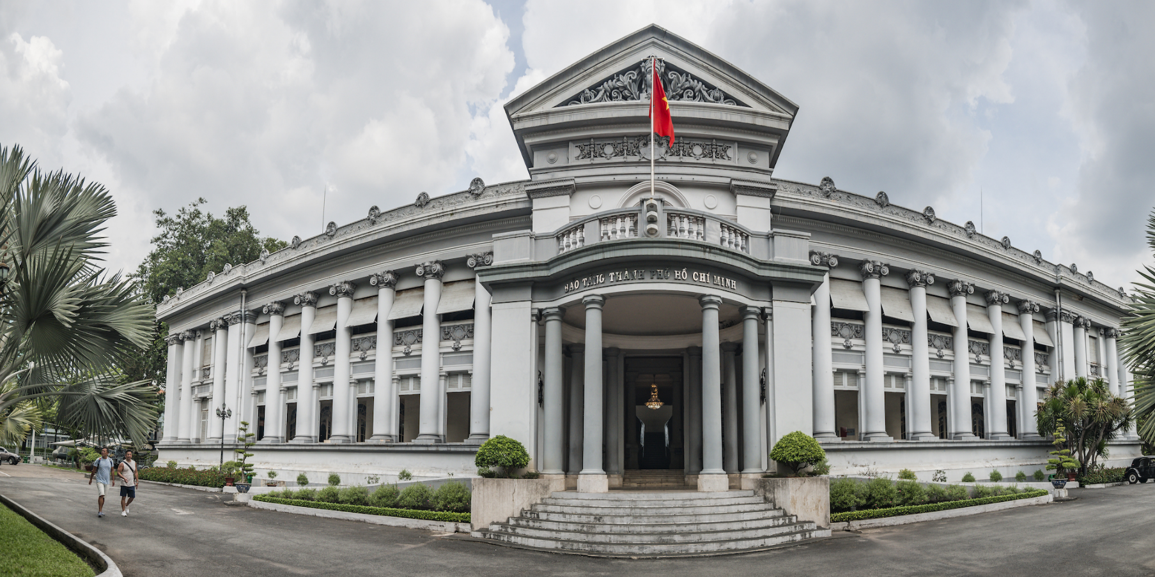
Ho Chi Minh City Museum

Slide 7



Slide 8
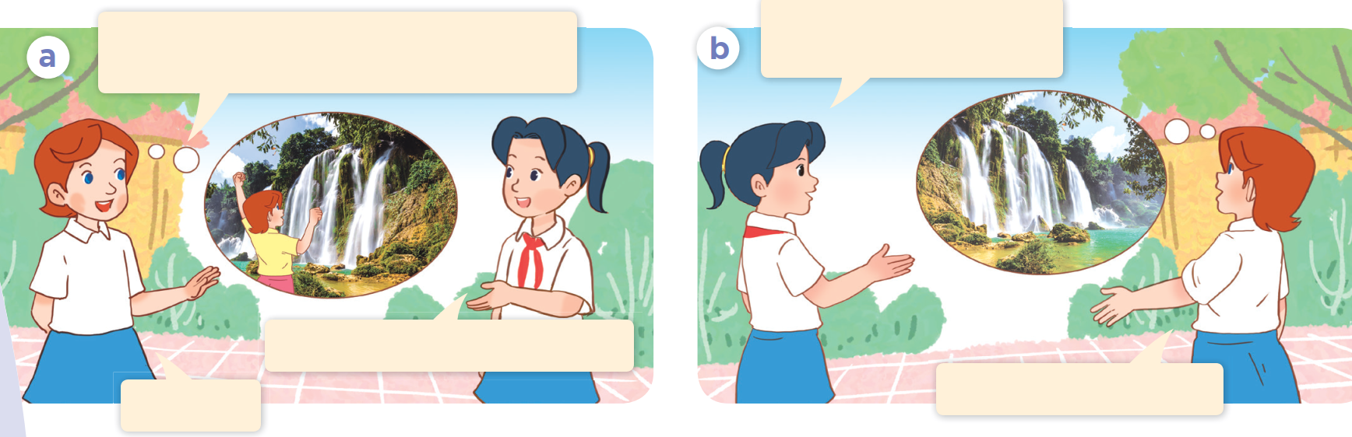

Who are they?
What are they talking about?
Ban Gioc Waterfall
LUCY AND MAI

Slide 9











UNIT 19
Places of interest
Period 124 - Lesson 1(1,2,3)

Slide 10
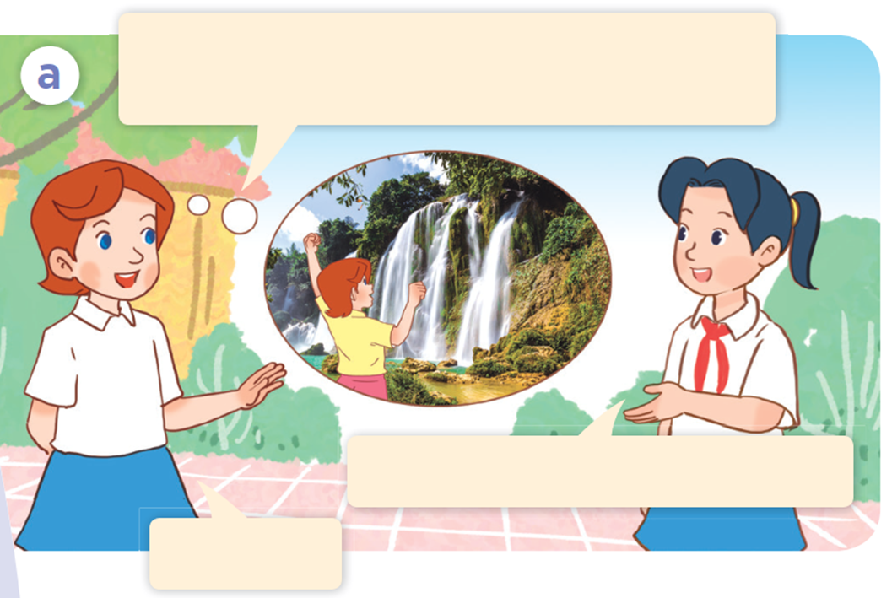
1. Look, listen and repeat.
Hi, Mai. It’s a pity you didn’t come to Ban Gioc Waterfall with us.
I had to finish my project.
Oh, I see.

Slide 11
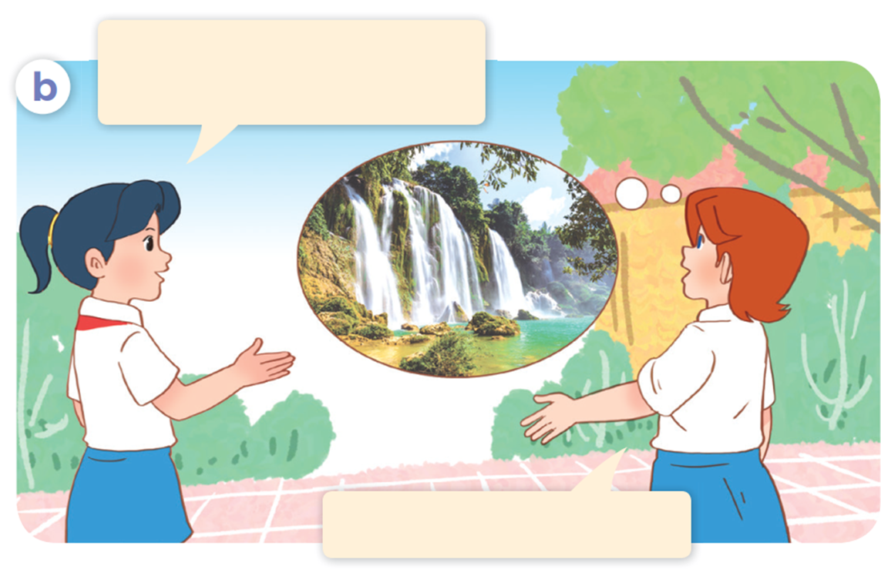
1. Look, listen and repeat.
What do you think of
Ban Gioc Waterfall?
I think it’s beautiful.

Slide 12
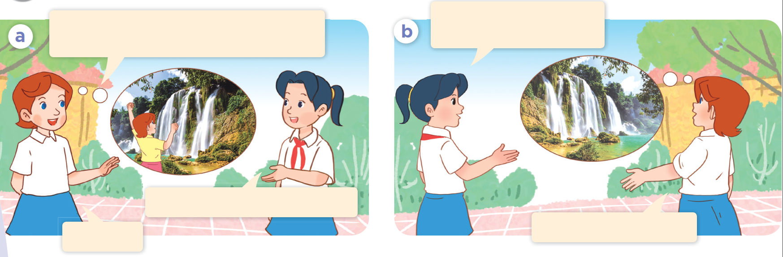
Hi, Mai. It’s a pity you didn’t come to Ban Gioc Waterfall with us.
What do you think of
Ban Gioc Waterfall?
I had to finish my project.
Oh, I see.
I think it’s beautiful.

Slide 13
2. Listen, point and say.

Slide 14
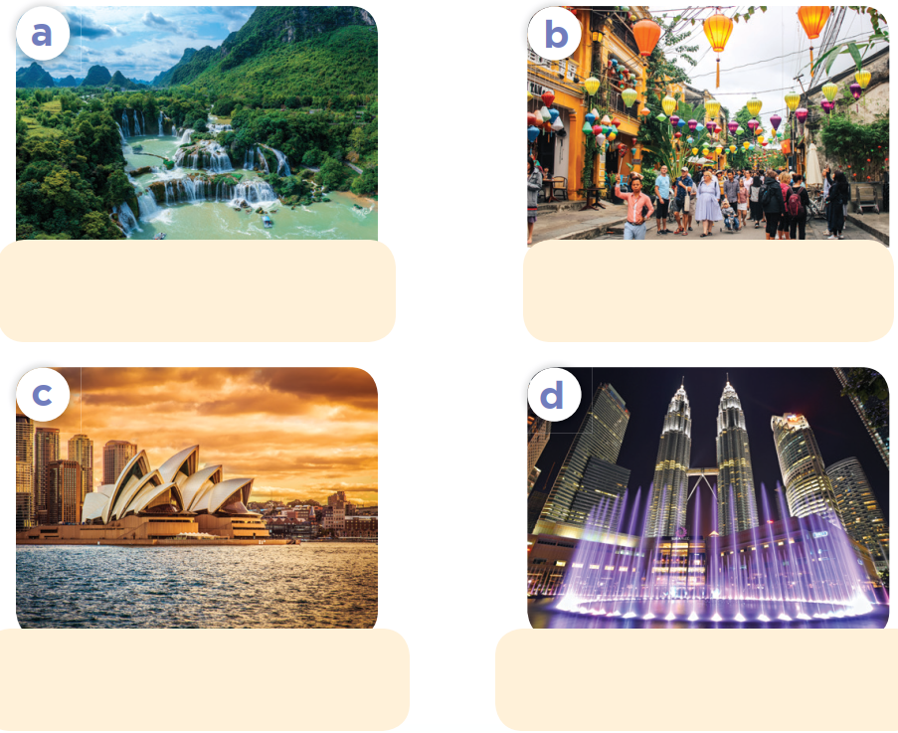

Slide 15
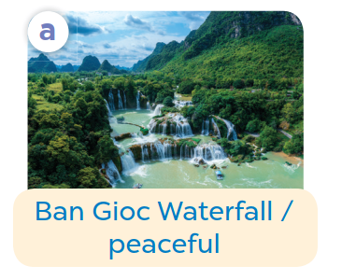
Listen, point and say.
Ban Gioc Waterfall /
peaceful

Slide 16
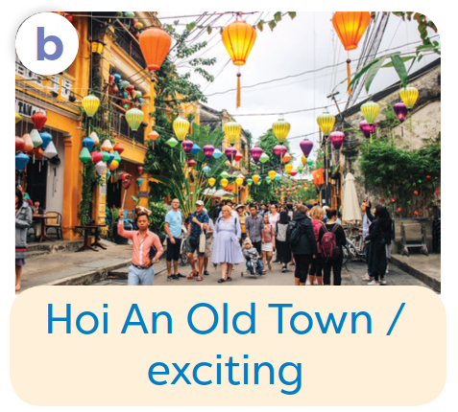
Listen, point and say.
Hoi An Old Town /
exciting

Slide 17

Listen, point and say.
Sydney Opera House /
beautiful

Slide 18
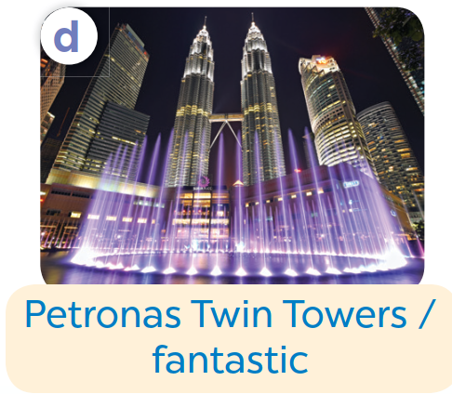
Listen, point and say.
Petronas Twin Towers /
fantastic

Slide 19

2. Listen, point and say.
What do you think of __?
I think it's / they’re __.

Slide 20
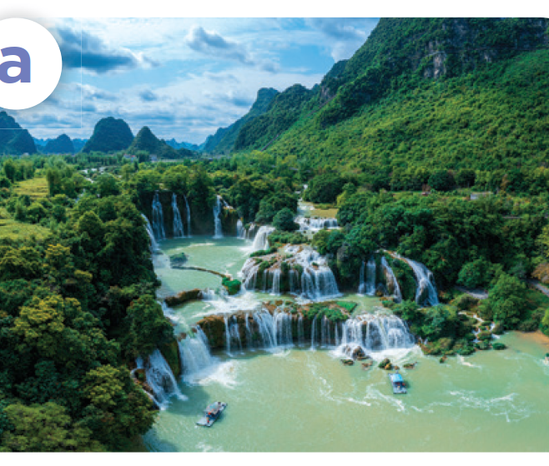


Listen, point and say.
What do you think of Ban Gioc Waterfall?
I think it's peaceful.
Ban Gioc Waterfall / peaceful

Slide 21
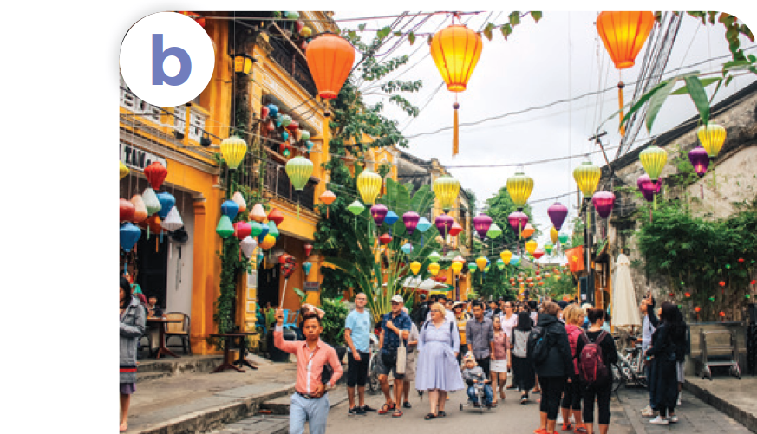


Listen, point and say.
What do you think of Hoi An Old Town?
I think it's exciting.
Hoi An Old Town / exciting

Slide 22
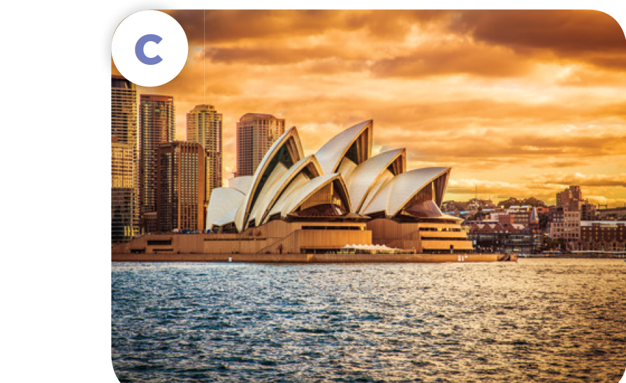


Listen, point and say.
What do you think of
Sydney Opera House?
I think it's beautiful.
Sydney Opera House / beautiful

Slide 23
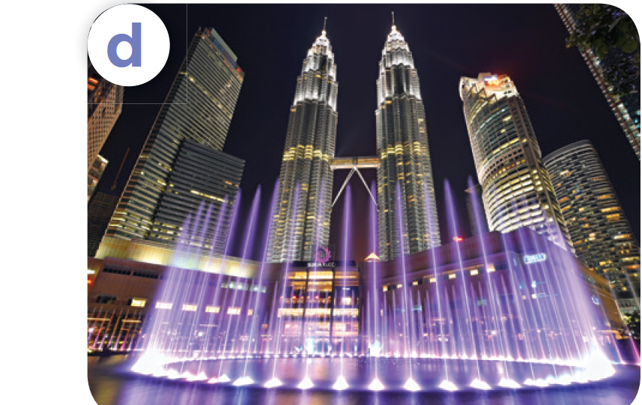


Listen, point and say.
What do you think of Petronas Twin Towers?
I think they're fantastic.
Petronas Twin Towers / fantastic

Slide 24
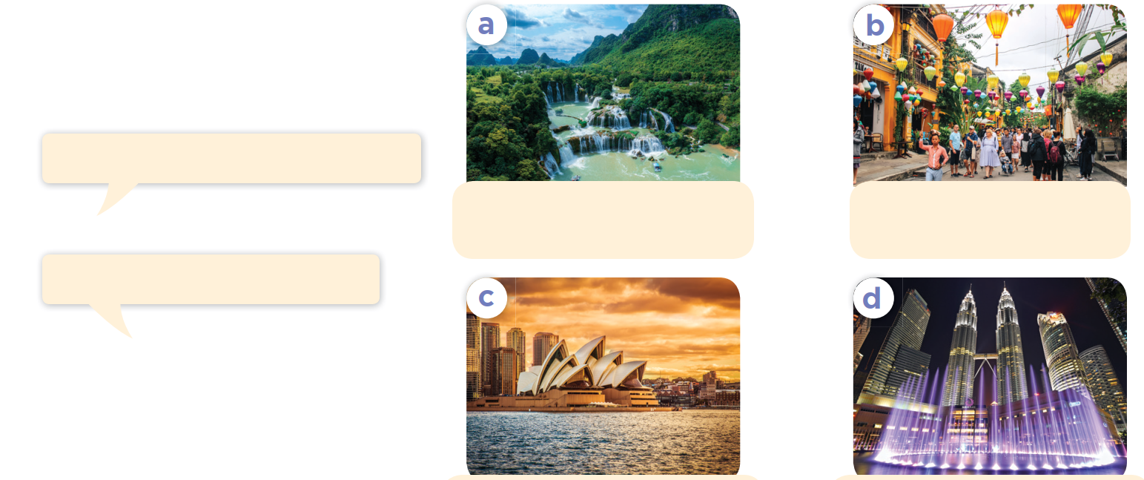
Work in pairs. Ask and answer.
What do you think of _______?
Ban Gioc Waterfall /
peaceful
Hoi An Old Town /
exciting
I think it’s / they’re _______.
Sydney Opera House /
beautiful
Petronas Twin Towers /
fantastic

Slide 25
3. Let's talk.

Slide 26
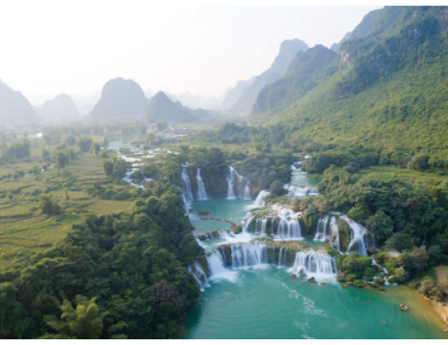
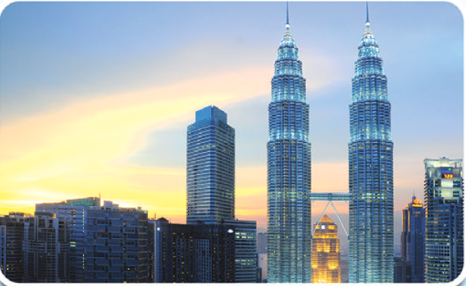
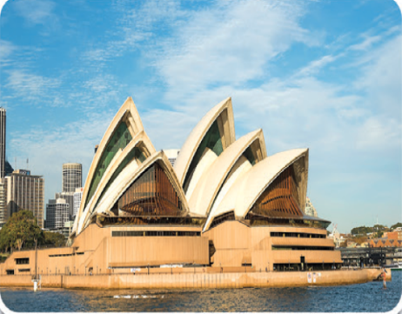
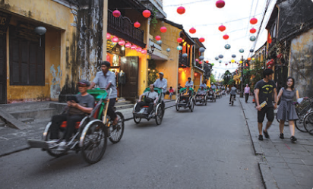
Ask and answer.
Look and say
What do you think of __?
I think __.
Ban Gioc Waterfall
Petronas
Twin Towers
Sydney
Opera House
Hoi An
Old Town

Slide 27
Fun corner and Wrap-up
Lucky Doraemon

Slide 28
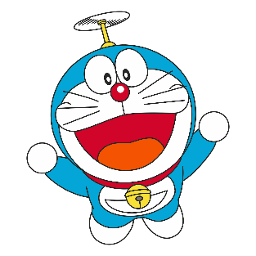
1
2
3
4
5
6
7
8
Notes:
Click on Doraemon to go to the question.

Slide 29
What do you think of Ngo Mon Square?
I think it's ____.
Notes:
Go to next slide for the scores.

Slide 30
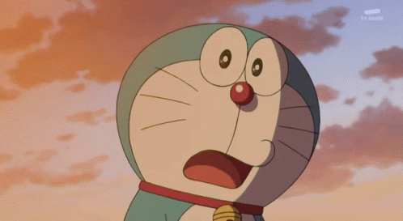
Wow!
+ 4 dorayaki
Notes:
Click on the Return button to questions slide.

Slide 31
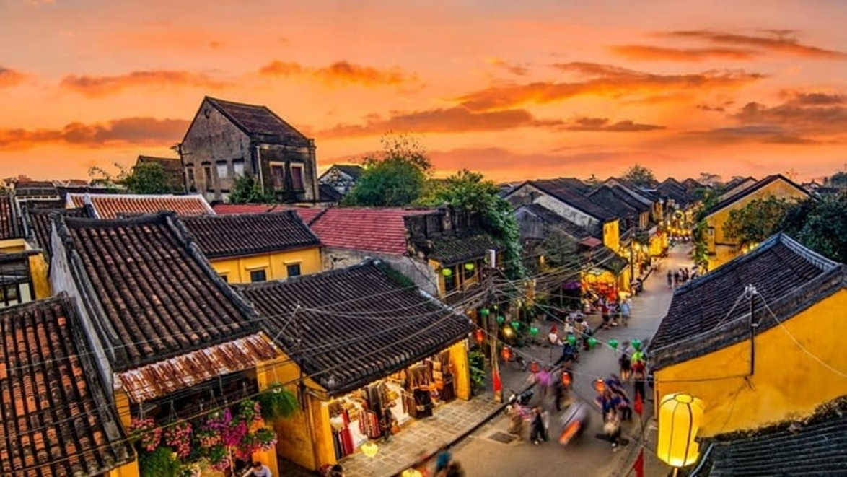
What do you think of Hoi An Old Town?
I think it's ____.
Notes:
Go to next slide for the scores.

Slide 32
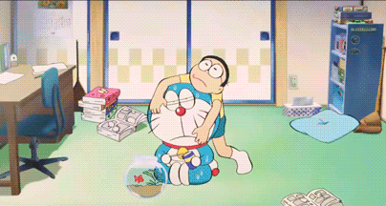
-2 dorayaki
It's a bad day!
Notes:
Click on the Return button to questions slide.

Slide 33
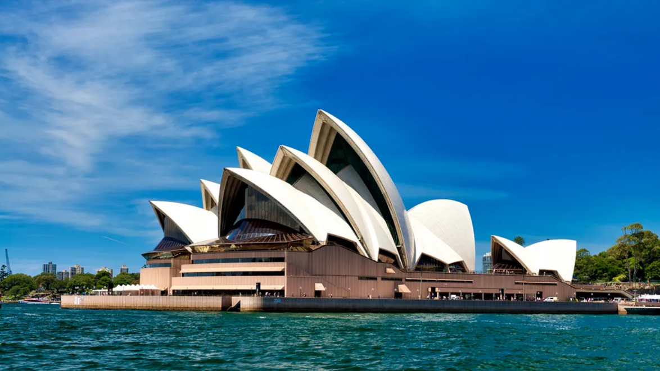
What do you think of Sydney Opera House?
I think it's ____.
Notes:
Go to next slide for the scores.

Slide 34


+2 dorayaki
Doraemon is happy today!
Notes:
Click on the Return button to questions slide.

Slide 35
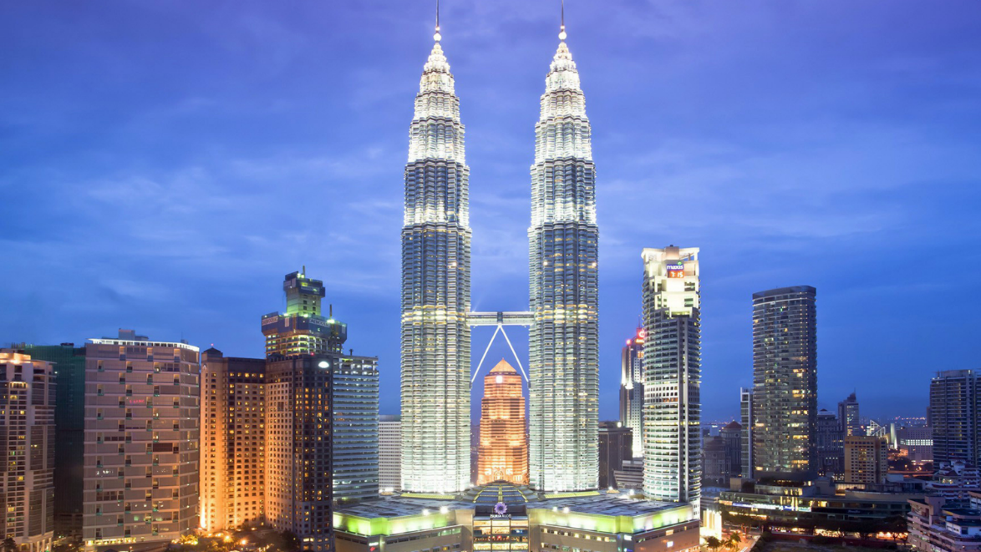
What do you think of Petronas Twin Towers?
I think they're ____.
Notes:
Go to next slide for the scores.

Slide 36

0 dorayaki
Not feeling lucky
Notes:
Click on the Return button to questions slide.

Slide 37
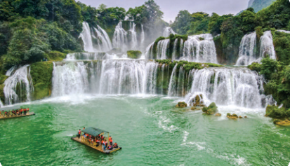
What do you think of Ban Gioc Waterfall?
I think it's ____.
Notes:
Go to next slide for the scores.

Slide 38
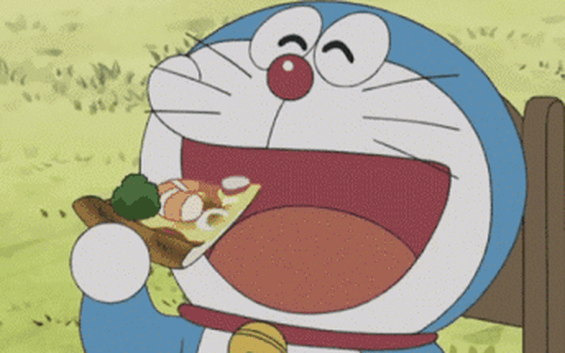
+3 dorayaki
Doraemon is
in a good mood!
Notes:
Click on the Return button to questions slide.

Slide 39

___ do you think of Hanoi Opera House?
A. Where
B. How
C. What
Notes:
Go to next slide for the scores.

Slide 40
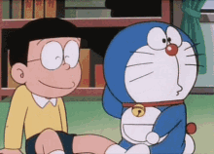
+2 dorayaki
Such a funny story!
Notes:
Click on the Return button to questions slide.

Slide 41
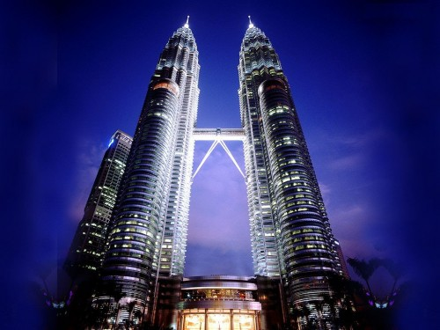
A: What do you think of Twin Towers.
B: I think ________ fantastic.
A. it's
B. they're
C. it are
Notes:
Go to next slide for the scores.

Slide 42

+3 dorayaki
Doraemon has a gift for you.
Notes:
Click on the Return button to questions slide.

Slide 43
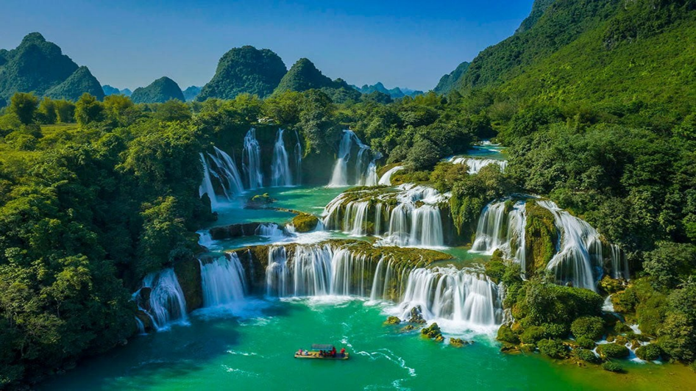
A: What do you think of Ban Gioc Waterfall?
B: I think it's ______.
A. peaceful
B. fantastic
Notes:
Go to next slide for the scores.

Slide 44
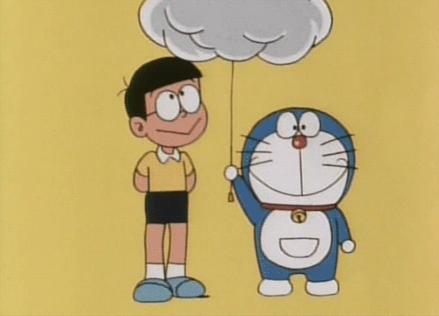
-1 dorayaki
It's rainy. They get wet.
Notes:
Click on the Return button to questions slide.

Slide 45
Website: hoclieu.vn
Fanpage: https://www.facebook.com/tienganhglobalsuccess.vn/

