Slide 1



Slide 2
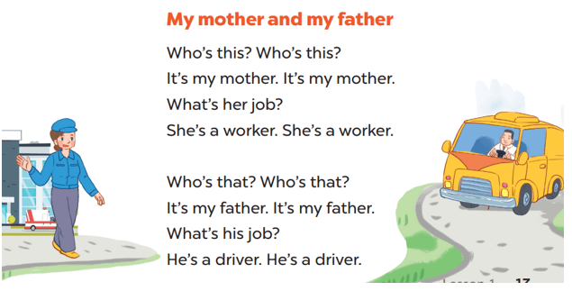

Let’s sing

Slide 3
MY house

Slide 4
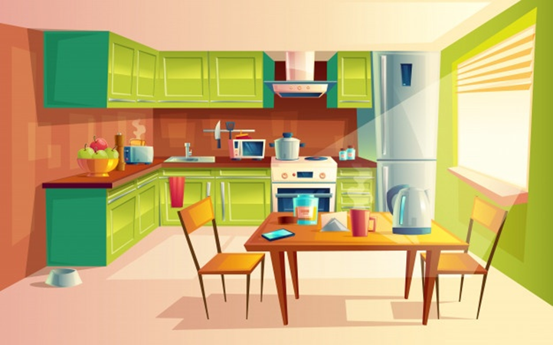
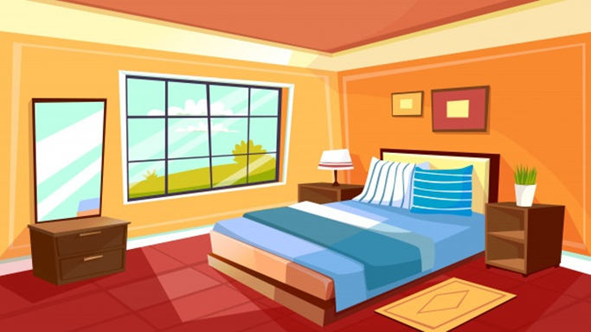
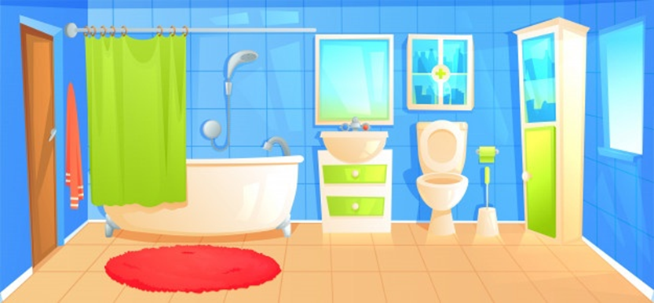

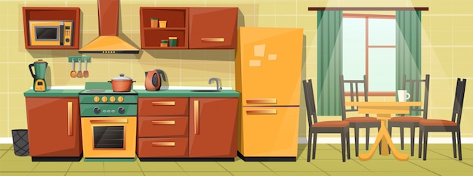

here
there

Slide 5

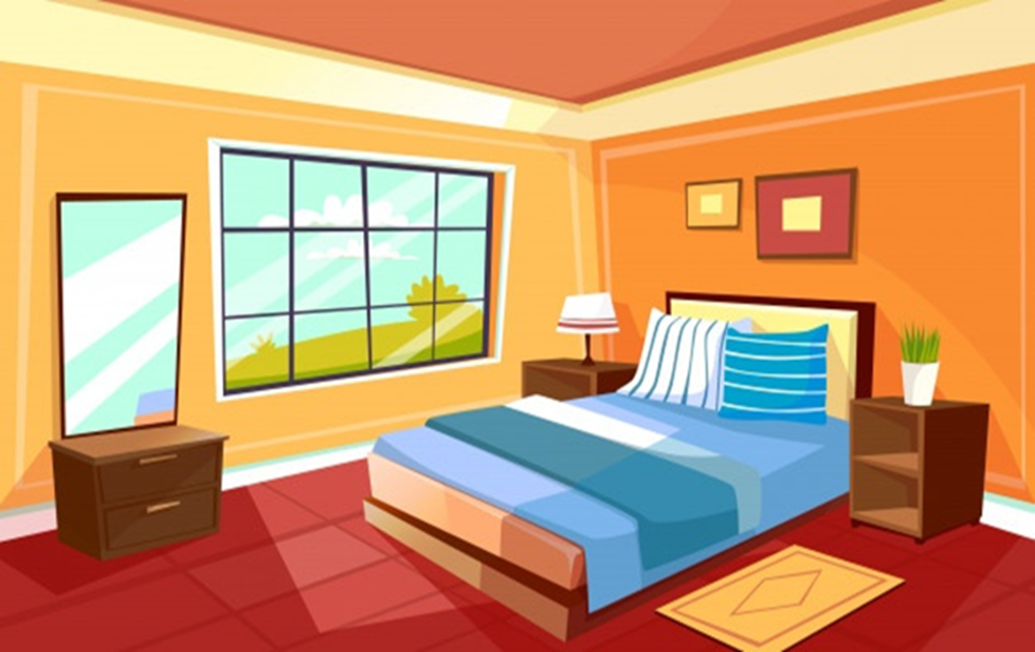

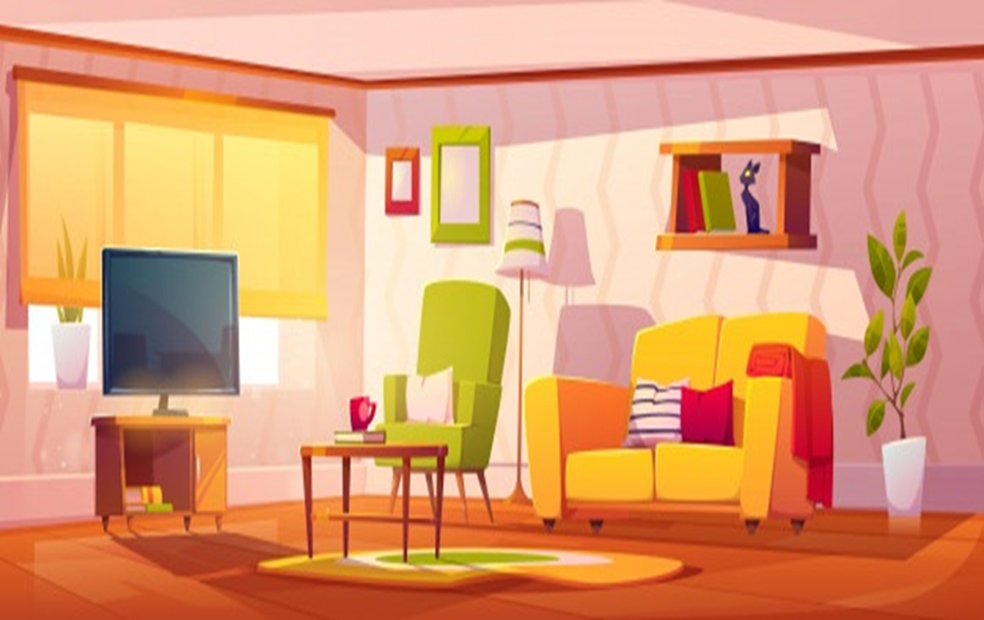
Checking

Slide 6
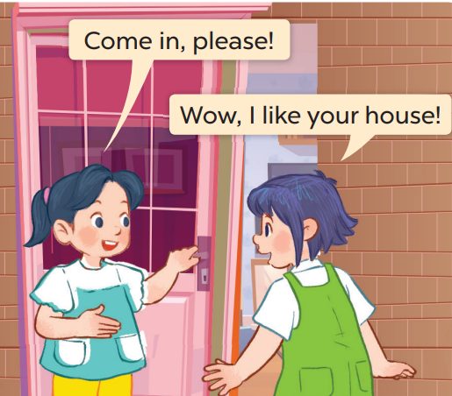
Mai
Linh

Slide 7

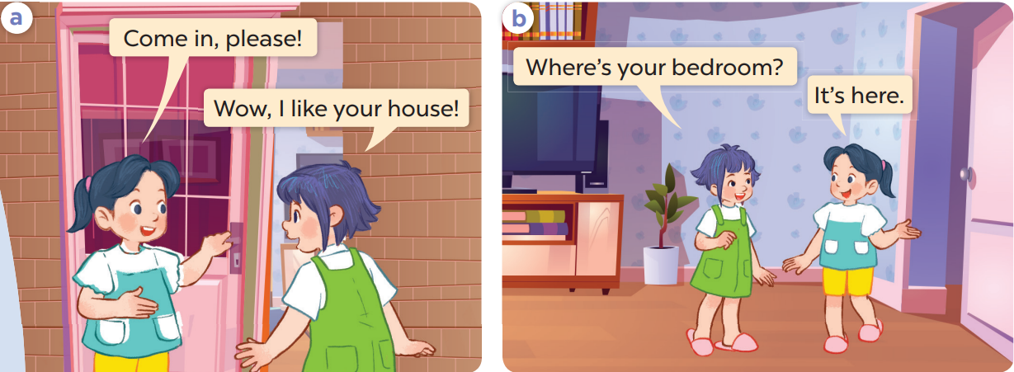
1. Look, listen and repeat.

Slide 8
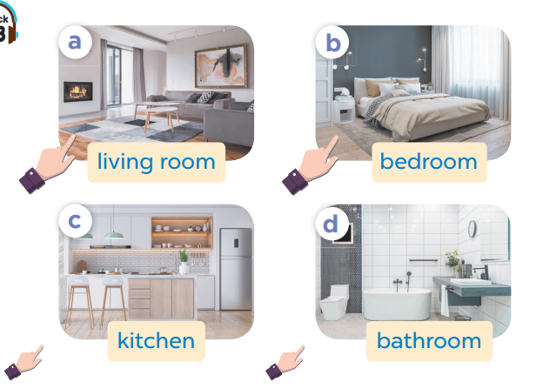
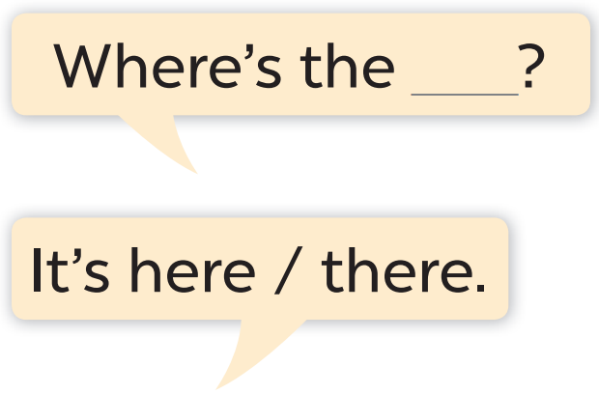
2. Listen, point and say.

Slide 9
Work in pairs. Ask and answer.

Slide 10
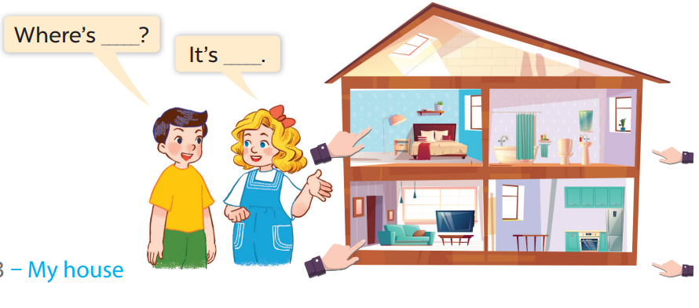
3. Let’s talk.

Slide 11
Fun corner and wrap-up

Slide 12

Play
What’s behind the square?

Slide 13





1
2
3
4
5
6
7
8
Next
tekhnologic

Slide 14


A. Where
………is the living room?
BACK
C. How
B. What

Slide 15

A. living room
Where is the………..?
BACK
C. kitchen
B. bathroom

Slide 16
Where is the kitchen?
BACK
A. It’s there.
B. It’s here.

Slide 17
Where is the living room?
BACK
A. It’s there.
B. It’s here.

Slide 18

C. living room
Where is the………..?
BACK
A. kitchen
B. bathroom

Slide 19

A. living room
Where is the………..?
BACK
C. bathroom
B. bedroom

Slide 20
Where is the kitchen?
BACK
A. It’s there.
C. It’s here.

Slide 21

Where is the house?
BACK
A. It’s there.
C. It’s here.

Slide 22



HOMEWORK:
- Học thuộc và viết đúng các từ mới và mẫu câu vừa học
- Làm lại “2. Listen, Point and say” vào vở học.

Slide 23


Thanks for your listening.
Goodbye.
See you again!

