Slide 1




.HOATHANG 2 primary school
Welcome to our class

Slide 2
Monday, March 3rd, 2025
UNIT 15: AT THE DINING TABLE
LESSON 2 (4,5,6)
1, Warm up
Sing a song
*Procedure: - Show the song on the screen. https://www.youtube.com/watch?v=qZyJPZxsmZk - Ask pupils to listen, sing and dance the song. - Say “Open your book page 33” and look at “Unit 15, Lesson 2 (4,5,6)”.

Slide 3
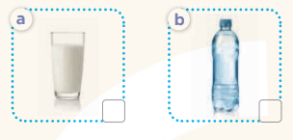
2.Practice: (27’) Activity 1. Listen and number: *Aims: Ss will be able to listen to and understand four communicative contexts in relation to food and drinks. *Procedure:

Slide 4
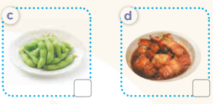
Elitcit the name of the characters in the pictures

Slide 5
T asks students to guess the answers
+ T writes Ss’guessing on the board. - Listen to the tape: + Play the recording + Play the recording again and get Ss to swap books with their partners. + Play the recording again to check answers together as a class. + Write the answers on the board for Ss to correct their answers. Then checks Ss’ guessing. - Play the recording, sentence by sentence, for the class to listen and repeat in chorus. Key: 1.c 2. d 3. a 4. b

Slide 6
- Have Ss look at the pictures and identify food and drink in the pictures.

Slide 7
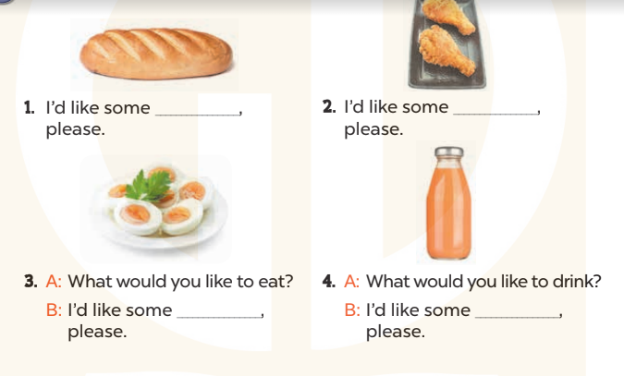

Slide 8
+ Ask them what is missing in the answer (bread) + Have Ss circle the correct options + Have Ss read the completed sentence in chorus. -Have Ss work in pairs and circle the sentences 2, 3 and 4. - Invite pairs of pupils to stand up and read aloud the sentences. -T gives feedbacks. Key: 1. b 2. b 3. a 4. b

Slide 9
Activity 3. Let’s play. *Aims: Ss will be able to revise target words about food and drinks by playing the game Board race.

Slide 10
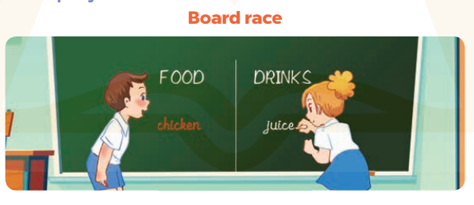

Slide 11
- Explain that a pupil who makes spelling
- Tell Ss that they are going to play the game Board race. Write Food and Drinks on opposite sides of the board. - Have two teams play the game. When you say “Go”, the teams have to race to write the name of a food or drinks. Each pupil writes one word at a time, before passing the marker /chalk to the next pupil and going to the back of the line.

Slide 12
Homework
Các em về nhà học thuộc từ mới.
Luyện tập các mẫu câu vừa học.
Làm bài tập ở sách bài tập

Slide 13


