Slide 2

OUR SPECIAL DAYS
Lesson 2 - Period 3

Slide 3
Table of contents
1
2
3
4
Warm-up
Activity 1
Look, listen and repeat.
Activity 2
Listen, point and say.
Activity 3
Let’s talk.
Fun corner
5
Let's play.

Slide 4
01
Warm-up
Guess the occasions

Slide 5
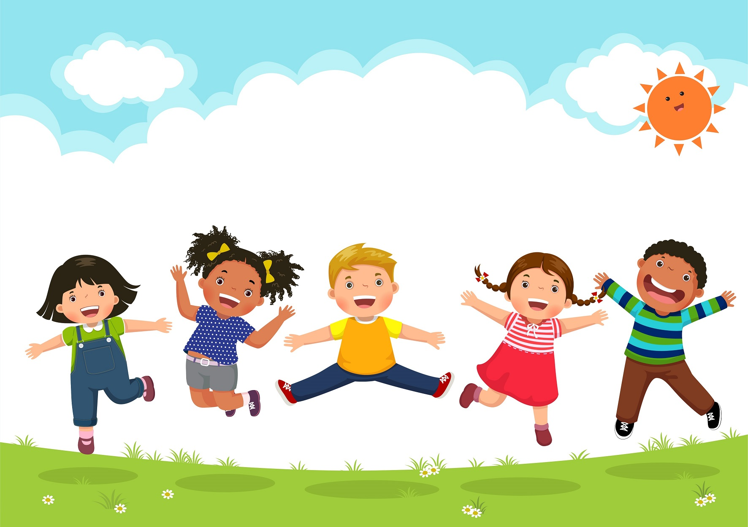
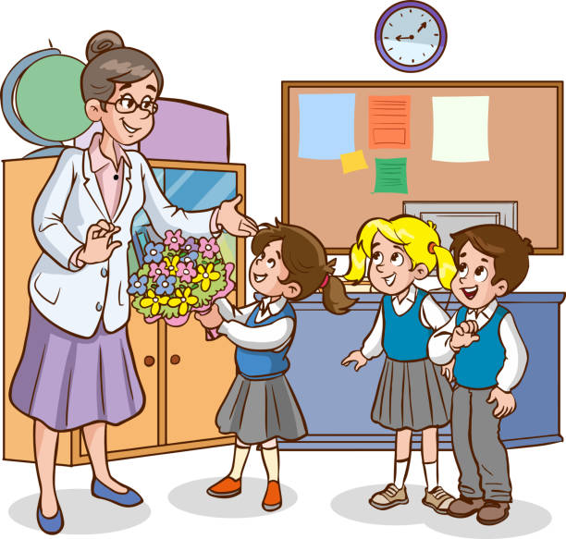
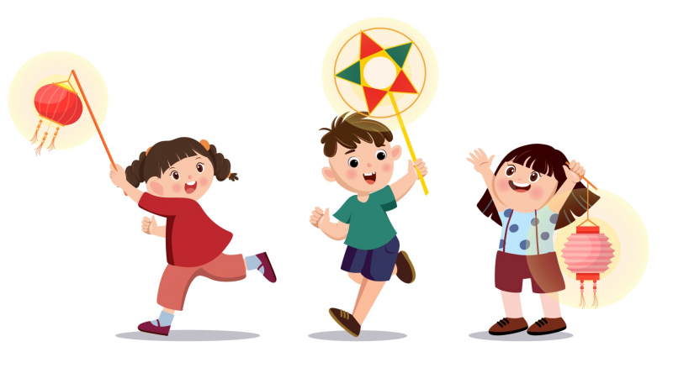
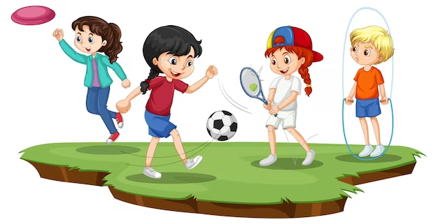
1st June
20th November
Teachers’ Day
Children’s Day
15th August (lunar)
27th March
Mid-Autumn Festival
Sports Day
actor

Slide 6
02
Activity 1
Look, listen and repeat.

Slide 7
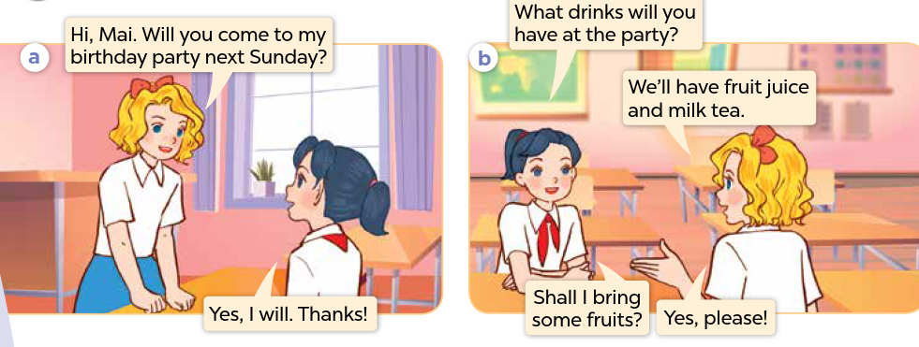
Who can you see?
What are they talking about?

Slide 8

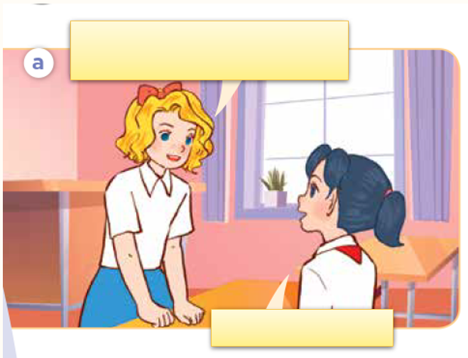
Look, listen and repeat.

Slide 9
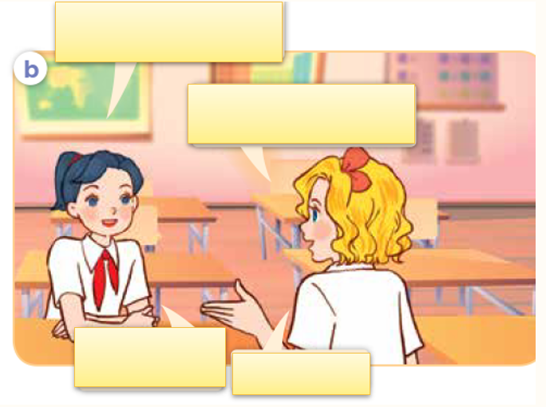
Look, listen and repeat.

Slide 10
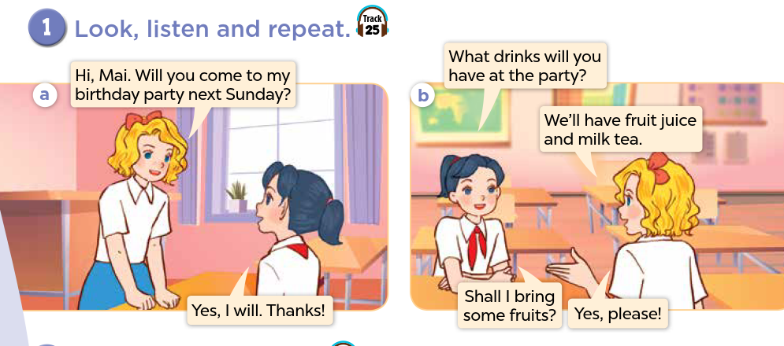

Slide 11
Sentence pattern
What drinks will you have at the party?
We’ll have fruit juice and milk tea.

Slide 12
03
Activity 2
Listen, point and say.

Slide 13
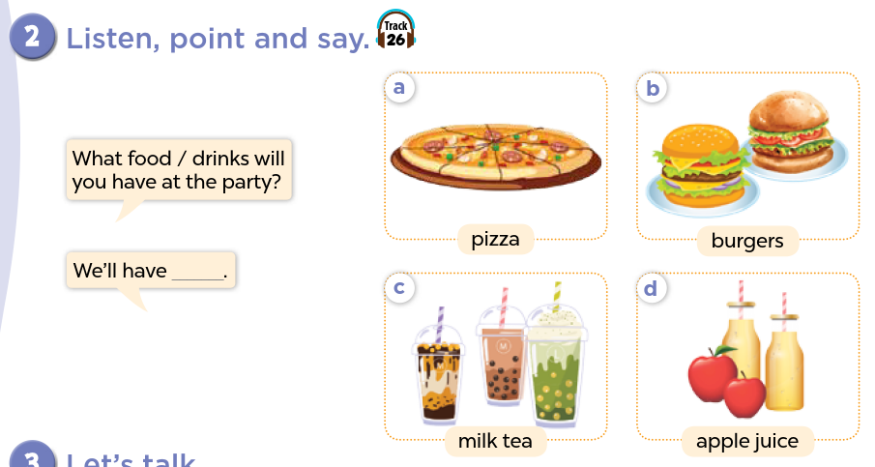

Slide 14
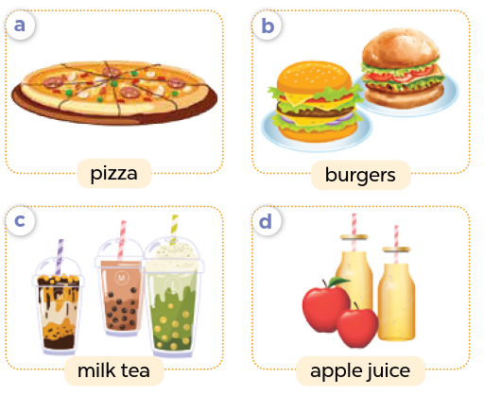
Name the food/drinks.

Slide 15
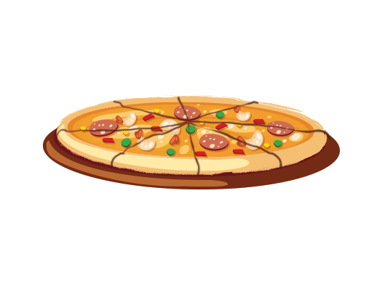
Listen, point and say.
a. pizza

Slide 16
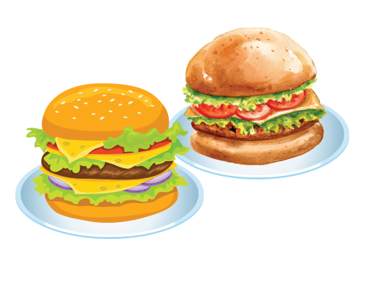
Listen, point and say.
b. burgers

Slide 17
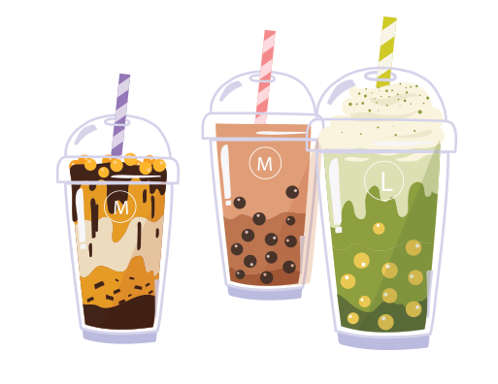
Listen, point and say.
c. milk tea

Slide 18
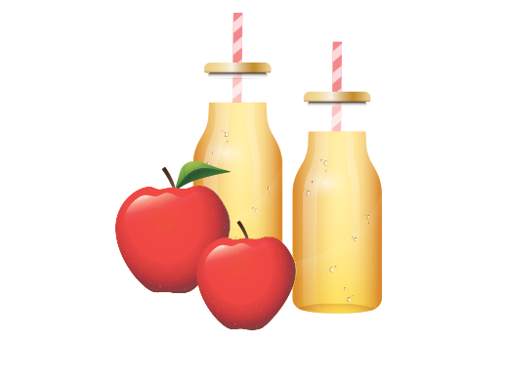
Listen, point and say.
d. apple juice

Slide 19
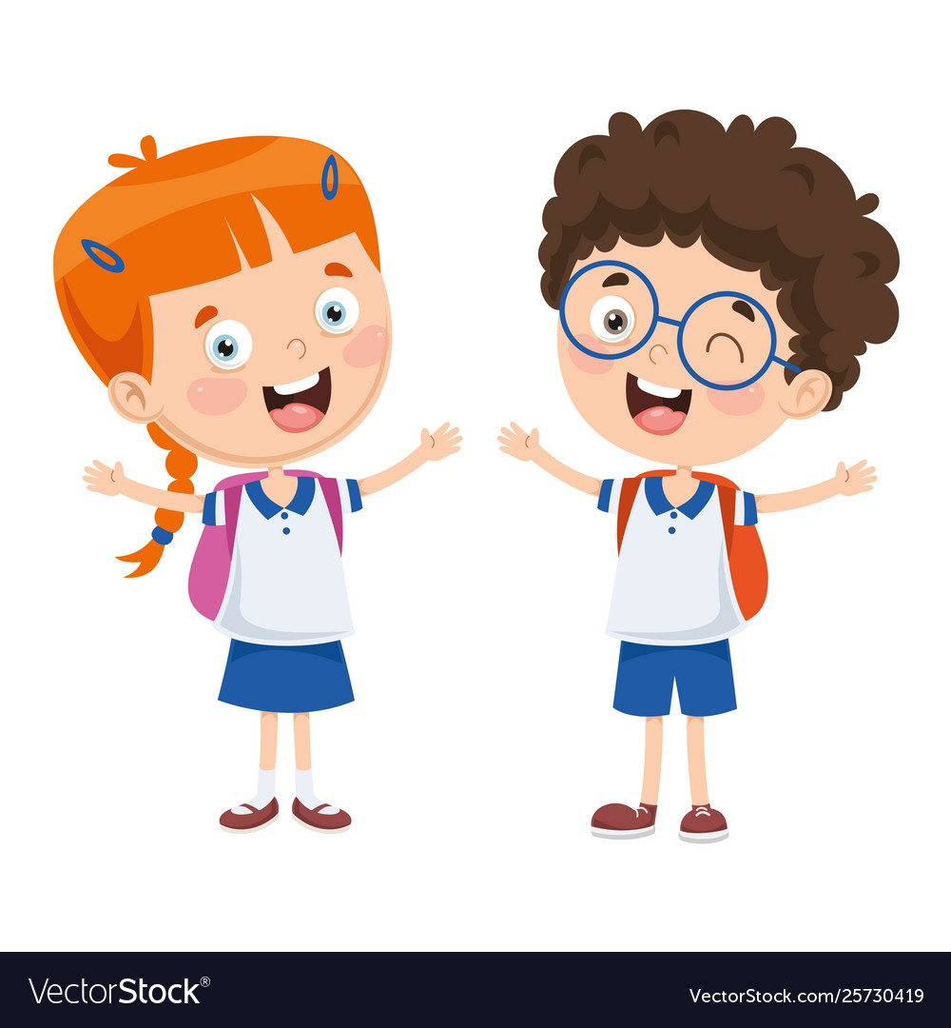
What food / drinks will you have at the party?
We’ll have ____.

Slide 20
What food will you have at the party?
We’ll have pizza.

Slide 21
What food will you have at the party?
We’ll have burgers.

Slide 22
What drinks will you have at the party?
We’ll have milk tea.

Slide 23
What drinks will you have at the party?
We’ll have apple juice.

Slide 24
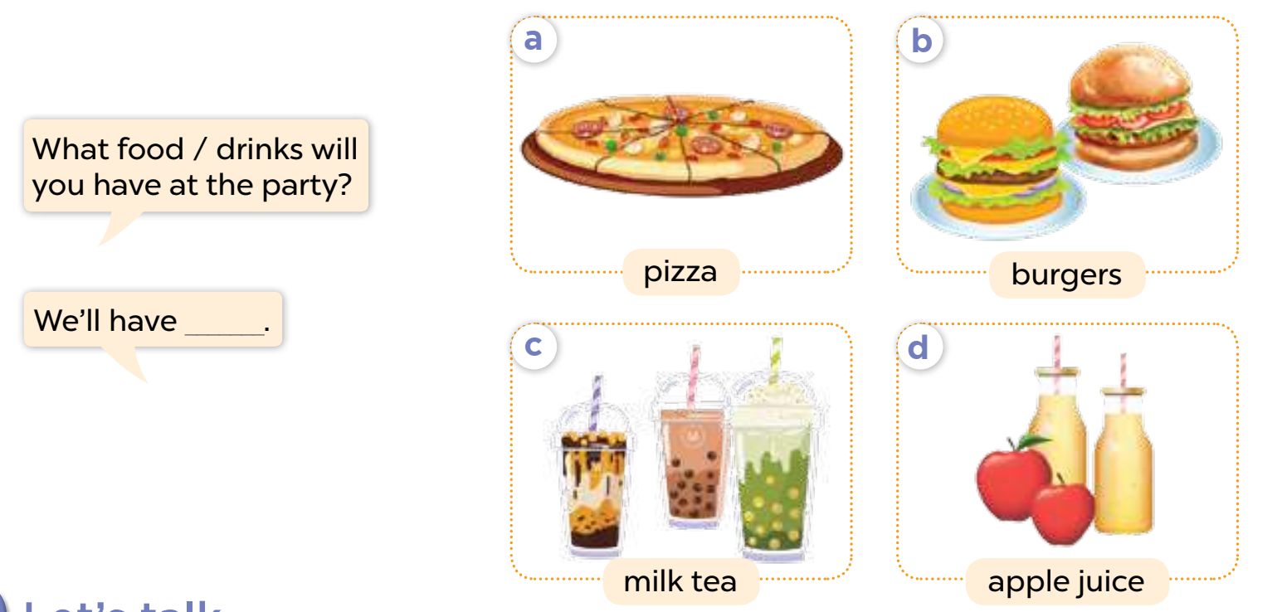
Listen, point, and say.

Slide 25
Activity 3
04
Let’s talk.

Slide 26
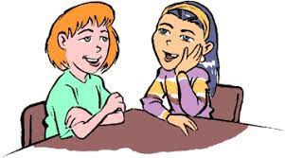
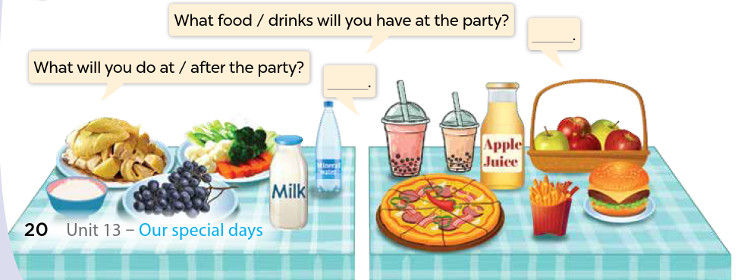
Look and name the food / drinks.
Let’s talk!

Slide 27
What food / drinks will you have at the party?
__________.

Slide 28
Fun Corner
05
Play the game.

Slide 29

Let’s get ready for the party!!!

Slide 30
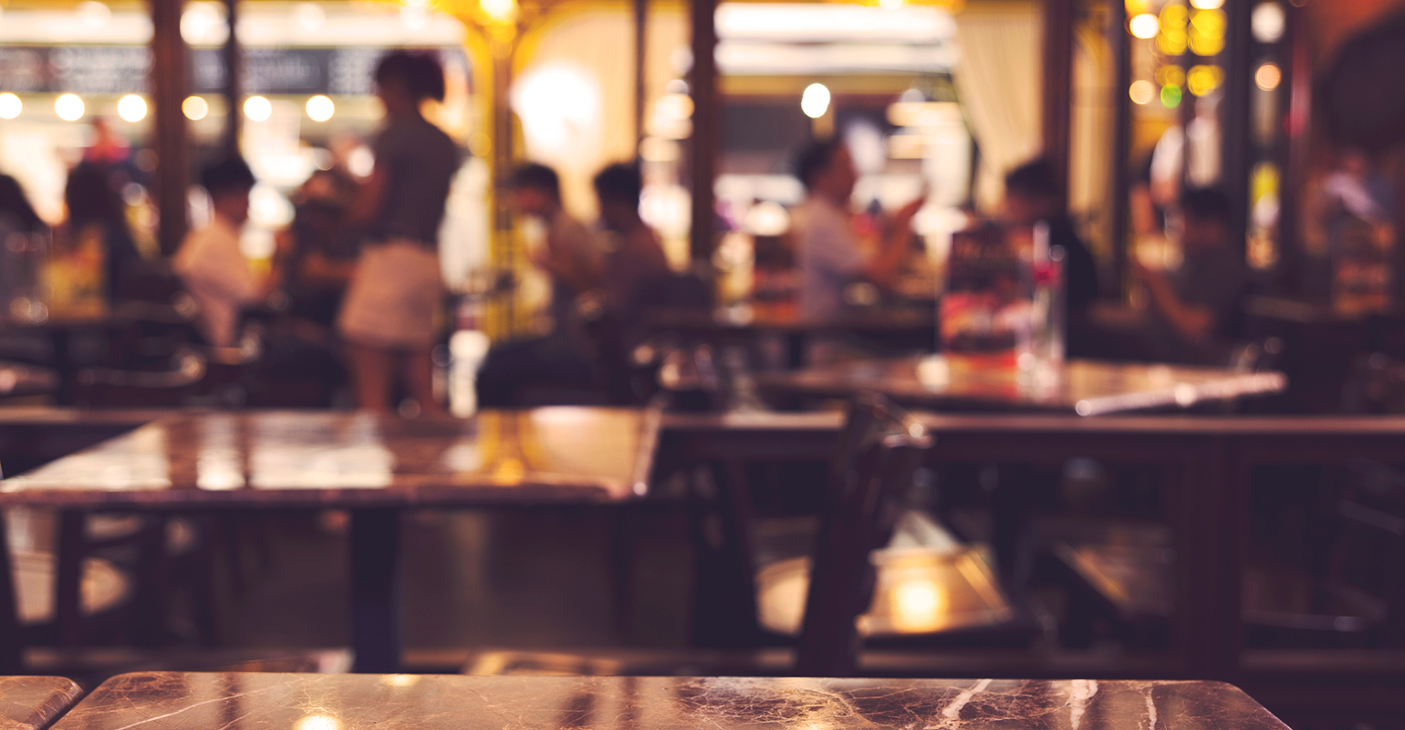

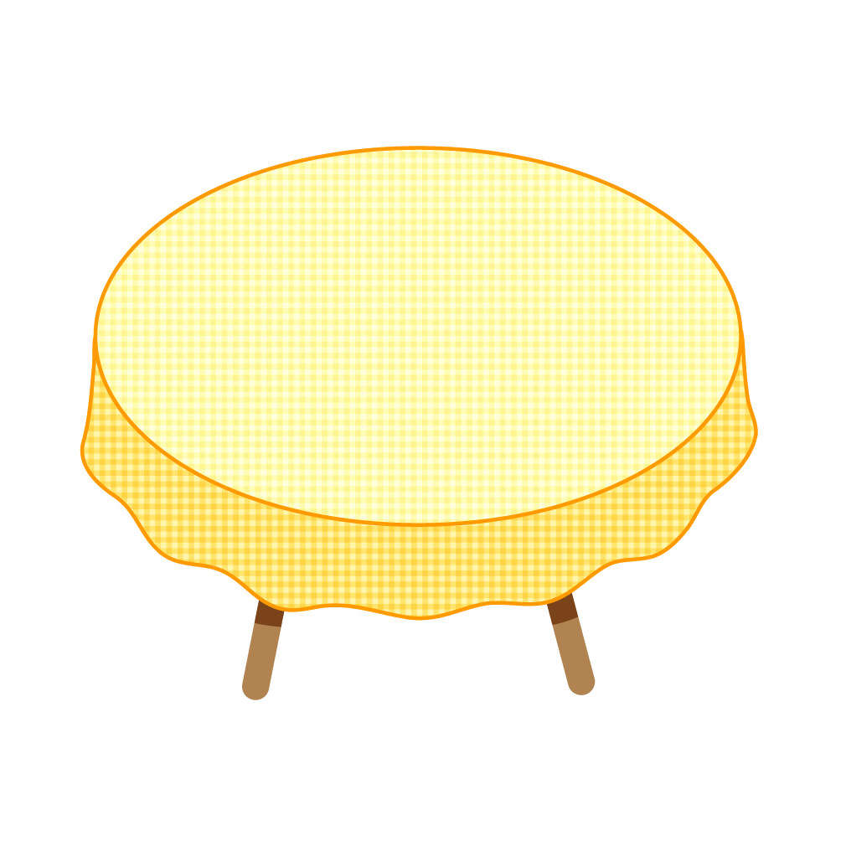
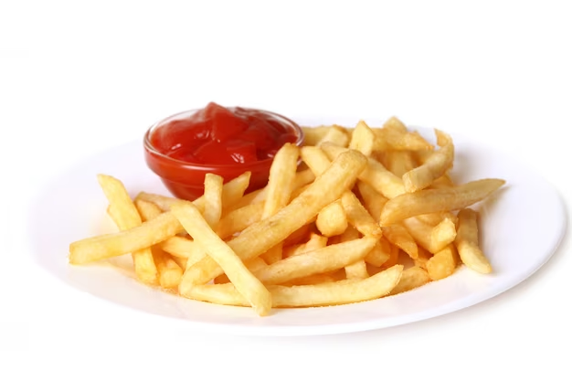

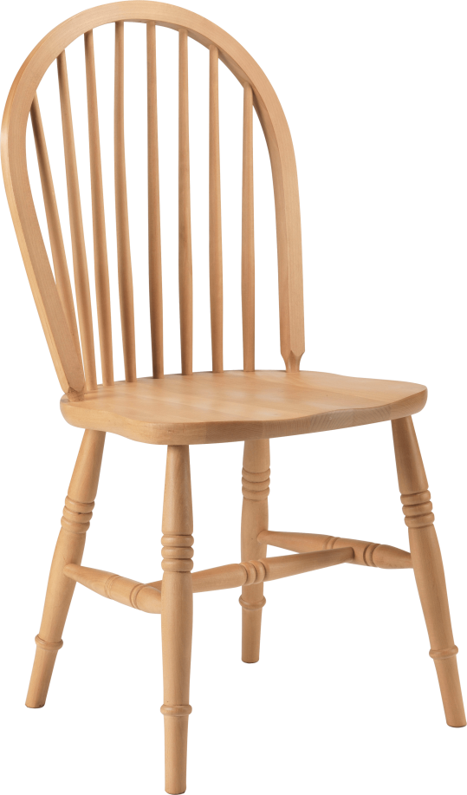
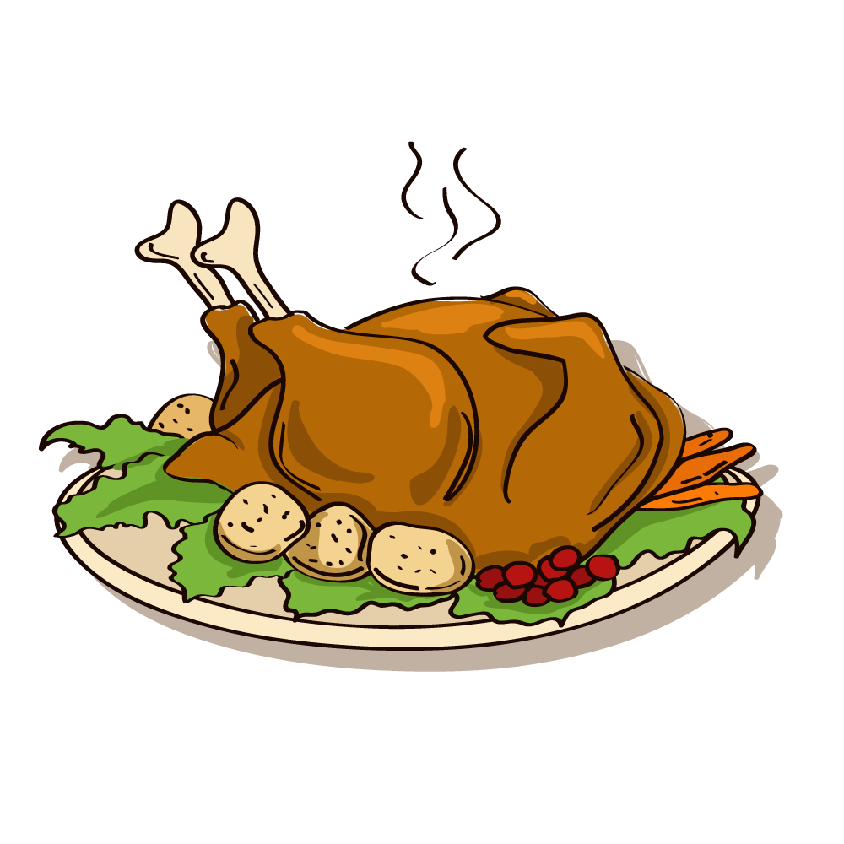
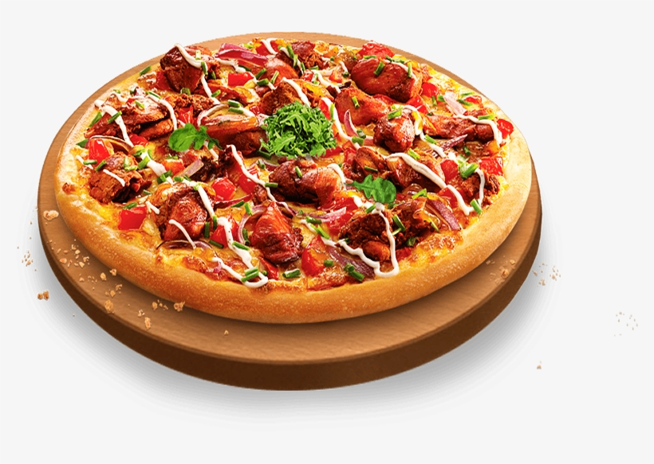
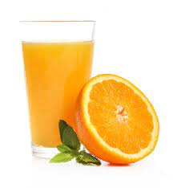

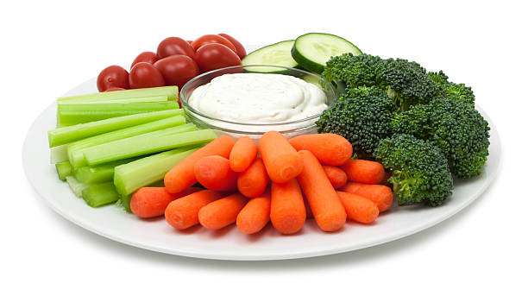

Slide 31






What food will you have at the party?
A
We will have pizza.
Time’s up!
B
We will have burgers.
C
We have pizza.
D
We will has pizza.

Slide 32
What food will you have at the party?
A
We will have vegetables.
Time’s up!
B
We will have apples.
C
We will have cakes.
D
We will have chips.

Slide 33
What food will you have at the party?
A
We will have sweets.
Time’s up!
B
We will have chicken.
C
We will have milk.
D
We will have fish.

Slide 34
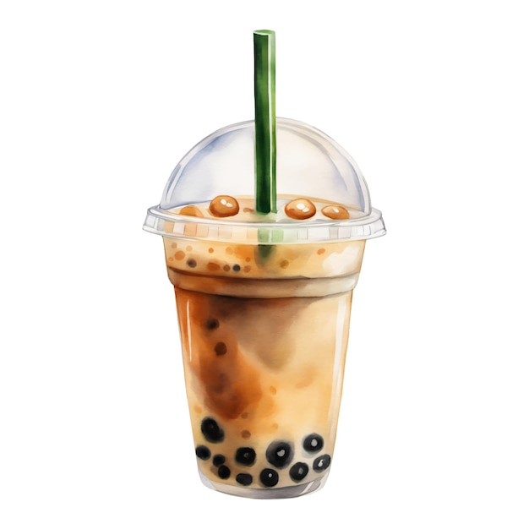
What drink will you have at the party?
A
We will have apple juice.
Time’s up!
B
We will have milk.
C
We will have milk tea.
D
We will have tea.

Slide 35
What food will you have at the party?
A
We will have chips.
Time’s up!
B
We will have fruit.
C
We will have rice.
D
We will have vegetables.

Slide 36
What drink will you have at the party?
A
We will have watermelon juice.
B
We will have grape juice.
Time’s up!
C
We will have apple juice.
D
We will have orange juice.

Slide 37
Website: hoclieu.vn
Fanpage: https://www.facebook.com/tienganhglobalsuccess.vn/

