Slide 1
UNIT 9 – GETTING AROUND
Lesson 9.4 Grammar 2
(SB page 94)

Slide 2
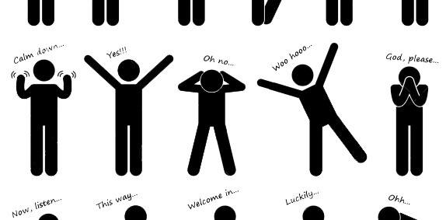
Miming
Work in groups.
Mime the activities you see.
Student 1 – read the words and mime
Others – guess

Slide 3
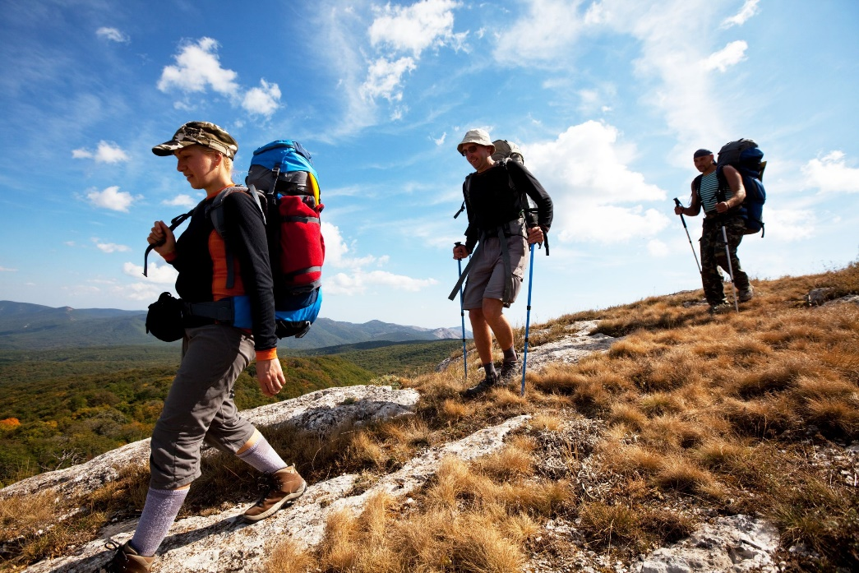
Miming
hiking

Slide 4
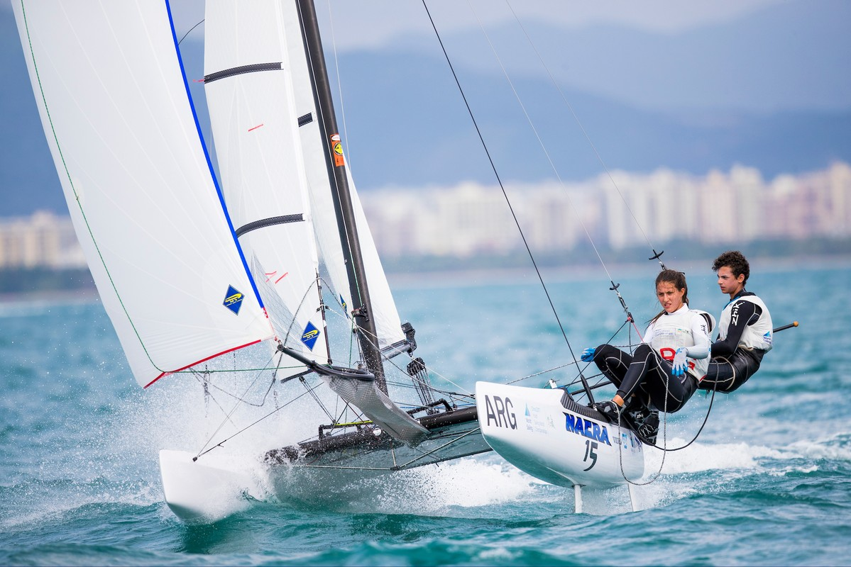
Miming
sailing

Slide 5
Miming
shopping

Slide 6
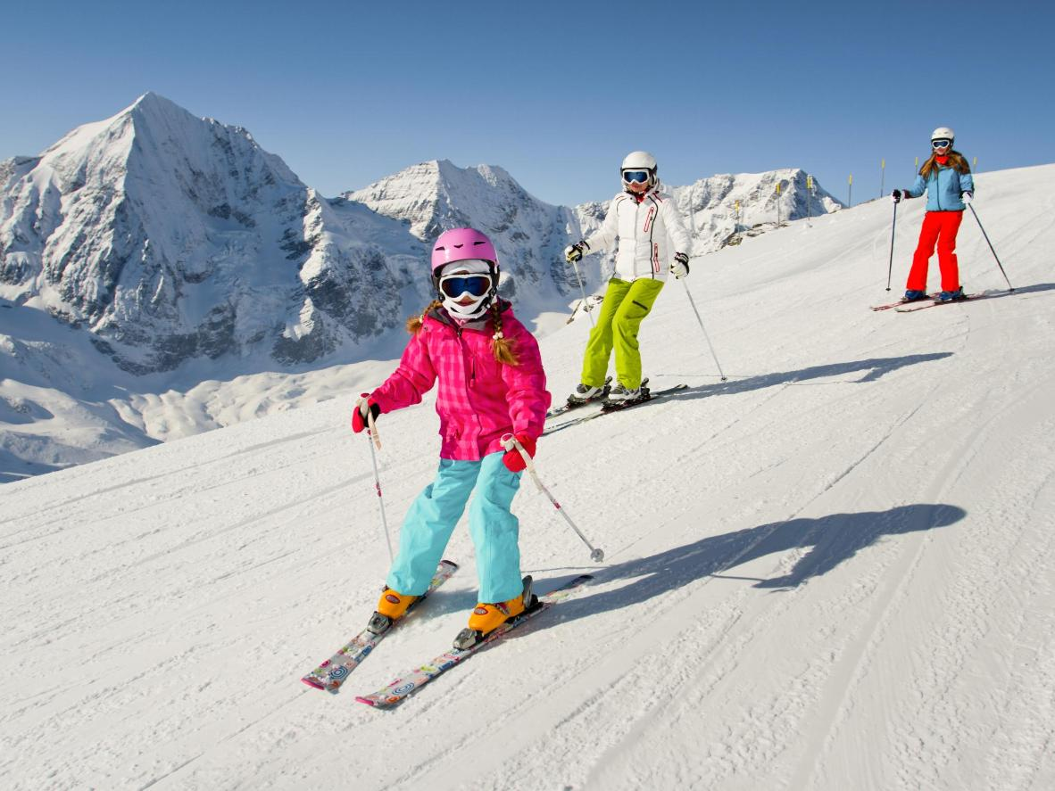
Miming
skiing

Slide 7
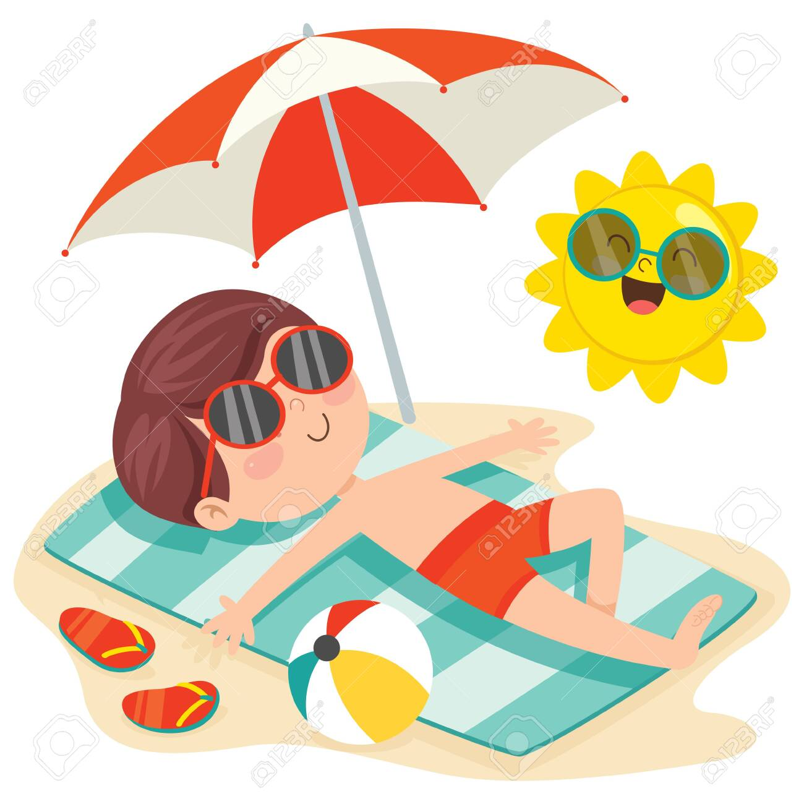
Miming
sunbathing

Slide 8
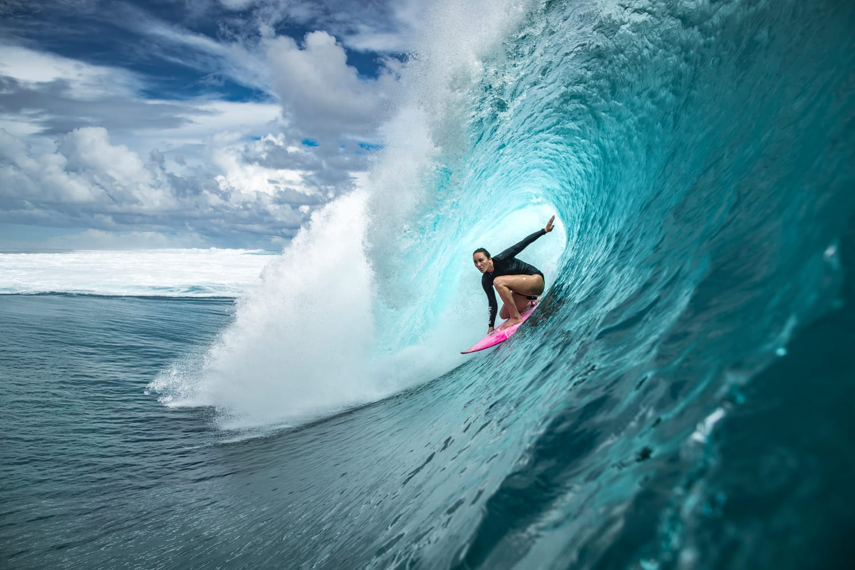
Miming
surfing

Slide 9
Objective
I can use be going to to talk about plans.

Slide 10
summer
plans

Slide 11
Exercise 1 (SB page 94)
Listen. Why is Max planning to go to London this summer?
1. Why is Max planning to go to London this summer?
Because he’s got an audition at the National Youth Theatre.
2. What is Eva’s plan?
She is going to visit her grandparents in Brazil.
3. What is Sol’s plan?
Sol isn’t going to do anything for a week.

Slide 12
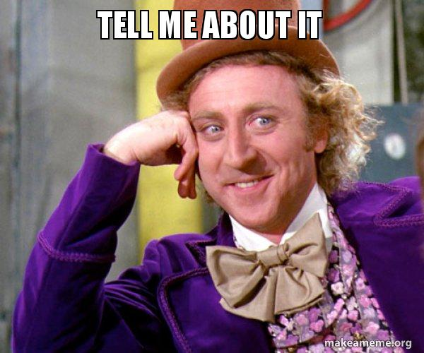
OUT of class
Understand what someone is complaining
Believe it or not
Lucky you
Surprising or positive news
Something good

Slide 13
Be going to
Meaning | Usage | Form
(+) S + tobe + going to V.
(-) S + tobe + not + going to V.
(?) Tobe + S + going to V?
(?) Wh-question + tobe + S + going to V?
I + am going to + V.
You/We/They + are going to + V.
He/She/It + is going to + V.
To talk
about plans

Slide 14
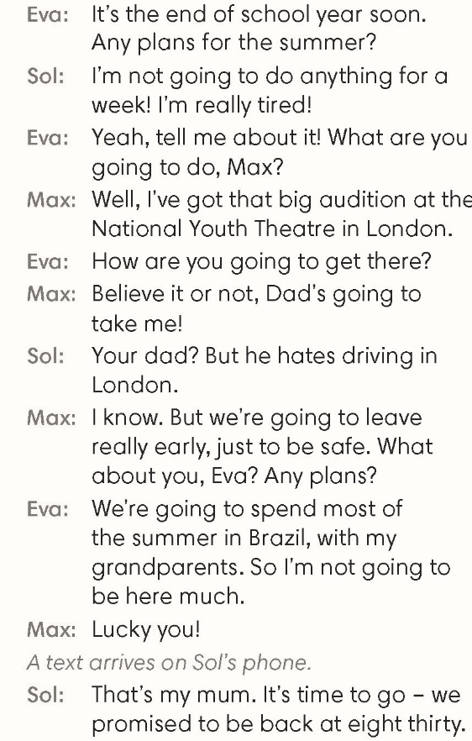
Exercise 2 (SB page 94)
Find examples of be going to in the dialogue.
Be going to
Present Continuous
Dad’s going to take me.
Dad is taking me.

Slide 15
Exercise 3 (SB page 94)
Complete the sentences with the correct form of be going to.
‘re going to work
2. Your exam results are terrible. You________________harder next year.
3. Nadia says she_________________ to university.
isn’t going to go
4. I’m worried about you. When ________________to the doctor’s?.
are you going to go
are traveling
5. Next year we __________________around Europe by train.
‘re going to travel
6. I __________________him a birthday present – he never buys one for me!
am not going to buy

Slide 16
Exercise 4 (SB page 94)
Finding friends
1. Positive – Sol or Eva
1. Eva is going to get up early.
2. Negative – Sol or Eva
2. Sol isn’t going to visit family.
3. Positive – Max and Lily
3. Max and Lily are going to get up early.
4. Negative – Max and Lily
4. Max and Lily aren’t going to visit family.
5. Your own choice
5. Sol isn’t going to help in the garden.

Slide 17
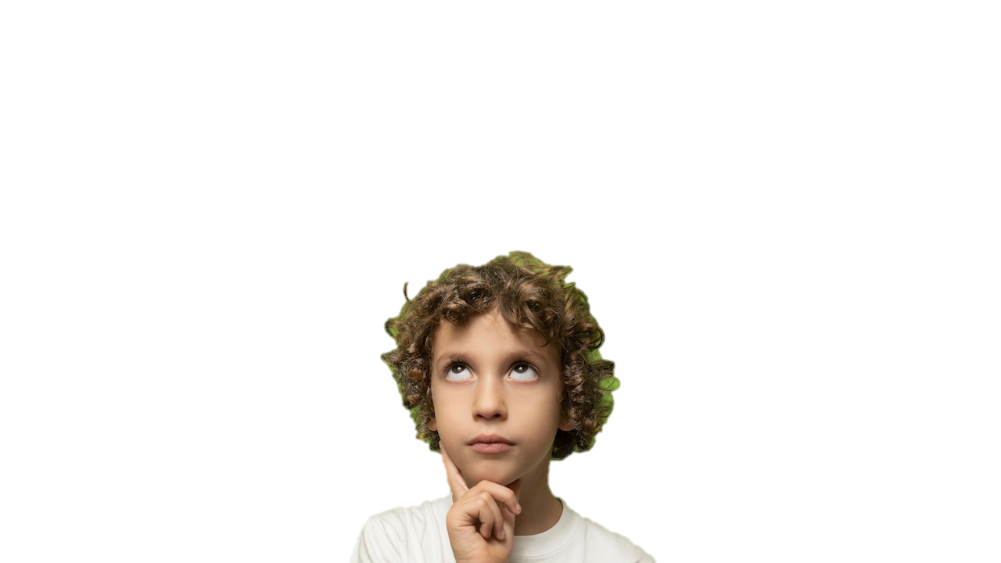
Exercise 5 (SB page 94)
Talk about your plans for next 10 years.
Be going to
Present Continuous
I’m going to learn to drive when I’m eighteen years old. I’m not going to buy an expensive car and I’m going to drive along Viet Nam with my friends.

