Slide 1
Welcome,
Students!

Slide 2
H
O
T
E
L
R
E
S
T
A
U
R
A
N
T
L
I
B
R
A
R
Y
S
P
O
R
T
S
C
E
N
T
R
E
Z
O
O
Crosswords
WHAT KIND OF THING IS IN TODAY’S LESSON?
CRAZES
People usually stay in this place when they are on vacation
Place where you play sports.
This is a place where people can eat and drink.
Where people can borrow and read books.
Place where you see a lot of animals.

Slide 3
yoyo
Spinner
CRAZY CRAZES
popper fidget

Slide 4
UNIT 1
FADS AND FASHIONS
LESSON 2: READING
CRAZY CRAZES

Slide 5
Vocabulary:
- Generally (adv) nói chung, theo thường lệ
- Obviously (adv) : rõ ràng, hiển nhiên
- Pole (n) cái cọc, cột cờ
Pole sitter (n) người ngồi / đứng trên cột cao
- Current (a) = present: hiện thời
- Absolutely (adv) tuyệt đối, chắc chắn, thuần túy
- Apparently (adv) rõ ràng, rành rành

Slide 6
Exercise 3:
Vocabulary Plus
Use a dictionary to check the meaning of the words in blue in the text.
Words | Meanings
crazes (n) | activities, objects, or ideas that are extremely popular, usually in the short time
generally (adv) | usually or in most situations
obviously (adv) | in a way that is easy to understand or see
pole (n) | a long, thin stick of wood or metal, often used standing straight up in the ground to support things
amazingly (adv) | in a way that is extremely surprising
absolutely (adv) | completely
apparently (adv) | used to say that something seems to be true, although it is not certain

Slide 7
LOOK AT THE PICTURES IN THE BOOK AND GUESS T-F, THEN READ THE TEXT
a) Crazes start at schools.
b) Toy and card collecting were popular.
c) People bought pet rocks in the 1980s.

Slide 8
TRUE - FALSE QUIZ
a) Crazes start at schools.
F
T
b) Toy and card collecting were popular.
F
c) People bought pet rocks in the 1980s.

Slide 9
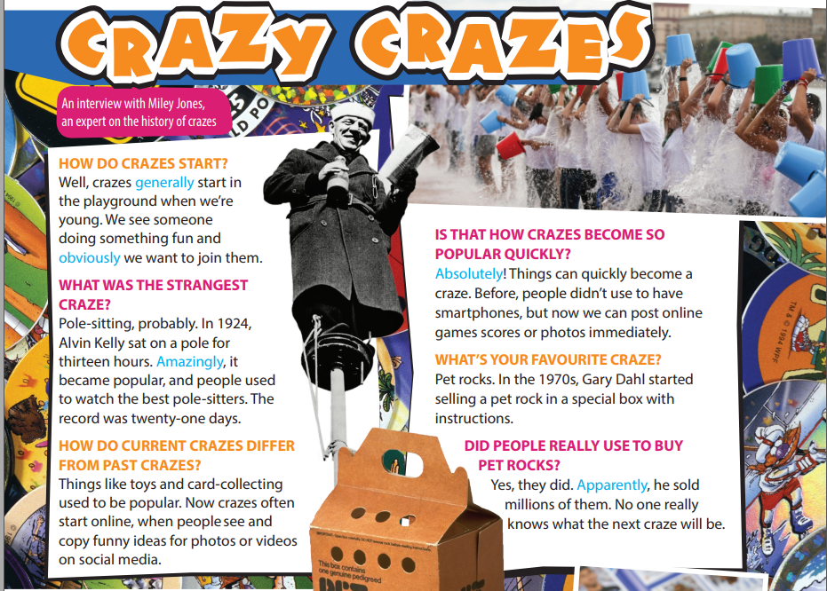
Exercise 1:
Read and interview with an expert of crazes. What is the purpose of the article?

Slide 10
Comprehension questions
1. Where do crazes start ?
2. How do crazes start ?
3. How long did the best pole sitter stay on the pole ?
4. How can crazes become so popular quickly?
5. When were pet rocks sold?

Slide 11
Comprehension questions
1. Where do crazes start ?
They start in the playground.
2. How do crazes start ?
When we see someome do something fun, and we want to do it / join them.
3. How long did the best pole sitter stay on the pole ?
He stayed there for 21 days.
4. How can crazes become so popular quickly?
People use smartphones, and they see and copy funny ideas, post online games scores and photos.
5. When were pet rocks sold?
In the 1970s.

Slide 12
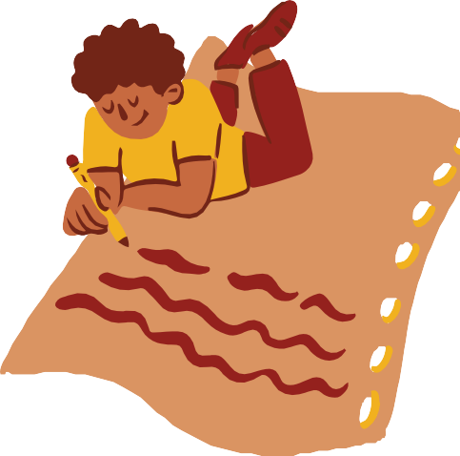
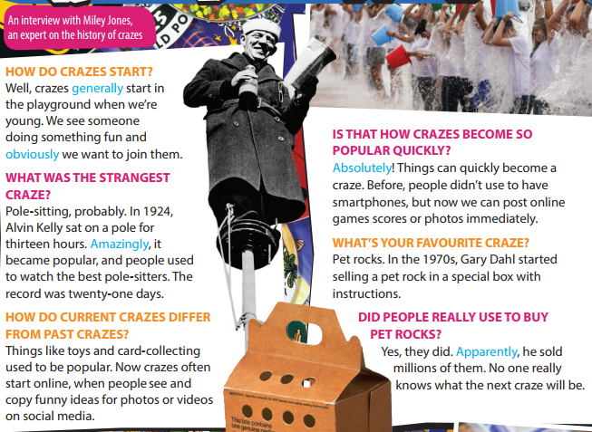
Exercise 2:
Read and listen to the interview. Write the questions for the answers from 1 to 5.
Questions
Answers
When did the craze of pole-sitting start?
in 1924.
How long did Alvin Kelly sit on a pole?
For thirteen hours
Where do crazes often start these days?
On social media
What did he sell / do in the 1970s?
He sold pet rocks
How many pet rocks did he sell?
Millions
https://www.youtube.com/watch?v=CuvxezayHMk

Slide 13
Exercise 4:
Use It! Work in groups. Say what you think of the crazes in the interview.
Take a vote on which is the silliest, the strangest and the most fun

Slide 14
Homework
 Learn by heart all the new words.
Do exercises in worbook
Prepare for new lesson

Slide 15
THANK YOU!

Slide 16
Game:
Name 5
things beginning with B
places
popular games
past simple forms of verb

Slide 17
English Lesson
UNIT 1
FADS AND FASHION
Lesson 2:
Reading - Crazes
with: Ms Quin

