Slide 2
Unit
3
HEALTHY LIVING FOR TEENS
LESSON 6: SKILLS 2
1

Slide 3
LESSON 2: SKILLS 2
LESSON 1: GETTING STARTED
WARM-UP
UNSCRAMBLED WORDS
Vocabulary
Task 1: Work in pairs. Discuss the following question.
Task 2: You will hear Trang, Phong, and Tom talking about how to manage their time effectively. For each student (1 – 3), choose the opinion (A – C) each of them expresses.
Task 3: Listen again and choose the correct answer A, B, or C.
LISTENING
Task 4: Match the time management tips in column a with the explanations and / or reasons in column B.
Task 5: Write a paragraph (about 100 words) about how to manage your time effectively. Use the tips in 4 or your own ideas.
WRITING
CONSOLIDATION
Wrap-up
Homework

Slide 4
UNSCRAMBLE
Play in 2 teams.
Write unscrambled words in notebooks.
Raise hand and say out “FINISH”.
LET’S PLAY!

Slide 5
UNSCRAMBLE THE WORD
COWKROSHOL
SCHOOLWORK

Slide 6
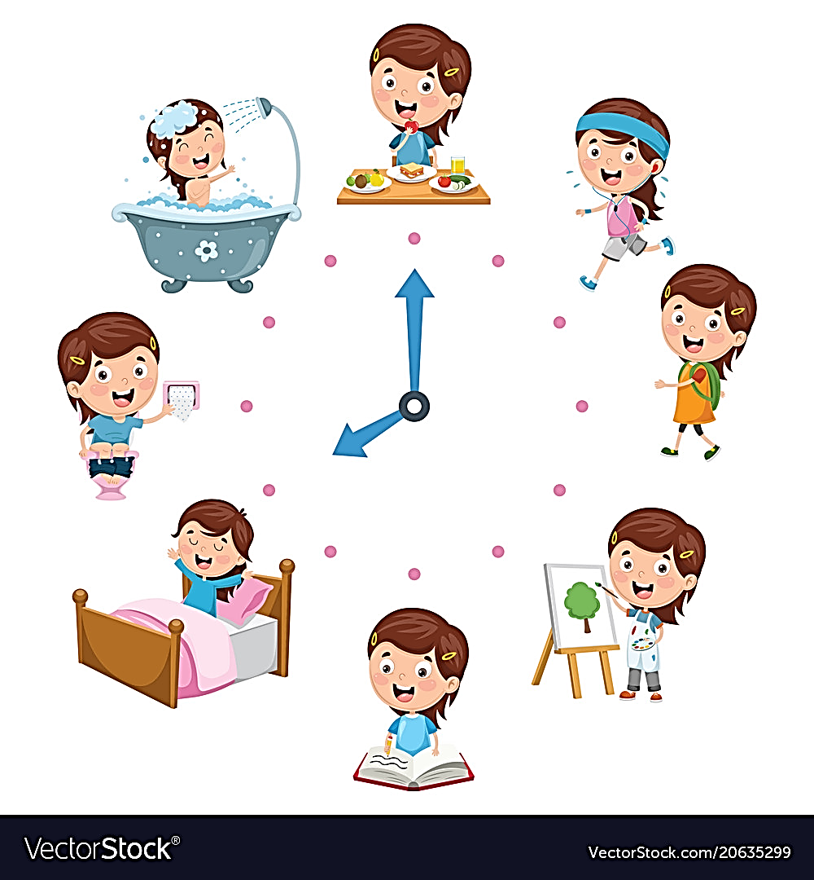
UNSCRAMBLE THE WORD
RTNUOIE
ROUTINE

Slide 7
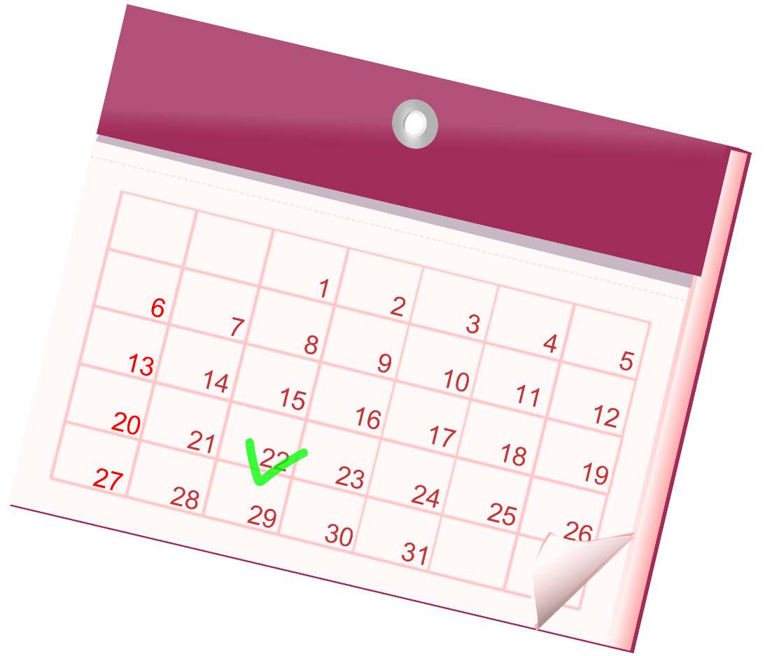
UNSCRAMBLE THE WORD
LCEADANR
CALENDAR

Slide 8
UNSCRAMBLE THE WORD
UIMBTS
SUBMIT

Slide 9
UNSCRAMBLE THE WORD
EIALNEDD
DEADLINE

Slide 10
UNSCRAMBLE THE WORD
MIMZIINE
MINIMIZE

Slide 11
UNSCRAMBLED WORDS
SCHOOLWORK
ROUTINE
CALENDAR
SUBMIT
MINIMIZE
DEADLINE

Slide 12
LISTENING
schoolwork (n)
.
/ˈskuːl.wɝːk/
việc học tập
Notes:
studying done by a child at school or at home

Slide 13
LISTENING
routine (n)
.
/ruːˈtiːn/
việc thường làm (hàng ngày)
Notes:
a usual or fixed way of doing things:

Slide 14
LISTENING
submit (v)
.
/səbˈmɪt/
nộp, đệ trình
Notes:
to give or offer something for a decision to be made by others

Slide 15
LISTENING
minimize (v)
.
/ˈmɪn.ɪ.maɪz/
giảm đến mức tối thiểu
Notes:
to reduce something to the least possible level or amount:

Slide 16
LISTENING
New words | Pronunciation | Meaning
1. schoolwork (n) | /ˈskuːl.wɝːk/ | việc học tập
2. routine (n) | /ruːˈtiːn/ | việc thường làm (hàng ngày)
3. submit (v) | /səbˈmɪt/ | nộp, đệ trình
4. minimize (v) | /ˈmɪn.ɪ.maɪz/ | giảm đến mức tối thiểu

Slide 17
SPEAKING
1
Work in pairs. Discuss the following question.
How do you make time for study and other activities?

Slide 18
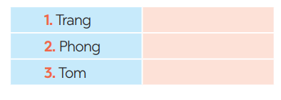
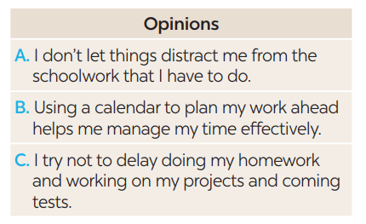
LISTENING
2
You will hear Trang, Phong, and Tom talking about how to manage their time effectively. For each student (1 – 3), choose the opinion (A – C) each of them expresses.
B
A
C
Notes:
Trang: B, Phong: A, Tom: C.

Slide 19
LISTENING
3
Listen again and choose the correct answer A, B, or C.
1. Trang enters what she has to do into a ______ at the beginning of each term.
poster
routine
calendar
2. Trang often uses ______ colours to mark project due dates and exam times on her calendar.
different
the same
similar
Notes:
1. C 2. A 3. A 4. A 5. B

Slide 20
LISTENING
3
Listen again and choose the correct answer A, B, or C.
3. Phong turns off his cell phone and signs out of social media ______ when he starts his work.
accounts
networks
websites
4. Tom tries not to ______ homework until just before the due date.
leave
complete
submit
Notes:
1. C 2. A 3. A 4. A 5. B

Slide 21
LISTENING
3
Listen again and choose the correct answer A, B, or C.
5. Tom ______ his projects and coming tests and adds them to his schedule.
prepares
reviews
revises
Notes:
1. C 2. A 3. A 4. A 5. B

Slide 22
WRITING
4
Match the time management tips in column A with the explanations and / or reasons in column B.
A | B
1. Making a plan or schedule for things you need to do, including appointments, projects, homework and tests | a. You should decide which is the most urgent and important task so that you can concentrate on it first. By doing this, you may not be at a loss to deal with too much work at the same time.
2. Giving priority to the most important task | b. An effective routine can help you accomplish the things you need to do. The more you follow a daily routine, the less you will worry or get stressed.
3. Building an effective daily routine | c. You can plan your work ahead by using a calendar, a diary, or a mobile app. It helps you remember what you need to accomplish and when you should do it.
Notes:
Key: 1. c 2. a 3. b

Slide 23
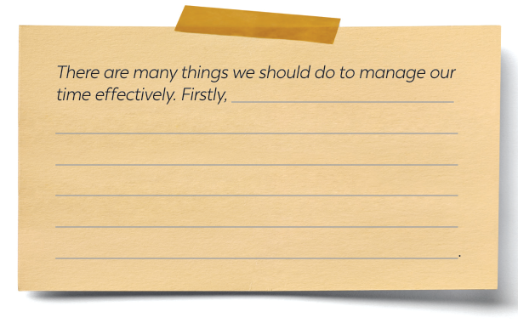
WRITING
5
Write a paragraph (about 100 words) about how to manage your time effectively. Use the tips in 4 or your own ideas.
Notes:
Key: 1. c 2. a 3. b

Slide 24
WRITING
5
Write a paragraph (about 100 words) about how to manage your time effectively. Use the tips in 4 or your own ideas.
Suggested answer:
There are many things we should do to manage our time effectively. Firstly, we should set specific goals and prioritise them according to their importance level. This will help us keep focused on our most important tasks and avoid wasting time on tasks that do not contribute to our goals. Secondly, creating a schedule or to-do list can help us manage our time efficiently by breaking down our day into manageable chunks. We should also be realistic about how long each task will take and build in extra time for unexpected interruptions or delays. Thirdly, it is essential to eliminate distractions and time-wasting activities, such as social media or unnecessary meetings, which can reduce our productivity. By following these tips, you we can effectively manage your time and achieve success in all aspects of your life.
Notes:
Key: 1. c 2. a 3. b

Slide 25
CONSOLIDATION
1
Wrap-up
What have we learnt in this lesson?
Listening skill for specific information.
Writing a paragraph about how to manage their time effectively, using the given tips or their own ideas.

Slide 26
CONSOLIDATION
2
Homework
Do exercises in the workbook.

Slide 27
Website: hoclieu.vn
Fanpage: facebook.com/www.tienganhglobalsuccess.vn/

