Slide 2
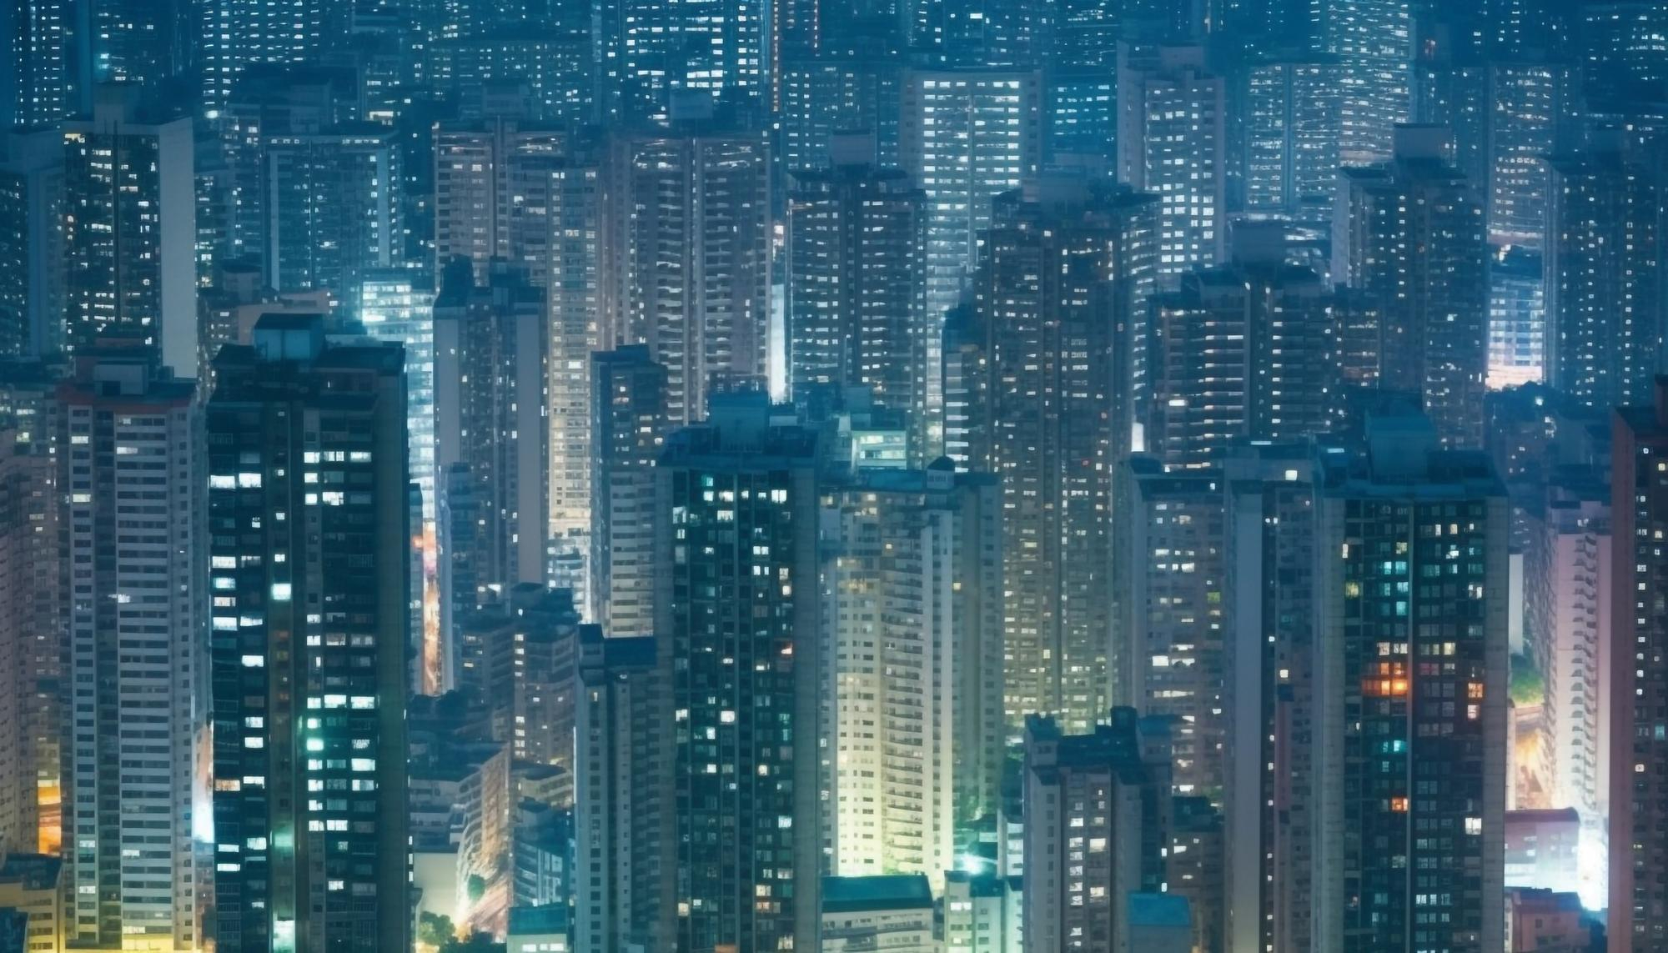


Unit
2
CITY LIFE
LESSON 2: A CLOSER LOOK 1

Slide 3
LESSON 2: A CLOSER LOOK 1
LESSON 2: A CLOSER LOOK 1
WARM-UP
Option 1: Game: Jumble words
Option 2: Game: Emoji quiz
- Vocabulary
- Task 1: Match the words/phrases with their explanations.
- Task 2: Choose the correct answer A, B, C, or D to complete each sentence.
- Task 3: Complete the texts, using the words and phrase from the box.
VOCABULARY
PRONUNCIATION
- Task 4: Put the words in the correct column. Then listen and check.
- Task 5: Read the sentences. Circle the words with /aʊ/, underline those with /əʊ/, and put a tick (√) next to those with /eə/. Then listen, check, and practise the sentences.
CONSOLIDATION
Wrap-up
Homework

Slide 4
WARM-UP
OPTION 1
J
B
M
U
E
L
O
R
W
S
D

Slide 5
WARM-UP
OPTION 1
HOW TO PLAY
- There are some JUMBLE WORDS.
- Work in teams to unscramble them.
J
M
B
E
U
L
W
O
R
D
S

Slide 6
WARM-UP
OPTION 1
O | N | C | E | S | E | D | T | G
 |  |  | D | A | R | O
C | O | N | G | E | S | T | E | D
 |  |  | R | O | A | D

Slide 7
WARM-UP
OPTION 1
N | E | R | R | G | N | D | U | O
U | D | E | R | G | R | O | U | N | D

Slide 8
WARM-UP
OPTION 1
c | e | e | h | y | i | t | y
i | t | c | h | y |  | e | y | e

Slide 9
WARM-UP
OPTION 1
o | n | d | t | n | o | w | w
d | o | w | n | t | o | w | n

Slide 10
WARM-UP
OPTION 1
r | f | a | i | f | c | t | m | a | j
t | r | a | f | f | i | c |  | j | a | m

Slide 11
WARM-UP
OPTION 1
O | N | C | T | S | U | C | R | N | O | T | I
 |  |  | I | E | T | S
C | O | N | S | T | R | U | C | T | I | O | N
 |  |  | S | I | T | E

Slide 12

WARM-UP
OPTION 2
EMOJI/PICTURES QUIZ

Slide 13
WARM-UP
OPTION 2
- Each round, one student from each team stands up.
- There are some emojis/pictures.
- Try to guess the secret word from the emojis/pictures and make a sentence using that word.

Slide 14
WARM-UP
OPTION 2
EXAMPLE:

Slide 15

WARM-UP
OPTION 2
🚌
bus driver

Slide 16
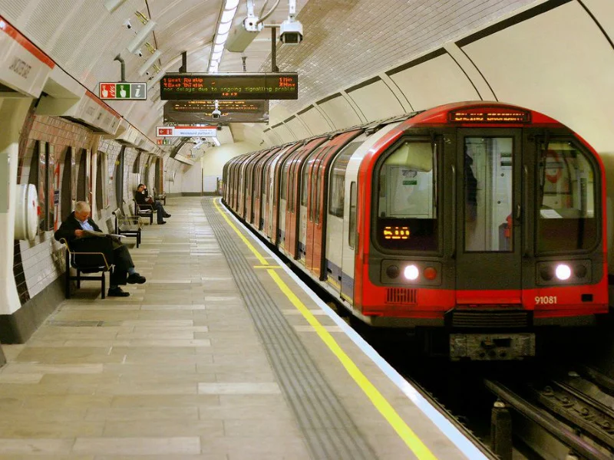
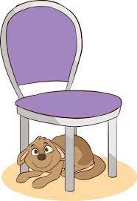
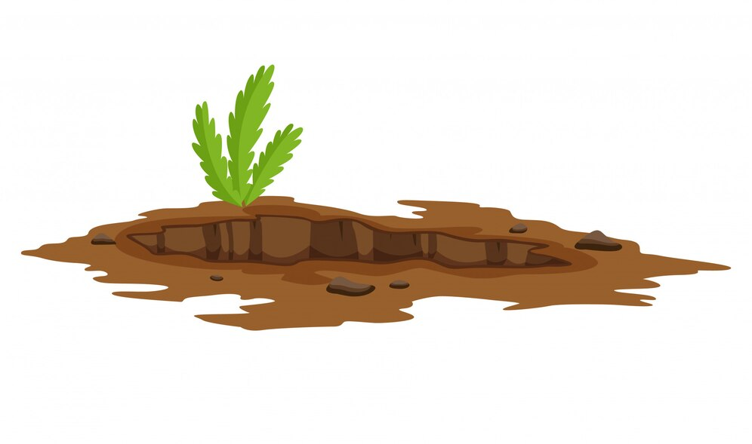
WARM-UP
OPTION 2
underground

Slide 17
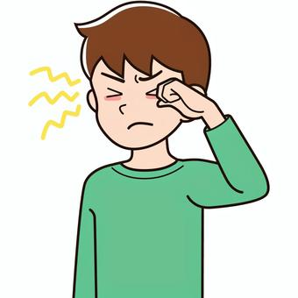

WARM-UP
OPTION 2
👁️
itchy eye

Slide 18


WARM-UP
OPTION 2
downtown

Slide 19
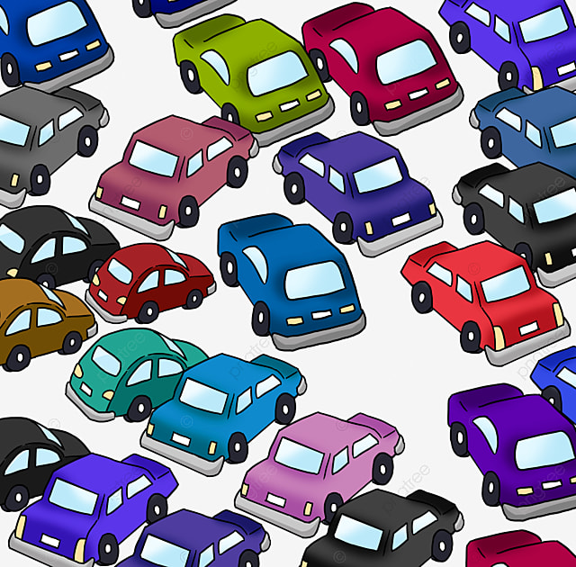
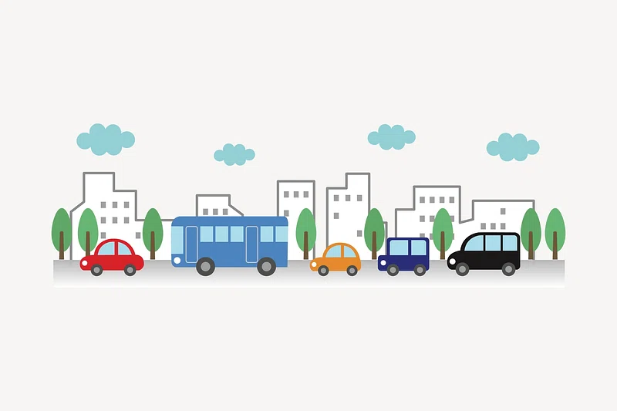

WARM-UP
OPTION 2
traffic jam

Slide 20
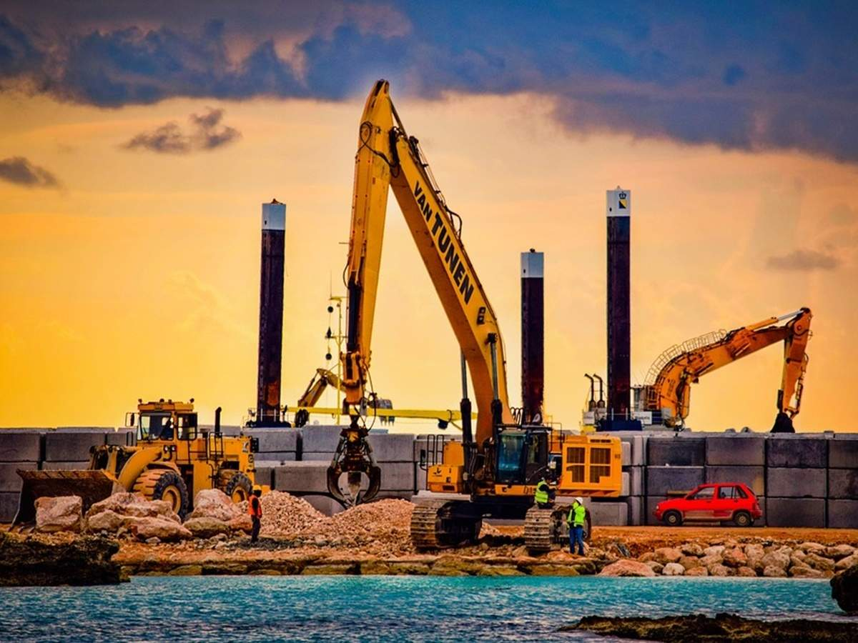

WARM-UP
OPTION 2
🚧
construction site

Slide 21
WARM-UP
OPTION 2
THE END

Slide 22
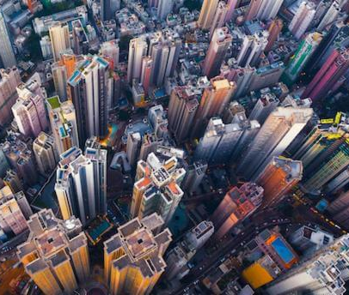

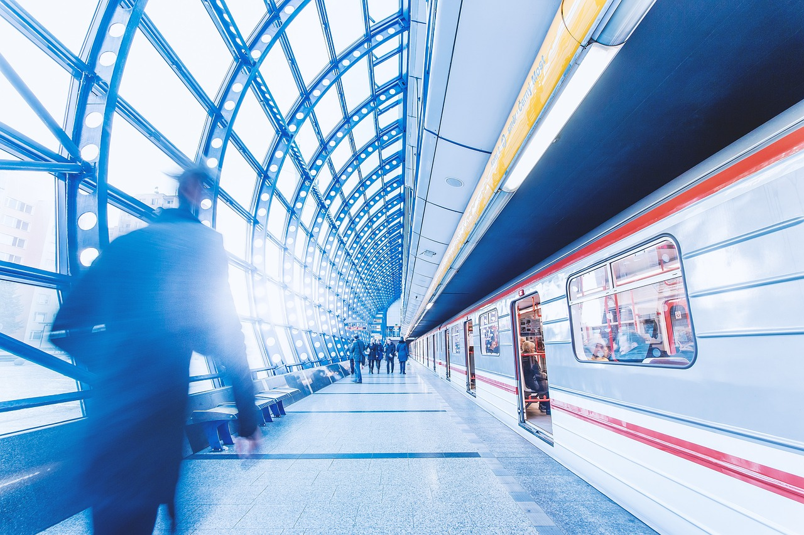
VOCABULARY
concrete jungle (n)
an ugly grey area of a city where people live in closely crowded apartment buildings .
/ˌkɒŋkriːt ˈdʒʌŋɡl/
rừng bê tông

Slide 23
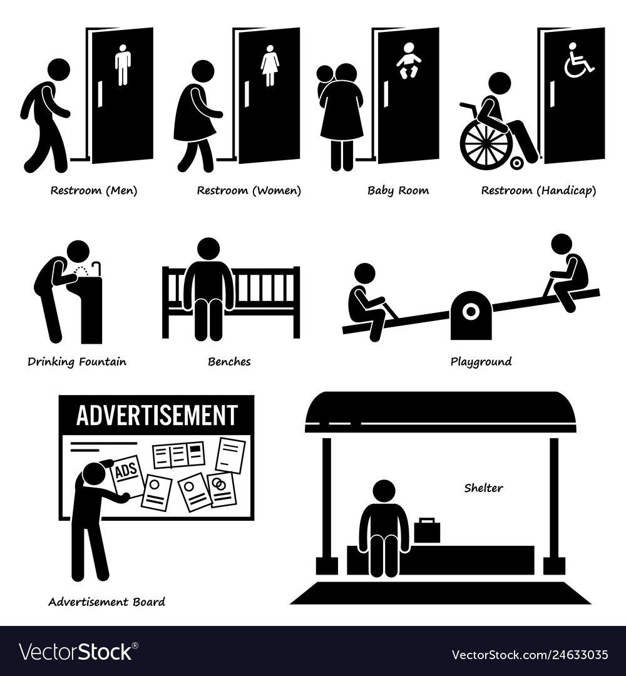
VOCABULARY
metro (n)
underground railway
/ˈmetrəʊ/
hệ thống tàu điện ngầm

Slide 24

VOCABULARY
available to everyone in the area.
public amenity
/ˈpʌblɪk əˈmiːnəti/
tiện ích công cộng

Slide 25
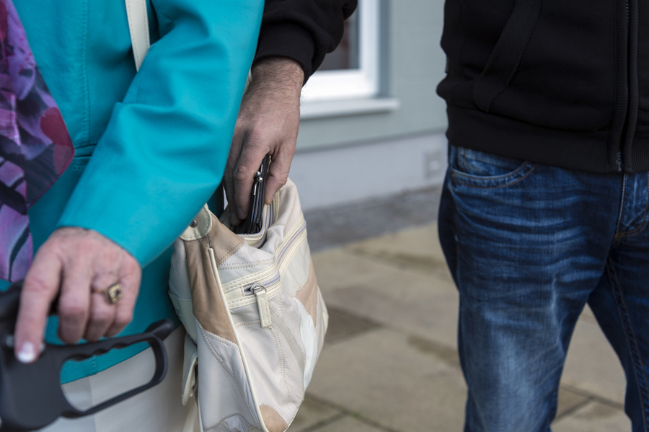
VOCABULARY
someone who regularly travels between work and home
commuter (n)
/kəˈmjuː.t̬ɚ/
người đi làm

Slide 26
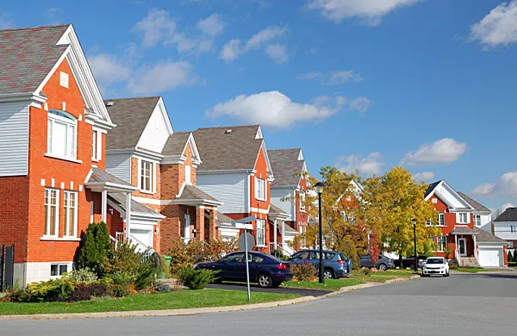
VOCABULARY
a thief who steals things out of pockets or bags, especially in a crowd
pickpocketing (n)
/ˈpɪkˌpɑː.kɪ.t̬ɪŋ/
móc túi

Slide 27

VOCABULARY
an area on the edge of a large town or city where people who work in the town or city often live
suburb (n)
/ˈsʌb.ɝːb/
ngoại ô

Slide 28
VOCABULARY
bustling (adj)
full of busy activity
/ˈbʌs.lɪŋ/
hối hả, nhộn nhịp, náo nhiệt.

Slide 29
VOCABULARY
liveable (adj)
suitable or good for living in
/ˈlɪvəbl/
(nơi, địa điểm) đáng sống

Slide 30
VOCABULARY
New words | Pronunciation | Meaning
1.concrete jungle (n) | /ˌkɒŋkriːt ˈdʒʌŋɡl/ | rừng bê tông
2. metro (n) | /ˈmetrəʊ/ | hệ thống tàu điện ngầm
3.public amenity | /ˈpʌblɪk əˈmiːnəti/ | tiện ích công cộng
4. commuter (n) | /kəˈmjuː.t̬ɚ/ | người đi làm

Slide 31
VOCABULARY
New words | Pronunciation | Meaning
5. pickpocketing (n) | /ˈpɪkˌpɑː.kɪ.t̬ɪŋ/ | móc túi
6. suburb (n) | /ˈsʌb.ɝːb/ | ngoại ô
7. bustling (adj) | /ˈbʌs.lɪŋ/ | hối hả, nhộn nhịp, náo nhiệt
8. liveable (adj) | /ˈlɪvəbl/ | (nơi, địa điểm) đáng sống

Slide 32

VOCABULARY
c
1. downtown | a. an underground train system | 1.
2. concrete jungle | b. a city or part of a city with many buildings next to each other | 2.
3. sky train | c. the centre of a city, especially its main business area | 3.
4. metro | d. things in a neighbourhood that make life more comfortable such as parks and shopping centres | 4.
5. public amenities | e. a type of train that runs on a railway high above the ground | 5.
1
Match the words/phrases with their explanations.( p.20)
b
- Work in pairs and match the words/phrases with their explanations.
e
a
d

Slide 33
VOCABULARY
EXTRA ACTIVITY
- Work in teams.
- Each team choose 4 members to join the game and stand in a line.
- When you hear a word / phrase, you need to run quickly to the board and write that word/ phrase on the board.
- The team with the most number of correct answers will be the winner.

Slide 34
VOCABULARY
EXTRA ACTIVITY
LET’S PLAY

Slide 35
VOCABULARY
2
Choose the correct answer A, B, C, or D (p.20)
1. The sky train is ______ with commuters at rush hour.
A. packed | B. full
C. busy | D. interesting
2. The town’s public amenities make it a ______ place for its residents
A. crowded | B. boring
C. liveable | D. dull

Slide 36
VOCABULARY
2
Choose the correct answer A, B, C, or D (p.20)
3. It’s not always ______ on the metro. Pickpocketing sometimes takes place.
A. careful | B. dangerous
C. noisy | D. safe
4. It is often more ______ to live in the downtown than in the suburbs.
A. convenient | B. peaceful
C. quiet | D. silent

Slide 37
VOCABULARY
2
Choose the correct answer A, B, C, or D (p.20)
5. Hong Kong is like a concrete jungle with so many people in it. It’s a ______ city.
A. calm | B. quiet
C. bustling | D. high
metro
liveable
downtown
concrete jungles
safe
public amenities

Slide 38
VOCABULARY
3
Complete the texts, using the words and phrases from the box. (p.20)
metro
John: City life is great! People can travel by public transport, like buses and the (1) ______. There are good schools and hospitals, and other (2) ______ such as parks, cinemas, and sports facilities. They make cities (3) ______ places for people.
liveable
metro
downtown
public amenities
safe
concrete jungles
liveable
public amenities

Slide 39
- Who you agree with, John or Jenny, and explain why.
VOCABULARY
3
Complete the texts, using the words and phrase from the box. (p.20)
metro
Jenny: City life is terrible! The (4) ______area is too crowded. Public transport is always packed with people. Some cities are like (5) ______ with so many buildings. Some cities are not (6) ______ because of high crime rates.
downtown
liveable
downtown
concrete jungles
safe
safe
concrete jungles
public amenities

Slide 40
VOCABULARY
3
Complete the texts, using the words and phrase from the box. (p.20)
- Who you agree with, John or Jenny, and explain why.
Example answers:
I agree with John. I think that life in the city is great. There are many good public amenities. The public transport system is convenient, too.

Slide 41
VOCABULARY
Example answers:
I agree with Jenny. City life is terrible. Cities are often too crowded. They don’t have much green space. They are not liveable.

Slide 42
PRONUNCIATION
Review the diphthong sounds.
Listen and repeat:
crowded locate square
outdoor repair airport
council coastal overseas
/aʊ/
/əʊ/
/eə/
/aʊ/ | /əʊ/ | /eə/

Slide 43
PRONUNCIATION
4
Put the words in the correct column. Then listen and check.
crowded locate square
outdoor repair airport
council coastal overseas
- Say some words you know that have diphthong sounds /aʊ/, /əʊ/, and /eə/
/aʊ/ | /əʊ/ | /eə/
crowded
locate
repair
outdoor
coastal
square
council
overseas
airport

Slide 44
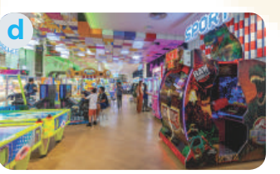
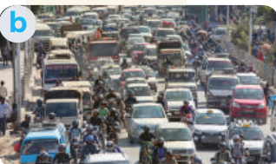
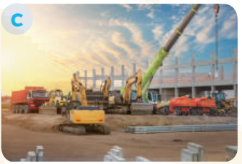

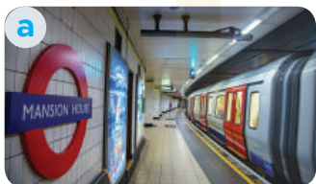
PRONUNCIATION
Read the sentences. Circle the words with /aʊ/, underline those with /əʊ/, and put a tick (√) next to those with /eə/. Then listen, check, and practise the sentences.
5
- Look at the sentences in exercise 5 p.20
- You need to circle the words with /aʊ/, underline those with /əʊ/, and put a tick (√) next to those with /eə/.

Slide 45
PRONUNCIATION
1. They go shopping downtown.
2. The chairman comes from a coastal city.
3. Buses in the old days were not as crowded as they are now.
4. She gets around the city easily thanks to the apps on her phone.
5. I hope we will arrive at the city square in time for the fashion show.
√
√
Now, listen and check.

Slide 46

CONSOLIDATION
1
Wrap-up
What have we learnt in this lesson?
Use the lexical items related to the topic City life;
Pronounce the diphthong sounds /aʊ/, /əʊ/, and /eə/ in words and sentences correctly.

Slide 47

CONSOLIDATION
2
Homework
- Do exercises in the workbook.
- Find 3 more words that have the diphthong sounds /aʊ/, /əʊ/, and /eə/.

Slide 48
Website: hoclieu.vn
Fanpage: facebook.com/www.tienganhglobalsuccess.vn/

