Slide 2


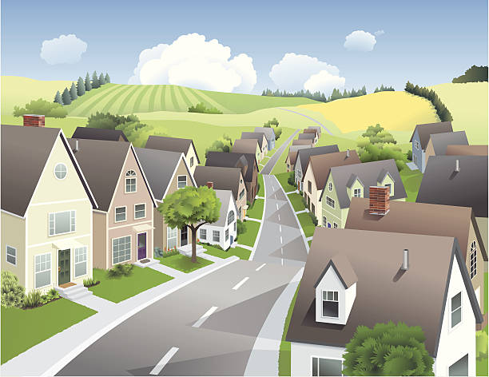
Unit
1
LOCAL COMMUNITY
LESSON 2: A CLOSER LOOK 1
1

Slide 3
LESSON 2: A CLOSER LOOK 1
LESSON 1: GETTING STARTED
WARM-UP
Warm up: Game
Vocabulary
VOCABULARY
Task 1: Match the community helpers with their responsibilities.
Task 2: Write a word or phrase in the box under the correct picture.
Task 3: Fill in each blank with a word or phrase from the box.
PRACTICE
Task 4: Listen and number the words you hear. Then listen again and repeat.
Task 5: Listen and practise the sentences. Underline the bold words with /æ/, circle the bold words with /ɑ:/, and tick the bold words with /e/.
PRONUNCIATION
CONSOLIDATION
Wrap-up
Homework

Slide 4
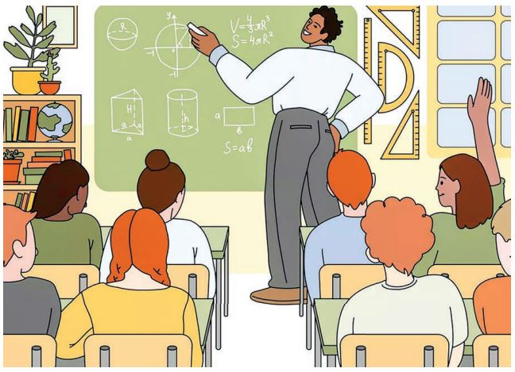
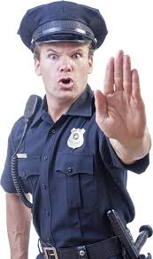


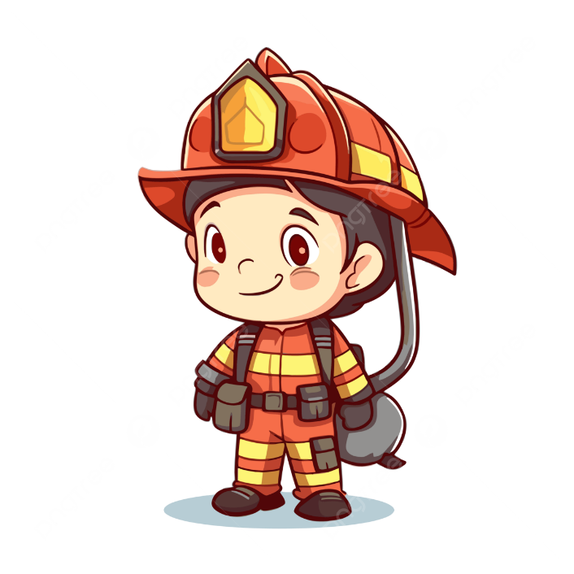
WARM-UP
HOT SEAT

Slide 5
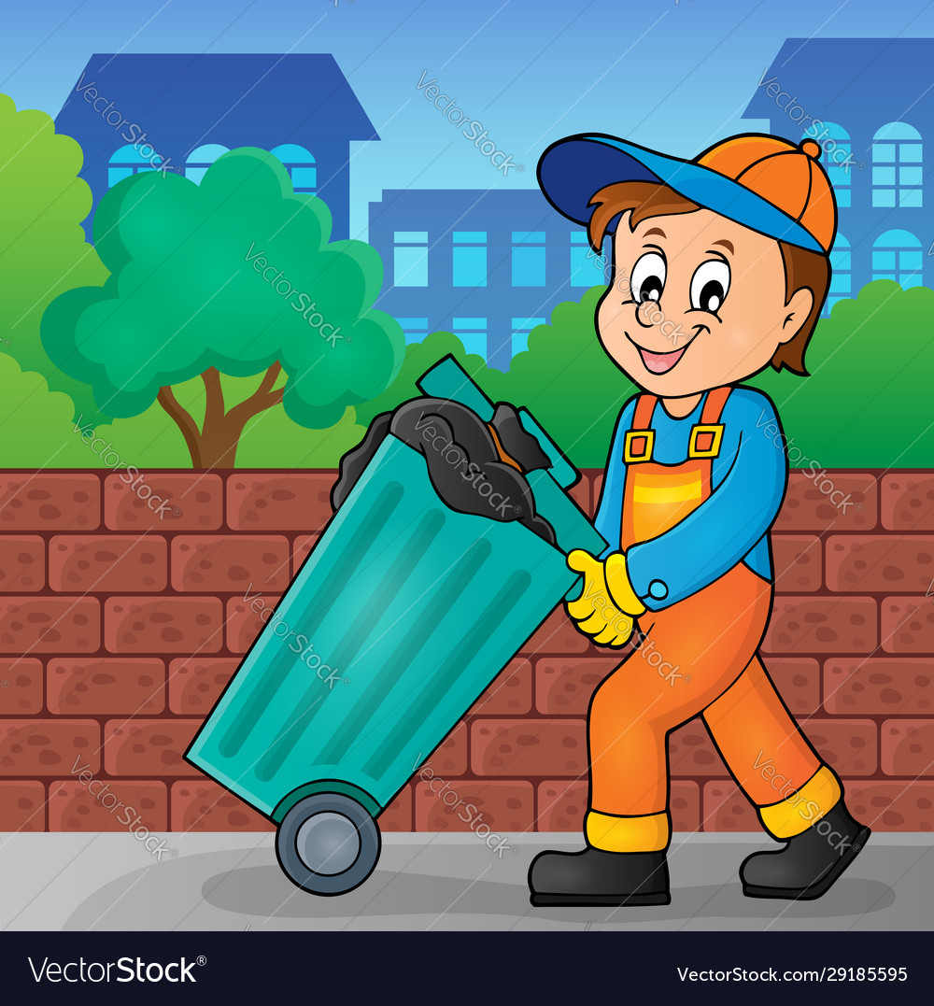
PRESENTATION
garbage collector (n)
/ˈɡɑːbɪdʒ kəlektə/
nhân viên dọn vệ sinh

Slide 6
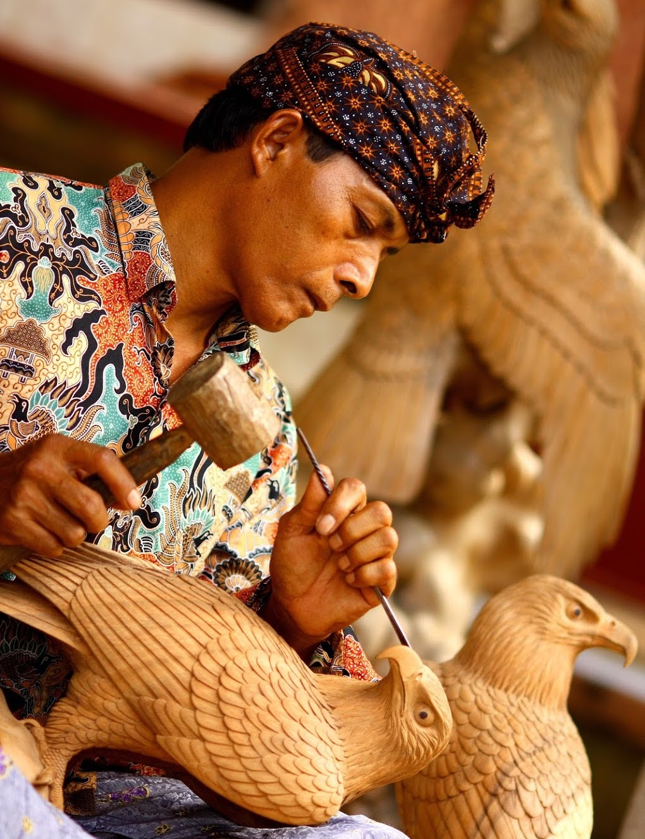
PRESENTATION
artisan (n)
/ˌɑːtɪˈzæn/
thợ làm nghề thủ công

Slide 7
* Vocabulary:
- garbage collector (n):
- artisan (n):
- police officer (n):
- electrician (n):
- firefighter (n):
- delivery person (n):
- handicraft (n):
- pottery (n):
- speciality (n):
- tourist attraction (n)
nhân viên dọn vệ sinh
thợ làm nghề thủ công
công an
thợ điện
lính cứu hỏa
nhân viên giao hàng
sản phẩm thủ công
đồ gốm
đặc sản
điểm du lịch

Slide 8
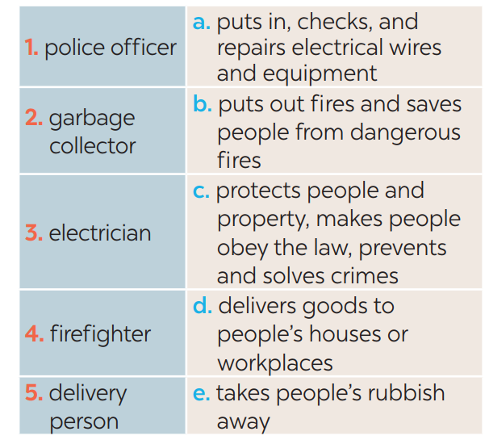
PRACTICE
1
Match the community helpers with their responsibilities.
1. c
2. e
3. a
4. b
5. d

Slide 9
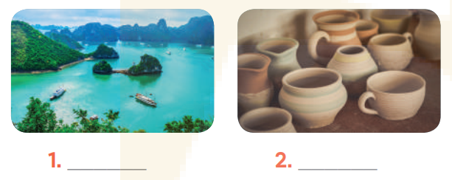
PRACTICE
2
Write a word or phrase in the box under the correct picture.
tourist attraction
pottery

Slide 10
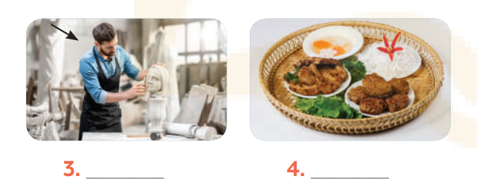
PRACTICE
2
Write a word or phrase in the box under the correct picture.
artisan
speciality

Slide 11
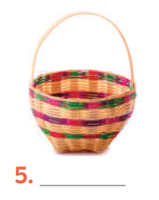
PRACTICE
2
Write a word or phrase in the box under the correct picture.
handicraft

Slide 12
PRACTICE
3
Fill in each blank with a word or phrase from the box.
artisans
1. Skilled local ____________ made these beautiful flower vases.
2. The electrical wires in our neighbourhood broke down yesterday, so we had to call a(n) ______________.
3. Bun cha, pho, and hu tieu are examples of famous Vietnamese ________________.
4. The _________________ in our street usually comes at 6 p.m. to take the rubbish away.
5. Tourists to Hoi An usually buy traditional ______________ such as lanterns as souvenirs.
electrician
speciality food
garbage collector
handicrafts

Slide 13
PRONUNCIATION
4
Listen and number the words you hear. Then listen again and repeat.
______ pack ______ park
______ kettle ______ cattle
______ marry ______ merry
______ chart ______ chat
3.
5.
7.
4.
8.
2.
1.
6.

Slide 14
PRONUNCIATION
5
Listen and practise the sentences. Underline the bold words with /æ/, circle the bold words with /ɑ:/, and tick the bold words with /e/.
1. Thanks to garbage collectors, our streets are clean.
2. My grandmother is a well-known artist.
3. That bakery makes the best bread in our neighbourhood.
4. Do you know where to buy bamboo beds?
5. We sometimes go to the park to relax.
√
√

Slide 15

CONSOLIDATION
1
Wrap-up
What have we learnt in this lesson?
Use the lexical items related to the topic Local community;
Pronounce the vowel sounds /æ/, /ɑ:/, and /e/ in words and sentences correctly;

Slide 16

CONSOLIDATION
2
Homework
- Do exercises in the Workbook.

Slide 17
Website: hoclieu.vn
Fanpage: facebook.com/www.tienganhglobalsuccess.vn/

