Slide 2
REVIEW
1
UNITS 1 – 2 – 3
LESSON 2: SKILLS
1

Slide 3
LESSON 2: SKILLS
LESSON 1: GETTING STARTED
Board Race
WARM-UP
READING
Task 1: Read parts of the notices about different workshops for teens. Tick the appropriate box(es) to show which workshop has the following features.
Task 2: Work in groups. Discuss with your partners to decide what kind of workshop you would like to have at your school. Use the following questions as cues. Take notes of your answers and report them to the class.
SPEAKING
LISTENING
Task 3: Listen to Demi, a student from the Netherlands, talking about her life in the city and in the countryside. Fill in each blank with no more than TWO words.
WRITING
Task 4: Write a paragraph (about 100 words) about three things that make you proud of your community. You may use the following questions as cues.
CONSOLIDATION
Wrap-up
Homework

Slide 4
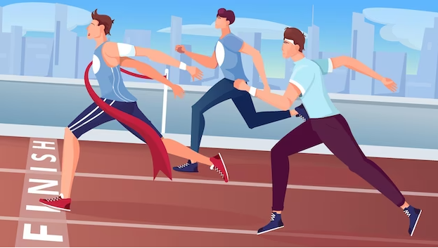
WARM-UP
BOARD RACE
- Work in teams.
- One students from each team comes to the board.
- Teacher asks a question.
- The first person to write the correct answer on the board wins a point for their team. (The students at the board only get one try.)
- If they all miss the question, teacher takes the answer from the first person in the audience who raises their hand.

Slide 5
WARM-UP
a person who has the type of job that needs a high level of education and training
PROFESSIONAL
Notes:
- professional (n): a person who has the type of job that needs a high level of education and training
- workshop (n): a period of discussion and practical work on a particular subject, in which a group of people share their knowledge and experience
- template (n) something that is used as a pattern for producing other similar things
- priority (n) something that is very important and must be dealt with before other things
- feedback (n) information or statements of opinion about something, such as a new product, that can tell you if it is successful or liked

Slide 6
WARM-UP
a period of discussion and practical work on a particular subject, in which a group of people share their knowledge and experience
WORKSHOP

Slide 7
WARM-UP
something that is used as a pattern for producing other similar things
TEMPLATE
Notes:
- professional (n): a person who has the type of job that needs a high level of education and training
- workshop (n): a period of discussion and practical work on a particular subject, in which a group of people share their knowledge and experience
- template (n) something that is used as a pattern for producing other similar things
- priority (n) something that is very important and must be dealt with before other things
- feedback (n) information or statements of opinion about something, such as a new product, that can tell you if it is successful or liked

Slide 8
WARM-UP
something that is very important and must be dealt with before other things
PRIORITY
Notes:
- professional (n): a person who has the type of job that needs a high level of education and training
- workshop (n): a period of discussion and practical work on a particular subject, in which a group of people share their knowledge and experience
- template (n) something that is used as a pattern for producing other similar things
- priority (n) something that is very important and must be dealt with before other things
- feedback (n) information or statements of opinion about something, such as a new product, that can tell you if it is successful or liked

Slide 9
WARM-UP
information or statements of opinion about something, such as a new product, that can tell you if it is successful or liked
FEEDBACK
Notes:
- professional (n): a person who has the type of job that needs a high level of education and training
- workshop (n): a period of discussion and practical work on a particular subject, in which a group of people share their knowledge and experience
- template (n) something that is used as a pattern for producing other similar things
- priority (n) something that is very important and must be dealt with before other things
- feedback (n) information or statements of opinion about something, such as a new product, that can tell you if it is successful or liked

Slide 10
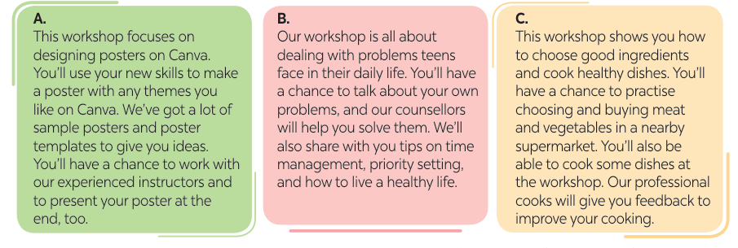
READING
1
Read parts of the notices about different workshops for teens. Tick the appropriate box(es) to show which workshop has the following features.
Notes:
A
C
D
C
B

Slide 11
READING
1
Read parts of the notices about different workshops for teens. Tick the appropriate box(es) to show which workshop has the following features.
 | A | B | C
1. Teens will practise doing things, using the new skills.
2. Teens can work with professional people.
3. It deals with teens’ daily problems.
4. Teens can improve their skills based on the feedback from professionals.
5. Teens will present their product.
Notes:
A
C
D
C
B

Slide 12
SPEAKING
2
Work in groups. Discuss with your partners to decide what kind of
workshop you would like to have at your school. Use the following questions as cues. Take notes of your answers and report them to the class.
1. What kind of workshop would you like to have at your school? Why?
2. What can students do at the workshop?
3. What can they learn from the workshop?
4. Who do you think should be invited to lead the workshop?

Slide 13
SPEAKING
2
Suggested answer:
We would like to have a DIY workshop at our school because we want to know how to make new things from used items such as plastic bottles or old clothes. At the workshop, we can practise making useful things from these items. By doing this, we can learn about the green lifestyle and ways to save our environment. We think we should invite Ms Mai Huong, our form teacher, to lead the workshop because she knows many creative ways to reuse old things.

Slide 14
LISTENING
3
Listen to Demi, a student from the Netherlands, talking about her life in the city and in the countryside. Fill in each blank with no more than TWO words.
three years
1. Demi used to live in London for ________________ with her parents.
2. At weekends, they usually visited attractions and ________________.
3. Now Demi lives in one of the ______________________ villages in the world.
4. In the village, people only _______________, walk, or cycle.
5. Her favourite place of interest is the ________________.
famous parks
most beautiful
sail round
museum
Notes:
three years
famous parks
most beautiful
sail round
museum

Slide 15
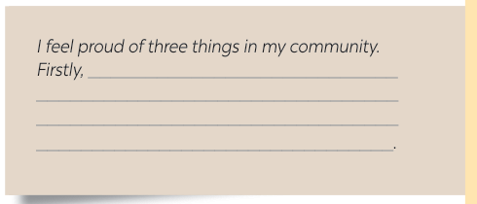
WRITING
4
Write a paragraph (about 100 words) about three things that make you
proud of your community. You may use the following questions as cues.
1. What are the three things that make you proud of your community?
2. Why does each of them make you feel proud?

Slide 16
WRITING
4
Write a paragraph (about 100 words) about three things that make you
proud of your community. You may use the following questions as cues.
Suggested answer:
I feel proud of three things in my community. Firstly, it is spacious. There are not many people living in my community, and the streets and roads are wide. Therefore, I do not feel confined here. Secondly, my community has enough facilities for its people. Near my house there are two small parks with sport facilities for people of all ages. Also, there are good schools, hospitals and supermarkets nearby. Thirdly, the people here are very friendly and helpful. Neighbours greet each other whenever they meet. They are also willing to help each other in difficult situations. In short, I am proud of and love living in my community.
Notes:
I feel proud of three things in my community. Firstly, the people here are very hospitable. They are always willing to help each other, which makes me happy to be part of such a caring community. Moreover, we have a number of good schools that focus on helping children learn and grow as education is essential for our future. However, what really stands out is how our residents preserve customs and traditions. We celebrate festivals together and being part of these celebrations fills me with joy and pride. In conclusion, the kindness of the people, the emphasis on education, and the vibrant traditions make Hanoi a wonderful community.

Slide 17
CONSOLIDATION
1
Wrap-up
What have we learnt in this lesson?
Read for specific information;
Ask and answer about kinds of workshops;
Listen for specific information;
Write a paragraph about three things that make them proud of their community.

Slide 18
CONSOLIDATION
2
Homework
Do the exercises in the workbook.

Slide 19
Website: hoclieu.vn
Fanpage: facebook.com/www.tienganhglobalsuccess.vn/

