Slide 2
REVIEW
1
UNITS 1 – 2 – 3
LESSON 1: LANGUAGE
1

Slide 3
LESSON 1: LANGUAGE
LESSON 1: GETTING STARTED
WARM-UP
Keywords game
PRONUNCIATION
Task 1: Choose the word in which the underlined part is pronounced differently.
Task 2: Choose the correct answer A, B, C, or D to complete each sentence.
Task 3: Fill in each blank with the suitable form of the word given.
VOCABULARY
Task 4: Choose the correct answer A, B, C, or D to complete each sentence.
Task 5: Write the correct form of each verb in brackets.
GRAMMAR
CONSOLIDATION
Wrap-up
Homework

Slide 4
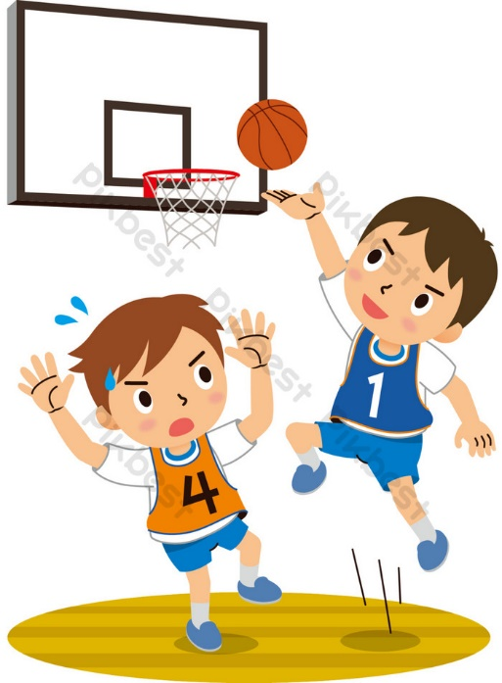
WARM-UP
SET 1
UNIT 3: HEALTHY LIVING FOR TEENS
Notes:
well-balanced life,
optimistic,
a good night's sleep

Slide 5
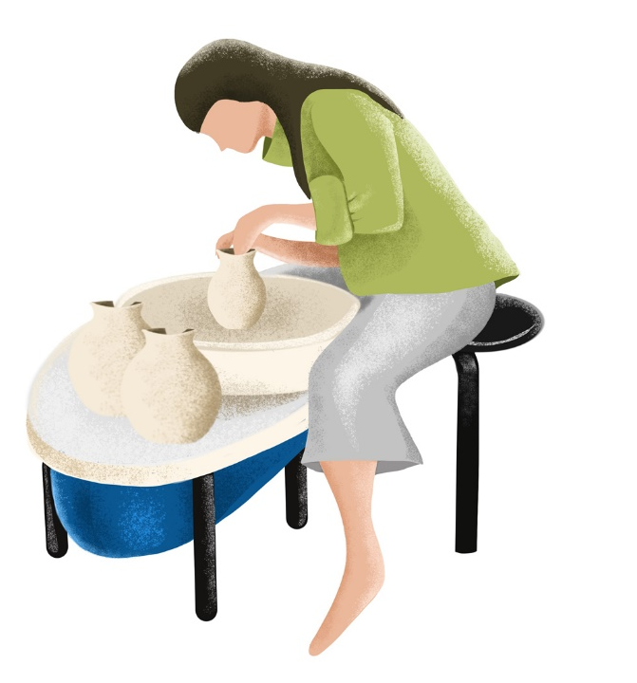
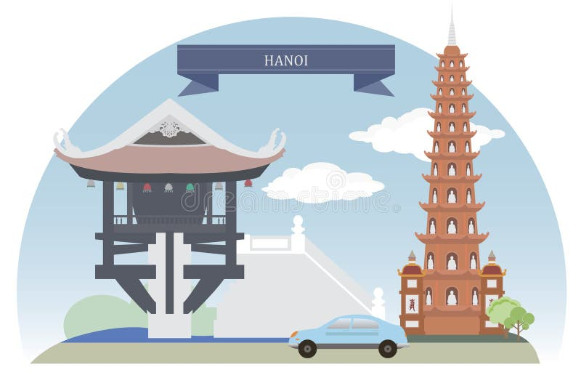
WARM-UP
SET 2
UNIT 1: LOCAL COMMUNITY
Notes:
Speciality/specialty
Artisan
Tourist attraction

Slide 6
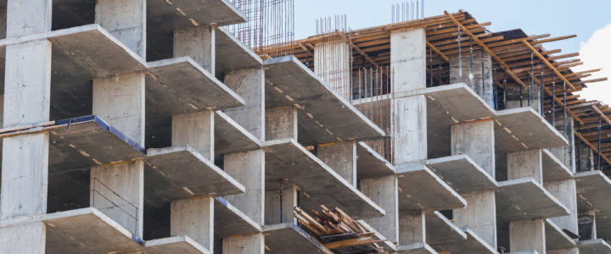
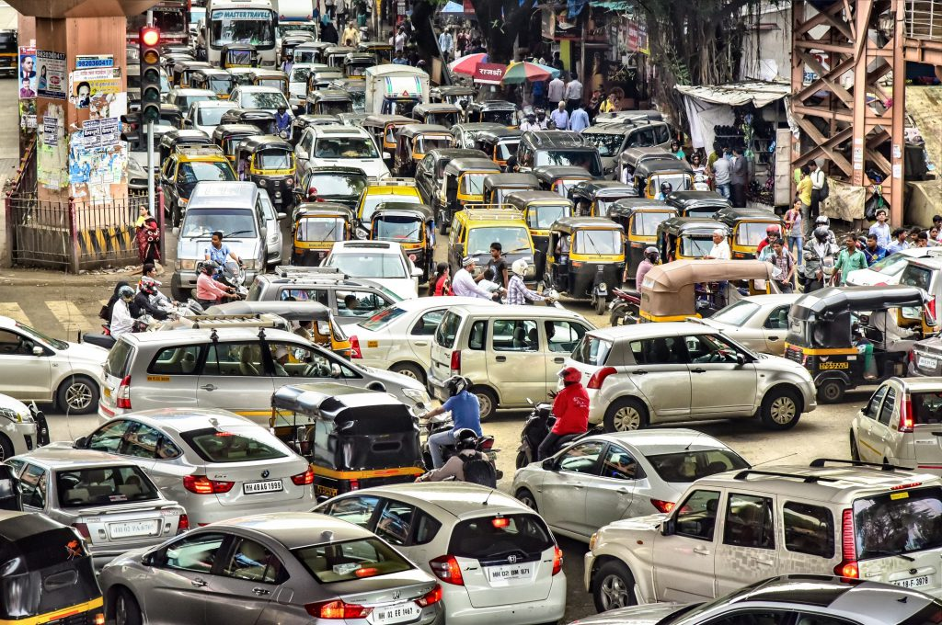
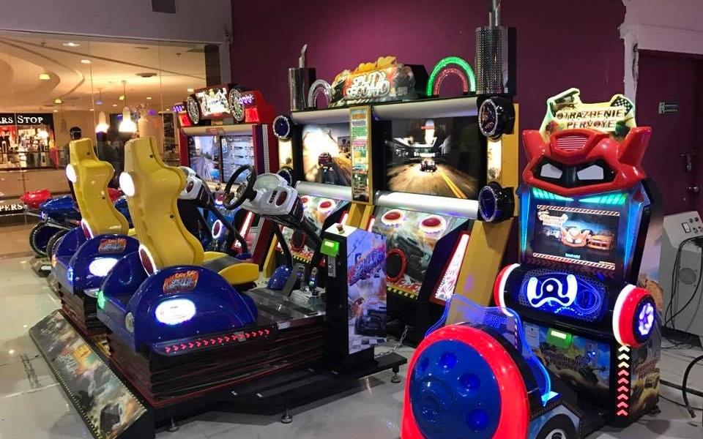
WARM-UP
SET 3
UNIT 2: CITY LIFE
Notes:
concrete jungle,
traffic congestion,
entertainment centre

Slide 7
PRONUNCIATION
1
Choose the word in which the underlined part is pronounced differently.
1. A. below B. down C. town D. nowadays
2. A. ahead B. handicraft C. honour D. hospital
3. A. meat B. read C. heater D. wear
4. A. head B. bread C. leave D. instead
5. A. carry B. garbage C. paragraph D. attraction
Notes:
A
C
D
C
B

Slide 8
VOCABULARY
2
Choose the correct answer A, B, C, or D to complete each sentence.
1. It’s necessary to decide which we should ______ priority to work or study.
A. make B. give
C. bring D. take
2. I don’t like living in this area because it is like a ______ with all these tall buildings.
A. concrete jungle C. concrete wood
B. tourist attraction D. green space
Notes:
Key: 1. B 2. A 3. C 4. B 5. D

Slide 9
VOCABULARY
2
Choose the correct answer A, B, C, or D to complete each sentence.
3. They were happy because their children ______ their goal of attending a famous university.
A. administered B. got C. accomplished D. ended
4. There is a sense of ______ in our neighbourhood; we care for and help each other.
A. humour B. community C. responsibility D. duty
5. My grandfather is a skilful ______; he can make unique vases.
A. maker B. worker C. employee D. artisan
Notes:
Key: 1. B 2. A 3. C 4. B 5. D

Slide 10
VOCABULARY
3
Fill in each blank with the suitable form of the word given.
speciality/specialty
1. Bun hen is a local _______________________ of this area, so you must try it. (special)
2. My brother is working as an ______________; he repairs electrical equipment very well. (electric)
3. She tried to ______________ my attention from the interesting film on TV. (distraction)
4. There is a ______________ site near our house, so it’s quite noisy. (construct)
5. My neighbourhood is not the best place, but it’s ______________. (live)
electrician
distract
construction
liveable
Notes:
1. speciality 2. electrician 3. distract 4. construction 5. liveable

Slide 11
GRAMMAR
4
Choose the correct answer A, B, C, or D to complete each sentence.
1. My sister and I are trying to ______ sweet food and soft drinks.
A. carry out B. cut down on
C. hand down D. come down with
2. When we visit a city, we usually ______ its downtown.
A. look after B. find out C. look around D. pass down
3. The ______ he gets, the ______ he becomes.
A. more old; more experienced B. older; experienced
C. more older; more experienced D. older; more experienced
Notes:
Key: 1. B 2. C 3. D 4. A 5. B

Slide 12
GRAMMAR
4
Choose the correct answer A, B, C, or D to complete each sentence.
4. The ______ my neighbourhood gets, the ______ I feel.
A. bigger; less secure B. bigger; fewer secure
C. more big; less secure D. more bigger; less secure
5. If you finish reading a book, you ______ put it back on the shelf. It’s necessary.
A. will B. should C. may D. can
Notes:
Key: 1. B 2. C 3. D 4. A 5. B

Slide 13
GRAMMAR
5
Write the correct form of each verb in brackets.
wants
1. If Lan (want) ________________ to focus on her homework, she should turn off the TV.
2. I don’t know who (ask) ________________ for advice about my future career.
3. If he (continue) ________________ making noise, he must leave immediately.
4. They are wondering what (buy) ________________ for their grandmother on her birthday.
5. We can make the air in the city cleaner if we (not use) ________________ our cars as much.
to ask
continues
to buy
don’t use
Notes:
1. wants 2. to ask 3. continues 4. to buy 5. don’t use

Slide 14
CONSOLIDATION
1
Wrap-up
What have we learnt in this lesson?
Review the vocabulary and grammar of Unit 1, 2, 3.

Slide 15
CONSOLIDATION
2
Homework
Do the exercises in the workbook.

Slide 16
Website: hoclieu.vn
Fanpage: facebook.com/www.tienganhglobalsuccess.vn/

