Slide 2
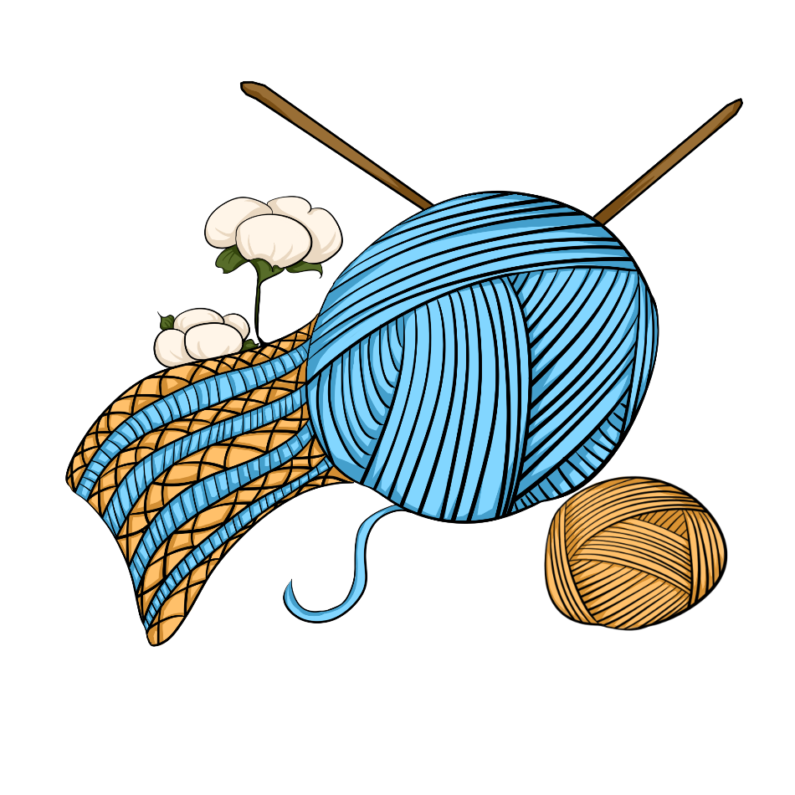
Unit
6
LIFESTYLES
LESSON 2: A CLOSER LOOK 1
1

Slide 3
LESSON 2: A CLOSER LOOK 1
WARM-UP
Matching game (Task 1)
Vocabulary
Task 2: ﻿Complete the sentences with the words and phrases from the box.
Task 3: ﻿Choose the correct answer A, B, or C to complete each sentence.
VOCABULARY
Task 4: ﻿Listen and repeat the words.
Task 5: ﻿Listen and practise the sentences. Underline the words with the sound /br/ and circle the words with the sound /pr/.
PRONUNCIATION
CONSOLIDATION
Wrap-up
Homework

Slide 4
WARM-UP
Match the words to the suitable pictures
DOGSLED
MAKE CRAFTS
MATCHING
GAME
NATIVE ART
WEAVE
TRIBAL DANCE

Slide 5
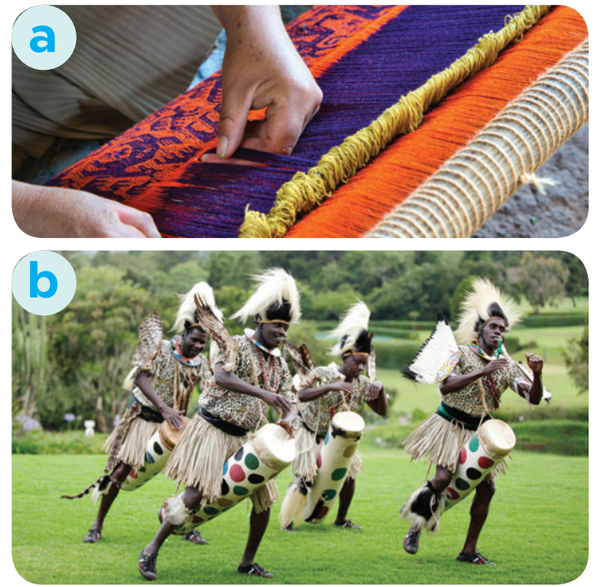
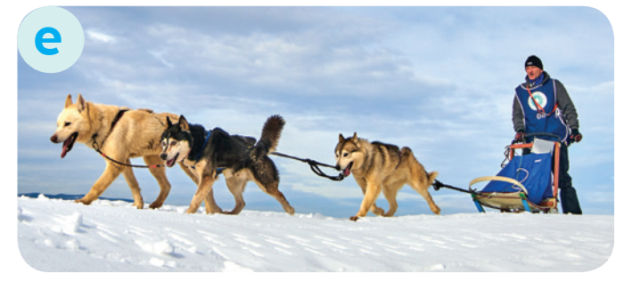
WARM-UP
dogsled
make crafts
native art
weave
tribal dance

Slide 6
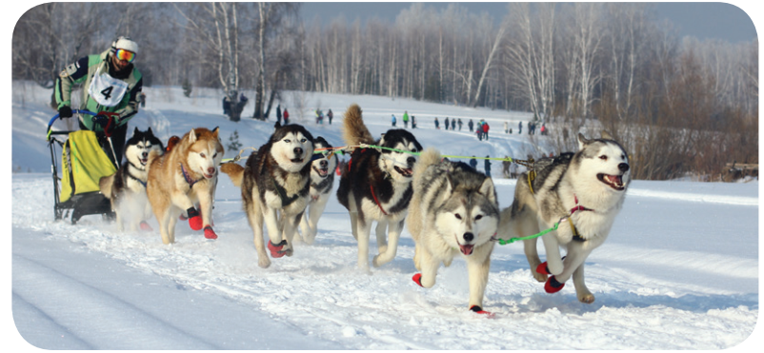
VOCABULARY
dogsled (n)
/ˈdɒɡsled/
a sledge pulled by dogs

Slide 7
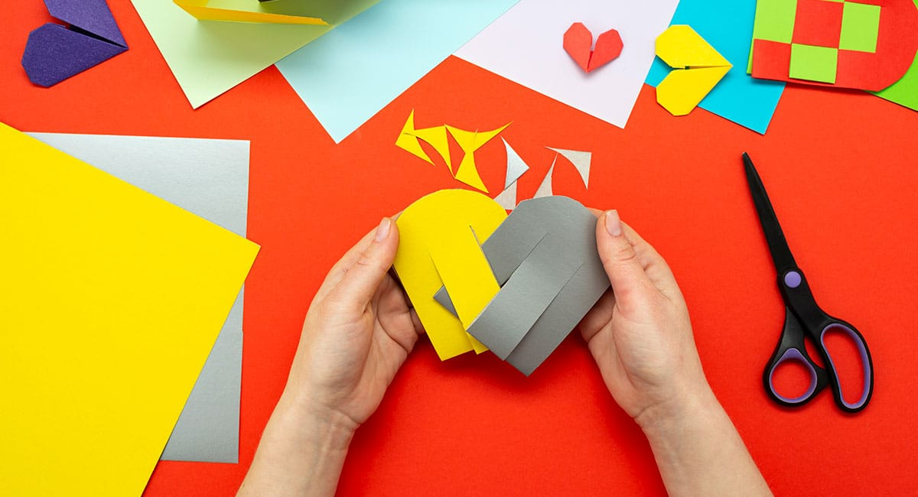
VOCABULARY
﻿make crafts (v)
/meɪk krɑːft/
make things with your hands in a skilled way

Slide 8
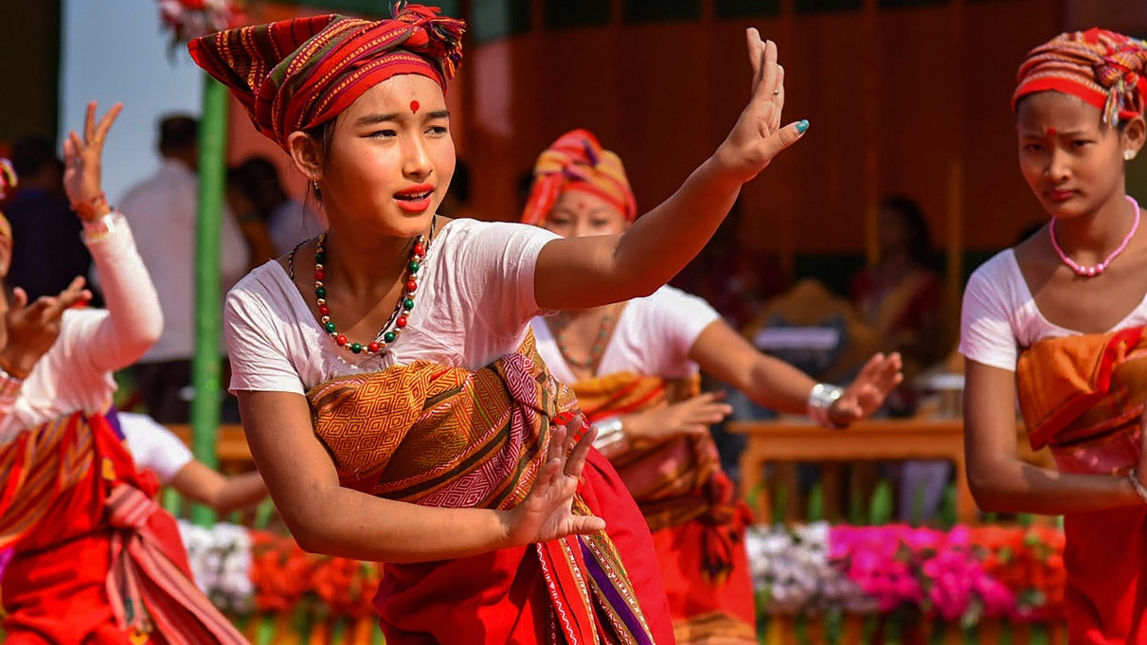
VOCABULARY
﻿tribal dance (n)
/ˈtraɪbl dɑːns/
a dance performed by tribal people based on their customs and beliefs

Slide 9
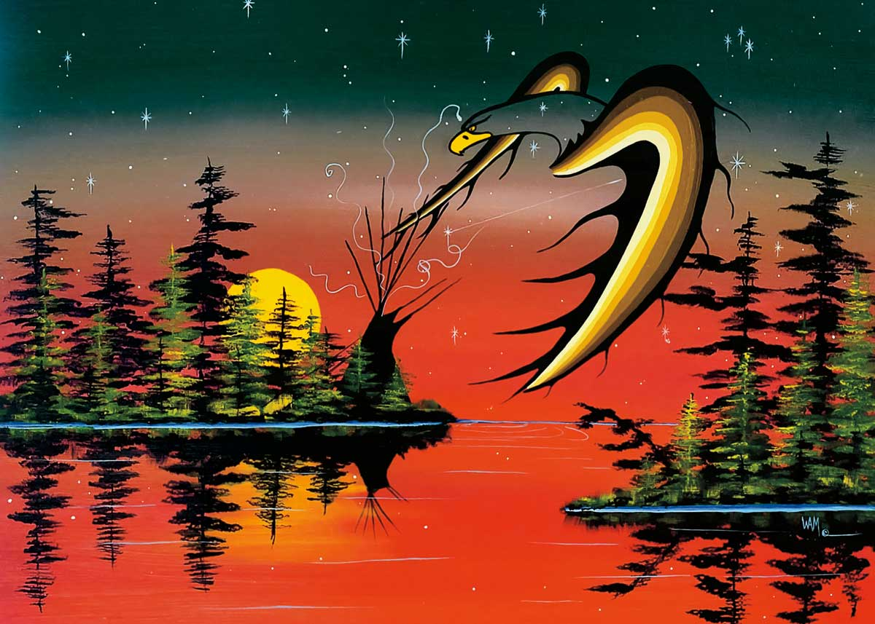
VOCABULARY
﻿native art (n)
/ˈneɪtɪv ɑːt/
the artwork created by the original native people

Slide 10
VOCABULARY
New words | Pronunciation | Meaning
1. dogsled (n) | ﻿/ˈdɒɡsled/ | ﻿xe trượt tuyết chó kéo
2. ﻿make crafts (v) | ﻿/meɪk krɑːft/ | ﻿làm đồ thủ công
3. tribal dance (n) | ﻿/ˈtraɪbl dɑːns/ | ﻿điệu nhảy của bộ tộc, bộ lạc
4. native art (n) | /ˈneɪtɪv ɑːt/ | tác phẩm nghệ thuật bản địa

Slide 11
VOCABULARY
2
Complete the sentences with the words and phrases from the box.
tribal dances
weaving
dogsled
making crafts
native art
﻿1. The traditional craft of the villagers is _________ bamboo baskets.
2. We all joined in the ______________ when we attended the local festival.
3. The gallery in the city centre has an excellent collection of ___________.
4. Hoa is very keen on _____________. She loves to knit gloves after school.
5. The _________ is still used as a means of transport in Alaska today.

Slide 12
VOCABULARY
3
﻿Choose the correct answer A, B, or C to complete each sentence.
1. The tribal women know how to ______ these threads into beautiful clothes.
A. weave B. make C. cut
2. She comes from Korea, so her ______ language is Korean.
A. modern B. native C. practical
3. Sticking out one’s tongue was a way of greeting in ______ Tibetan culture.
A. traditional B. leisurely C. simple

Slide 13
VOCABULARY
3
﻿Choose the correct answer A, B, or C to complete each sentence.
4. How do people ______ New Years in your country, Jack?
A. practise B. keep C. celebrate
5. We like that restaurant: it ______ very delicious food.
A. practises B. serves C. buys

Slide 14
PRONUNCIATION
4
Listen and repeat the words. Pay attention to the sounds /br/ and /pr/.
/br/ | /pr/
﻿bridge broccoli breakfast algebra celebrate | present practise precious programme express
Notes:
Youtube pronunciation video link: https://www.youtube.com/watch?v=oWgAfkyvZHc&list=PL8_ETpRL2xNZS5A2pZ5LE7Vbrk1jzDA6k&index=7

Slide 15
PRONUNCIATION
5
Listen and practise the sentences. Underline the words with the sound /br/ and circle the words with the sound /pr/.
﻿1. My brother says online learning improves our IT skills.
2. Santa Claus brings a lot of presents to children.
3. She briefly introduced the new programme.
4. He spent a lot of time preparing for his algebra test.
5. My mum prays at the temple before breakfast on Sundays.

Slide 16
CONSOLIDATION
1
Wrap-up
What have we learnt in this lesson?
Vocabulary: The lexical items related to Lifestyles
Pronunciation: How to correctly pronounce words that contain the sounds: /br/ and /pr/

Slide 17
CONSOLIDATION
2
Homework
Do exercises in the Workbook.

Slide 18
Website: hoclieu.vn
Fanpage: facebook.com/www.tienganhglobalsuccess.vn/

