Slide 1


Slide 2



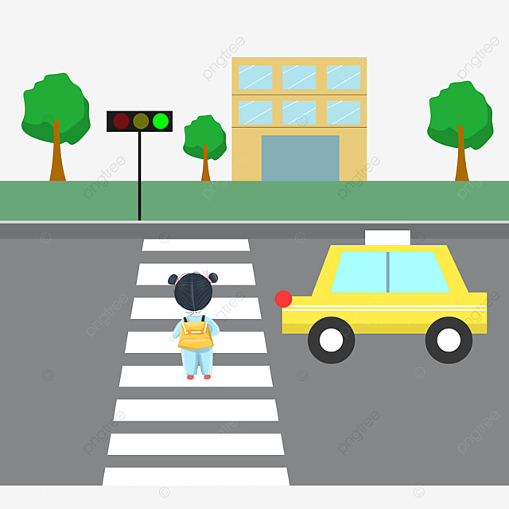
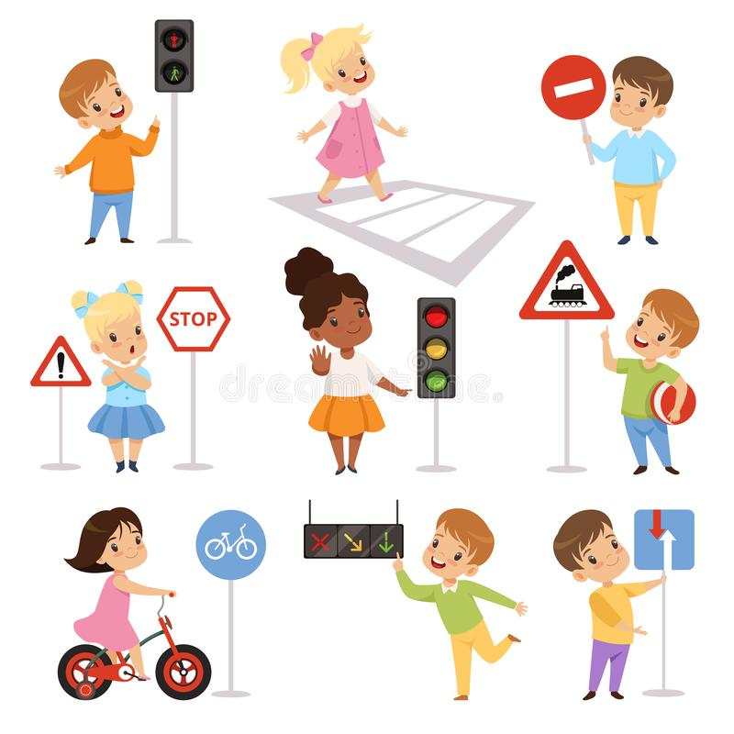
Unit
7
TRAFFIC
LESSON 5: SKILLS 1
Unit
ROAD SAFETY
HOW TO AVOID TRAFFIC ACCIDENTS
READING
SPEAKING

Slide 3

OBJECTIVES
By the end of the lesson, students will be able to:
+ Reading: read for specific information about some road safety rules
+ Speaking: talk about how to avoid traffic accidents

Slide 4
LESSON 5: SKILLS 1
WARM-UP
Game: Hangman
* Vocabulary
Task 1: Look at the picture. Can you see anything that is dangerous?
Task 2: Read the following text and choose the correct answer.
Task 3: Read the text again and answer the questions.
READING
Task 4: Work in groups. Ask and answer the question. Make a list.
Task 5: Read the sentences. Discuss who is being safe, and who isn’t.
Task 6: Give advice on dangerous situations on the road.
SPEAKING
CONSOLIDATION
Wrap-up
Homework

Slide 5


LESSON 5: SKILLS 1
WARM-UP
Game: Hangman
Aims of the stage:
To introduce the topic of reading

Slide 6
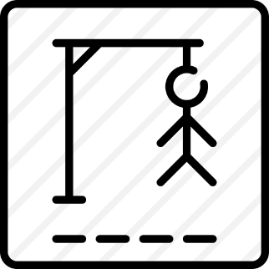
WARM-UP
D A N G E R O U S

Slide 7
LESSON 5: SKILLS 1
WARM-UP
Game: Hangman
* Vocabulary
Task 1: Look at the picture. Can you see anything that is dangerous?
Task 2: Read the following text and choose the correct answer.
Task 3: Read the text again and answer the questions.
READING

Slide 8
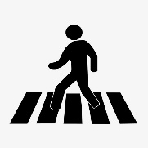
VOCABULARY
pedestrian (n)
/pəˈdestriən/
người đi bộ

Slide 9
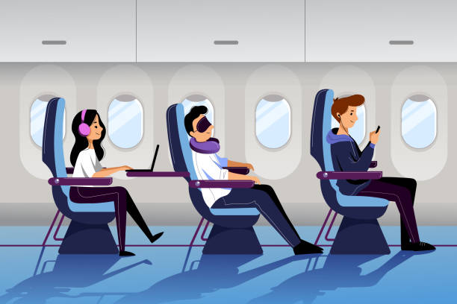
VOCABULARY
passenger (n)
/ˈpæsɪndʒə(r)/
hành khách

Slide 10
VOCABULARY
obey (v)
/əˈbeɪ/
tuân thủ

Slide 11
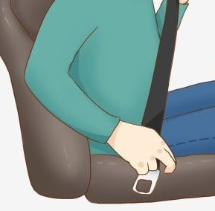
VOCABULARY
seatbelt (n)
/ˈsiːtbelt/
dây an toàn

Slide 12
VOCABULARY
New words | Pronunciation | Meaning
pedestrian (n) | /pəˈdestriən/ | người đi bộ
passenger (n) | /ˈpæsɪndʒə(r)/ | hành khách
obey (v) | /əˈbeɪ/ | tuân thủ
seatbelt (n) | /ˈsiːtbelt/ | dây an toàn

Slide 13

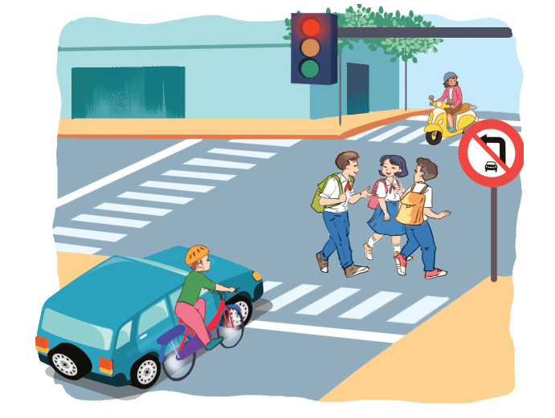
READING
1
Look at the pictures and discuss the question.
Can you see anything that is dangerous?

Slide 14
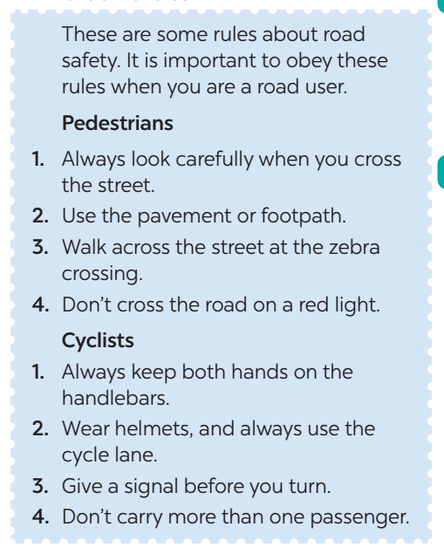
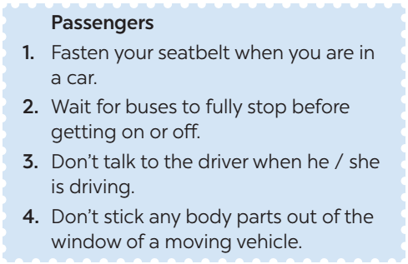
READING
2
Read the following text and choose the correct answer.
This text is about ______.
A. rules for pedestrians
B. traffic lights
C. traffic rules

Slide 15
READING
3
Read the text again and answer the questions
1. Where should pedestrians cross the street?
________________________________________________
2. Which lane should you use when riding a bike?
________________________________________________
3. What should you do before you turn while riding a bike?
________________________________________________
4. What must you do when you get on or off a bus?
________________________________________________
5. What mustn’t you do when you are in a moving vehicle?
________________________________________________
They shoud cross the street at the zebra crossing.
We should use the cycle lane.
We should give a signal.
We must wait for buses to fully stop before getting on or off.
We mustn’t stick any body parts out of the window.

Slide 16
LESSON 5: SKILLS 1
WARM-UP
Game: Hangman
* Vocabulary
Task 1: Look at the picture. Can you see anything that is dangerous?
Task 2: Read the following text and choose the correct answer.
Task 3: Read the text again and answer the questions.
READING
Task 4: Work in groups. Ask and answer the question. Make a list.
Task 5: Read the sentences. Discuss who is being safe, and who isn’t.
Task 6: Give advice on dangerous situations on the road.
SPEAKING

Slide 17
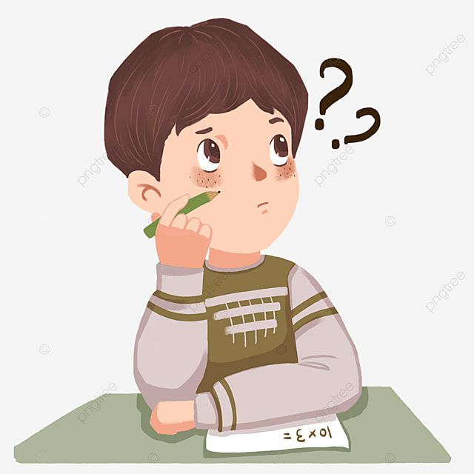
SPEAKING
4
Work in groups. Ask and answer the following question.
When you are a road user, what should you NOT do? Make a list.

Slide 18



SPEAKING
5
Read the following sentences about these people.
Then work in groups. Discuss who is being safe, and who isn’t.
1. Hoang is riding a bike, and he is wearing a helmet.
2. It is raining hard, but Mr Long is driving quickly.
3. The students are standing in a line to get on the school bus.
4. Mr Binh is taking his daughter to school on his motorbike. She is sitting in front of him.
5. Michelle is cycling to school and she is waving and shouting to her friends.
6
Give advice on dangerous situations on the road.

Slide 19
LESSON 5: SKILLS 1
WARM-UP
Game: Hangman
* Vocabulary
Task 1: Look at the picture. Can you see anything that is dangerous?
Task 2: Read the following text and choose the correct answer.
Task 3: Read the text again and answer the questions.
READING
Task 4: Work in groups. Ask and answer the question. Make a list.
Task 5: Read the sentences. Discuss who is being safe, and who isn’t.
Task 6: Give advice on dangerous situations on the road.
SPEAKING
CONSOLIDATION
Wrap-up
Homework

Slide 20

CONSOLIDATION
1
WRAP-UP
READING
SPEAKING

Slide 21

CONSOLIDATION
2
HOMEWORK
Do exercises in the workbook.
Prepare for the next lesson: Skills 2

Slide 22

Website: hoclieu.vn
Fanpage: facebook.com/www.tienganhglobalsuccess.vn/

