Slide 2
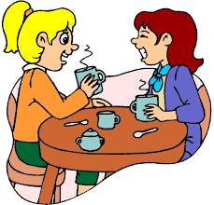
Unit
4
MUSIC AND ARTS
LESSON 4: COMMUNICATION
Unit
HOBBIES

Slide 3
OBJECTIVES
By the end of the lesson, students will be able to:
learn how to deal with some ways of expressing preferences
practise using some grammar points and vocabulary related to the topic

Slide 4
LESSON 4: COMMUNICATION
WARM-UP
Game: Pelmanism
Expressing preferences
Task 1: Listen and read the dialogue, paying attention to the highlighted parts.
Task 2: Work in pair. Ask and answer about your preferences.
EVERYDAY ENGLISH
Task 3: Choose the correct answer to each question.
Task 4: Read and underline the words related to the topic of arts and music.
Task 5: Talk about how you learn music and arts. Compare Susie’s school with your school.
MUSIC AND ARTS IN SCHOOL
CONSOLIDATION
Wrap-up
Homework

Slide 5
LESSON 4: COMMUNICATION
WARM-UP
Game: Pelmanism
Aims of the stage:
To revise the old lesson and introduce the new lesson

Slide 6
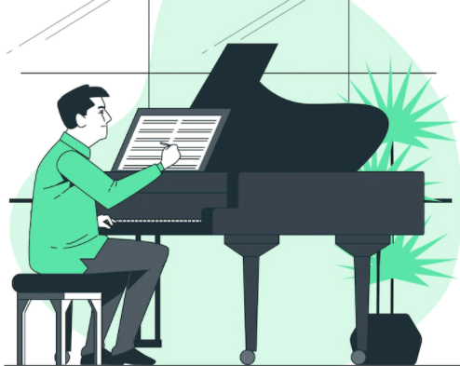
WARM-UP
art gallery
concert hall
actress
portrait
composer
landscape
painter
puppet theatre

Slide 7
LESSON 4: COMMUNICATION
WARM-UP
Game: Pelmanism
Expressing preferences
Task 1: Listen and read the dialogue, paying attention to the highlighted parts.
Task 2: Work in pair. Ask and answer about your preferences.
EVERYDAY ENGLISH
Aims of the stage:
to introduce two ways of expressing preferences

Slide 8
EVERYDAY ENGLISH
1
Listen and read the conversations. Pay attention to the highlighted sentences.
Nick: Which do you prefer, pop or folk music?
Nam: I prefer folk music. It has a better beat.
Nick: And which do you like better, modern art or folk art?
Nam: I like modern art better.

Slide 9
EVERYDAY ENGLISH
- Prefer sth
- Like sth better
I prefer folk music.
I like modern art better.

Slide 10
EVERYDAY ENGLISH
2
Work in pairs. Make similar conversations.

Slide 11
EVERYDAY ENGLISH
2
Work in pairs. Make similar conversations.

Slide 12
LESSON 4: COMMUNICATION
WARM-UP
Game: Pelmanism
Expressing preferences
Task 1: Listen and read the dialogue, paying attention to the highlighted parts.
Task 2: Work in pair. Ask and answer about your preferences.
EVERYDAY ENGLISH
Task 3: Choose the correct answer to each question.
Task 4: Read and underline the words related to the topic of arts and music.
Task 5: Talk about how you learn music and arts. Compare Susie’s school with your school.
MUSIC AND ARTS IN SCHOOL

Slide 13
MUSIC AND ARTS IN SCHOOL
Aims of the stage:
to help Ss recall or get to know some information about famous people in the field of music and arts, and some common forms of arts
to help students talk about how Ss in Viet Nam study music and arts
to help them compare their school and schools in other countries

Slide 14
MUSIC AND ARTS IN SCHOOL
3
Choose the correct answer to each question.
Who is the composer of Viet Nam’s national anther “Tien Quan Ca”?
Pham Tuyen B. Van Cao C. An Thuyen
2. Where in Viet Nam did water puppetry originate?
In the North B. In the central region C. In the South
3. What is Bac Ninh famous for?
Quan Ho singing B. Vi Dam singing C. Cai Luong opera
4. Mozart is one of the world’s greatest ______ .
A. singers B. composers C. poets

Slide 15
MUSIC AND ARTS IN SCHOOL
4
Read and underline the words related to the topic of arts and music.
Hi. My name is Susie. I’m from Australia. I’m in grade 7. My school teaches arts and music to all the students. Some forms of art such as painting, or drama are optional: you can choose to learn them if you like. Music and dancing are compulsory: all of us must study them every week. The school even has a choir, and they perform every month. There are also different art clubs, and you can join any of them.

Slide 16
FUTHER PRACTICE
5
Work in groups. Talk about how you learn music and arts. Compare Susie’s school with your school.

Slide 17
LESSON 4: COMMUNICATION
WARM-UP
Game: Pelmanism
Expressing preferences
Task 1: Listen and read the dialogue, paying attention to the highlighted parts.
Task 2: Work in pair. Ask and answer about your preferences.
EVERYDAY ENGLISH
Task 3: Choose the correct answer to each question.
Task 4: Read and underline the words related to the topic of arts and music.
Task 5: Talk about how you learn music and arts. Compare Susie’s school with your school.
MUSIC AND ARTS IN SCHOOL
CONSOLIDATION
Wrap-up
Homework

Slide 18
CONSOLIDATION
1
WRAP-UP
In this lesson, we have:
learnt how to expressing preferences
practised using some grammar points and vocabulary related to the topic

Slide 19
CONSOLIDATION
2
HOMEWORK
Do exercises in the workbook.

Slide 20
Website: hoclieu.vn
Fanpage: facebook.com/www.tienganhglobalsuccess.vn/

