Slide 1


Slide 2



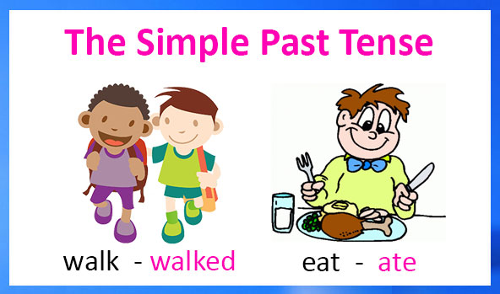
Unit
3
COMMUNITY SERVICE
LESSON 3: A CLOSER LOOK 2
Unit

Slide 3

OBJECTIVES
By the end of the lesson, students will be able to:
understand the use of the past simple tense
practise using the past simple tense in contexts

Slide 4
LESSON 3: A CLOSER LOOK 2
WARM-UP
Chatting
PRESENTATION
The past simple tense
Task 1: Circle the correct answer A, B, or C to complete each sentence.
Task 2: Complete the sentences the the past simple form of the given verbs.
Task 3: Complete the sentences with the correct forms of the verbs from the box.
Task 4: Write complete sentences from the prompts.
PRACTICE
PRODUCTION
Task 5: The Red Cross in 2016 and 2020
CONSOLIDATION
Wrap-up
Homework

Slide 5

LESSON 3: A CLOSER LOOK 2
WARM-UP
Chatting
Aims of the stage:
To activate activate students’ prior knowledge related to the targeted grammar: the past simple

Slide 6
WARM-UP
What did you do last weekend?
What did you watch yesterday?
Who did you meet two days ago?

Slide 7
LESSON 3: A CLOSER LOOK 2
WARM-UP
Chatting
PRESENTATION
The past simple tense

Slide 8
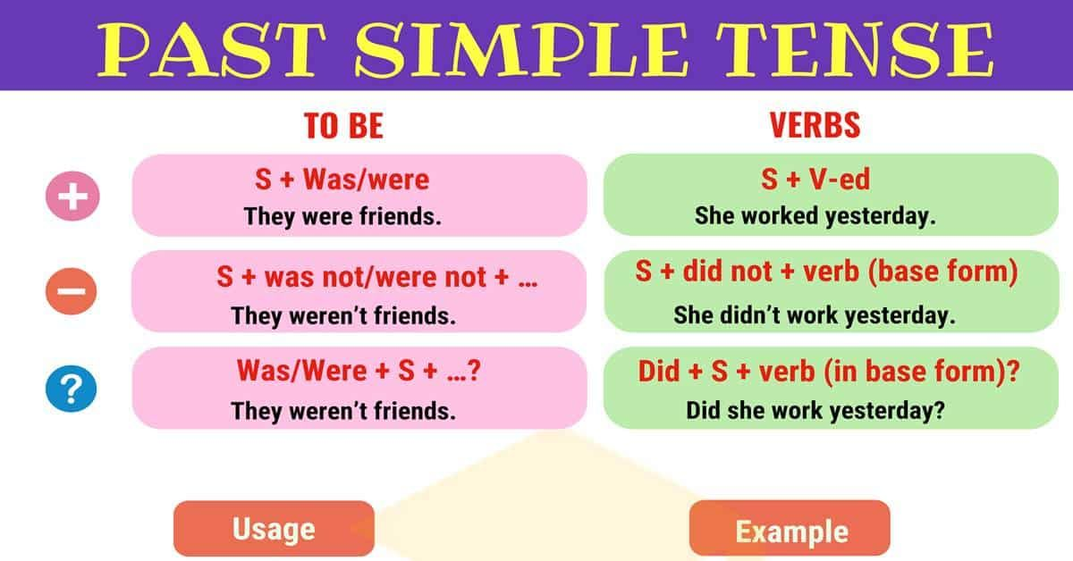
PRESENTATION

Slide 9
LESSON 3: A CLOSER LOOK 2
WARM-UP
Chatting
PRESENTATION
The past simple tense
Task 1: Circle the correct answer A, B, or C to complete each sentence.
Task 2: Complete the sentences the the past simple form of the given verbs.
Task 3: Complete the sentences with the correct forms of the verbs from the box.
Task 4: Write complete sentences from the prompts.
PRACTICE

Slide 10
PRACTICE
1
Circle the correct answer A, B, or C to complete each sentence.
1. Green School ______ vegetables for an orphanage last spring.
A. is growing B. grew C. grows
2. Children ______ plastic bottles for recycling a month ago.
A. are collecting B. collect C. collected
3. We ______ English to children in a primary school last summer.
A. are teaching B. taught C. teach

Slide 11
PRACTICE
1
Circle the correct answer A, B, or C to complete each sentence.
4. Our school club ______ gloves for old people in nursing homes last winter.
A. made B. is making C. make
5. We ______ bottles to help the environment last month.
A. are reusing B. reuse C. reused

Slide 12
PRACTICE
2
Complete the sentences the the past simple form of the given verbs.
took
1. Care for Animals (take) _______ care of thousands of homeless dogs and cats last year.
2. ___________ teenagers (join) ___________ Lending Hand in 2015?
3. We (help) ___________ the elderly in a village last summer.
4. Last year, we (send) ___________ textbooks to help children in a rural village.
5. Tom (volunteer) ______________ to teach English in our village last winter.
Did
join
helped
sent
volunteered

Slide 13
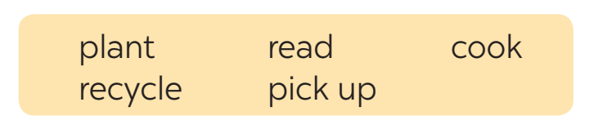
PRACTICE
3
Complete the sentences with the correct forms of the verbs from the box.
1. The club members _____________ food for patients every Sunday.
2. ________ you _____________ those trees in the playground last month?
3. Nick and his friends _________________ rubbish on the beach now.
4. Tom ______________ the plastic bottles, and now he has some nice vases.
5. We often ____________ books to old people in a nursing home.
cook
Did
plant
are picking up
recycled
read

Slide 14
PRACTICE
4
Write complete sentences from the prompts.
1. last year / our club / donate / books / children in rural areas.
_____________________________________________________
2. children / send / you thank-you cards / a week ago?
_____________________________________________________
3. I / teach / two children in grade 2 / last summer.
_____________________________________________________
4. Last spring / we / help / the elderly / nursing home.
_____________________________________________________
5. How / you / help / people / in flooded areas / last year?
_____________________________________________________
Last year, our club donated books to children in rural areas.
Did children send you thank-you cards a week ago?
I taught two children in grade 2 last summer.
Last spring, we helped the elderly in a nursing home.
How did you help the people in flooded areas last year?

Slide 15
LESSON 3: A CLOSER LOOK 2
WARM-UP
Chatting
PRESENTATION
The past simple tense
Task 1: Circle the correct answer A, B, or C to complete each sentence.
Task 2: Complete the sentences the the past simple form of the given verbs.
Task 3: Complete the sentences with the correct forms of the verbs from the box.
Task 4: Write complete sentences from the prompts.
PRACTICE
PRODUCTION
Task 5: The Red Cross in 2016 and 2020

Slide 16
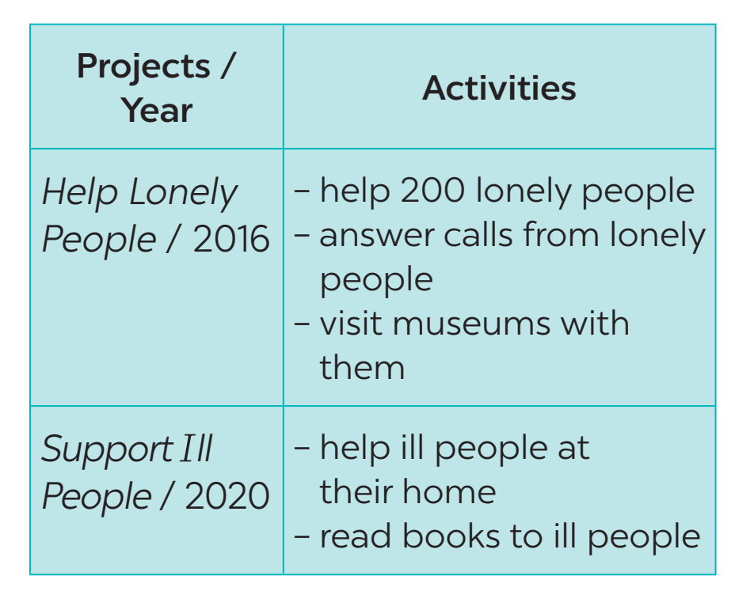
PRODUCTION
5
The Red Cross in 2016 and 2020
Tom is from the Red Cross. Look at the fact sheet and ask Tom about his projects in 2016 and 2020.
Example:
Tom: I’m from the Red Cross. I worked on the Help Lonely People project in 2016.
Lan: What did you do?
Tom: We helped 200 lonely people …

Slide 17
LESSON 3: A CLOSER LOOK 2
WARM-UP
Chatting
PRESENTATION
The Past Simple tense
Task 1: Circle the correct answer A, B, or C to complete each sentence.
Task 2: Complete the sentences the the past simple form of the given verbs.
Task 3: Complete the sentences with the correct forms of the verbs from the box.
Task 4: Write complete sentences from the prompts.
PRACTICE
PRODUCTION
Task 5: The Red Cross in 2016 and 2020.
CONSOLIDATION
Wrap-up
Homework

Slide 18
CONSOLIDATION
1
WRAP-UP

Slide 19

CONSOLIDATION
2
HOMEWORK
Complete exercises in the Workbook.

Slide 20

Website: hoclieu.vn
Fanpage: facebook.com/www.tienganhglobalsuccess.vn/

