Slide 2
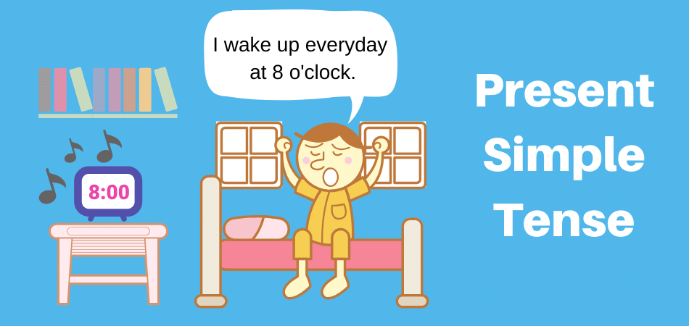
Unit
1
HOBBIES
LESSON 3: A CLOSER LOOK 2
Unit

Slide 3
OBJECTIVES
By the end of the lesson, students will be able to use the present simple tense.

Slide 4
LESSON 3: A CLOSER LOOK 2
WARM-UP
Guessing game
PRESENTATION
Grammar focus
Present simple tense: Review
Task 1: Match the sentences to the correct uses.
Task 2: Complete the sentences. use the present simple form of the verbs.
Task 3: Fill in each blank with the correct form of the verb in brackets.
Task 4: Write complete sentences, using the given words and phrases.
PRACTICE
PRODUCTION
Task 5: Game - Sentence race
CONSOLIDATION
Wrap-up
Homework

Slide 5
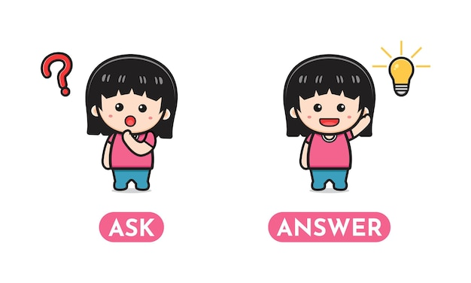
LESSON 3: A CLOSER LOOK 2
WARM-UP
Guessing game
Aims of the stage:
- to review some hobbies
- to increase Ss’ interest in hobbies
- to enhance Ss’ skills of cooperating with teammates

Slide 6
WARM-UP
Guess What the hobby is?
The team with the most points is the winner.
Example:
A: Water, grow, flowers, vegetable.
B: Is it gardening?
A: Yes, it is.

Slide 7
LESSON 3: A CLOSER LOOK 2
WARM-UP
Guessing game
PRESENTATION
Grammar focus
Present simple tense: Review

Slide 8
PRESENTATION
The present simple

Slide 9
PRESENTATION

Slide 10
LESSON 3: A CLOSER LOOK 2
WARM-UP
Guessing game
PRESENTATION
Grammar focus
Present simple tense: Review
Task 1: Match the sentences to the correct uses.
Task 2: Complete the sentences. use the present simple form of the verbs.
Task 3: Fill in each blank with the correct form of the verb in brackets.
Task 4: Write complete sentences, using the given words and phrases.
PRACTICE

Slide 11
PRACTICE
1
Match the sentences (1 – 5) to the correct uses (a – c).
b
a
c
a
b

Slide 12
PRACTICE
2
Complete the sentences. Use the present simple form of the verbs.
1. My brother and I (make) ________ a new model every month. 2. What _________ Lan (do) ________ in her free time? 3. I (have) _________ a drawing lesson every tuesday. 4. Mark (not like) ____________ doing judo. 5. _________ your English lesson (start) _________ at 6 p.m.?
make
does
do
have
doesn’t like
Does
start

Slide 13
PRACTICE
3
Fill in each blank with the correct form of the verb in brackets.
My family members have different hobbies. My dad (1. enjoy) _________ gardening. He (2. spend) __________ two hours in our garden every day. My mum and sister (3. not like) __________ gardening, but they love cooking. They (4. go) _______ to a cooking class every Sunday. Their lesson (5. begin) ________ at 9 a.m. I (6. not enjoy) _______________ cooking, and I cannot cook very well.
enjoys
spends
don’t like
go
begins
don’t enjoy

Slide 14
PRACTICE
4
Write complete sentences, using the given words and phrases. You may have to change the words or add some.
1. sun / set / in / west / every evening. __________________________________________________________ 2. Trang and Minh / play / basketball / every day / after school? __________________________________________________________ 3. flight / from / Ho Chi minh City / not arrive / 10:30. __________________________________________________________ 4. our science teacher / start / our lessons / 1 p.m. / on Fridays. __________________________________________________________ 5. you / make / model / at / weekend? __________________________________________________________
The sun sets in the west every evening.
Do Trang and Minh play basketball every day after school?
The flight from Ho Chi Minh City doesn’t arrive at 10:30.
Our science teacher starts our lessons at 1 p.m. on Fridays.
Do you make models at the weekend?

Slide 15
LESSON 3: A CLOSER LOOK 2
WARM-UP
Guessing game
PRESENTATION
Grammar focus
Present simple tense: Review
Task 1: Match the sentences to the correct uses.
Task 2: Complete the sentences. use the present simple form of the verbs.
Task 3: Fill in each blank with the correct form of the verb in brackets.
Task 4: Write complete sentences, using the given words and phrases.
PRACTICE
PRODUCTION
Task 5: Game - Sentence race

Slide 16
PRODUCTION
5
Game: Sentence Race

Slide 17
LESSON 3: A CLOSER LOOK 2
WARM-UP
Guessing game
Grammar focus
Present simple tense: Review
PRESENTATION
Task 1: Match the sentences (1 – 5) to the correct uses (a – c)
Task 2: Complete the sentences. use the present simple form of the verbs.
Task 3: Fill in each blank with the correct form of the verb in brackets.
Task 4: Write complete sentences, using the given words and phrases. You may have to change the words or add some.
PRACTICE
PRODUCTION
Task 5: Game - Sentence race
CONSOLIDATION
Wrap-up
Homework

Slide 18
CONSOLIDATION
1
WRAP-UP

Slide 19
CONSOLIDATION
2
HOMEWORK
Complete exercises in the Workbook.

Slide 20
Website: hoclieu.vn
Fanpage: facebook.com/www.tienganhglobalsuccess.vn/

