Slide 1
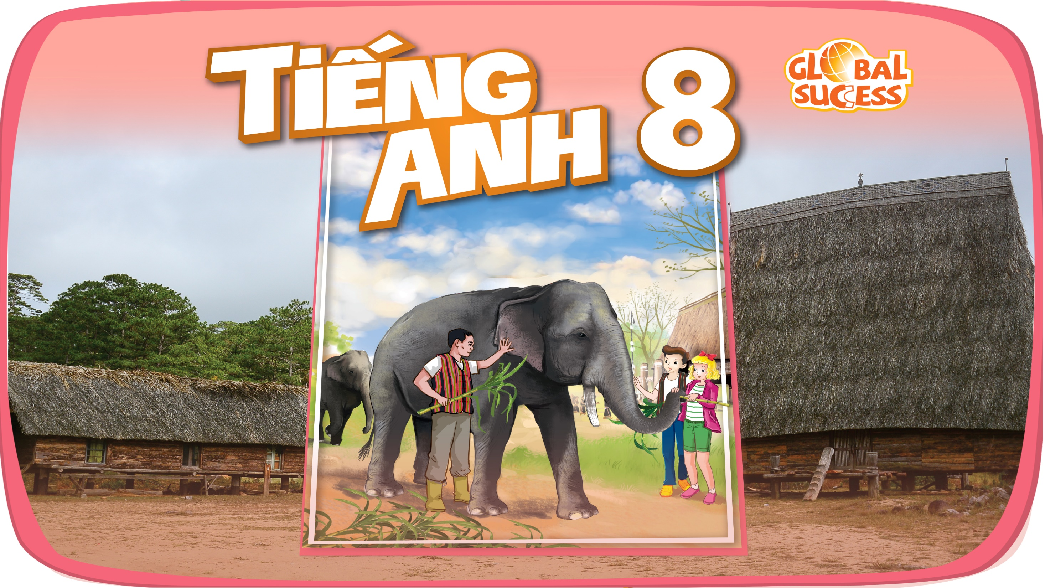

Slide 2

Unit
12
LIFE ON OTHER PLANETS
LESSON 4: COMMUNICATION
EVERYDAY ENGLISH
THREE PLANETS IN THE SOLAR SYSTEM
1

Slide 3
LESSON 3: A CLOSER LOOK 2
WARM-UP
Discussion
Task 1: Listen and read the conversations. Pay attention to the highlighted sentences.
Task 2: Work in pairs. Make similar conversations with the following situations.
EVERYDAY ENGLISH
Task 3: Read the information below and answer the questions that follow.
Task 4: Work in pairs. Discuss and match the three planets in 3 with the pictures (1 - 3) below.
Task 5: Work in groups. Take turns to talk about one of the three planets in 3.
THREE PLANETS IN THE SOLAR SYSTEM
CONSOLIDATION
Wrap-up
Homework

Slide 4
WARM-UP
Questions:
1. Do you think the Vietnamese football team may take part in the World Cup?
 I don’t know yet.
2. Do you think we can have anywhere-door in the future?
 I don’t think so.
→ If you aren’t sure about it, you can express uncertainty.

Slide 5

EVERYDAY ENGLISH
1
Listen and read the conversations. Pay attention to the highlighted sentences.
1.
Nick: Do you think Mars may support life?
Mark: I’m not sure about it. Scientists are trying to find life there.
2.
Mary: Do you think Ann will win tomorrow?
Tommy: I doubt it. She injured her arm in a match last week.

Slide 6
EVERYDAY ENGLISH
2
Work in pairs. Make similar conversations with the following situations.
1. You are not sure about the possibility of water on Mars.
A: Do you think Mars may have water?
B: I’m not sure about it. We haven’t seen water here yet.

Slide 7
EVERYDAY ENGLISH
2
Work in pairs. Make similar conversations with the following situations.
2. You doubt that one of your friends will get a good mark on the English test.
A: Do you think … will get good marks on the English test?
B: I doubt it. She/ he is lazy.

Slide 8
EVERYDAY ENGLISH
2
Work in pairs. Make similar conversations with the following situations.
3. You are not sure if the weather will be fine tomorrow.
A: Do you think the weather will be fine tomorrow?
B: It’s very unlikely. It’s raining today.

Slide 9
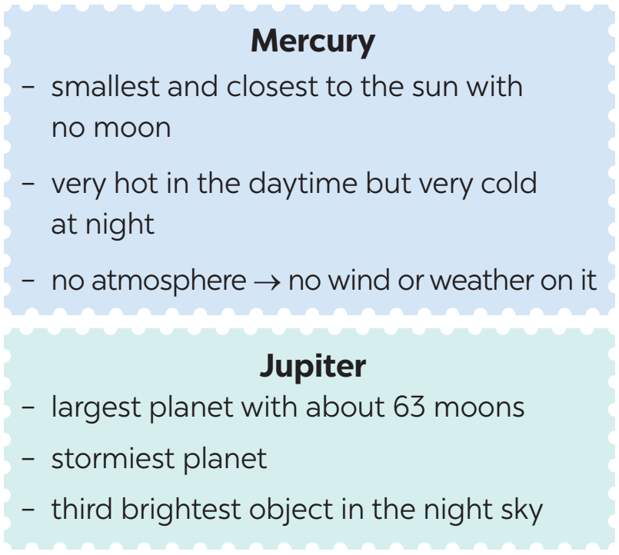
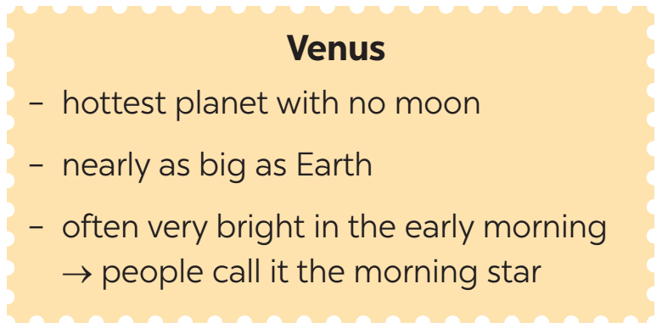
THREE PLANETS IN THE SOLAR SYSTEM
3
Read the information below and answer the questions that follow.

Slide 10
THREE PLANETS IN THE SOLAR SYSTEM
3
Read the information below and answer the questions that follow.
1. What planets have no moon?
2. What planet is similar in size to Earth?
3. What planet is the smallest and closest to the sun?
4. What planet is called the morning star?
5. What is the largest and stormiest planet?
Mercury and Venus.
Venus.
Mercury.
Venus.
Jupiter.

Slide 11
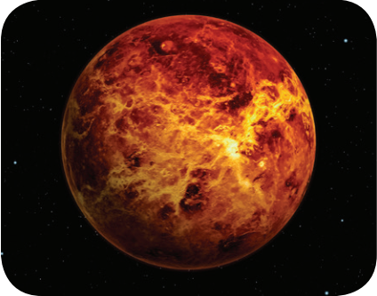
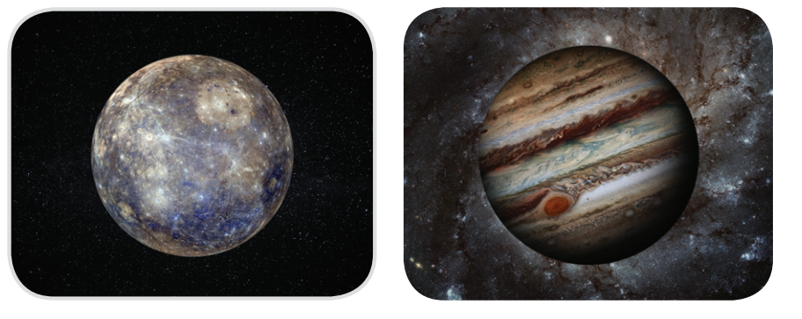
THREE PLANETS IN THE SOLAR SYSTEM
4
3
Work in pairs. Discuss and match the three planets in with the pictures (1 - 3) below.
Venus
Mercury
Jupiter
1. __________
2. __________
3. __________

Slide 12
THREE PLANETS IN THE SOLAR SYSTEM
5
3
Work in groups. Take turns to talk about one of the three planets in .
Example:
I would like to tell you about Mercury.
It is the smallest planet ...
You can begin with:
Today, I would like to tell you about …
In my talk, I’ll tell you about …
Today I’m going to talk about …
What I’d like to present to you today is …

Slide 13
THREE PLANETS IN THE SOLAR SYSTEM
5
3
Work in groups. Take turns to talk about one of the three planets in .
Suggested answers:
I would like to tell you about Mercury. It is the smallest planet. It is the closest planet to the sun, and it doesn’t have any moons. It is hot in the daytime but very cold at night. Mercury doesn’t have an atmosphere so there is no wind or weather.
In my talk I’ll tell you about Jupiter. It is the largest planet with about 63 moons. It is the stormiest planet. Jupiter is the third brightest object in the night sky.

Slide 14

CONSOLIDATION
1
Wrap-up
What have we learnt in this lesson?
Express uncertainty
Planets in the solar system

Slide 15

CONSOLIDATION
2
Homework
Do the exercises in workbook.

Slide 16

Website: hoclieu.vn
Fanpage: facebook.com/tienganhglobalsuccess.vn/

