Slide 2
Unit
12
LIFE ON OTHER PLANETS
LESSON 6: SKILLS 2
1
Unit
LISTENING
WRITING

Slide 3
LESSON 6: SKILLS 2
WARM-UP
Describe the aliens
Task 1: Look at the picture and answer the questions.
Task 2: Listen and choose the correct answer A, B, or C.
Task 3: Listen again and fill in each blank with ONE word or number that you hear.
LISTENING
WRITING
Task 4: Make notes about the aliens.
Task 5: Write a paragraph describing the aliens.
CONSOLIDATION
Wrap-up
Homework

Slide 4
WARM UP
Draw the picture in 3 minutes about the alien you like:
What does it look like?
Where does it live?

Slide 5
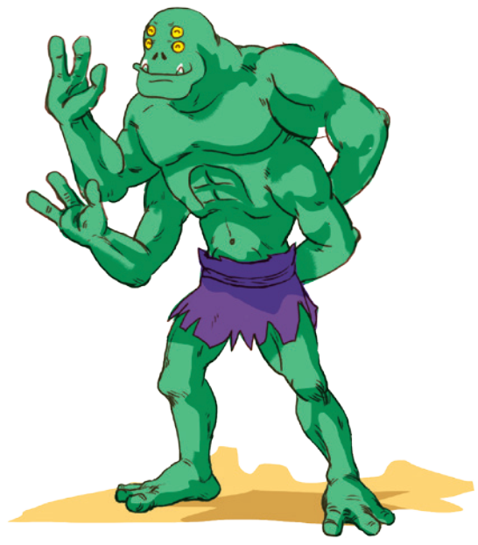
LISTENING
1
Work in pairs. Look at the picture and answer the following questions.
1. Where do you think this creature is from?
2. What do you think it can do?
It is from another planet/ Mars/ Venus…
It can jump. It can catch 4 fish at the same time with his hands. It can do handstand…

Slide 6
LISTENING
2
You will hear a student talking about an imaginary planet that supports life. Listen and choose the correct answer A, B, or C.
1. Planet Hope is located _____.
A. in the Milky Way Galaxy
B. in the Andromeda Galaxy
C. close to the Milky Way Galaxy
2. Planet Hope is _____.
A. as big as Earth
B. half the size of Earth
C. three times the size of Earth

Slide 7
LISTENING
2
You will hear a student talking about an imaginary planet that supports life. Listen and choose the correct answer A, B, or C.
3. The climate on Planet Hope is _____.
A. very hot all year around
B. very cold all year around
C. hot in the day but very cold at night
4. Hopeans have thick skin to protect them from _____.
A. the heat B. the cold C. alien attacks

Slide 8
LISTENING
2
You will hear a student talking about an imaginary planet that supports life. Listen and choose the correct answer A, B, or C.
5. Hopeans drink _____.
A. liquid water from the sea
B. petrol from under the ground
C. almost nothing

Slide 9
LISTENING
3
Read the following information about Hopeans. Listen again and fill in each blank with ONE word or number that you hear.
Name | Hopeans
Living place | Planet Hope in the Milky Way Galaxy
Apperance | – have a big head, (1) _____ eyes, two legs, and (2)_____ arms. – have thick skin to protect them from the heat.
Behaviour | – friendly and (3) __________. – only (4) _________ to people who try to attack them.
Lifestyle | – eat special (5) ______ and drink petrol from under the ground. – travel by (6) ______ at very high speeds.
4
4
hospitable
dangerous
plants
rockets

Slide 10
WRITING
4
Work in pairs. Use your imagination to make notes in the table below about what aliens living on another planet would be like.
LUCKY
LUCKY PLANET
– have a small head, one small eyes, two legs, two wings and six arms – have green skin
– friendly and hospitable – only dangerous to people who try to attack them
– eat special meat and drink alcohol – fly with their wings
Name
Living place
Apperance
Behaviour
Lifestyle

Slide 11
WRITING
5
Write a paragraph (80 - 100 words) describing aliens living on another planet. Use your notes in .
4
Sample writing:
Creatures living on Zagy planet are called Zagians. These aliens have a unique appearance with green, scaly skin, a long tail, and three eyes. They live in a vast network of caves deep underground. They are very friendly and hospitable. But they become very dangerous when they feel threatened. Zagians grow insects for their food. They do not drink liquid water; they drink special liquid from underground streams and lakes. Zagians build a system of tunnels to help them travel quickly through their underground world using skateboards. The discovery of these aliens could help us expand our understanding of the universe.

Slide 12
CONSOLIDATION
1
Wrap-up
What have we learnt in this lesson?
Listen about an imaginary planet and its creatures.
Write a paragraph to describe imaginary planet and its creatures.

Slide 13
CONSOLIDATION
2
Homework
- Rewrite the paragraph on the notebook.
- Prepare for Lesson 7 – Looking back & Project.

Slide 14
Website: hoclieu.vn
Fanpage: facebook.com/tienganhglobalsuccess.vn/

