Slide 2


Unit
5
OUR EXPERIENCES
LESSON 2: A CLOSER LOOK 1
1

Slide 3
LESSON 2: A CLOSER LOOK 1
LESSON 1: GETTING STARTED
WARM-UP
Asking questions
Vocabulary
Task 1: Write an activity next to each picture.
Task 2: Complete each sentence with an adjective in the box.
Task 3: Choose the correct answer A, B, C or D.
VOCABULARY
PRONUNCIATION
Pronunciation
Task 4: Listen and repeat the words. Pay attention to the sounds /j/ and /w/.
Task 5: Listen to the sentences. Underline the words with /j/ and circle the words with /w/. Practise the sentences.
CONSOLIDATION
Wrap-up
Homework

Slide 4
WARM-UP
HOT SEAT!!
1. Work in 4 teams
2. Act out some learnt vocabulary given by the teacher one by one and let their team members guess the word.
3. The team with the most correct answers in the fastest time is the winner.
EXPERIENCES

Slide 5
WARM-UP
VOCABULARY LIST
1. experience
2. eco-tour
3. memorable
4. thrilling
5. brilliant
6. tribal dance
EXPERIENCES

Slide 6


PRESENTATION
learning by rote (phr)
/ˈlɜːnɪŋ baɪ rəʊt/
học thuộc lòng

Slide 7

PRESENTATION
campus (n)
/ˈkæmpəs/
khuôn viên
trường học

Slide 8
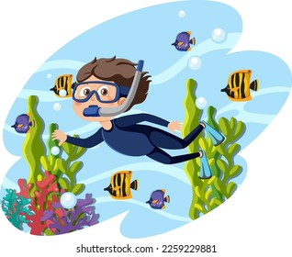
PRESENTATION
snorkelling (n)
/ˈsnɔːkəlɪŋ/
lặn với ống thở

Slide 9

PRESENTATION
performance (n)
/pəˈfɔːməns/
Buổi/màn biểu diễn

Slide 10

PRESENTATION
exhilarating (adj)
/ɪɡˈzɪləreɪtɪŋ/
đầy phấn khích

Slide 11
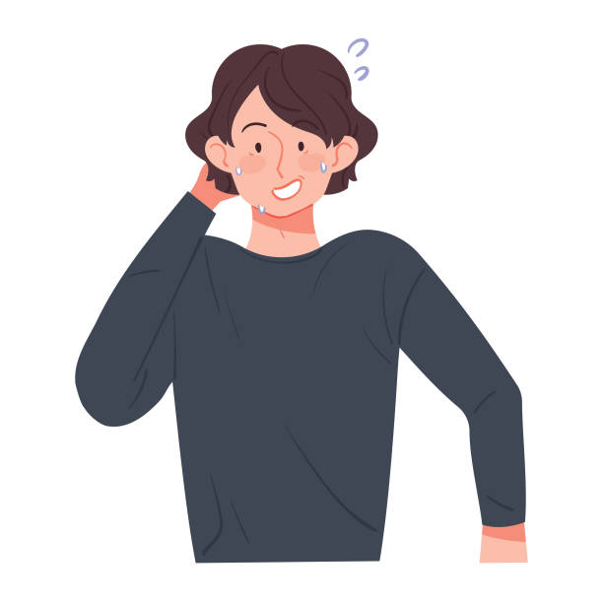
PRESENTATION
embarrassing
(adj)
/ɪmˈbærəsɪŋ/
làm ai bối rối, ngượng ngùng.

Slide 12
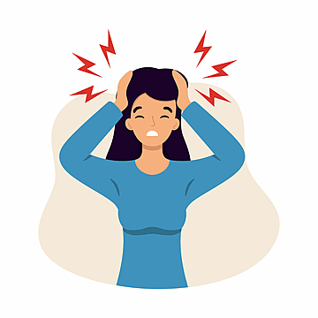
PRESENTATION
unpleasant (adj)
/ ʌnˈpleznt /
không thoải mái, không vui vẻ

Slide 13
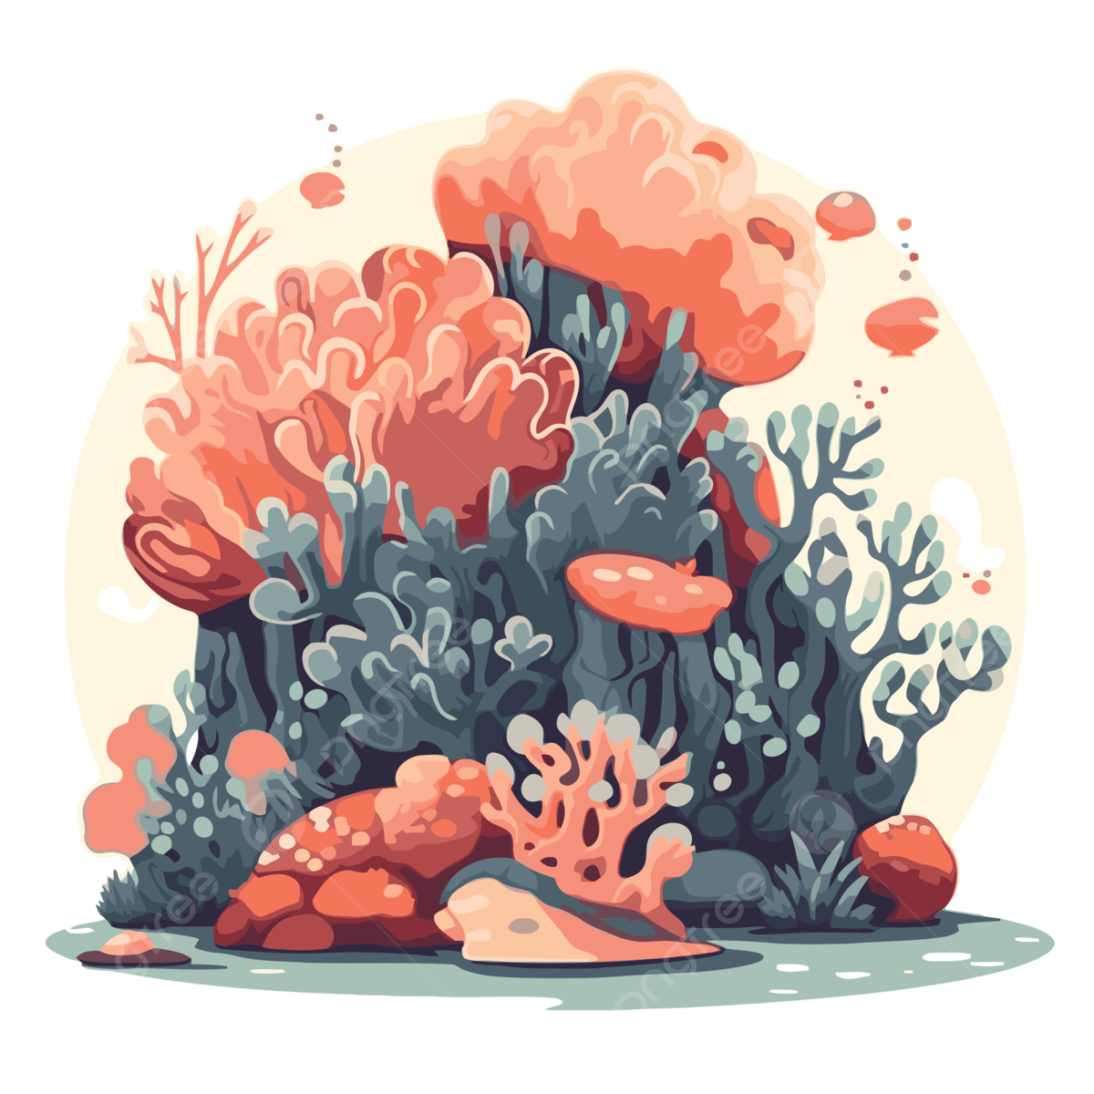
PRESENTATION
coral reef (n)
/ ˈkɒrəl riːf /
rặng san hô

Slide 14
PRESENTATION
New words | Pronunciation | Meaning
1. learning by rote (phr) | /ˈlɜːnɪŋ baɪ rəʊt/ | học thuộc lòng
2. campus (n) | /ˈkæmpəs/ | khuôn viên trường học
3. snorkelling (n) | /ˈsnɔːkəlɪŋ/ | lặn với ống thở
4. performance (n) | /pəˈfɔːməns/ | buổi biểu diễn

Slide 15
PRESENTATION
New words | Pronunciation | Meaning
5. exhilarating (adj) | /ɪɡˈzɪləreɪtɪŋ/ | đầy phấn khích
6. embarrassing (adj) | /ɪmˈbærəsɪŋ/ | làm ai bối rối, ngượng ngùng.
7. unpleasant (adj) | /ʌnˈpleznt/ | không thoải mái, không vui vẻ
8. coral reef (n phr) | /ˈkɒrəl riːf/ | rặng san hô

Slide 16
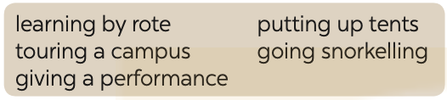

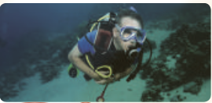

VOCABULARY
1
Write an activity next to each picture
touring a campus
going snorkelling
learning by rote
1. ___________
2. ____________
3. ____________

Slide 17
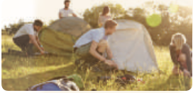
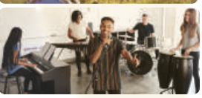
VOCABULARY
1
Write an activity next to each picture
putting up tents
giving a performance
4. ___________
5. ____________

Slide 18

VOCABULARY
2
Complete each sentence with an adjective in the box.
1. He felt _______ when he couldn’t protect himself from bullying.
2. The parachute jump was a(n) __________ experience for the boy. He was so excited.
3. It was so _______ to view the mountain range from the distance.
helpless
exhilarating
amazing

Slide 19
VOCABULARY
2
Complete each sentence with an adjective in the box.
4. I had a(n) ___________ experience when I took her bag by mistake.
5. The Tom had a(n) __________ experience putting up a tent in the rain.
embarrassing
unpleasant

Slide 20
PRACTICE
3
Choose the correct answer A, B, C, or D.
1. His mind ______ when I asked him how to do the homework.
A. went blank B. went empty
C. became exhausted D. put up
2. Students could see the university’s facilities when they ______.
took an excursion B. toured the campus
C. gave a performance D. took an eco-tour

Slide 21
PRACTICE
3
Choose the correct answer A, B, C, or D.
3. Snorkelling in the coral reef is a(n) ______.
A. touching moment B. happy time
C. exciting experience D. embarrassing moment
4. Nam and his friends felt ______ when they couldn’t put up a tent by themselves.
A. pleasant B. embarrassing C. embarrassed D. pleased

Slide 22
PRACTICE
3
Choose the correct answer A, B, C, or D.
5. I didn’t understand the lesson. I learnt it ______.
A. on purpose B. by chance D
C. with memory D. by rote

Slide 23
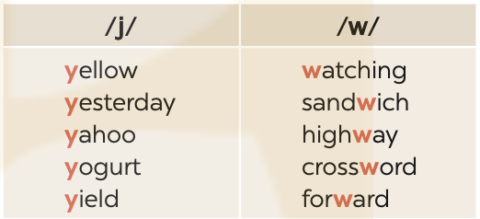
PRONUNCIATION
4
Listen and repeat the words. Pay attention to the sounds /j/ and /w/.

Slide 24
PRONUNCIATION
5
Listen to the sentences. Underline the words with /j/ and circle the words with /w/. Practise the sentences.
He tried sailing a yacht, and he did it well.
We’ve made a class yearbook. It looks wonderful.
They awarded him a gold medal yesterday.
Youngsters should be aware of their responsibilities.
5. They haven’t yet understood the role of wildlife.

Slide 25

CONSOLIDATION
1
Wrap-up
What have we learnt in this lesson?
Vocabulary: The lexical items related to experiences
Pronunciation: How to correctly pronounce words that contain the sounds: /j/ and /w/

Slide 26

CONSOLIDATION
2
Homework
Do exercises in the workbook.
Find 10 more words describing experiences that have the sound /j/ or /w/.

Slide 27
Website: hoclieu.vn
Fanpage: facebook.com/www.tienganhglobalsuccess.vn/

