Slide 1
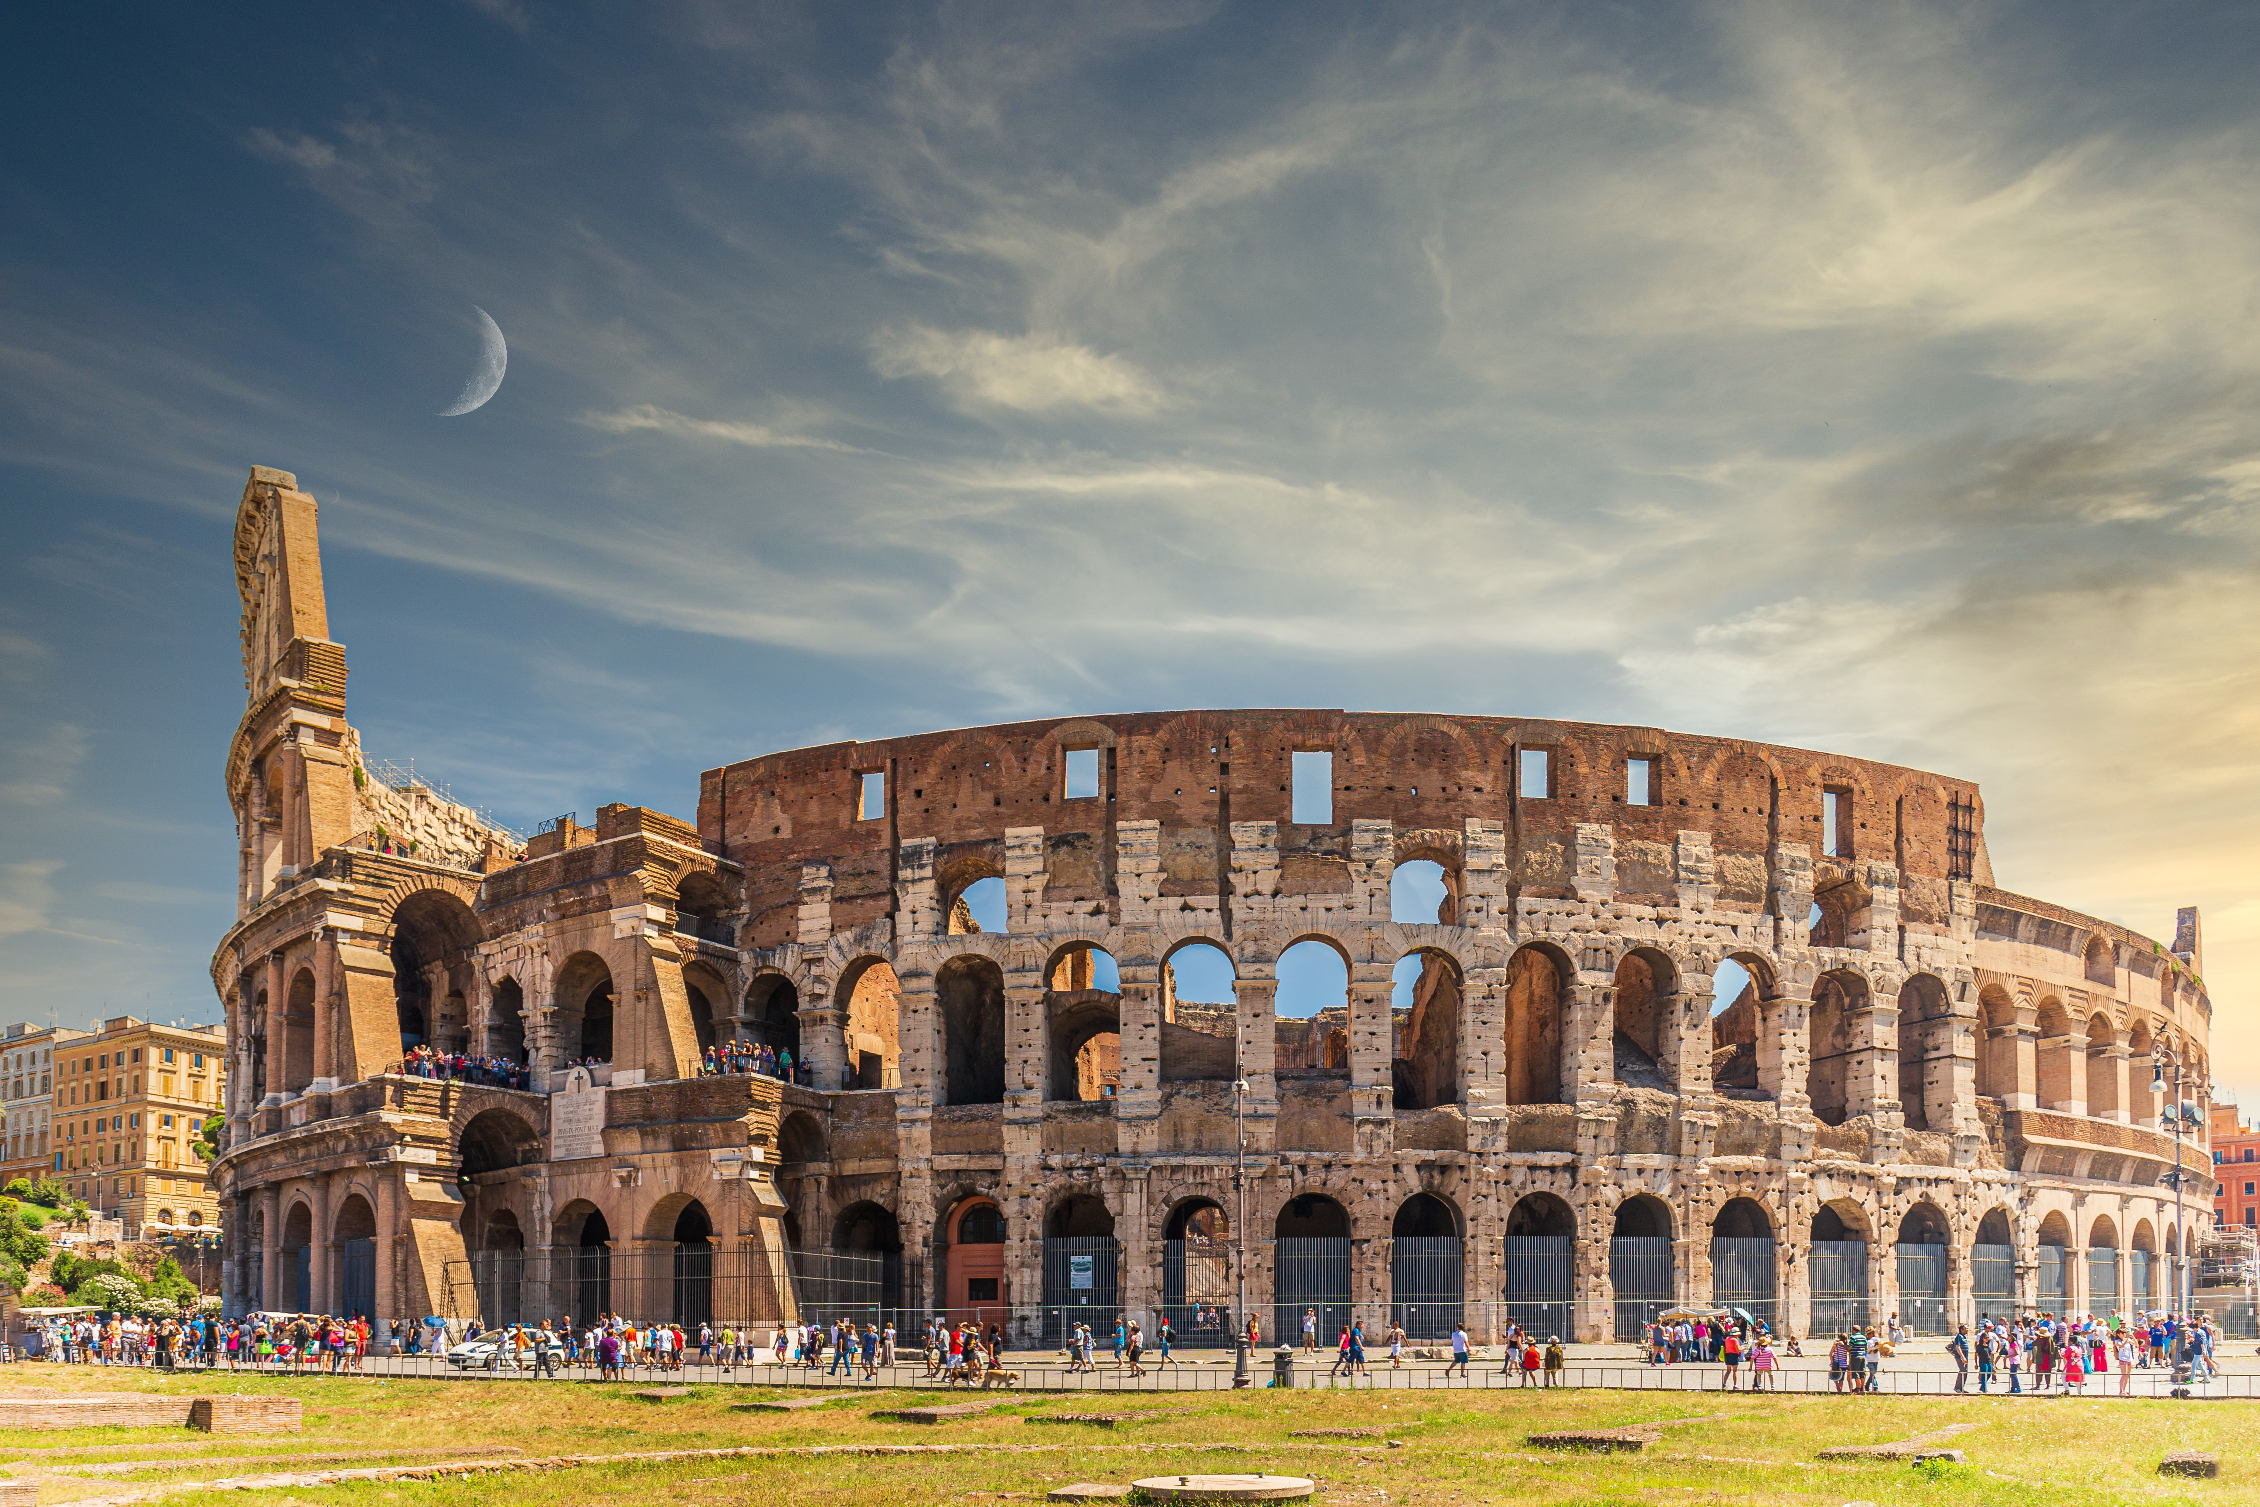

Slide 2


Unit
4
REMEMBERING THE PAST
LESSON 3: A CLOSER LOOK 2

Slide 3

OBJECTIVES
By the end of the lesson, students will be able to:
Recognise and use past continuous and wish + past simple.

Slide 4
LESSON 3: A CLOSER LOOK 2
LESSON 1: GETTING STARTED
WARM-UP
Option 1: Think!
Option 2: Picture Description
Task 1: Put the verbs in brackets in the past continuous
Task 2: Complete the sentences, using the past continuous forms of the given verbs.
PAST CONTINUOUS
Grammar explanation
Task 3: Put the verbs in brackets in the correct forms.
Task 4: Read the passage and write down five things that Jenny might wish for.
WISH + PAST SIMPLE
PRODUCTION
Task 5: Work in pairs. Tell your partner three wishes.
CONSOLIDATION
Wrap-up
Homework

Slide 5
WARM-UP
OPTION 1
- Do you remember the past continuous you have learned in Tiếng Anh 8 (Unit 9)
- Give some examples

Slide 6

WARM-UP
OPTION 2
Picture Description

Slide 7
WARM-UP
OPTION 2
- Look at the picture
- Describe what was happening in the picture, using the past continuous tense
HOW TO PLAY

Slide 8
WARM-UP
OPTION 2
LET’S PLAY

Slide 9

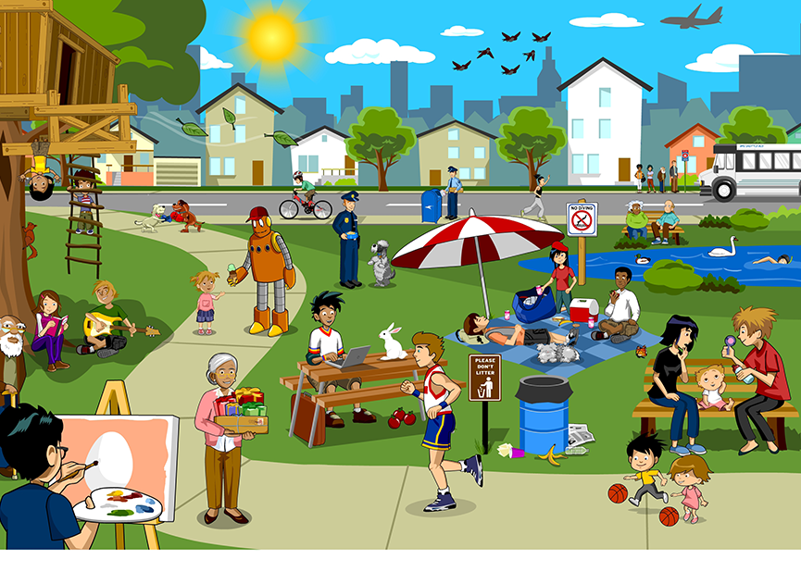
WARM-UP
OPTION 2

Slide 10
PAST CONTINUOUS
1
Put the verbs in brackets in the past continuous
1. My dad first met my mum when he (visit) __________________ Hoi An Ancient Town.
was visiting
2. Tom had a nightmare while he (sleep) ______________ in the camp by the old castle.
was sleeping
was going
3. David hurt his foot while he (go) ___________down the steps of the pagoda.

Slide 11

PAST CONTINUOUS
1
Put the verbs in brackets in the past continuous
4. My brother was just sitting while I (look) _________________ around the weaving workshop.
was looking
Were
watching
5. ______ you (watch) __________ TV at 9 p.m. last night? There was a very good programme on Duong Lam Ancient Village preservation.

Slide 12
live make preserve
work build
PAST CONTINUOUS
We also use the past continuous to emphasise how long an action took and how much time somebody spent doing it. We usually use adverb phrases that explain the length of time such as:
all morning / week / year/ for hours / days / weeks / months / years
Example:
We were cooking all morning because we had our friends coming for lunch.
We use the past continuous to describe an action that was happening at a particular time in the past, or a past action that was happening when another action interrupted it.

Slide 13
PAST CONTINUOUS
2
Complete the sentences, using the past continuous forms of the given verbs.
live make preserve
work build
were preserving
1. People _____________________ the monument for years because it had great value.
was / were living
2. When I finished school, my family _____________________in the countryside.
were building
3. People _____________________the Taj Mahal – a World Heritage Site while Shah Jahan was emperor.

Slide 14
PAST CONTINUOUS
2
Complete the sentences, using the past continuous forms of the given verbs.
live make preserve
work build
Were
working
4. “______ you still _____________ on the coffee farm when the war broke out, Grandpa?”
was making
5. I __________________ a presentation when the microphone stopped working.

Slide 15
LESSON 3: A CLOSER LOOK 2
LESSON 1: GETTING STARTED
WARM-UP
Option 1: Think!
Option 2: Picture Description
Task 1: Put the verbs in brackets in the past continuous
Task 2: Complete the sentences, using the past continuous forms of the given verbs.
PAST CONTINUOUS
Grammar explanation
Task 3: Put the verbs in brackets in the correct forms.
Task 4: Read the passage and write down five things that Jenny might wish for.
WISH + PAST SIMPLE

Slide 16
WISH + PAST SIMPLE
- Look at the Grammar Box p.43
We use wish + past form verb when we want something now or in the future to be different.
Subject + wish + subject + past simple
Example:
I wish I had enough money to travel around the world.
I wish (that) my mother didn’t have to work so hard.

Slide 17
WISH + PAST SIMPLE
3
Put the verbs in brackets in the correct forms.
1. The children wish they (get) ______________more presents every Christmas
got
had
2. I wish I (have) _________________ enough money to visit London and Windsor Castle.
had
3. Do you wish we (have) __________a swimming pool in our school?

Slide 18
WISH + PAST SIMPLE
3
Put the verbs in brackets in the correct forms.
could spend
4. We wish we (can spend) _______________our summer holiday on the seaside.
5. I wish I (can go) ______________ back to my grandparents’ time.
could go
My sister Jane is very untidy. She and I share the same room, but I have to clean it every day. Whenever she’s at home, she lies in bed reading or playing computer games. She often puts her dirty clothes on my bed. I’d like to have my own room, but it’s impossible now.
I hope she can change her way one day.
Jenny, 14

Slide 19
WISH + PAST SIMPLE
4
Read the passage and write down five things that Jenny might wish for.
Example:
Jenny wishes (that) her sister Jane was tidier.
My sister Jane is very untidy. She and I share the same room, but I have to clean it every day. Whenever she’s at home, she lies in bed reading or playing computer games. She often puts her dirty clothes on my bed. I’d like to have my own room, but it’s impossible now.
I hope she can change her way one day.
Jenny, 14

Slide 20
WISH + PAST SIMPLE
My sister Jane is very untidy. She and I sharethe same room, but I have to clean it every day. Whenever she’s at home, she lies in bed reading or playing computer games. She often puts her dirty clothes on my bed. I’d like to have my own room, but it’s impossible now.
I hope she can change her way one day.
Jenny, 14
Example:
Jenny wishes (that) her sister Jane was tidier.
1. Jenny wishes (that) she didn’t have to share the room with her sister.
2. Jenny wishes (that) she didn’t have to clean the room every day.
3. She wishes (that) her sister Jane didn’t lie in bed reading or playing computer games.
4. She wishes (that) her sister Jane didn’t put dirty clothes on her bed.
5. She wishes (that) she had her own room.

Slide 21
My sister Jane is very untidy. She and I sharethe same room, but I have to clean it every day. Whenever she’s at home, she lies in bed reading or playing computer games. She often puts her dirty clothes on my bed. I’d like to have my own room, but it’s impossible now.
I hope she can change her way one day.
Jenny, 14
WISH + PAST SIMPLE
Possible answers:
1. Jenny wishes (that) she didn’t have to share the room with her sister.
2. Jenny wishes (that) she didn’t have to clean the room every day.
3. She wishes (that) her sister Jane didn’t lie in bed reading or playing computer games.
4. She wishes (that) her sister Jane didn’t put dirty clothes on her bed.
5. She wishes (that) she had her own room.

Slide 22
LESSON 3: A CLOSER LOOK 2
LESSON 1: GETTING STARTED
WARM-UP
Option 1: Think!
Option 2: Picture Description
Task 1: Put the verbs in brackets in the past continuous
Task 2: Complete the sentences, using the past continuous forms of the given verbs.
PAST CONTINUOUS
Grammar explanation
Task 3: Put the verbs in brackets in the correct forms.
Task 4: Read the passage and write down five things that Jenny might wish for.
WISH + PAST SIMPLE
PRODUCTION
Task 5: Work in pairs. Tell your partner three wishes.

Slide 23
PRODUCTION
5
Work in pairs. Tell your partner three wishes.
- Work in pairs and exchange your wishes
Example:
I wish I had a dishwasher to do the washing-up for me every day.

Slide 24
EXTRA ACTIVITY
- Work in groups to talk about what your family members wish
Example:
My mum wishes (that) she had a new dishwasher.
My little sister often wishes (that) she became a princess

Slide 25
LESSON 3: A CLOSER LOOK 2
LESSON 1: GETTING STARTED
WARM-UP
Option 1: Think!
Option 2: Picture Description
Task 1: Put the verbs in brackets in the past continuous
Task 2: Complete the sentences, using the past continuous forms of the given verbs.
PAST CONTINUOUS
Grammar explanation
Task 3: Put the verbs in brackets in the correct forms.
Task 4: Read the passage and write down five things that Jenny might wish for.
WISH + PAST SIMPLE
PRODUCTION
Task 5: Work in pairs. Tell your partner three wishes.
CONSOLIDATION
Wrap-up
Homework

Slide 26

CONSOLIDATION
1
Wrap-up
What have we learnt in this lesson?
Recognise and use past continuous and wish + past simple.

Slide 27

CONSOLIDATION
2
Homework
- Do exercises in the workbook.
- Make 5 sentences by using past continuous and wish + past simple.

Slide 28
Website: hoclieu.vn
Fanpage: facebook.com/www.tienganhglobalsuccess.vn/

