Slide 2
B.I.N.G.O
WARM-UP
Work in pairs.
Receive slips of paper with halves of first conditional sentences.
Join two slips of paper together to make meaningful sentences.
Say “Bingo” when finish.
The Ss who are the fastest with more correct answers will be the winner.
RULES

Slide 3
B.I.N.G.O
WARM-UP
ANSWER
If she trains harder,
she can run faster than you.
you should balance your study and life.
If you want to have good mental health,
he may / might get a good job.
If he is good at IT,
you can hand it in and leave for home.
If you finish your paper,
If you want to manage your time effectively,
you must get rid of all the distractions.

Slide 4
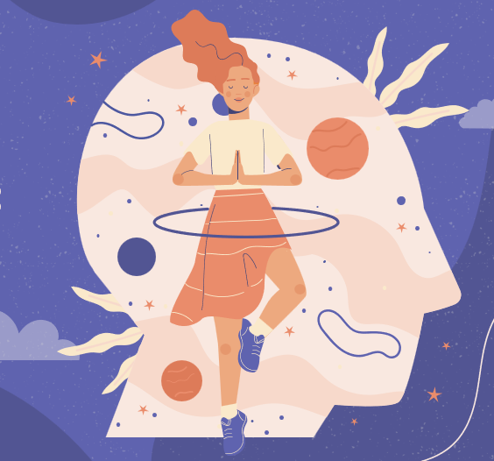
Unit
3
HEALTHY LIVING FOR TEENS
LESSON 3: A CLOSER LOOK 2
Grammar: Modal verbs in first conditional sentences
1

Slide 5
LESSON 3: A CLOSER LOOK 2
LESSON 1: GETTING STARTED
WARM-UP
B.I.N.G.O game
PRESENTATION
Modal verbs in first conditional sentences
Task 1: Write the correct form of each verb in brackets.
Task 2: Circle the correct modal verbs to complete the following sentences.
Task 3: Match the first half of the sentence in A with the second half in B.
Task 4: What will you say in each situation below? Use first conditional sentences with modal verbs.
PRACTICE
PRODUCTION
Task 5: Complete the sentences with your own ideas using the modal verbs you have learnt.
CONSOLIDATION
Wrap-up
Homework

Slide 6
PRESENTATION
 | IF - CLAUSE | MAIN CLAUSE
 | If you do physical exercise regularly, | Your health will improve.
 | If she trains harder, | she can run faster than you.
 | If you finish your paper, | you can hand it in and leave for home.
 | If you want to have good mental health, | you should balance your study and life.
 | If he is good at IT, | he may / might get a good job.
 | If you want to manage your time effectively, | you must get rid of all the distractions.
standard form
ability
permission
advice
possibility
necessity

Slide 7
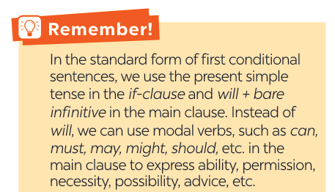
PRESENTATION

Slide 8
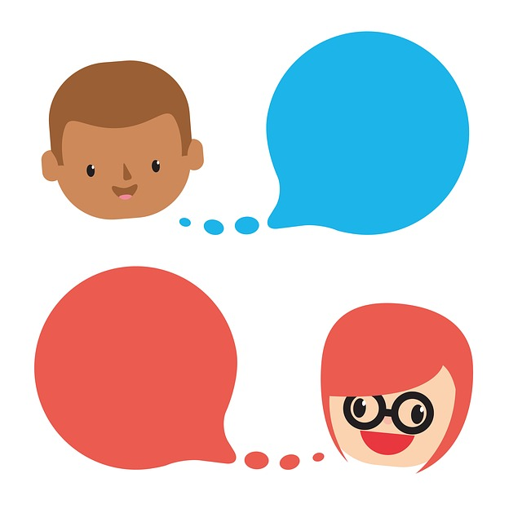
PRACTICE
Work in pairs.
Write a short dialogue where you use at least three different modal verbs in first conditional sentences.
Example:
A: If you have time tonight, you should go to the cinema.
B: I agree. If I don’t, I might watch a movie at home……"

Slide 9
mental
counsellor
well-balanced
physical
PRACTICE
1
Write the correct form of each verb in brackets.
doesn’t want
1. If Mai (not want) _____________________ to gain weight, she shouldn’t eat much fast food.
2. If you stay up too late tonight, you might (feel) __________ tired tomorrow morning.
3. You should (sleep) __________ eight hours a night if you want to be awake and fully alert.
4. If Tom (complete) ___________ his assignment on Friday, he can go out with his friends at the weekend.
5. You must (be) _____ careful if you don’t want to get burnt.
feel
sleep
completes
be

Slide 10
PRACTICE
2
Circle the correct modal verbs to complete the following sentences.
1. She can / should go home early if she finishes her work.
2. If you train hard, you might / shouldn’t win the first prize.
3. If they don’t want to be punished, they must / may follow the rules.
4. If students have an upcoming exam, they shouldn’t / can’t wait to study until the day before it.
5. If you’re having a bad day, you should / may do your best to get through it.

Slide 11
PRACTICE
3
Match the first half of the sentence in A with the second half in B.
1. If you spend too much time on the computer,
2. If you put too much sugar in your coffee,
3. If you want to manage your time effectively,
4. If you want to have perfect white teeth,
5. If you take a cooking class,
a. you can make your favourite food at home.
b. you should use a calendar to plan your work ahead.
c. you may put on more weight.
d. you might get shoulder pains.
e. you must brush your teeth regularly.

Slide 12
PRACTICE
3
Match the first half of the sentence in A with the second half in B. KEY
1. If you spend too much time on the computer,
2. If you put too much sugar in your coffee,
3. If you want to manage your time effectively,
4. If you want to have perfect white teeth,
5. If you take a cooking class,
d. you might get shoulder pains.
c. you may put on more weight.
b. you should use a calendar to plan your work ahead.
e. you must brush your teeth regularly.
a. you can make your favourite food at home.

Slide 13
PRACTICE
4
What will you say in each situation below? Use first conditional
sentences with modal verbs.
1. Your friend wants to lose weight. You
advise him / her to eat less high fat food
and do more exercise.
=> If you want to lose weight, you should eat less high fat food and do more exercise.

Slide 14
PRACTICE
4
What will you say in each situation below? Use first conditional
sentences with modal verbs.
2. Your friend invites you out for an ice cream,
but it’s possible that you will have a sore
throat.
=> If I have an ice cream, I may have a sore throat.

Slide 15
PRACTICE
4
What will you say in each situation below? Use first conditional
sentences with modal verbs.
3. Your roommate often stays up late at
night. You think it is necessary to get
enough sleep every night; otherwise,
his health will suffer.
=> If you want to have good health, you must get 8 hours of sleep per night.

Slide 16
PRACTICE
4
What will you say in each situation below? Use first conditional
sentences with modal verbs.
4. Your little brother wants to go for a swim.
You agree but ask him to finish all his
homework first.
=> You can go for a swim if you finish all your homework.

Slide 17
PRACTICE
4
What will you say in each situation below? Use first conditional
sentences with modal verbs.
5. You’re able to make a delicious pizza when
you have all the needed ingredients.
=> If I have all needed ingredients, I can make a delicious pizza.

Slide 18
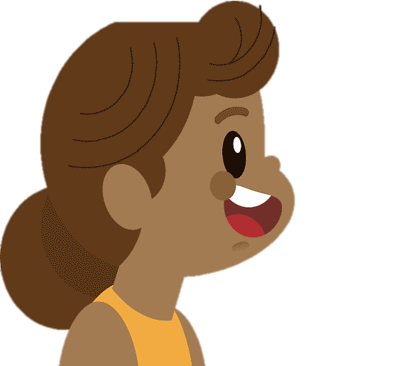
PRODUCTION
5
Complete the sentences with your own ideas using the modal verbs you have learnt.
1. If you spend too much time playing
computer games, ________________ ______________________________.
2. If you want to get a good night’s sleep,
______________________________
______________________________.
3. If you don’t feel well, ___________
______________________________.

Slide 19
PRODUCTION
5
Complete the sentences with your own ideas using the modal verbs you have learnt.
SUGGESTED ANSWER
1. If you spend too much time playing computer games, ________________________________________________________
2. If you want to get a good night’s sleep, _____________
________________________________________________________
3. If you don’t feel well, __________________________
________________________________________________________
you might miss out on other important activities like exercising, socialising, and studying.
you should avoid
drinking caffeine or alcohol before bed and try to establish a regular sleep schedule.
.
you should consult a doctor
or a medical professional to get a proper diagnosis and treatment.

Slide 20
EXTRA ACTIVITY
LUCKY NUMBERS
1
2
3
4
5
6
7
END GAME

Slide 21
WARM-UP
LUCKY NUMBERS
You have 2 points.
GO BACK

Slide 22
WARM-UP
LUCKY NUMBERS
Question 2:
Make a first conditional sentence
using the suggested words.
maintain good health/ can
GO BACK

Slide 23
WARM-UP
LUCKY NUMBERS
Question 3:
Make a first conditional sentence
using the suggested words.
reduce stress/ should
GO BACK

Slide 24
WARM-UP
LUCKY NUMBERS
Question 4:
Make a first conditional sentence
using the suggested words.
mangage time/ must
GO BACK

Slide 25
WARM-UP
LUCKY NUMBERS
You have 2 points.
GO BACK

Slide 26
WARM-UP
LUCKY NUMBERS
Question 6:
Make a first conditional sentence
using the suggested words.
balance study and play time/ may
GO BACK

Slide 27
WARM-UP
LUCKY NUMBERS
Question 7:
Make a first conditional sentence using
the suggested words.
delay/ must
GO BACK

Slide 28
CONSOLIDATION
1
Wrap-up
What have we learnt in this lesson?
Summarise the main points of the lesson.
Make first conditional sentences about yourselves, using modal verbs instead will.

Slide 29
CONSOLIDATION
2
Homework
Do exercises in the workbook.
Start preparing for the Project of the unit.
.

Slide 30
Website: hoclieu.vn
Fanpage: facebook.com/www.tienganhglobalsuccess.vn/

