Slide 2
Unit
3
HEALTHY LIVING FOR TEENS
LESSON 1: GETTING STARTED
Advice from a School Counsellor
1

Slide 3
LESSON 1: GETTING STARTED
LESSON 1: GETTING STARTED
WARM-UP
I.N.I.T.I.A.L game
Vocabulary
PRESENTATION
Task 1: Listen and read.
Task 2: Read the conversation again and write T (true) or F (False).
Task 3: Match the words with their definitions.
Task 4: Complete the sentences with the words in the box.
PRACTICE
PRODUCTION
Task 5: Work in pairs. Interview each other about how healthy you are. Give each other advice.
CONSOLIDATION
Wrap-up
Homework

Slide 4
WARM-UP
I.N.I.T.I.A.L GAME
Work in 2 teams.
Look at 10 pictures.
Find the word for each picture, then take the first letter from each picture to form the mystery word.
Which team finds the mystery word first will become the winner.
RULES

Slide 5
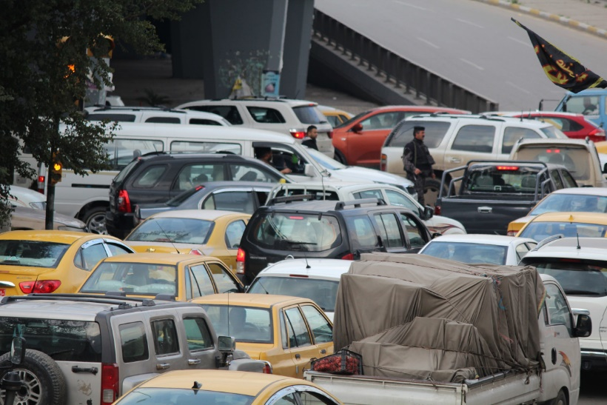
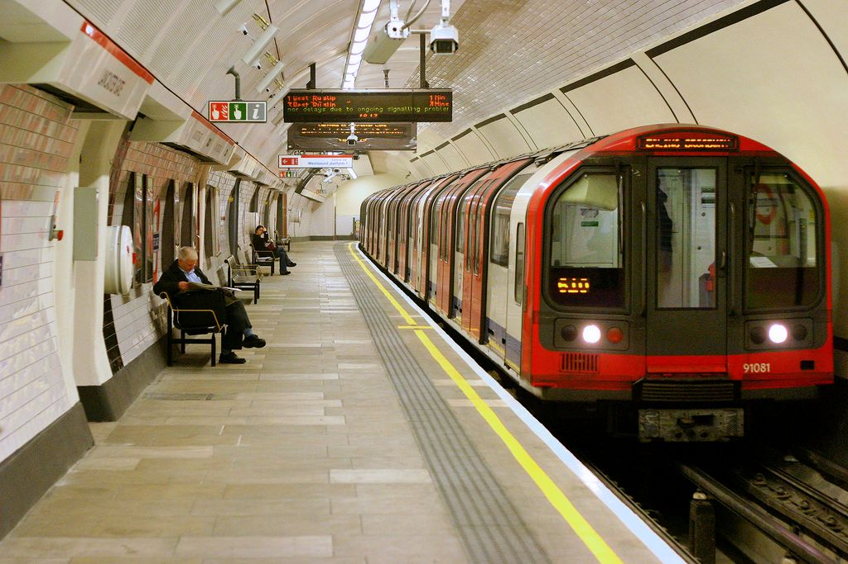
WARM-UP
I.N.I.T.I.A.L GAME
Congestion
Overcrowded
Underground
Noise
Sky train
Electrician

Slide 6
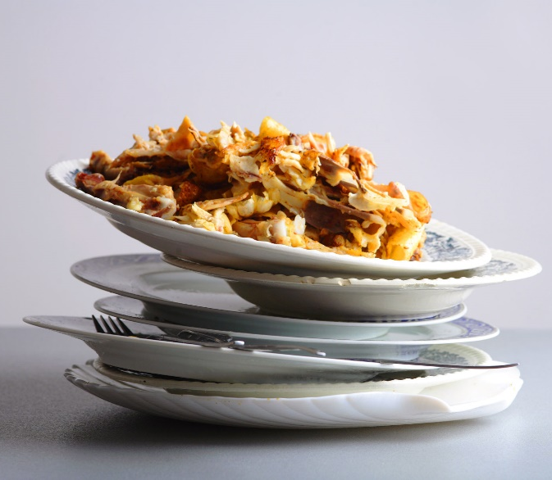
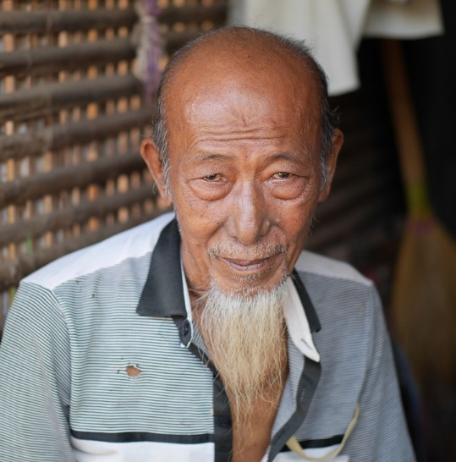
WARM-UP
I.N.I.T.I.A.L GAME
Leftovers
Lake
Old
Rush hour

Slide 7
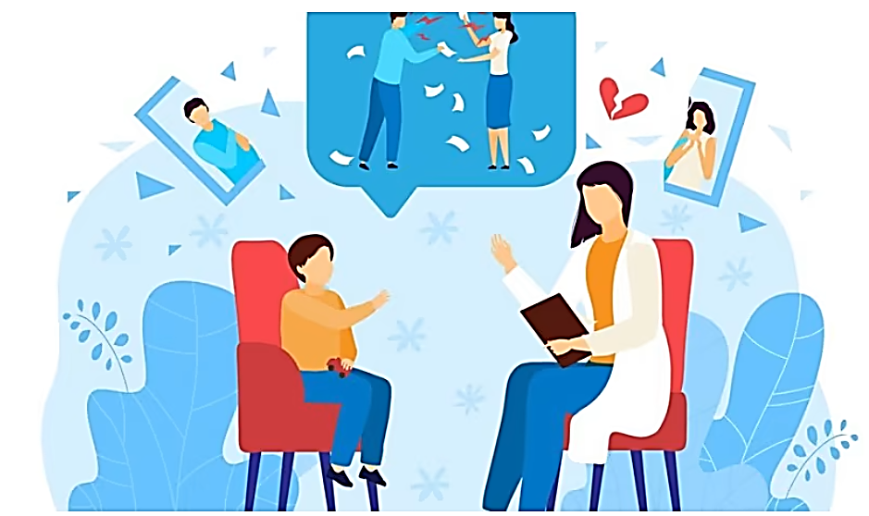
WARM-UP
I.N.I.T.I.A.L GAME
Does your secondary school have a school counsellor?
What does a school counsellor do in a secondary school?

Slide 8
PRESENTATION
maintain (v)
.
/meɪnˈteɪn/
duy trì
Notes:
Maintain (v): make something continue at the same level, standard, etc

Slide 9
PRESENTATION
advice (n)
/ədˈvaɪs/
lời khuyên
Notes:
Advice (n): an opinion or a suggestion about what somebody should do in a particular situation

Slide 10
PRESENTATION
bring about (ph. v)
/brɪŋ əˈbaʊt/
đem lại, gây ra
Notes:
Bring about (ph.v): make something happen

Slide 11
PRESENTATION
balance (v)
/ˈbæləns/
cân bằng
Notes:
Balance (v): to give equal importance to two things or parts of something which are very different

Slide 12
PRESENTATION
manage (v)
.
/ˈmænɪdʒ/
quản lý
Notes:
Manage (v): control or be in charge of a business, a team, an organization, land, etc.

Slide 13
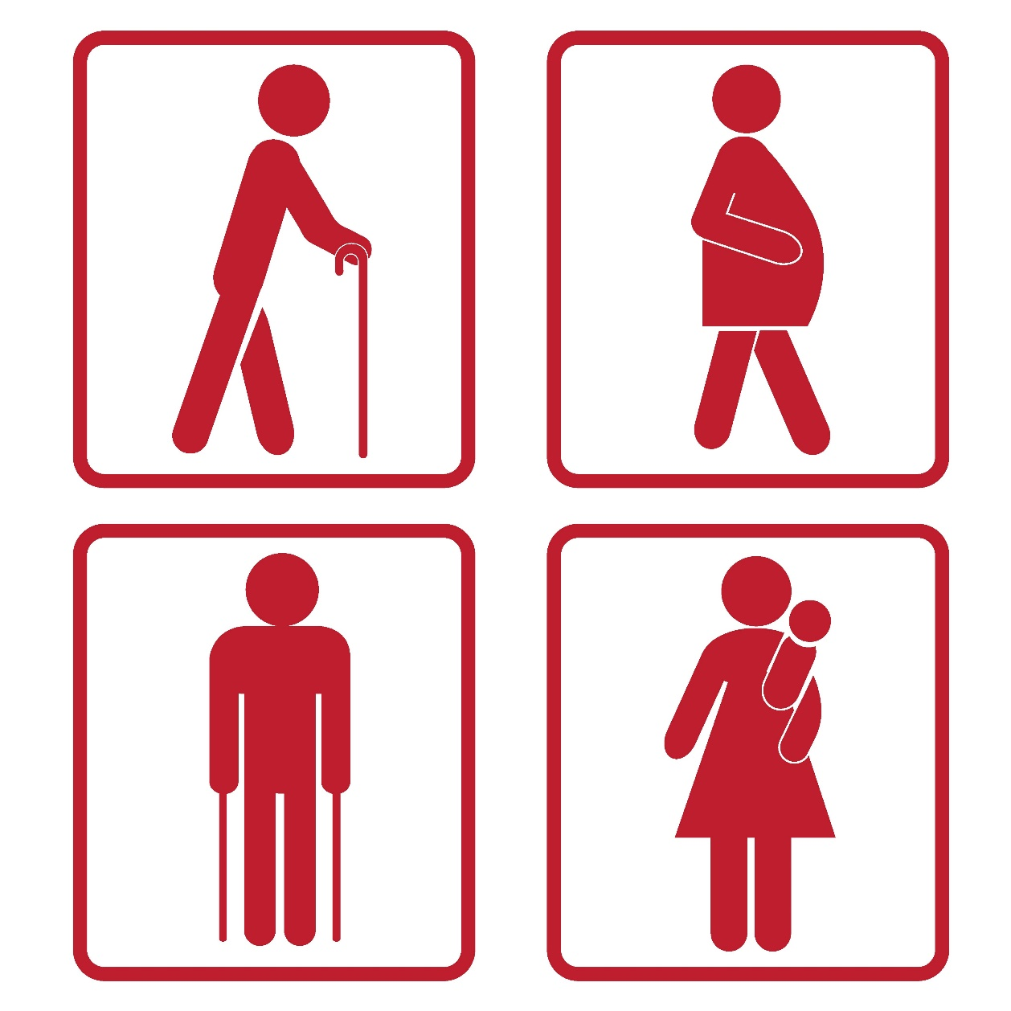
PRESENTATION
priority (n)
/praɪˈɔːr.ə.t̬i/
sự ưu tiên
Notes:
Balance (v): to give equal importance to two things or parts of something which are very different

Slide 14
PRESENTATION
New words | Pronunciation | Meaning
1. maintain (v) | /meɪnˈteɪn/ | duy trì
2. advice (n) | /ədˈvaɪs/ | lời khuyên
3. bring about (ph.v) | /brɪŋ əˈbaʊt/ | đem lại, gây ra
4. balance (n) | /ˈbæləns/ | cân bằng
5. manage (v) | /ˈmænɪdʒ/ | quản lý
6. priority (n) | /praɪˈɔːrət/ | sự ưu tiên

Slide 15
PRACTICE
1
Listen and read.
School Counsellor: Good morning, class. Welcome to our “Tips for Good Physical and Mental Health”. In this session, feel free to ask any questions.
Nick: How can we maintain good physical health?
School Counsellor: You should get enough sleep, eat a healthy diet, and do physical exercise regularly.
Mai: My parents say students of our age need to sleep at least eight hours a day. Is that right?
School Counsellor: Yes, it is.
Phong: But we often find it difficult to get a good night’s sleep, especially before exams. Could you offer us any advice?
School Counsellor: I understand that exams bring about lots of stress. You can reduce this stress by studying long before the exam, not waiting until the night before it.
Phong: Thank you. Do you have any tips about looking after our mental health?
School Counsellor: If you want to have good mental health, you should have a well-balanced life. I mean you should balance your study and life.
Nick: But how can we balance them? School Counsellor: Well, you have to manage your time by planning your schedule and giving priority to your work. And you should keep a balance between study and play.

Slide 16
PRACTICE
2
Read the conversation again and write T (true) or F (False).
 | TRUE (T) | FALSE (F)
1. The counsellor is giving advice on how to maintain good physical and mental health.
2. According to Mai’s parents, students shouldn’t sleep more than eight hours a day.
3. Many students find it easy to get a good night’s sleep before exams.
4. Nick doesn’t know how to have a well-balanced life.
5. The school counsellor advises the students to balance their study and play time.

Slide 17
PRACTICE
3
Match the words with their definitions.
a. a person whose job is to help and support people with problems
b. connected with a person’s body rather than their mind
c. something that you think is more important than other things and should be dealt with first
d. connected with the state of health of the mind
e. having the right amounts of all the different parts that make up something
1. physical
1. b
2. d
3. e
4. c
5. a
2. mental
3. well-balanced
4. priority
5. counsellor

Slide 18
PRACTICE
4
Complete the sentences with the words in the box.
physical counsellor well-balanced priority mental
priority
1. You should make a list of all the jobs you have to do and give _________ to them.
2. Maintaining a ______________ life often means making time for the things you have to do, as well as the things you want to do in a suitable way.
3. The police asked them to describe his ___________ appearance.
4. You need to maintain your physical and ___________ health.
5. The ______________ is willing to listen to the students to help them solve their problems.
well-balanced
physical
mental
counsellor

Slide 19
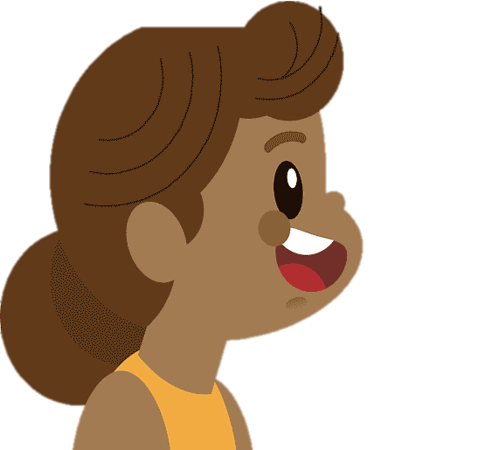
PRODUCTION
5
Work in pairs. Interview each other about how healthy you are.
Give each other advice.
Example:
A: How healthy are you? B: I’m tired.
A: You should take a break and do some physical exercise

Slide 20
CONSOLIDATION
1
Wrap-up
What have we learnt in this lesson?
Identify the topic of the unit;
Use lexical items related to Healthy living for teens;
Identify the language features that are covered in the unit.

Slide 21
CONSOLIDATION
2
Homework
Do exercises in the workbook.
Start preparing for the Project of the unit.

Slide 22
Website: hoclieu.vn
Fanpage: facebook.com/www.tienganhglobalsuccess.vn/

