Slide 2

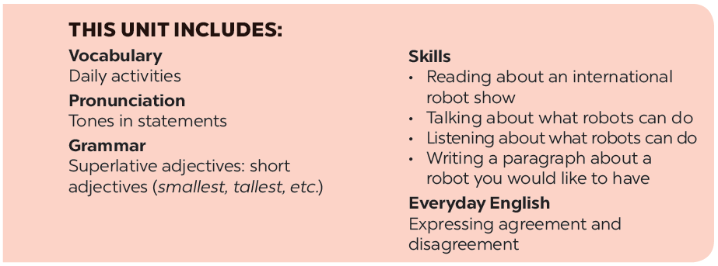

Slide 3








Grammar
Superlative adjectives: short adjectives
Write the superlative form of the adjectives in the table below.
Work in pairs. Look at the information of the three robots: M10, H9, and A3 and talk about each of them, using superlative adjectives.
Complete the following sentences with superlative form of the adjectives in brackets. 1 is an example.
Find someone who…
Complete the following sentences with comparative or superlative form of the adjectives in brackets.
Work in pairs. Ask your partner to find in your class someone who is

Slide 4

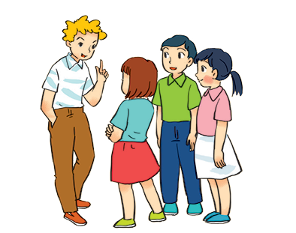

Grammar
Superlative adjectives: short adjectives
We use superlative adjectives to compare three or more people or things.
Example:
- Tom is the tallest in his class.
- This is the biggest of the three bags.

Slide 5


Write the superlative form of the adjectives in the table below.
Adjectives | Superlative form
fast
tall
noisy
nice
hot
light
quiet
heavy
large
fastest
tallest
noisiest
nicest
hottest
lightest
quietest
heaviest
largest

Slide 6

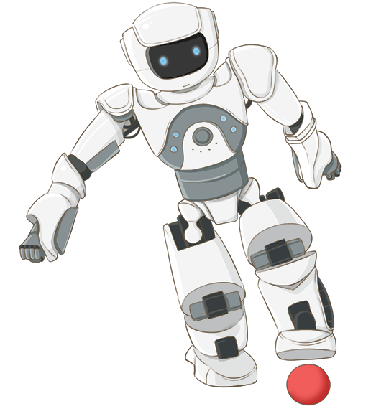
Complete the following sentences with superlative form of the adjectives in brackets. 1 is an example.
1.
Bonbon can move 10 tons; it’s the strongest of all. (strong)
2.
This robot can understand all of what we say. It’s the
_______ in the robot show. (smart)
smartest in the robot show. (smart)
He is the
he is about 1.8 m tall. (tall)
_______ in our class;
3.
tallest in our class;
This is the
we can put it in our bag. (small)
4.
_______ of all home robots;
smallest of all home robots;
5.
This robot is only 200 dollars.
It’s the
cheapest in our shop. (cheap)
_______ in our shop. (cheap)

Slide 7

Complete the following sentences with comparative or superlative form of the adjectives in brackets.
My brother’s room is
_______ than mine. (tidy)
1.
tidier than mine. (tidy)
2.
_______ desert of all is the Sahara and it’s in Africa. (hot)
The
hottest desert of all is the Sahara and it’s in Africa. (hot)
Travelling by plane is
faster than going by car. (fast)
3.
_______ than going by car. (fast)
Who is the
_______ in your family? (tall)
4.
tallest in your family? (tall)
_______ than cats. (smart)
5.
I think dogs are
smarter than cats. (smart)

Slide 8

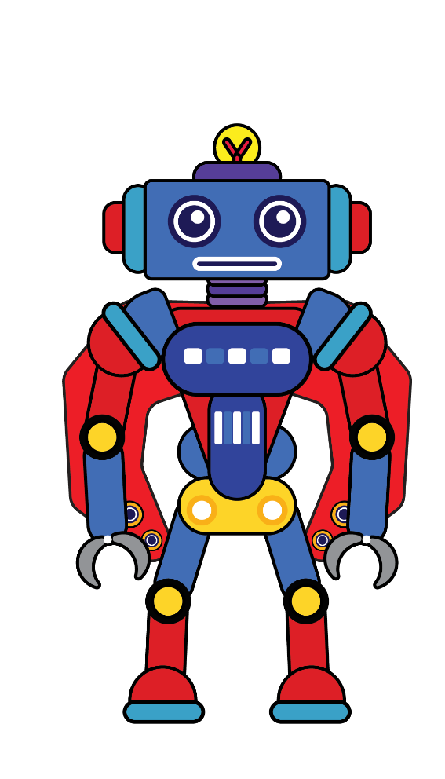
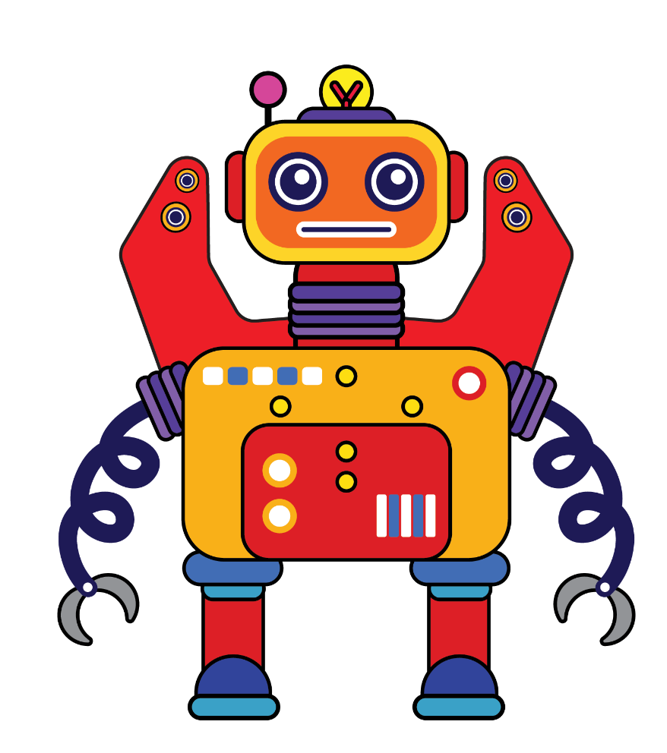

Work in pairs. Look at the information of the three robots: M10, H9, and A3 and talk about each of them, using superlative adjectives.
A3
H9
M10
M10

Slide 9



 | M10 | H9 | A3
Age | 5 | 7 | 10
Weight | 20 kg | 45 kg | 50 kg
Height | 80 cm | 120 cm | 150 cm
Price | $1.800 | $1.000 | $1.500
H9
M10
A3
Example:
A: A3 is the tallest of the three robots.
B: M10 is the youngest of the three robots.
…

Slide 10

Find someone who…
Work in pairs. Ask your partner to find in your class someone who is
the tallest
the oldest
the smartest
the shortest
the biggest
the smallest

Slide 11







