Slide 2
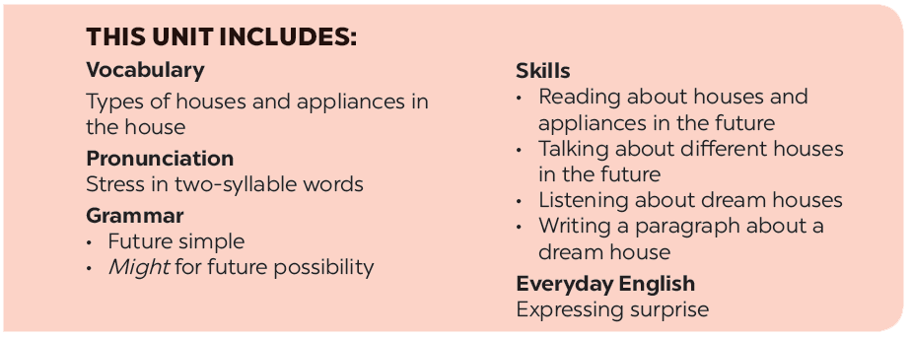

Slide 3
Everyday English
Houses and appliances in the future
Expressing surprise
Read the questions in the class survey below. Tick () Y (Yes) or N (No).
Listen and read the conversation. Pay attention to the highlighted sentences.
Work in pairs. Use the questions in 3 to interview your partner.
Work in pairs. Express your surprise when you see your partner’s new watch, TV, mobile phone, etc.
Tell the class about your interview.

Slide 4
Everyday English
Expressing surprise

Slide 5
Listen and read the conversation. Pay attention to the highlighted sentences.
David: John! Hello!
John: Oh, hi, David. Wow! Is that your computer? It looks great.
David: Yes, it’s my new computer. My parents gave it to me for my birthday.

Slide 6
Wow! Is that your ……….?
It looks ……………………….

Slide 7
Work in pairs. Express your surprise when you see your partner’s new watch, TV, mobile phone, etc.
E.g.
A: Wow! Is that your mobile phone? It looks great.
B: Yes, it’s my new mobile phone. My grandparents gave it to me for my birthday.

Slide 8
Houses and appliances in the future

Slide 9
Read the questions in the class survey below.
Tick () Y (Yes) or N (No).
 | Y | N
1. Will you live in a hi-tech house?
2. Will your house be in space?
3. Will you have a lot of trees and ﬂowers around your house?
4. Will you have a fridge that can cook your meals?
5. Will you have a robot that can look after your children?
6. Will you have a car that can ﬂy?
✓
✓
✓
✓
✓
✓
✓
✓
✓
✓
✓
✓

Slide 10
Hi tech: công nghệ cao
In space: ngoài vũ trụ
Look after: chăm sóc

Slide 11
Work in pairs. Use the questions in 3 to interview your partner.
Example:
You: Hi, Nam. Will you live in a hi-tech house in the future?
Nam: Yes, I will.
You: Will your house be in space?
Nam: Oh, no. It won’t.
You: So where will it be?
Nam: I’m not sure. It might be by the sea.
Notes:
City landmarks phải ở trên mục 3

Slide 12
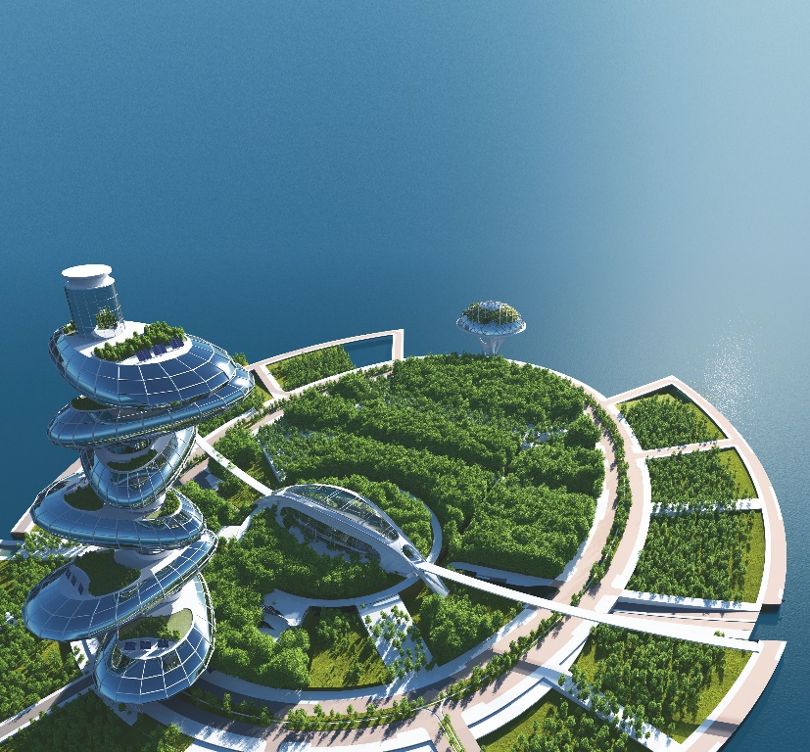
Tell the class about your interview.
Example:
In the future, Nam will live in a hi-tech house.
It won’t be in space. It might be by the sea.
He might have a robot to help him with his home.

