Slide 3
Grammar
Possessive adjectives
Possessive pronouns
Match the sentences with the pictures, paying attention to the underlined part in each sentence.
Complete the sentences with the correct possessive pronouns.
Underline the correct word in brackets to complete each sentence.
Complete the sentences with the correct possiessive adjectives.
Choose the correct word to complete the sentences.

Slide 4
Grammar
Possessive adjectives
A possessive adjective is used only when there’s a noun following it.
Example:
I have a pen.
This is my pen.

Slide 5
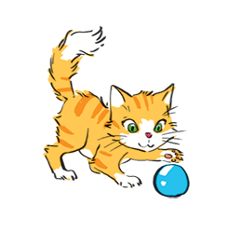
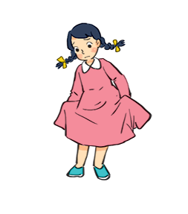
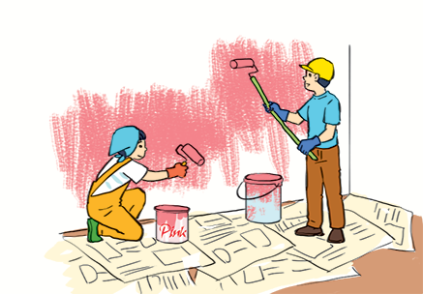
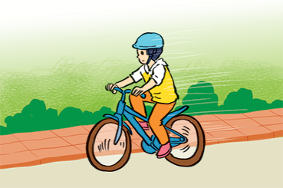
Match the sentences with the pictures, paying attention to the underlined part in each sentence.
1.
Sue doesn’t like her new dress.
1 - d
a
b
2.
Billy is riding his bicycle.
2 - f
3.
I’ll write my name in red. Could you write
your name in blue?
d
c
3 - e
4.
The cat is playing with its ball.
4 - b
5.
We love our school.
5 - a
e
f
6.
They are painting their room pink.
6 - c

Slide 6
Complete the sentences with the correct possessive adjectives.
1.
My favourite cartoon is Dragon Balls.
I love cartoons.
________ favourite cartoon is Dragon Balls.
This book has your name on it. Is it
_______ book?
2.
your book?
The lion has three cubs.
Its cubs are playing under a big tree.
3.
_______ cubs are playing under a big tree.
4.
Do you know my friend Anna?
_______ house is close to the park.
Her house is close to the park.
We are from Switzerland.
________ country is famous
5.
Our country is famous for chocolate.
for chocolate.

Slide 7
Grammar
Possessive pronouns
A possessive pronoun is used alone, without a noun following it.
Example:
This book is my book, not your book.
This book is mine, not yours.

Slide 8
Complete the sentences with the correct possessive pronouns.
1.
I have a new bike. The bike is .
mine
These are Mai’s and Lan’s maps. These maps are .
2.
theirs
3.
This is a present for you. It’s .
yours
4.
My father has new shoes. They’re .
his
5.
This is our new house. The house is .
ours

Slide 9
Underline the correct word in brackets to complete each sentence.
1.
Australia is a strange country. All of (it’s / its) big cities are along the coast.
2.
Our city is very crowded. How about (your / yours)?
3.
I love my football club. Does Phong like (his / him)?
4.
(Our / Ours) street is short and narrow.
5.
They cannot find (their / theirs) city map anywhere.

Slide 10
Choose the correct word to complete the sentences.
1.
The book is (my / mine / yours), but you are welcome to read it.
2.
( Your / Yours / You) bike is dirty, and I can’t tell what colour it is.
3.
Your country is much bigger than (our / ours / their).
4.
(They / Their / Theirs) dog is so friendly. It never barks.
5.
(It / It’s / Its) not easy to find your way in a strange city.

