Slide 2
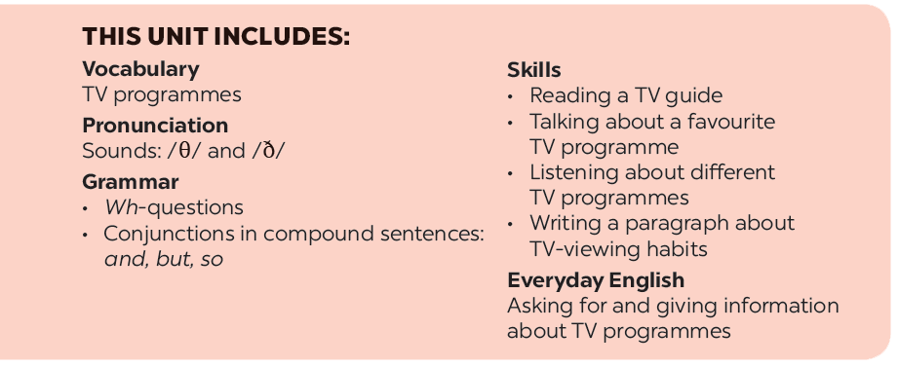

Slide 3
What’s on today?
Listen and read.
Find and write the adjectives in the conversation which describe the programmes and characters below.
Choose the correct answer A, B, or C.
Work in groups. Interview your partners about their favourite TV programmes and report to the class.
Read the conversation again and match 1-5 with a-e.

Slide 4
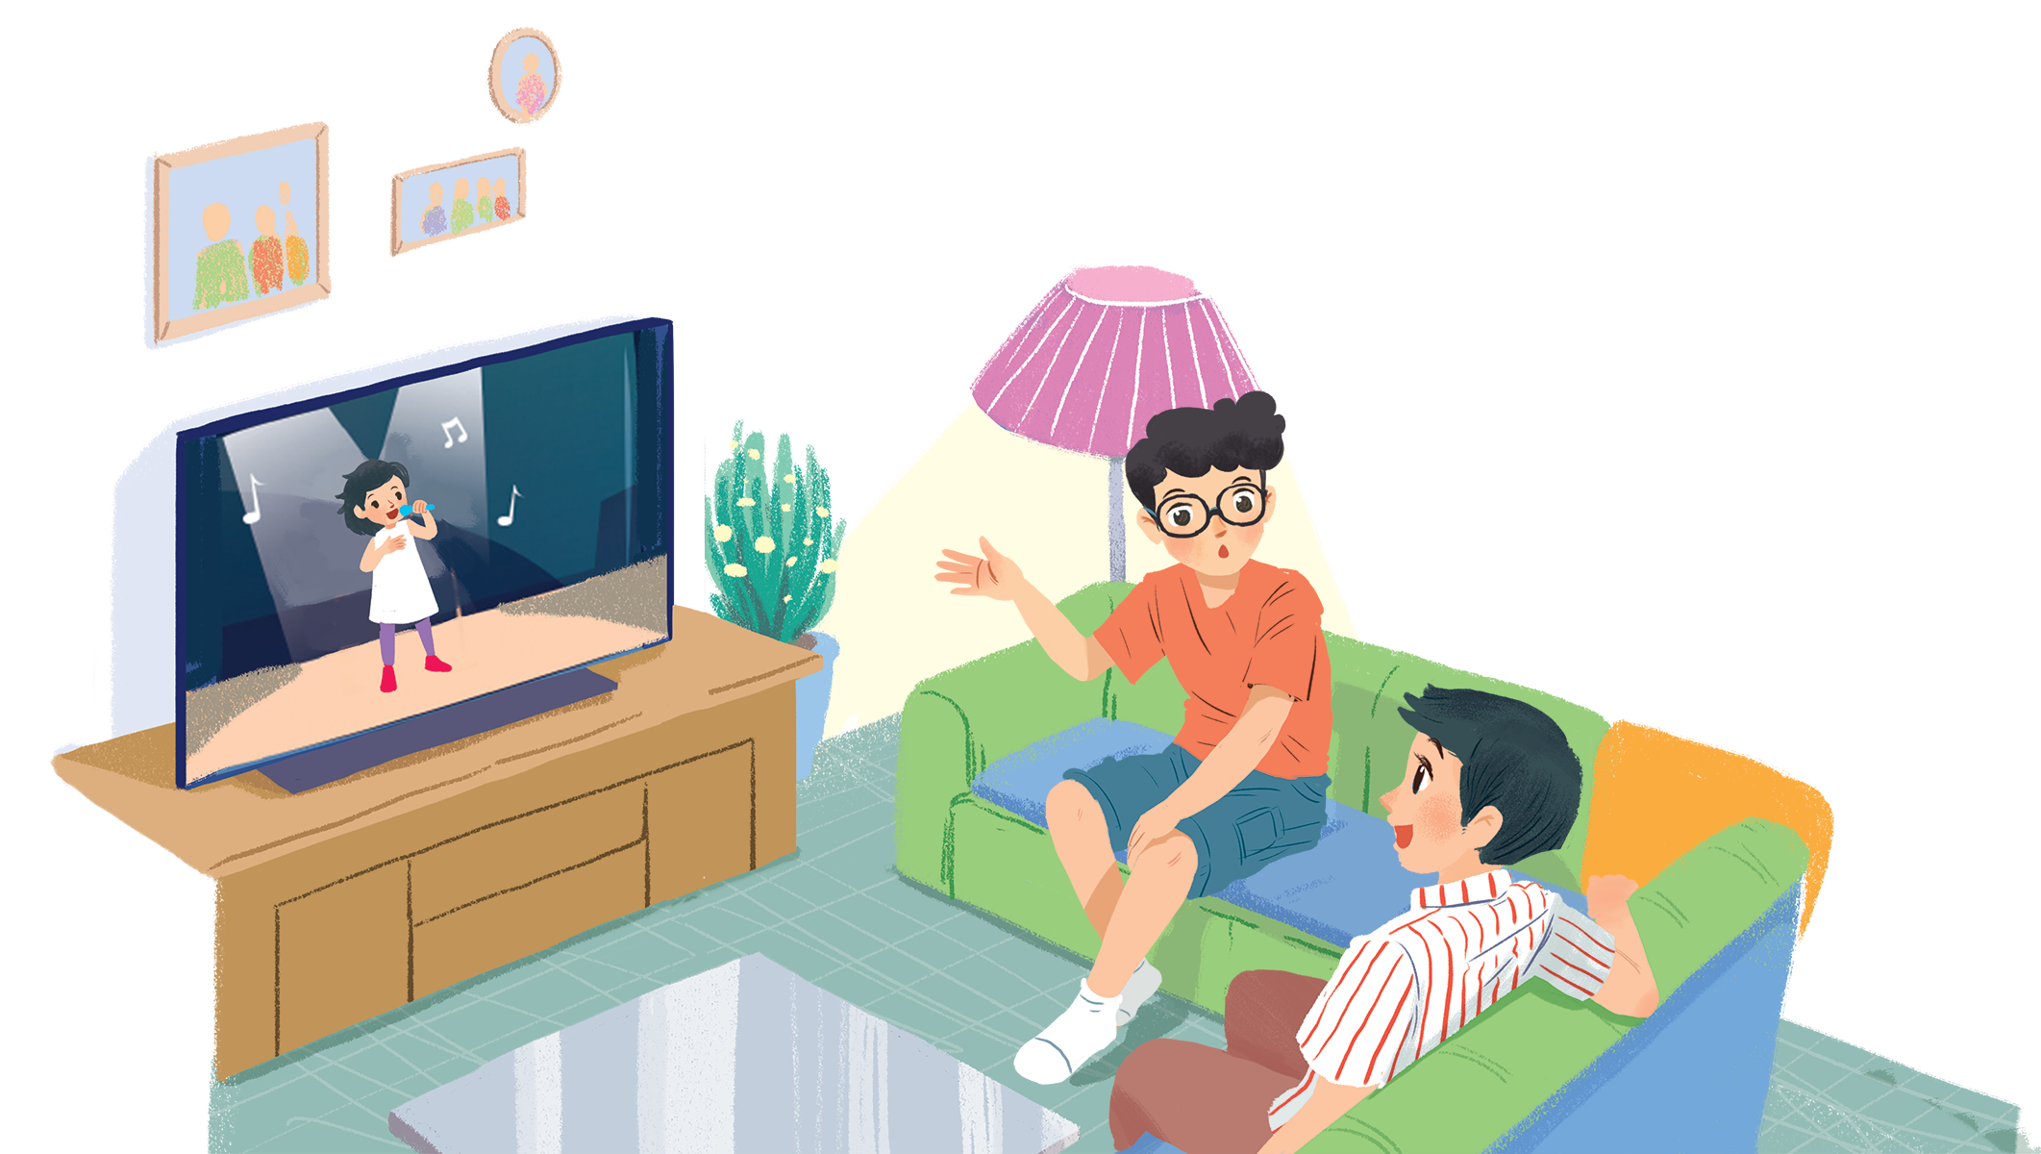
Listen and read.
What’s on today?

Slide 5
What’s on today?
Phong: What are you watching, Hung?
Hung: The Voice Kids.
Phong: That music talent show is very interesting.
Hung: It is. What programme do you often watch, Phong?
Phong: Films. I like animated films like The Lion King.
Hung: I love them, too. They’re wonderful.
Phong: I often watch them with my little brother, but he prefers cartoons.
Hung: Tom and Jerry?
Phong: Ha ... ha ... Yes, he loves Jerry the mouse.
Hung: Jerry’s a clever character. Do you know any English programmes for children?
Phong: Yes. I watch English in a Minute on VTV7.
This channel has many educational programmes.
Hung: Great. I’ll watch it, too.

Slide 6
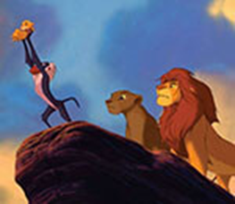
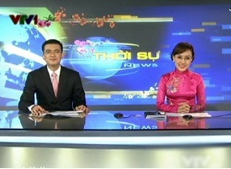
Vocabulary:
programme /ˈprəʊɡræm/ (n):
talent show /ˈtælənt ʃəʊ/ (n):
animated film /ˈænɪmeɪtɪd fɪlm/ (n):
character /ˈkærəktə(r)/ (n):
educational /ˌedʒuˈkeɪʃənl/(adj):
prefer / prɪˈfɜː/ (v):

Slide 7
Vocabulary:
1. programme /ˈprəʊɡræm/ (n):
chương trình
2. talent show /ˈtælənt ʃəʊ/ (n):
cuộc thi tài năng trên truyền hình
3. animated film /ˈænɪmeɪtɪd fɪlm/ (n):
phim hoạt hình
4. character /ˈkærəktə(r)/ (n):
nhân vật
5. educational /ˌedʒuˈkeɪʃənl/(adj):
mang tính giáo dục
6. prefer / prɪˈfɜː/ (v):
thích hơn

Slide 8
What’s on today?
Phong: What are you watching, Hung?
Hung: The Voice Kids.
Phong: That music talent show is very interesting.
Hung: It is. What programme do you often watch, Phong?
Phong: Films. I like animated films like The Lion King.
Hung: I love them, too. They’re wonderful.
Phong: I often watch them with my little brother, but he prefers cartoons.
Hung: Tom and Jerry?
Phong: Ha ... ha ... Yes, he loves Jerry the mouse.
Hung: Jerry’s a clever character. Do you know any English programmes for children?
Phong: Yes. I watch English in a Minute on VTV7.
This channel has many educational programmes.
Hung: Great. I’ll watch it, too.

Slide 9
Read the conversation again and match 1-5 with a-e.
1. The Voice Kids
2. The Lion King
3. Tom and Jerry
4. VTV7
5. English in a Minute
c. music talent show
a. animated film
a. animated film
b. channel
e. cartoon
c. music talent show
b. channel
d. educational programme
e. cartoon
d. educational programme

Slide 10
Read the conversation again and match 1-5 with a-e.
1. The Voice Kids
2. The Lion King
3. Tom and Jerry
4. VTV7
5. English in a Minute
c. music talent show
a. animated film
a. animated film
b. channel
e. cartoon
c. music talent show
b. channel
d. educational programme
e. cartoon
d. educational programme

Slide 11
Find and write the adjectives in the conversation which describe the programmes and characters below.
1.
The Voice Kids
interesting
2.
animated films
wonderful
3.
Jerry the mouse
clever
4.
programmes on VTV7
educational

Slide 12
Choose the correct answer A, B, or C.
1.
Phong and Hung are talking about _______.
A.
The Voice Kids programme
B.
English in a Minute programme
C.
different TV programmes
2.
Phong likes _______.
A.
animated films
B.
cartoons
C.
talent shows
3.
When you’re viewing a TV programme, you say: “I’m _______ TV.”
B.
C.
looking
A.
watching
seeing
4.
When a programme teaches you something, it’s _______.
A.
educational
B.
funny
C.
clever

Slide 14
Work in groups. Interview your partners about their favourite TV programmes and report to the class.
Example:
In our group, Mai likes sports programmes on TV. Binh likes ...

