Slide 1
REVIEW 2 UNITS 4 – 5 – 6. LESSON 2 - Skills
Start now!

Slide 2
Objectives
Monday
Tuesday
Wednesday
Thursday
Friday
Homework
By the end of the lesson, students can:
01.
02.
03.
Read the website about Singapore and find the information and then answer the questions.
Ask and answer the question about places which they want to go to and why.
Listen and answer the questions and then decide if these sentences are True (T) or False (F).

Slide 3
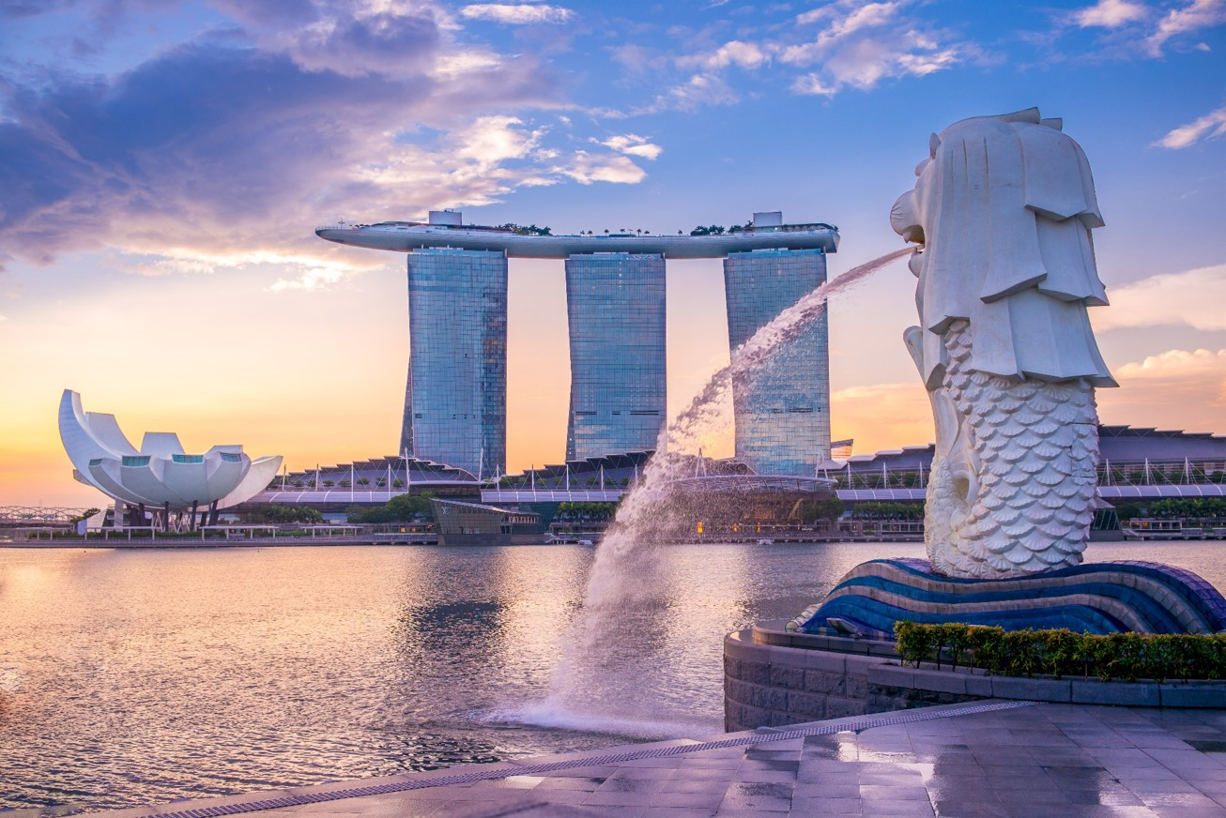
Visit Singapore
Reading
Ex 1. (p 68-69) Read the passage and match the headings (A, B, C) with the paragraphs.
A. Family
B. Nature
C. Culture
There are many parks in this country. You can visit them,
and enjoy beautiful plants and flowers, or do outdoor
activities: cycling or boating. You can also go to the zoo to
see animals in real life.
1.
There are many parks in this country. You can visit them,
and enjoy beautiful plants and flowers, or do outdoor
activities: cycling or boating. You can also go to the zoo to
see animals in real life.
Go to places like Chinatown and Little India to learn about
the people and cultures of China and India. There you can
see how they live, try their food, and buy souvenirs. There
are festivals too. They attract a lot of visitors.
2.
Go to places like Chinatown and Little India to learn about
the people and cultures of China and India. There you can
see how they live, try their food, and buy souvenirs. There
are festivals too. They attract a lot of visitors.
Families looking for exciting activities for both children and
adults should go to Sentosa. There are so many things for you
to see and to do there, so you will never get bored.
3.
Families looking for exciting activities for both children and
adults should go to Sentosa. There are so many things for you
to see and to do there, so you will never get bored.

Slide 4
Reading
Ex 2. (p 69) Read the passage again and choose the correct answer A, B or C.
1.
You can find beautiful plants and flowers in ______.
A.
a park
B.
Chinatown
C.
Sentosa
2.
You can see different kinds of animals in real life in a ______.
A.
zoo
B.
park
C.
town
3.
You can ______ in places like Chinatown.
B.
C.
do outdoor activities
A.
watch animals
watch festivals
4.
______ has interesting activities for both children and parents.
A.
B.
The zoo
C.
Sentosa
Little India

Slide 5
Reading
Ex 2. (p 69) Read the passage again and choose the correct answer A, B or C.
1.
You can find beautiful plants and flowers in ______.
A.
a park
B.
Chinatown
C.
Sentosa
→ You can find beautiful plants and flowers in a park.
2.
You can see different kinds of animals in real life in a ______.
A.
zoo
B.
park
C.
town
→ You can see different kinds of animals in a zoo.

Slide 6
Reading
Ex 2. (p 69) Read the passage again and choose the correct answer A, B or C.
3.
You can ______ in places like Chinatown.
B.
watch festivals
A.
watch animals
C.
do outdoor activities
→ You can watch festivals in places like Chinatown.
4.
______ has interesting activities for both children and parents.
A.
B.
The zoo
C.
Sentosa
Little India
→ Sentosa has interesting activities for both children and parents.

Slide 7
Reading
Ex 2. (p 69) Read the passage again and choose the correct answer A, B or C.
1.
You can find beautiful plants and flowers in ______.
A.
a park
B.
Chinatown
C.
Sentosa
2.
You can see different kinds of animals in real life in a ______.
A.
zoo
B.
park
C.
town
3.
You can ______ in places like Chinatown.
B.
C.
do outdoor activities
A.
watch animals
watch festivals
4.
______ has interesting activities for both children and parents.
A.
B.
The zoo
C.
Sentosa
Little India

Slide 8
A list of places:
Reading
Ex 3. (p 69) Work in pairs.
Read the passage ‘Visit Singapore’ again
Make a list of the places
- parks
- the zoo
- Chinatown
- Little India
- Sentosa

Slide 9
Ex 3. (p 69) Work in pairs. Take turns to ask and find out which place your partner wants to visit and why.
Example
Structure
A: Which place do you want to visit?
B: The zoo.
A: Why do you want to visit it?
B: I want to see the animals.
A: Which place do you want to visit?
B: Place
A: Why do you want to visit it?
B: Reason
Time to do

Slide 10
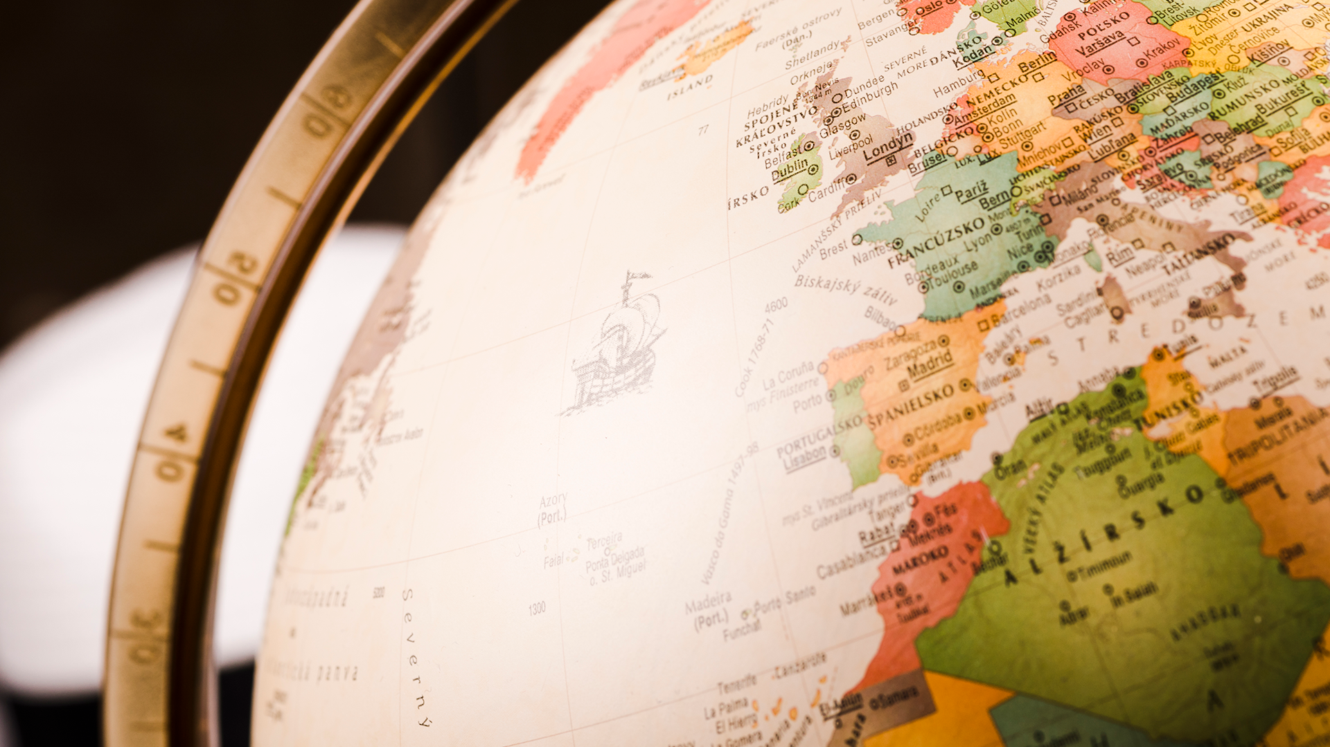
Underline the keywords.
Listening
Monday
Ex 4. (p 69) Listen and tick (✓) T (True) or F (False).
1. Mai's visit to Singapore is four days.
1. Mai's visit to Singapore is four days.
2. They won't go to the National Park.
2. They won't go to the National Park.
3. The visit to Sentosa takes a full day.
3. The visit to Sentosa takes a full day.
4. The Sea Aquarium is a zoo for fish.
4. The Sea Aquarium is a zoo for fish.
5. The Light and Sound Show is the afternoon.
5. The Light and Sound Show is the afternoon.

Slide 11
01.
Mai's visit to Singapore is four days.
Ex 4. (p 69) Listen and tick (✓) T (True) or F (False).
True
→ Travel agent: Here we have a four-day programme for you ...

Slide 12
They won't go to the National Park.
The visit to Sentosa takes a full day.
Ex 4. (p 69) Listen and tick (✓) T (True) or F (False).
02
→ Mai's mother: Do we visit somewhere natural?
Travel agent: Oh yes. We have two days for nature: one day at the National Park and one day at the zoo.
False
03
→ Mai's mother: How about Sentosa?
Travel agent: Sentosa is a 'must' for families. We spend one day there.
Mai's mother: Is it enough?
Travel agent: We start early and return late. There we visit the Sea Aquarium ...
True

Slide 13
True
Ex 4. (p 69) Listen and tick (✓) T (True) or F (False).
04
The Sea Aquarium is a zoo for fish.
→ Travel agent: We start early and return late. There we visit the Sea Aquarium ...
Mal's mother: What is it?
Travel agent: It's a zoo for fish.

Slide 14
False
Ex 4. (p 69) Listen and tick (✓) T (True) or F (False).
05
The Light and Sound Show is the afternoon.
→ Travel agent: In the evening we will watch the Light and Sound Show. And the last day is for...

Slide 15
Writing
Ex 5. (p 69) Complete this paragraph to describe the place you live.
I live in (1)__________. Life is very(2)__________here.
There is / are (3)__________ (places) in my
neighbourhood. At weekends, my friends and I often
go to (4)__________where we can (5)__________
(activities).That’s our favourite place.

Slide 16
WHAT TYPES OF EXERCISES TODAY?
RECAP
Read and decide T or F.
Listen and answer.
Fill in the blank to describe the place you live.
Match headings with their paragraph.

Slide 17
RECAP
Mark the words according to the topic units 4 5 6.
peaceful
exhausted
suburbs
geography
gatherings
ceilings
contests
customs

Slide 18
Your Teacher
Monday
Tuesday
Wednesday
Thursday
Friday
Homework
Thank you!

