Slide 2
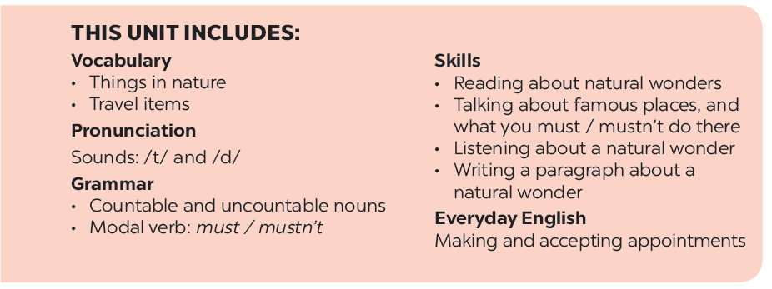

Slide 3
Vocabulary
Grammar
Write the name for each picture.
Find the mistake in each sentence and correct it.
Match the name of a natural wonder in column A with a word indicating it in column B. 1 is an example.
Complete the dialogue, using must or mustn’t.
Write the words.

Slide 4
Vocabulary

Slide 6
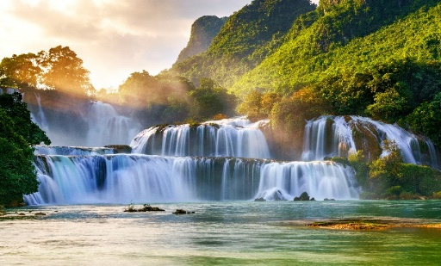
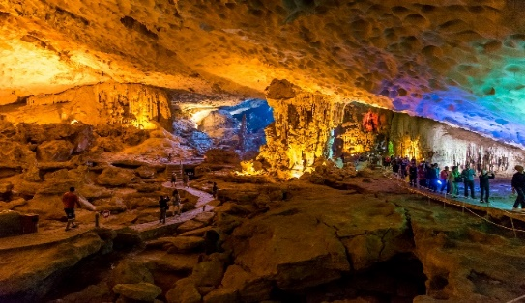
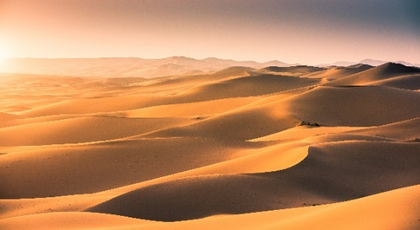
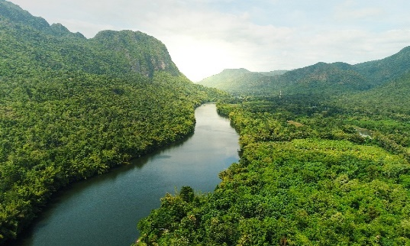
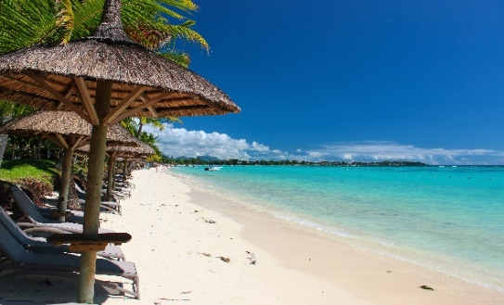
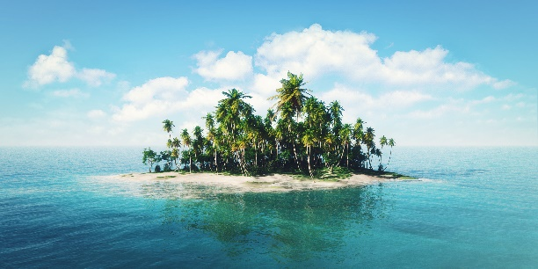
Kim’s game
1. …………………..
2. …………………..
3. …………………..
4. …………………..
5. …………………..
6. …………………..

Slide 7
Kim’s game
. waterfall
cave
desert
1. …………………..
2. …………………..
3. …………………..
river
beach
island
4. …………………..
5. …………………..
6. …………………..

Slide 8
Match the name of a natural wonder in column A with a word indicating it in column B. 1 is an example.
A
B
1. Fansipan
a. Bay
d. mount
2. Ban Gioc
b. Island
c. waterfall
3. Ha Long
c. waterfall
a. Bay
4. Cuc Phuong
d. mount
e. forest
5. The Sahara
e. forest
f. desert
6. Con Dao
f. desert
b. Island

Slide 9
Match the name of a natural wonder in column A with a word indicating it in column B. 1 is an example.
A
B
1. Fansipan
a. Bay
d. mount
2. Ban Gioc
b. Island
c. waterfall
3. Ha Long
c. waterfall
a. Bay
4. Cuc Phuong
d. mount
e. forest
5. The Sahara
e. forest
f. desert
6. Con Dao
f. desert
b. Island

Slide 10
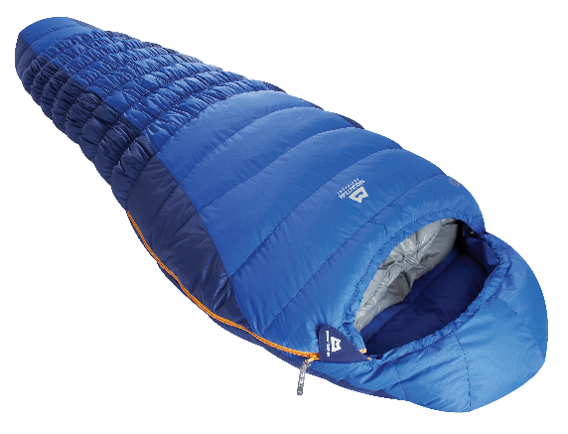
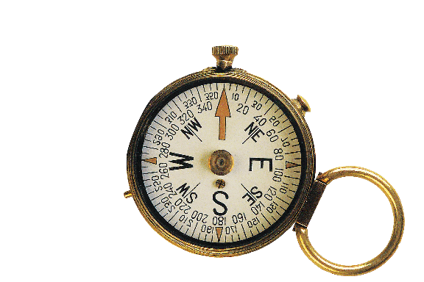
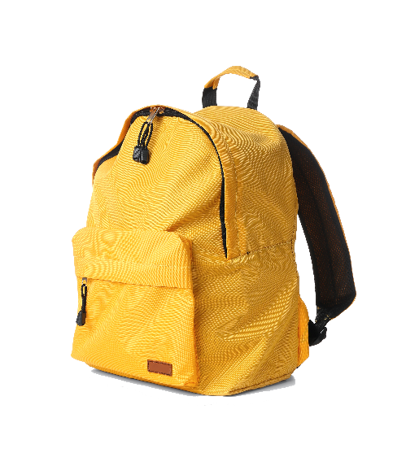
Write the words.
a. scissors
b. sleeping bag
c. compass
a.
b.
c.
d. backpack
e. plaster
d.
e.

Slide 11
Grammar

Slide 12
Find the mistake in each sentence and correct it.
Example:
There is some wonderful camping sites in our area.
is are

Slide 13
1.
How many candles is on that birthday cake?
is are
2.
There are so much snow on the road.
are is
3.
Michael can play different musical instrument.
instrument instruments
4.
There are not much milk left in the fridge.
are is
5.
Don’t take too much luggages on your trip.
luggages luggage

Slide 14
Complete the dialogue, using must or mustn’t.
must
A:
It’s dangerous to go hiking there. You (1) tell someone where you are going.
Yes. And I (2) take a warm coat.
It’s very cold there.
B:
must
Right. But you (3) bring any heavy or unnecessary things with you.
A:
mustn’t
OK, and I (4) take a mobile phone. It’s very important.
B:
must
A:
mustn’t
And you (5) forget to bring a compass.

Slide 15
DREAM DESTINATION
In groups, make a poster about a natural wonder you would like to visit. In the poster, draw / print a picture of the place. Then give some information about the place:
what the natural wonder is
where it is
how you can go there
what it is special about
what you can do there
…

Slide 16
DREAM DESTINATION
Introduce the attraction to your class.

Slide 17
Now I can … |  |  | 
use the words related to things in nature and travel items.
pronounce the sounds /t/ and /d/ correctly.
use countable and uncountable nouns.
use the modal verb must / mustn’t.
make and accept appointments.
read about natural wonders.
talk about famous places, and what you must / mustn’t do there.
listen about a natural wonder.
write a paragraph about a natural wonder.
✓
✓
✓
✓
✓
✓
✓
✓
✓
✓
✓
✓
✓
✓
✓
✓
✓
✓
✓
✓
✓
✓
✓
✓
✓
✓
✓

Slide 19
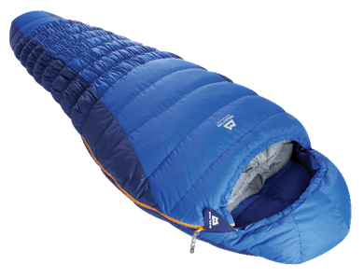
1. …………………..
2. …………………..
3. …………………..
4. …………………..
5. …………………..
6. …………………..
9. …………………..
7. …………………..
8. …………………..
10. …………………..
11. …………………..

Slide 20
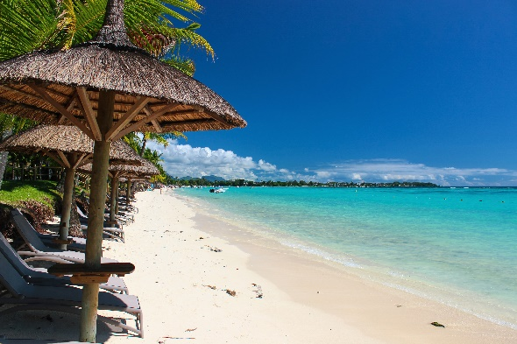
Write the name for each picture.

Slide 22
2.

Slide 23
3.

Slide 24
4.

Slide 25
5.

Slide 26
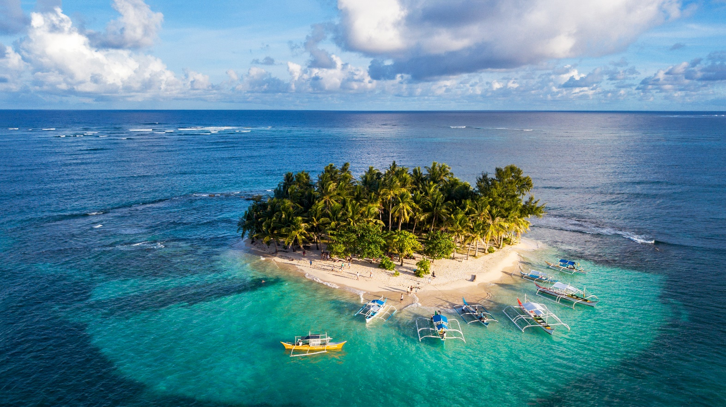
6.

