Slide 2
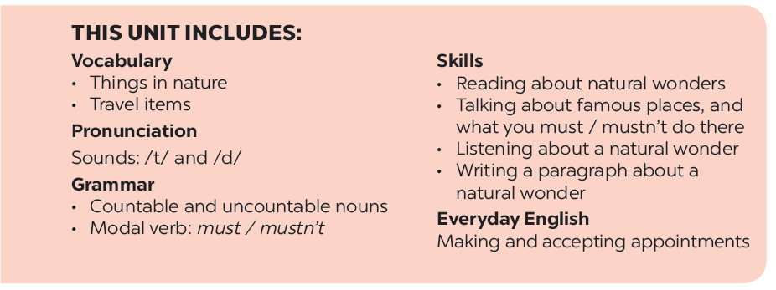

Slide 3
Listening
Writing
Work in groups. Discuss the question.
Fill each blank in the network with the information about a travel attraction you know.
Listen again and tick () T (True) or F (False).
Use the notes in 3 to write a paragraph of about 50 words.

Slide 4
Listening

Slide 5
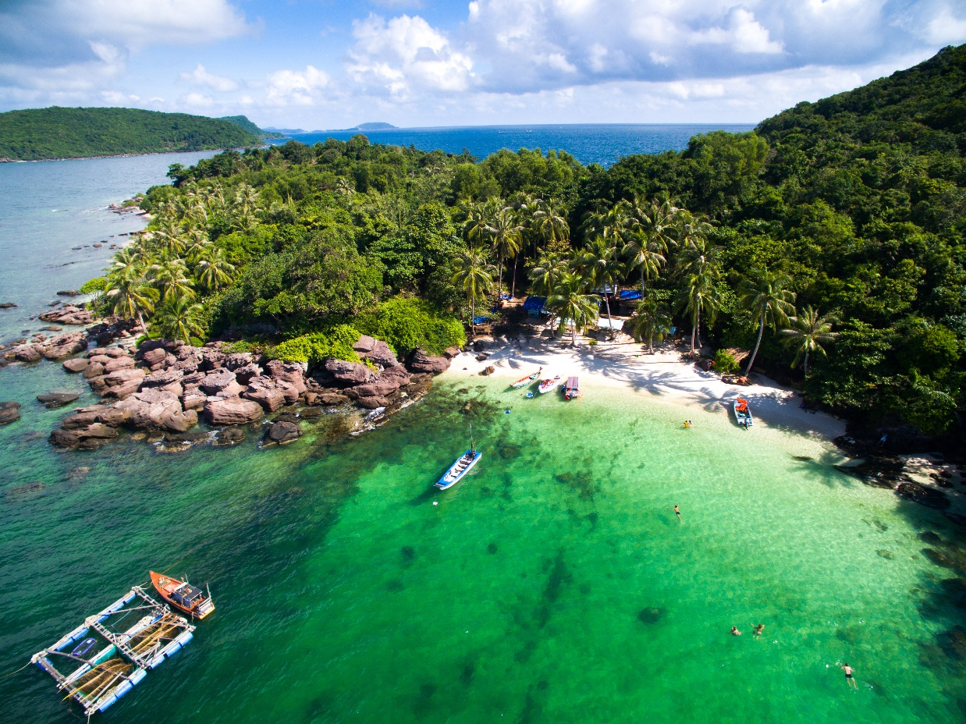
Work in groups. Discuss the question.
What do you know about Phu Quoc Island?
Listen to the talk and check your answers.
Audio script

Slide 6
AUDIO SCRIPT
Phu Quoc is a very beautiful island in Viet Nam. It is in Kien Giang. It has beautiful beaches and green forests. It also has resorts, hotels, and bars. The people here are friendly. Phu Quoc has an international airport, and travelling there is easy. Tourists can visit fishing villages, national parks, pagodas and temples. They also like to eat the seafood here. It is delicious. Sailing and fishing are popular water sports. You can buy interesting things at the markets on the island.

Slide 7
Listen again and tick () T (True) or F (False).
 |  | T | F
1. | Phu Quoc is a very beautiful island in Viet Nam.
2. | There are no green forests in Phu Quoc.
3. | Tourists can visit fishing villages and national parks there.
4. | You cannot play water sports in Phu Quoc.
5. | People sell interesting things at the markets.





Audio script

Slide 8
AUDIO SCRIPT
Phu Quoc is a very beautiful island in Viet Nam. It is in Kien Giang. It has beautiful beaches and green forests. It also has resorts, hotels, and bars. The people here are friendly. Phu Quoc has an international airport, and travelling there is easy. Tourists can visit fishing villages, national parks, pagodas and temples. They also like to eat the seafood here. It is delicious. Sailing and fishing are popular water sports. You can buy interesting things at the markets on the island.

Slide 9
Writing

Slide 10
Fill each blank in the network with the information about a travel attraction you know.
(2) Where is it?
(3) How can you go there?
(1) Name of the attraction
(5) What can you do there?
(4) What is special about it?

Slide 11
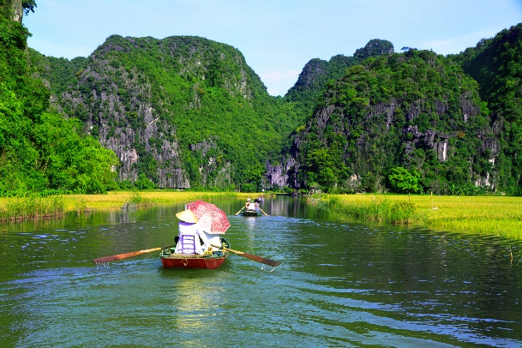
Use the notes in 3 to write a paragraph of about 50 words.
I am writing about
It is in

Slide 12
I am writing about Phu Quoc island. It is a beautiful island in Kien Giang province. You can go there by plane. You can visit the fishing villages, the national parks, beautiful beaches, temples, pagodas, etc. You can enjoy some water sports like sailing and fishing. You can buy interesting things at the night market. There you can enjoy great Vietnamese seafood. I think, you should have a visit to Phu Quoc.

Slide 13
I am writing about Ha Long Bay.
It is in Quang Ninh province. It’s very far from here - about 500 kilometers, so you can go there by bus or by train. Ha long Bay has many caves and islands. Tuan Chau is the biggest island in Ha Long Bay. You must take a boat ride around the islands. There you can enjoy great Vietnamese seafood. You can watch traditional dance. You can join exciting activities. Ha Long Bay is Vietnam’s most beautiful natural wonder.

