Slide 2
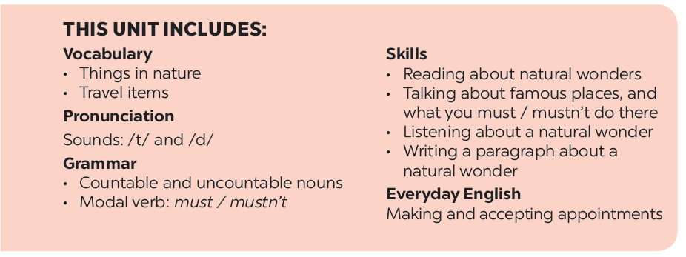

Slide 3
Reading
Speaking
Before you read, look at the pictures below. Make predictions about the reading. Then read and check your ideas.
Work in pairs. Make notes about one of the places in the reading. You can add your own ideas.
Some foreign visitors are visiting your city / town / area. You are their tour guide. Tell them some interesting things about the place as well as what they must and mustn’t do there.
Complete the sentences, using the words from the box.
Read the text again. Answer the following questions.

Slide 4
Reading

Slide 5
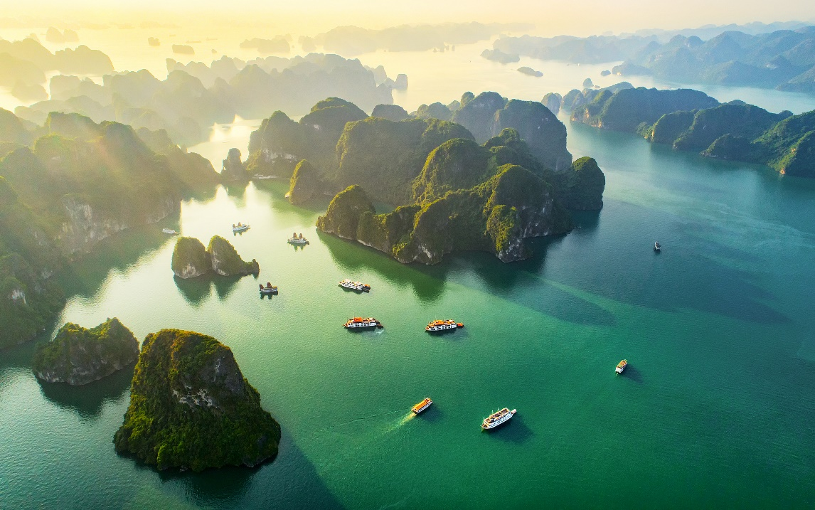
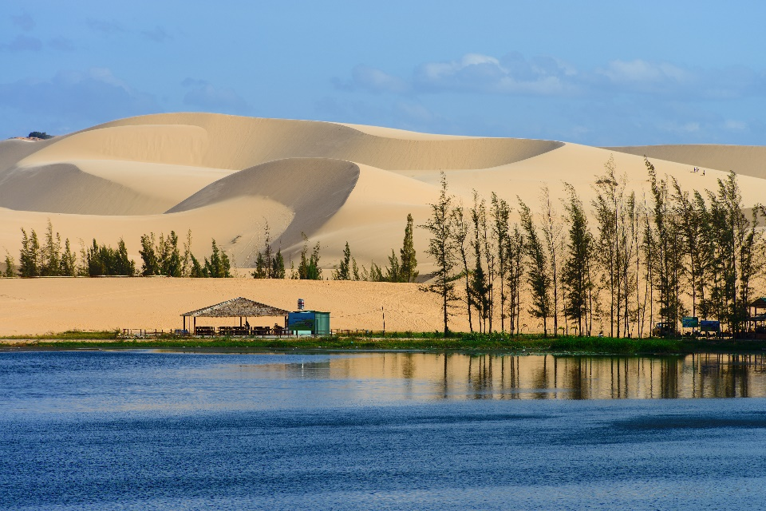
Before you read, look at the pictures below. Make predictions about the reading. Then read and check your ideas.
1.
What is the reading about?
2.
What do you know about these places?

Slide 6
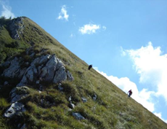
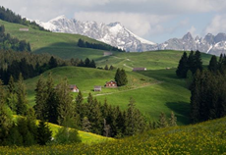
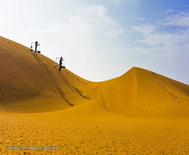
* Vocabulary:
tourist attraction (n) : điểm thu hút khách du lịch
/ ˈtʊə.rɪst əˈtræk.ʃən/
- popular / ˈpɒpjələr/(adj): phổ biến
- landscape /ˈlændskeɪp/ (n) : phong cảnh
- slope /sləʊp/ (n) : dốc, sườn
- sand dune /ˈsænd ˌdjuːn/ (n) : cồn cát

Slide 7
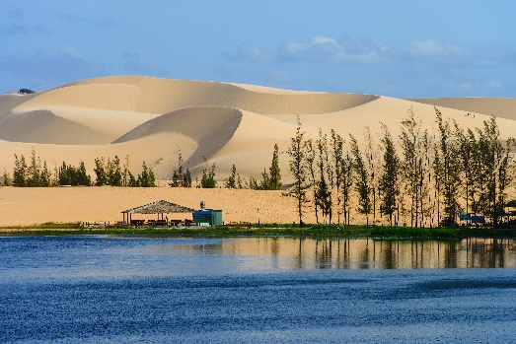
Ha Long Bay is in Quang Ninh. It has many islands and caves. Tuan Chau, with its beautiful beaches, is a popular tourist attraction in Ha Long Bay. There you can enjoy great seafood. And you can join in exciting activities. Ha Long Bay is Viet Nam’s best natural wonder.
Mui Ne is popular for its amazing landscapes. The sand has different colours: white, yellow, red ... It’s like a desert here. You can ride a bike down the slopes. You can also fly kites, or have a picnic by the beach. The best time to visit the Mui Ne Sand Dunes is early morning or late afternoon. Remember to wear suncream and bring water.

Slide 8
Before you read, look at the pictures below. Make predictions about the reading. Then read and check your ideas.
Note: Tuan Chau: a large island in Ha Long Bay, a popular tourist destination
Mui Ne: a tourist attraction in Binh Thuan Province

Slide 9
Complete the sentences, using the words from the box.
desert
visit
wonder
islands
remember
Ha Long Bay is famous for its beautiful .
1.
islands
wonder
2.
Ha long Bay is the number one natural in Viet Nam.
desert
3.
A is a large area of land with very little water.
Remember to bring an umbrella, as it often rains there.
4.
to bring an umbrella, as it often rains there.
5.
A lot of people Ly Son Island in the summer.
visit

Slide 10
Read the text again. Answer the following questions.
1.
Where is Ha Long Bay?
It is in Quang Ninh.
2.
What can you do at Ha Long Bay?
We can enjoy (great) seafood and join in exciting activities.
3.
Is there a desert in Mui Ne?
No, there isn’t.
4.
Where can you have a picnic in Mui Ne?
By the beach.
5.
What is the best time to visit the Mui Ne Sand Dunes?
Early morning or late afternoon.

Slide 11
Speaking

Slide 12
Work in pairs. Make notes about one of the places in the reading. You can add your own ideas.
Ha Long Bay | Mui Ne
interesting islands
a beautiful place
Then tell your partner about the place.
Example:
Ha Long Bay has a lot of interesting islands. It …

Slide 13
Ha Long Bay | Mui Ne
- interesting islands - many islands and caves - beautiful beaches - great seafood - exciting activities | - a beautiful place - amazing landscapes - different colours - like a desert - many activities
- Ha Long Bay has a lot of interesting islands. It also has many caves and beautiful beaches. You can enjoy great seafood here and take part in exciting activities.
Mui Ne is a beautiful place. It has amazing landscapes. The sand has different colours. It looks like a desert. You can join in many activities. You can fly the kites, have a picnic by the beach.

Slide 14
