Slide 2
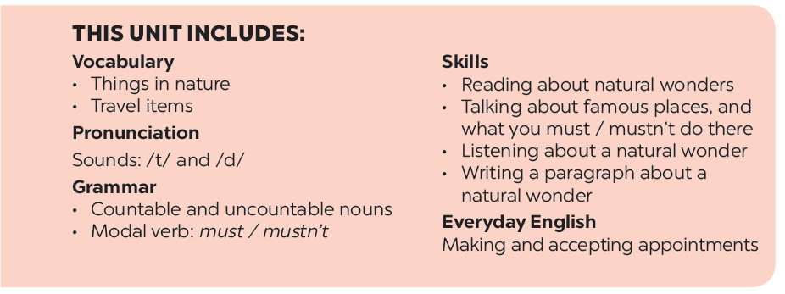

Slide 3
Grammar
Countable and uncountable nouns
Modal verb: must / mustn’t
Is the underlined noun countable or uncountable? Write C (countable) or U (uncountable).
Fill each blank with must or mustn’t.
Choose the correct option for each sentence.
Read the classroom rules below. Write some more rules for you and your classmates.
Fill each blank with a, any, some, much or many.

Slide 4
Grammar
Countable and uncountable nouns
- Countable nouns are for the people and things we can count using numbers. Countable nouns can be singular: a rock, an island ..., or plural: rocks, islands ...
- Uncountable nouns are for the things that we cannot count with numbers. They usually do not have a plural form: cream, chocolate ...

Slide 5
Is the underlined noun countable or uncountable? Write C (countable) or U (uncountable).
1.
The children are very tired after a day of fun.
C
2.
Be careful! The water is deep.
U
3.
My mother uses real butter in the cakes she bakes.
U
4.
Remember to bring the necessary travel items.
C
5.
How about meeting in the canteen for some tea?
Sure. What time?
U

Slide 6
Grammar
Countable and uncountable nouns
We use some, many, a few with countable nouns.
We use some, much, a little with uncountable nouns.

Slide 7
Choose the correct option for each sentence.
1.
I have questions to ask you.
A.
a few
B.
a little
2.
Australia is very nice. It has natural wonders.
A.
much
B.
many
3.
This is a difficult lesson, so only students can understand it.
A.
a few
B.
many
4.
It is a very dry area. There isn’t rain in summer.
A.
a little
B.
much
5.
We’ve got very time before our train leaves.
We must hurry up!
A.
little
B.
much

Slide 8
Fill each blank with a, any, some, much or many.
How books are there in your bag?
1.
many
any
2.
There isn’t milk in the fridge.
It’s empty.
much
3.
How sugar do you need for your tea, Mum?
4.
We need to buy new furniture for the house.
some
5.
There is
a
big cave in this area.
big cave in this area.

Slide 9
Grammar
Modal verb: must / mustn’t
We use must to say that something is very necessary or very important.
We use mustn’t to say that doing something is not allowed.
I / you | must
He / she / it
You / we / they
I / you | mustn’t
He / she / it
You / we / they

Slide 10
Fill each blank with must or mustn’t.
You leave the hotel room before 12 o’clock.
1.
must
mustn’t
2.
You make lots of noise in the museum.
3.
My mum says you
must
always tell the truth.
always tell the truth.
mustn’t
4.
You know you go to bed with your shoes on.
5.
I want to speak English better.
I
practice more.
must
practice more.

Slide 11
Read the classroom rules below. Write some more rules for you and your classmates.
1.
We must arrive on time.
2.
We mustn’t pick flowers in the school garden.
3.
We must .
4.
We mustn’t .
5.
.

