Slide 1
gm

Slide 2
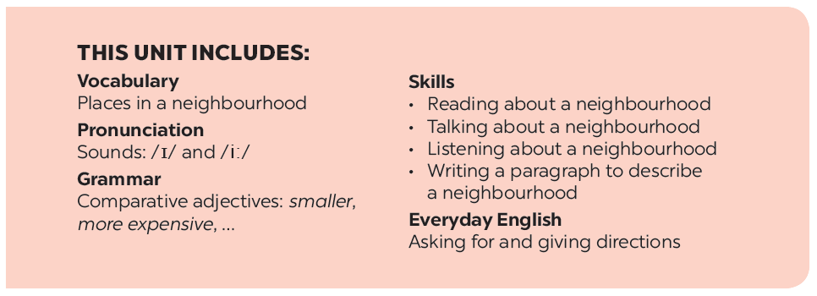

Slide 3
Listening
Writing
Listen to the conversation between Khang and Vy and tick () T (true) or F (False).
Tick () what you like or dislike about a neighbourhood.
Listen to the conversation again and fill the blanks.
Write a paragraph of about 50 words about your neighbourhood saying what you like and dislike about it. use Khang’s blog as a model.

Slide 4
Listening

Slide 5
Listen to the conversation between Khang and Vy and tick () T (true) or F (False).
 |  | T | F
1. | Vy lives in the centre of Ho Chi Minh City.
2. | There is a big market near her house.
3. | The streets are narrow.
4. | The schools are faraway.
5. | There are some factories near her neighbourhood.





Audio script

Slide 6
AUDIO SCRIPT
Khang: Where do you live, Vy?
Vy: I live in the suburbs of Ho Chi Minh City.
Khang: What do you like about it?
Vy: There are many things I like about it. There’s a big
market near my house. There are also many shops,
restaurants and art galleries here. The streets are
wide. The people here are helpful and friendly.
Khang: What do you dislike about it?
Vy: The schools are too faraway. There are also some
factories near here, so the air isn’t very clean and the
streets are noisy and crowded.

Slide 7
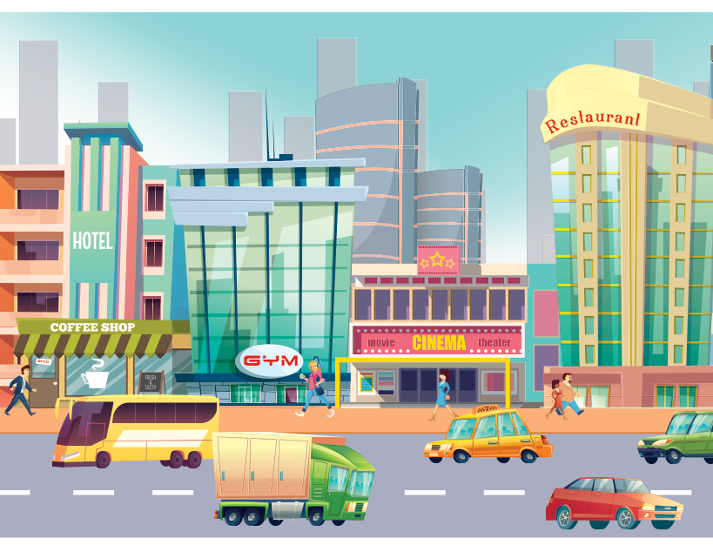
Listen to the conversation again and fill the blanks.
What Vy likes
What Vy dislikes
- many shops, restaurants, and (1) _______ in her neighbourhood
- too (4) _______ school
- dirty air
- (2) _______ streets
- noisy and (5) _______ streets
- helpful and (3) _______ people
Audio script

Slide 8
AUDIO SCRIPT
Khang: Where do you live, Vy?
Vy: I live in the suburbs of Ho Chi Minh City.
Khang: What do you like about it?
Vy: There are many things I like about it. There’s a big
market near my house. There are also many shops,
restaurants and art galleries here. The streets are
wide. The people here are helpful and friendly.
Khang: What do you dislike about it?
Vy: The schools are too faraway. There are also some
factories near here, so the air isn’t very clean and the
streets are noisy and crowded.

Slide 9
What Vy likes
- many shops, restaurants, and (1) in her neighbourhood
art galleries
- (2) streets
wide
- helpful and (3) people
friendly

Slide 10
What Vy dislikes
- too (4) school
faraway
- dirty air
- noisy and (5) streets
crowded

Slide 11
Writing

Slide 12
Tick () what you like or dislike about a neighbourhood.
 |  | Like | Dislike
1. | sandy beaches
2. | heavy traffic
3. | many modern buildings and offices
4. | peaceful streets
5. | good restaurants and cafés
6. | sunny weather
7. | helpful and friendly people
8. | many shops and markets

Slide 13
Write a paragraph of about 50 words about your neighbourhood saying what you like and dislike about it. Use Khang’s blog as a model.
I live in _______. There are many / some things I like about my neighbourhood.
However, there are some / many / one thing(s) I dislike about it.

