Slide 2

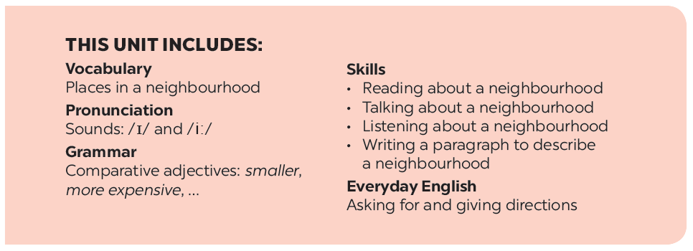

Slide 3






Grammar
Comparative adjectives
Complete the following sentences with the comparative form of the adjectives in brackets. Number 1 is an example.
Look at the pictures of the two neighbourhoods: Binh Minh and Long Son. Compare two neighbourhoods. You can use the adjectives below.
Use the correct form of the words in brackets to complete the letter.
Work in pairs. Ask and answer questions about Binh Minh and Long Son neighbourhoods using the pictures in 3.

Slide 4

Grammar
Comparative adjectives
We can use comparative adjectives to compare two people or things.

Slide 5
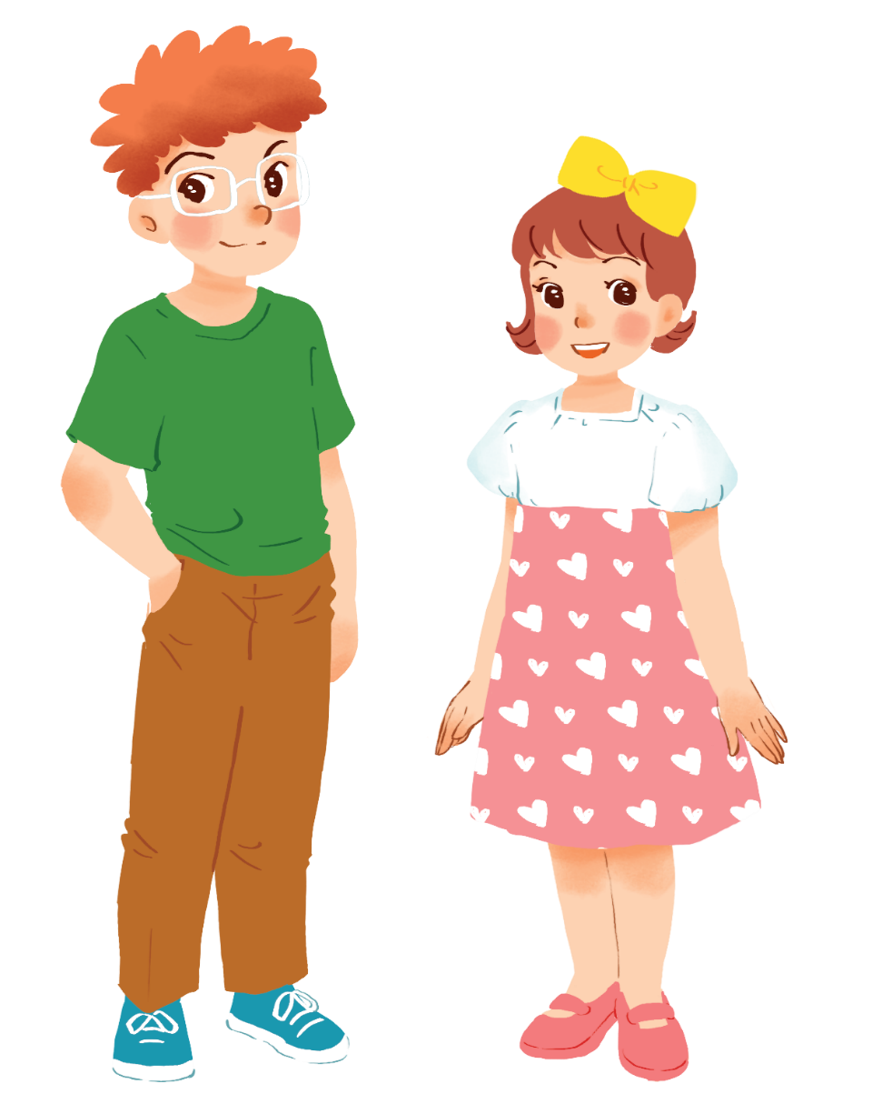
Example:
Tom is taller than Mary.

Slide 6
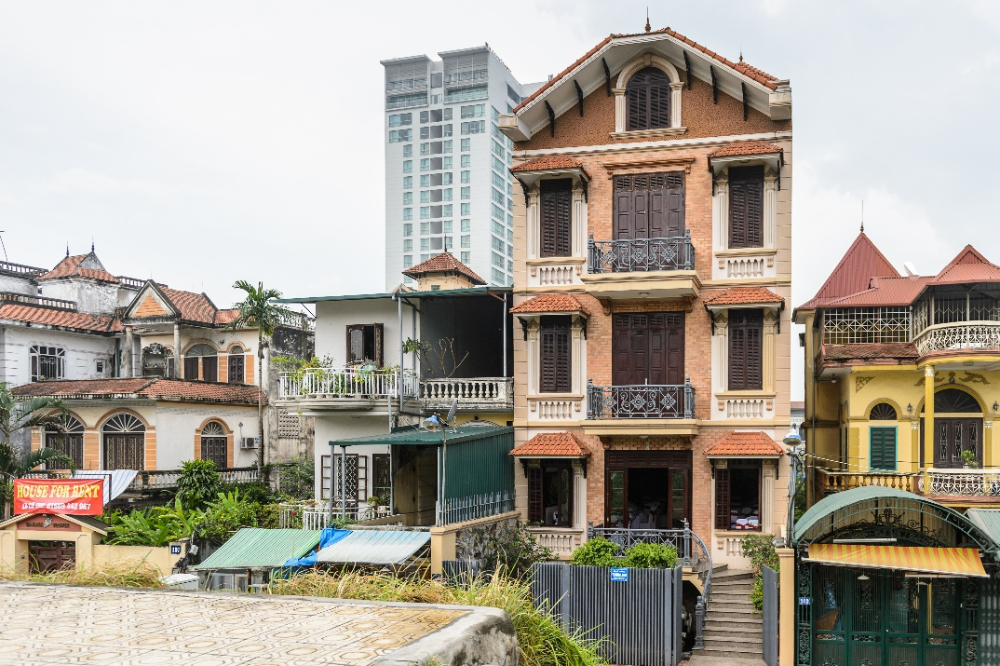
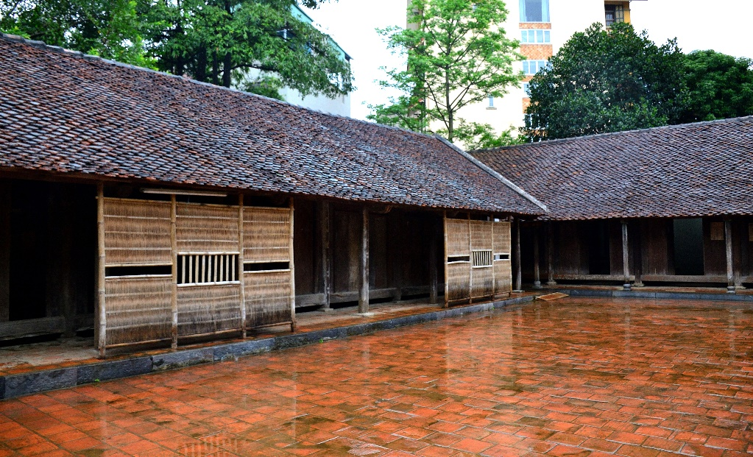
Example:
A house in a city is normally more expensive than a house in the countryside.

Slide 7


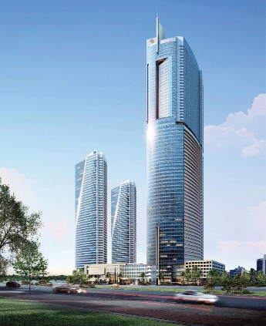
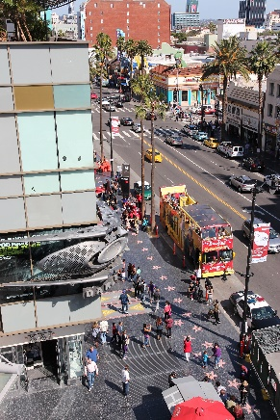

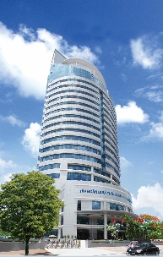
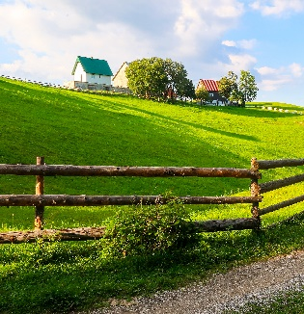
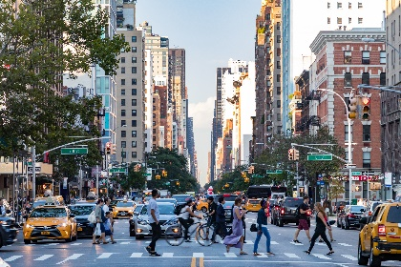
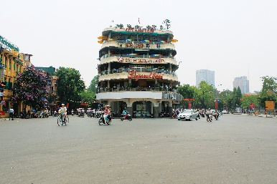
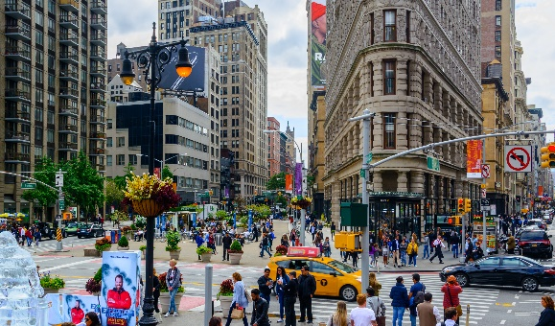
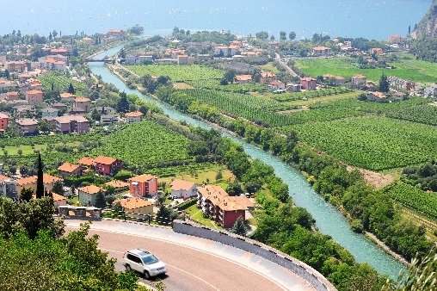
Complete the following sentences with the comparative form of the adjectives in brackets. Number 1 is an example.

Slide 8
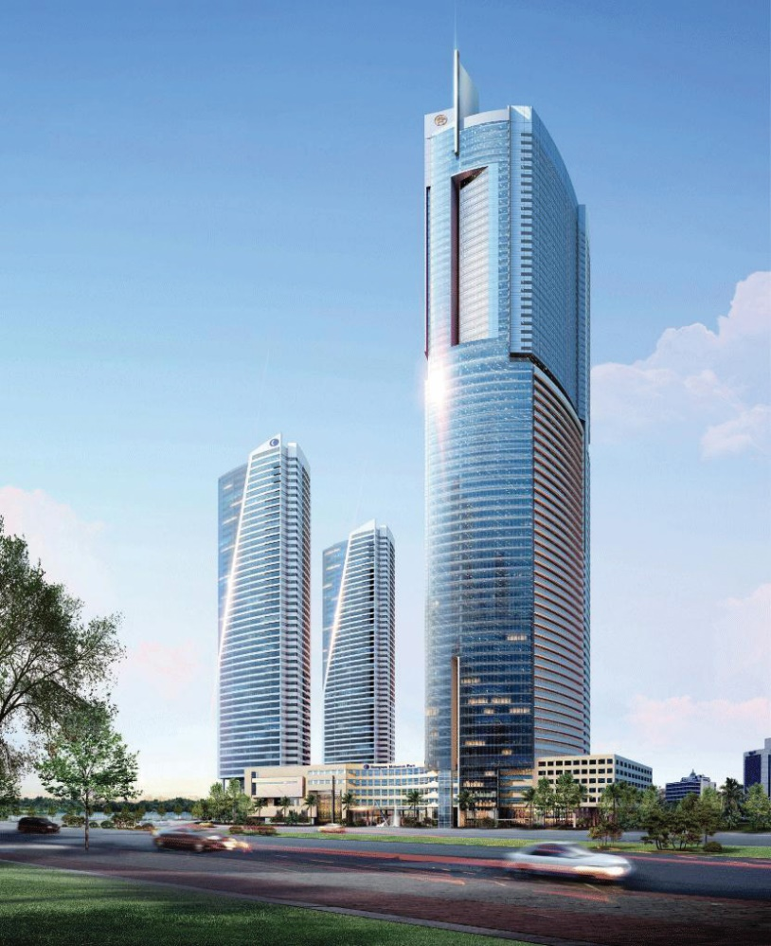

1.
This building is taller than that building. (tall)

Slide 9
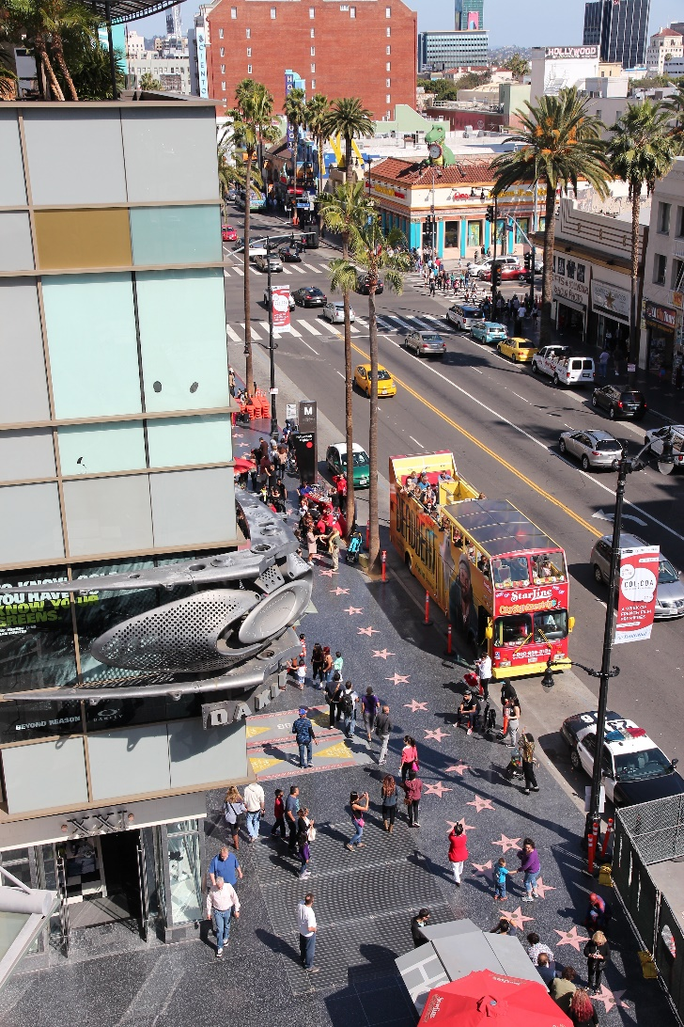

2.
My neighbourhood is than your neighbourhood. (noisy)
noisier

Slide 10

3.
The square in Ha Noi is than the square in Hoi An. (big)
bigger

Slide 11


more peaceful
4.
Living in the countryside is
in a city. (peaceful)
than living
than living

Slide 12
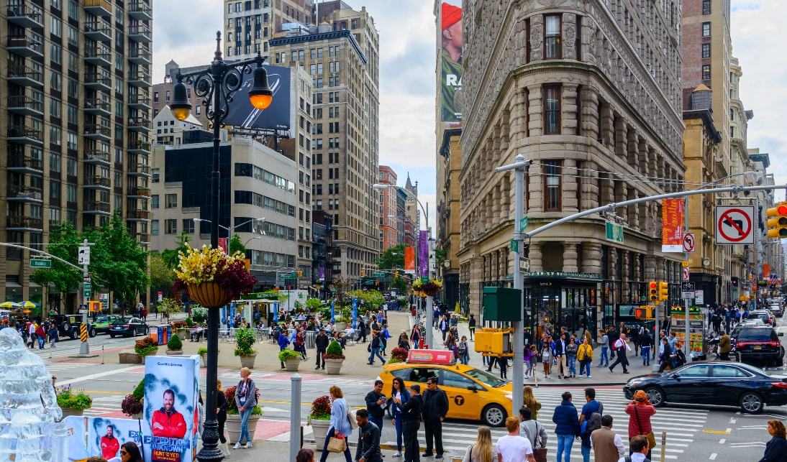

than living
than living
5.
more exciting
Is living in a city
in the countryside? (exciting)

Slide 13


Use the correct form of the words in brackets to complete the letter.
Dear Nick,
more delicious
How are you?
Ha Noi is beautiful but it’s too busy for me. I’m having a great time at Cua Lo Beach now. The weather is (1. hot) hotter than that in Ha Noi. The houses and buildings are (2. small) _______ and (3. old) _______ than those in Ha Noi.
The streets are (4. wide) _______ with less traffic. the seafood here is (5. delicious) _______ and (6. cheap) _______ than the seafood in Ha Noi.
See you soon,
Vy

Slide 14
Use the correct form of the words in brackets to complete the letter.
Dear Nick,
more delicious
How are you?
Ha Noi is beautiful but it’s too busy for me. I’m having a great time at Cua Lo Beach now. The weather is (1. hot) hotter than that in Ha Noi. The houses and buildings are (2. small) smaller and (3. old) older than those in Ha Noi.
The streets are (4. wide) wider with less traffic. the seafood here is (5. delicious) more delicious and (6. cheap) cheaper than the seafood in Ha Noi.
See you soon,
Vy

Slide 15

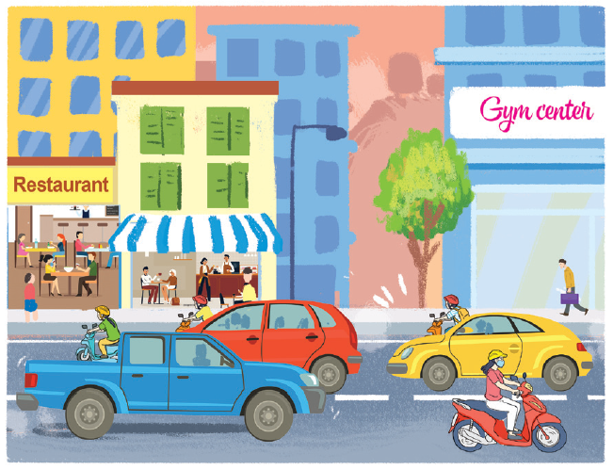
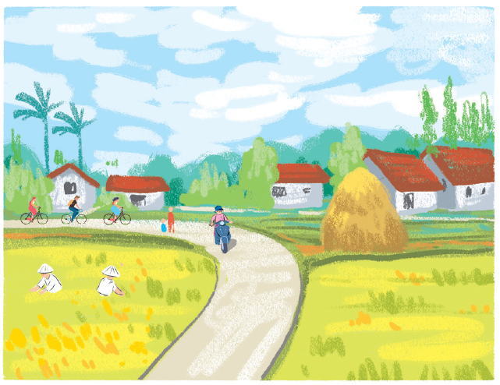
Look at the pictures of the two neighbourhoods: Binh Minh and Long Son. Compare two neighbourhoods. You can use the adjectives below.
noisy
quiet
modern
boring
crowded
peaceful
busy
Example:
Binh Minh is noisier than Long Son.
Binh Minh
Long Son

Slide 16

Work in pairs. Ask and answer questions about Binh Minh and Long Son neighbourhoods using the pictures in 3.
Example:
A: Is Binh Minh noisier than Long Son?
B: Yes, it is.
A: Is Long Son more modern than Binh Minh?
B: No, it isn’t.

Slide 17







