Slide 2
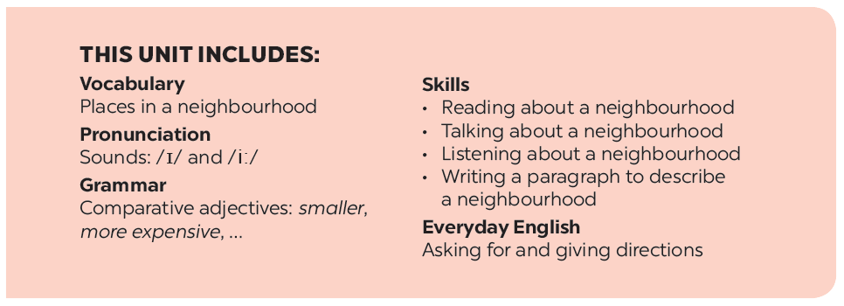

Slide 3
Vocabulary
Pronunciation
/ɪ/ and /i:/
Match the places below with the pictures. Then listen, check and repeat the words.
Listen and repeat the words. Pay attention to the sounds
/ɪ/ and /i:/
Work in pairs. Ask and answer questions about where you live.
Listen and practise the chant. Notice the sounds /ɪ/ and /i:/.
Work in groups. Ask and answer about your neighbourhood. You can use the adjectives below.

Slide 4
Vocabulary

Slide 5
* Vocabulary
- square (n) : quảng trường
- cathedral (n): thánh đường
- railway station (n) : nha ga
- crowded (adj) : đông đúc
- peaceful (adj) : yên bình
- modern (adj) : hiện đại
- boring (adj): buồn chán
- quiet (adj): yên tĩnh # noisy (adj): ồn ào
- busy (adj): nhộn nhịp

Slide 6
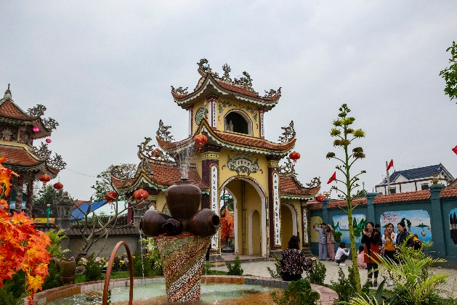
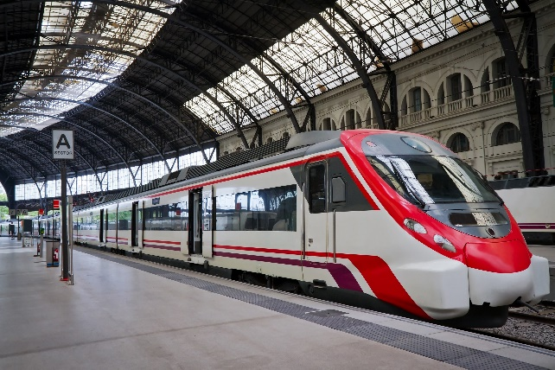
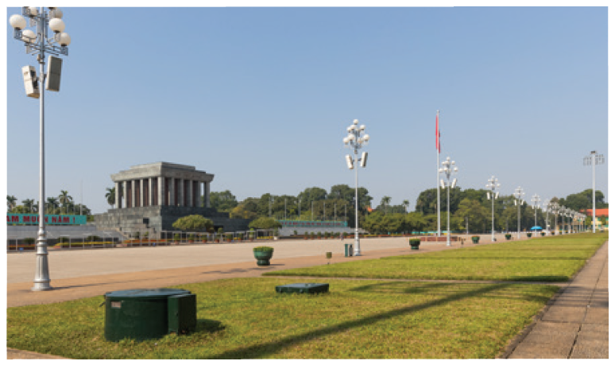
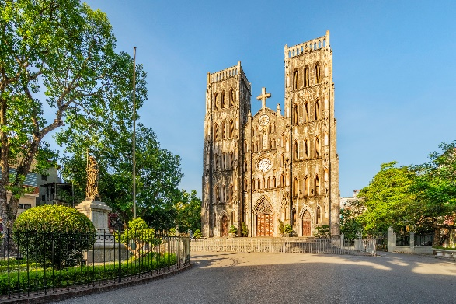
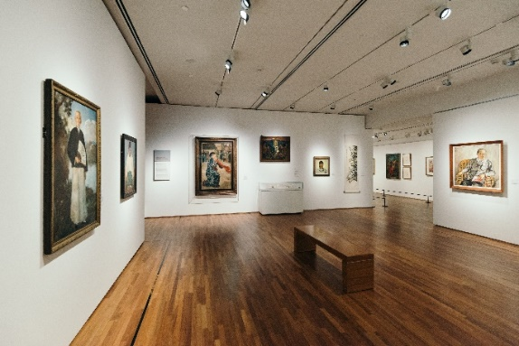
Match the places below with the pictures. Then listen, check and repeat the words.
a
b
b
a
1. square
2. art gallery
3. cathedral
4. temple
4. temple
4. temple
5. railway station
5. railway station
5. railway station
c
d
e
1. square
3. cathedral
2. art gallery
Name some other places in your neighbourhood.

Slide 7
Work in pairs. Ask and answer questions about where you live.
Example:
A: Is there a square in your neighbourhood?
B: Yes, there is. / No, these isn’t.

Slide 8
Work in groups. Ask and answer about your neighbourhood. You can use the adjectives below.
noisy
busy
modern
peaceful
quiet
crowded
boring
beautiful
Example:
A: Is your neighbourhood quiet?
B: Yes, it is. / No, it’s noisy.

Slide 9
Pronunciation
/ɪ/ and /i:/

Slide 10
Listen and repeat the words. Pay attention to the sounds /ɪ/ and /i:/.
noisy
cheap
peaceful
expensive
noisy
cheap
peaceful
expensive
clean
exciting
friendly
convenient
clean
exciting
friendly
convenient
Now, in pairs put the words in the correct column.
/ɪ/ | /i:/
noisy
convenient
expensive
cheap
exciting
peaceful
friendly
clean

Slide 11
Listen and practise the chant. Notice the sounds /ɪ/ and /i:/.
MY NEIGHBOURHOOD
My city is very noisy.
There are lots of trees growing. The people here are busy.
It’s a lively place to live in.
My village is very pretty.
There are lots of places to see.
The people here are friendly.
It’s a fantastic place to be.

