Slide 2
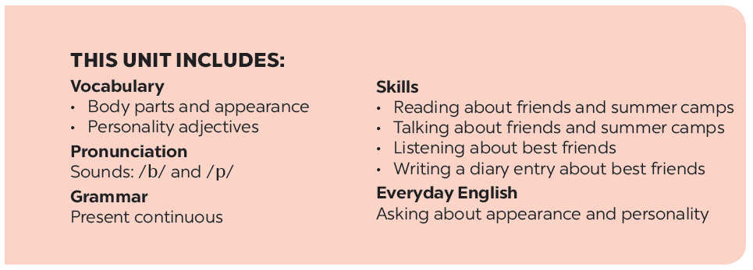

Slide 3
Listening
Writing
What are the students doing in each picture?
Work in pairs. Ask and answer about your best friend. Use these notes to help you.
Listen to Mi and Minh talking about their best friends. Look at the picture below and say which one is Lan and which one is Chi.
Write a diary entry of about 50 words about your best friend. Use the answers to the questions in 4.
Listen to the talk again. Fill each blank with a word / number you hear.

Slide 4
Listening

Slide 5
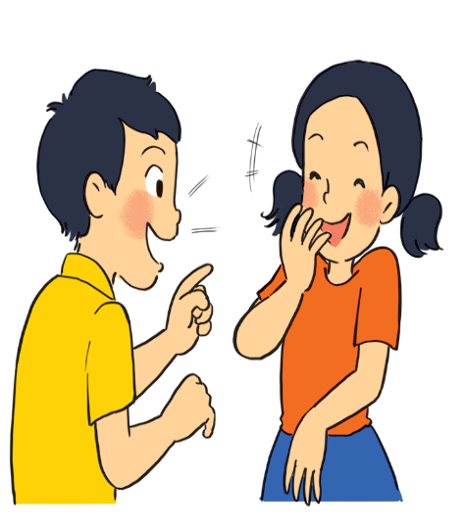
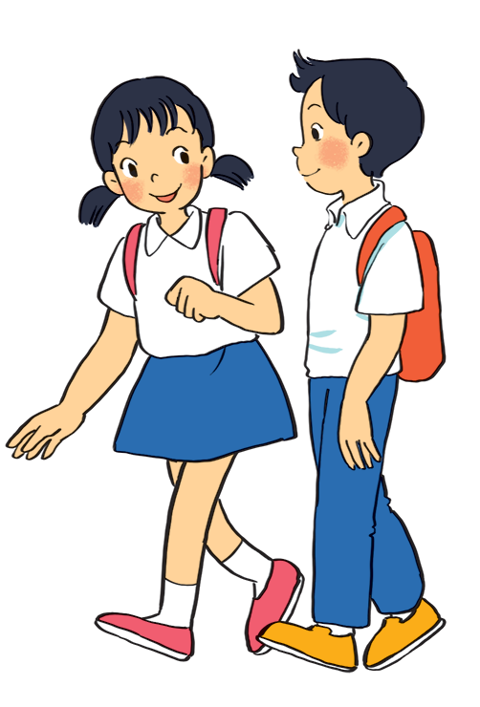
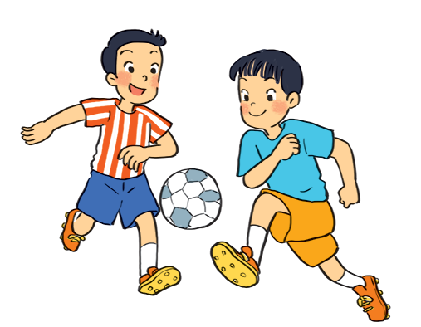
What are the students doing in each picture?
a
c
b

Slide 6
a
They are talking.

Slide 7
b
They are playing football.

Slide 8
c
They are walking.

Slide 9
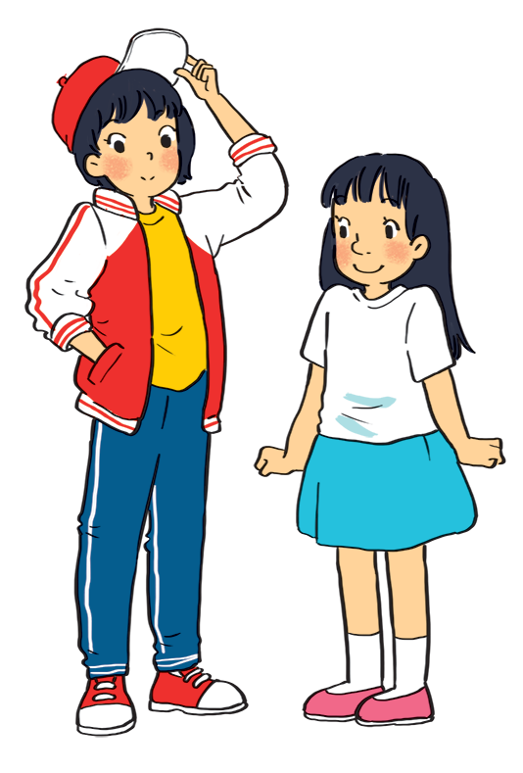
Listen to Mi and Minh talking about their best friends. Look at the picture below and say which one is Lan and which one is Chi.
Chi
Lan
Lan is the girl wearing a red and white jacket and a red cap.
Chi is the girl wearing a white T-shirt and a blue skirt.
Audio script

Slide 10
AUDIO SCRIPT
Mi: My best friend is Lan. She studies with me in class 6A. She’s tall and slim. She has short black hair and a small mouth. She’s very active and friendly. She likes playing sports and has many friends. Look, she’s playing football over there!
Minh: Chi is my best friend. We’re in class 6B. She’s short with long black hair and a big nose. I like her because she’s kind to me. She helps me with my English. She’s also hard-working. She always does her homework before class. Look, she’s going to the library.

Slide 11
Listen to the talk again. Fill each blank with a word / number you hear.
1.
Mi and Lan are studying in class
6A.
.
Lan has short hair and a small .
2.
black
mouth
Lan is active and .
3.
friendly
Chi’s hair is long and black, and her nose is
4.
big.
.
to Minh.
5.
Chi is
kind
to Minh.
Audio script

Slide 12
AUDIO SCRIPT
Mi: My best friend is Lan. She studies with me in class 6A. She’s tall and slim. She has short black hair and a small mouth. She’s very active and friendly. She likes playing sports and has many friends. Look, she’s playing football over there!
Minh: Chi is my best friend. We’re in class 6B. She’s short with long black hair and a big nose. I like her because she’s kind to me. She helps me with my English. She’s also hard-working. She always does her homework before class. Look, she’s going to the library.

Slide 13
Writing

Slide 14
Work in pairs. Ask and answer about your best friend. Use these notes to help you.
1.
What’s his / her name?
2.
What does he / she look like?
3.
What’s he / she like?
4.
Why do you like him / her?

Slide 15
Write a diary entry of about 50 words about your best friend. Use the answers to the questions in 4.
Dear Diary,
My best friend is
I like
because

